Slide 1
Macros
Anu Regmi

Slide 2
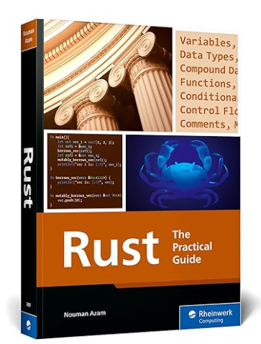
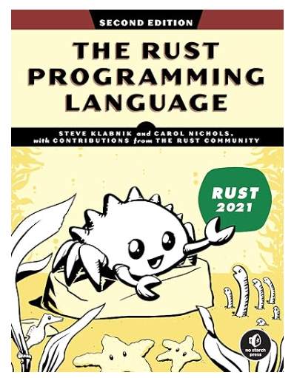
Note
Unhelpful
Pretty good
Notes:
Our main textbook – Rust Programming A Practical Guide – ch15.1 not well written or explained
So I found a section from Rust Programming Lanuage 2E was much better
Mainly from Rust Programming Lanuage 2E - Ch19-Advanced features, Macros – covered first couple of sections on declarative macros

Slide 3
Macros - outline
What we know – println!
Declarative macros using macro_rules!
Procedural macros
Notes:
We have already seen macros like println! But we don’t really know what macros actually are or what they do.
There are two different types of macro:
Declarative macros that use macro_rules
and procedural macros – not talking about

Slide 4
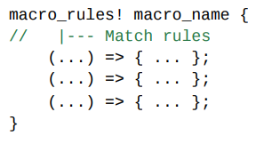
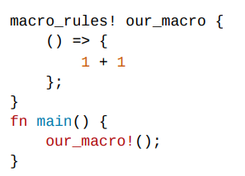
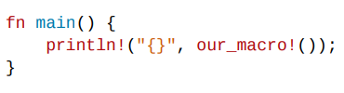
Declarative Macros – basic syntax
Rules
Syntax
Calling
Notes:
Ch15.1.1 and 15.1.2 – from main textbook rust programming a practical guide
Starts with: Macro_rules! This is the macro declaration:
Body of macro contains the match rules (syntax very similar to match statements) – a macro must contain at least one rule
Left side is a matching pattern which can have any matching expression
Right side is code substitution made when that pattern is matched, this can be any valid rust code
Every rule should end with a semicolon, but its optional for the last rule
The example underneath shows a macro where the pattern is empty and the code substitution is 1+1.
Calling the macro in the main just substitutes the code because there is no pattern it has to match.
Calling syntax is very similar to a function – just write the name of the macro
If you use a print statement so you can see that it prints 2

Slide 5
Macros vs Functions
Macros – a way of writing code that writes other code
Metaprogramming
println!, vec!
Notes:
So I was a little confused here – why couldn’t you just use a function for this
Rust Programming Language 2E cleared that up for me and actually defined what macros were by explaining the differences in capabilities between Macros and Functions
Macros fundamentally – a way of writing code that writes other code which is known as Metaprogramming
Already have seen and used println!, vec! These expand to produce more code
A key role of both metaprogramming and functions is that they reduce the amount of code you have to write and maintain
But macros have additional capabilities beyond that of functions

Slide 6



Parameter Handling
Functions
Must declare number and type of parameters
Operate at runtime so compiler needs to know exactly how call will look
Example:
Must pass exactly one argument Can’t pass 0 or 2:
Macros
Can take a variable number of parameters
Match patterns and not types
Examples:
Accepts anything that matches the pattern

Slide 7
Compile Time vs Runtime
Functions
Runs at runtime
Executes after program is compiled
So, functions can’t:
  Generate new code
  Implement traits
  Create new types or modules
Operate on values not structure of program
Macros
Expanded during compile time
Are expanded before the compiler interprets the meaning of the code
Allows a macro to do the following:
  Generate new Rust code
  Implement traits
  Create new types or modules
Operate on program structure at compile time
Notes:
Traits have to be created in compile time so can’t be done in functions that are called ruing runtime
Functions:
Executes once program is built and running
Must happen before compilation ends, so not possible for functions
Type checking, building program structure etc done by the time program runs
Macros
Compiler expands them -so replaces the macro call with the code generated by the macro
Macro runs before compiler checks types and interprets traits
Also means macros can create structs or enums

Slide 8
Complexity of definitions
Functions
Clear input and output
Executes as written
Example
Macros
Much more complex definitions
Writing Rust code that writes Rust code
More difficult to read, understand and maintain
Example
Notes:
Add examples

Slide 9
Scope
Functions
Can be defined anywhere
Can be called anywhere
Macros
Must be defined before being called
Notes:
Maybe add examples of where will and won’t work

Slide 10
Back to Declarative Macros
macro_rules!
Metaprogramming
Captures

Slide 11
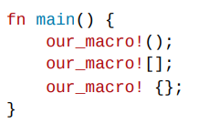
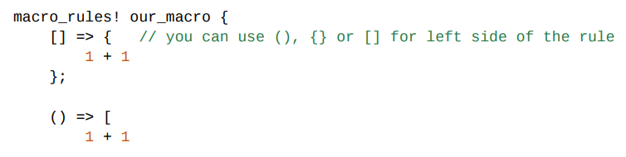

(),[],{}
Notes:
Other quick things to note – next few slides
Macro rules can be written using any kind of brackets, braces, parenthesis etc, same for calling.
Not sure why they chose to have this feature – maybe for giving freedom as you write your own code to mean something then also you can choose the syntax of the rules?
Original way shown on previous slide is the standard convention.

Slide 12
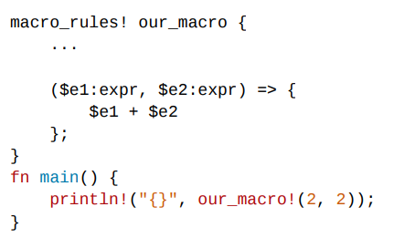

Captures - Syntax
Variables from surrounding scope
Referred to within the code
Dynamic values/ data from outside macro pattern
Notes:
Captures are variables from the surrounding scope that the macro can refer to and use within its body of code.
They allow a macro to use dynamic values or data from outside it’s pattern – makes it more flexible and powerful
The dollar sign means it’s a capture variable within a macro pattern.

Slide 13
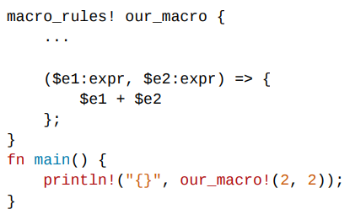
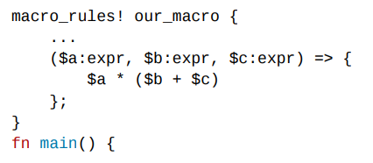

Capture - Examples
OR
Notes:
The pattern in this example will match any two expressions in Rust – (literals, function calls, arithmetic operations).

Slide 14
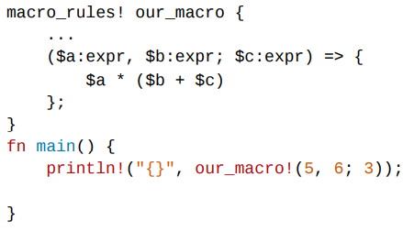


Strict matching
Macro call must have something that matches at least one rule
Notes:
The left side of the rule (matching pattern) needs to strictly match what is called.
Key point: The macro call must have something that matches at least one rule.

Slide 15
Final example

Slide 16
Summary comparison table
Feature | Functions | Macros | Example
Must declare type and number of parameters? | Yes | Can instead take variable number of parameters | One argument: Println!(“hello”) Two arguments: Println!(“hello {}”, name)
Called/expanded at runtime or compile time? | Runtime Can’t implement a Trait -Traits need to be implemented at compile time | Compile time Macros expanded before compiler interprets meaning of code Can implement a trait on a given type
More complex definitions – harder to read, understand and maintain | No | Yes
Can be defined anywhere | Yes | Must be defined or brought into scope before being called

