Slide 1
Thread Communication in Rust
Aidan Kent

Slide 2
The Two Paths of Communication
The Problem: Threads are isolated by default. To solve complex problems, they need to talk.
The Two Strategies:
Message Passing: "Don't communicate by sharing memory; share memory by communicating." (Channels).
Shared State: Multiple threads looking at the same memory address safely (Mutexes).

Slide 3

Message Passing
Concept: Think of a channel as a river.
Upstream (Transmitter/tx): Where you put data (the boat) into the water.
Downstream (Receiver/rx): Where the data arrives and is collected.
Safety: Once you put the boat in the river, you no longer "own" it. Rust's ownership rules enforce this perfectly.

Slide 4
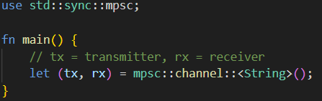
Creating a Channel
We use the mpsc module (Multiple Producer, Single Consumer).

Slide 5
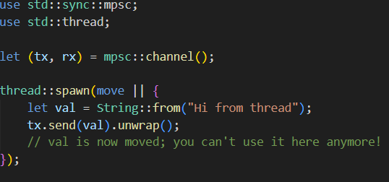
Sending Data across Threads
To send data, we must move the transmitter into the spawned thread.

Slide 6
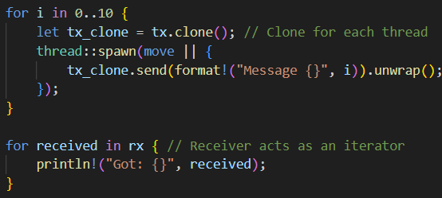
Multiple Producers (The "MP" in MPSC)
What if we want 10 threads sending to 1 receiver?
The Secret: We clone the transmitter.

Slide 7
Blocking vs. Non-Blocking
rx.recv(): (Blocking) The main thread stops and waits like a person waiting for a package. If the sender never sends, it waits forever.
rx.try_recv(): (Non-blocking) Immediately returns a Result. Useful if the main thread has other work to do while waiting.

Slide 8
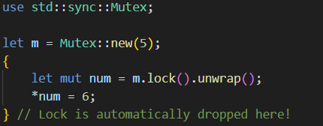
Shared State – The Mutex
Concept: Mutual Exclusion.
Only one thread can access the data at a time.

Slide 9
The Problem with Mutex in Threads
A standard Mutex cannot be moved into multiple threads because of ownership rules.
Simple Rc<T> (Reference Counting) isn't thread-safe (it's not "Atomic").
The Error: "Rc cannot be sent between threads safely."

Slide 10
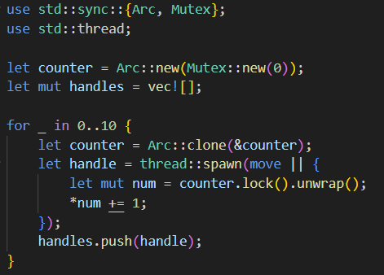
The Solution: Arc<Mutex<T>>
Arc: Atomic Reference Counting.
It's the thread-safe version of Rc.

Slide 11
Summary
Feature | Ownership | Best For | Complexity
Message Passing (Channels) | Transferred to receiver | Distributing work, pipelines | Conceptually simpler
Shared State (Mutex) | Shared via locks | Protecting a central data structure | Requires Arc and careful locking

