Slide 1
Size in Rust Part 1
Chapters 13.1 – 13.3

Slide 2
Why does Size matter?
Size is the memory occupied by a type like a variable or an array
Size is important for memory management and performance
Understanding Size helps us write better code

Slide 3
Sized vs Unsized types
Sized Types
Size is known at compile time
Unsized Types
Size is unknown at compile time (dynamically sized types)
Unsized types use references

Slide 4
Examples of Sized types
Primitive types
Tuples of primitives
Arrays
Structs
References and Pointers

Slide 5
Examples of Unsized types
Slices
String slices
Trait objects

Slide 6
References to Unsized types
Size of a Reference to Sized type: 8 bytes
Size of a Reference to Unsized type: 16 bytes
References that is 1 word is called a thin pointer
References that are 2 words are called fat pointers

Slide 7
Size vs Data Length
Size refers to the total amount of memory used
This tells you how much space a particular variable or type requires
Data Length refers to how many elements are in a collection like an array
This is the count of the items in a collection or the number of elements in a slice

Slide 8

Sized and Optionally Sized Traits
The Sized trait, is useful for handling unfixed size types
Sized works as an auto trait and a marker trait
  Auto traits are automatically implemented based on conditions met
  Marker traits indicate a specific property of that type
An example is the Default type

Slide 9
Derived vs Auto Traits
Derived Traits is a way to allow Rust to automatically implement common traits for your types
Auto Traits are traits the Rust compiler will automatically apply based on conditions

Slide 10
Opting out of Sized Traits
It is impossible to opt out of the Sized trait’s Implementation
Rust does this because it doesn’t make sense for the Rust compiler to lose awareness of a type’s size
Treating a Sized type as Unsized complicates things

Slide 11


?Sized (Optionally Sized traits)
Allows for flexibility when working with Generics
Automatically applied to every Generic type parameter

Slide 12
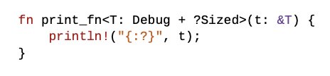
Generic Functions using ?Sized trait
Generics assume sized types, so the work around to this is using optionally sized traits
This let’s us work with strings, string slices and trait objects

Slide 13

Example
The size of a raw string slice is not known at compile time
We can fix this by adding one more reference to a string slice
This will turn a string slice into the type &&str, where the first & will match with the reference of & to T and T will be resolved to a &str.

Slide 14
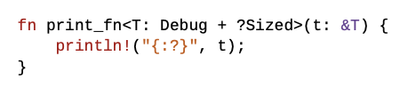
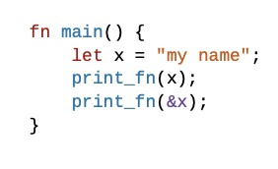
Example
This is a confusing model to understand and inconvenient, so this is where using optionally sized traits is useful.

