Slide 1
Chapter 18 Mutable Objects
Connor May

Slide 2
What is a Mutable Object
Mutable Objects are related to Non-Mutable
Very Similar to Java
Uses preface var for mutable variables inside classes

Slide 3
How to tell the difference
Mutable objects will have var
May inherit mutability
Let's see some examples

Slide 4
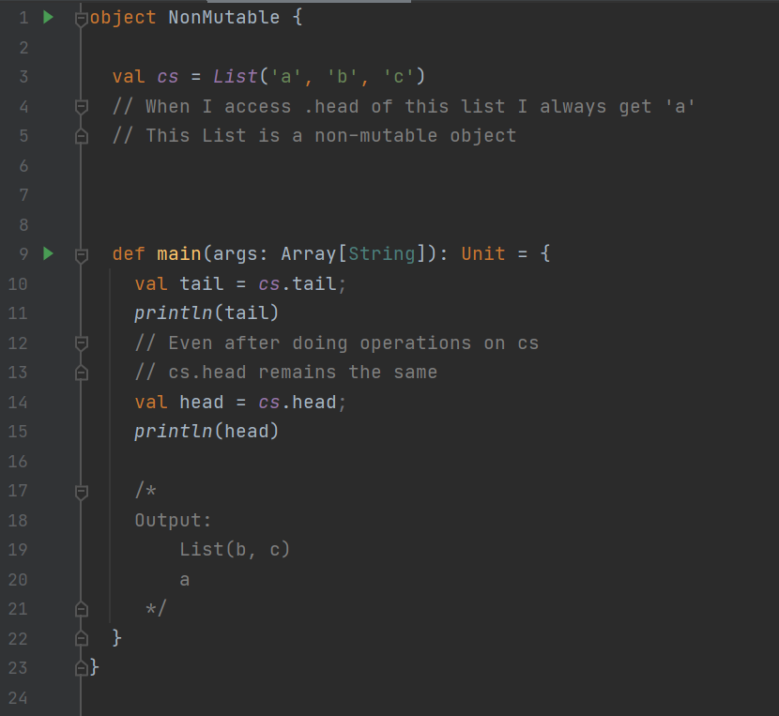

Slide 5
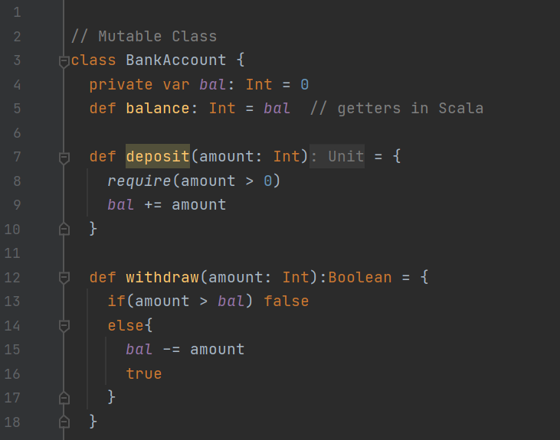

Slide 6
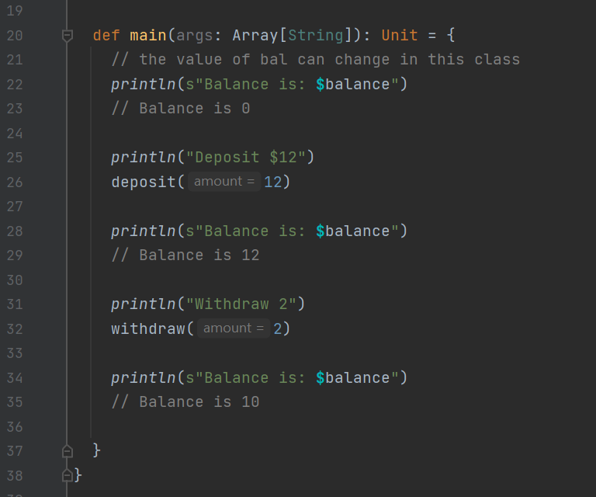

Slide 7
Functional vs Mutable
Mutable objects may not be mutable
If a mutable object extends an immutable object and doesn’t add immutability
Notes:
Same way that immutable objects can inheirit mutablility, mutable objects can inheirit immutablility

Slide 8
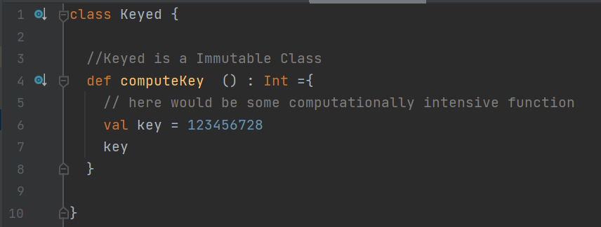
Functional vs Mutable
Mutable objects may not be mutable
If a mutable object extends an immutable object and doesn’t add immutability
Notes:
Same way that immutable objects can inheirit mutablility, mutable objects can inheirit immutablility

Slide 9
Functional vs Mutable
Notes:
Same way that immutable objects can inheirit mutablility, mutable objects can inheirit immutablility

Slide 10
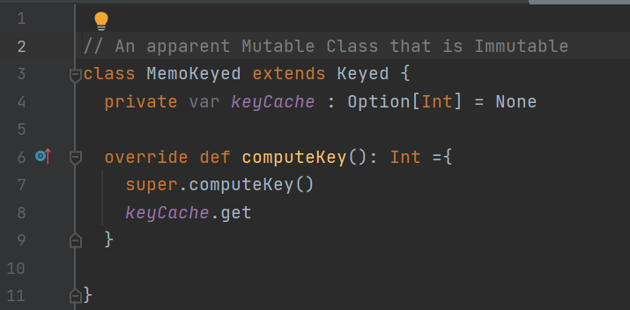
Getters and Setters
Every non-private var contains built in getters and setters
Notes:
Same way that immutable objects can inheirit mutablility, mutable objects can inheirit immutablility

Slide 11
Getters and Setters
Every non-private var contains built in getters and setters
If this boilerplate getter does not suit your needs, you can define it
Example:

Slide 12
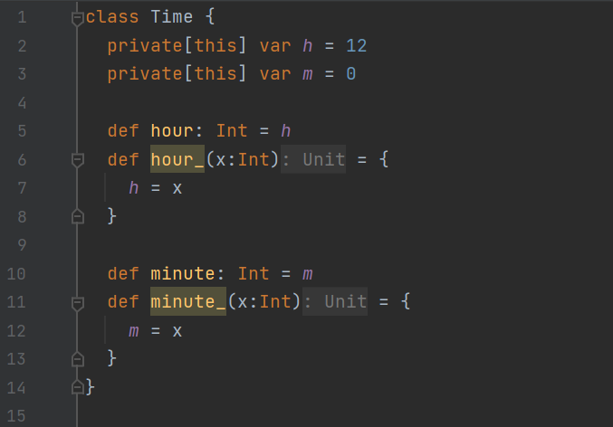
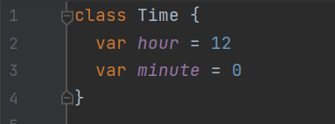
Getters and Setters
Notes:
This shows the advantage of innate getters and setters

Slide 13
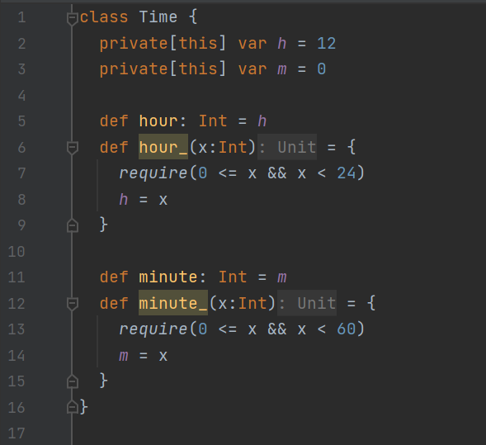
Getters and Setters
Notes:
This allows you to check the setters to make sure the input is valid

Slide 14
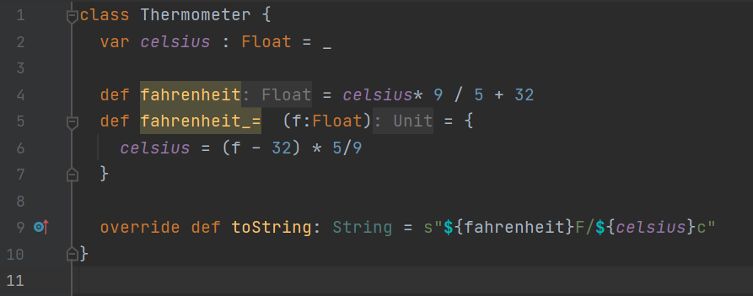
Getters and Setters
Notes:
In this case only Celsius is stored and when you ask for Fahrenheit you get the converted value

Slide 15
Mutable Objects with first class functions
Applying immutable functions to a mutable value
Using my mutable function, I can apply immutable functions to it
The book has a simulation example
The higher order functions are used as events
The mutable class stores the results

Slide 16
Domain specific languages
What is it?
A way of giving someone more control over a aspect of your code
An Example of a DSL: Markdown language
Gives the user more control over what they can write
In Scala:
<variable> <function> <another variable>

Slide 17
Domain specific languages
Notes:
From stack overflow

Slide 18
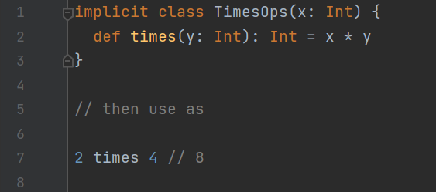
Domain specific languages
Improves readability
Allows people to use your operators in their class

Slide 19
Domain specific languages
Improves readability
Allows people to use your operators in their class
Technically they are also just methods
Note: Implicit classes must be defined inside of an object, class or trait

Slide 20
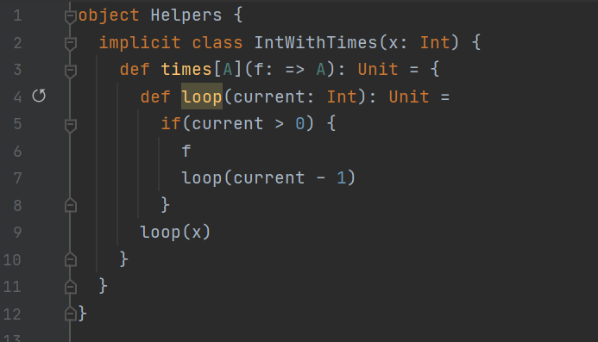
Domain specific languages

