Slide 1
Assertions & Tests
Thomas McGonagle

Slide 2
Assertions
Val left = 10
Val left = 10
Val right = 10
Val right = 10
assert(num1 == num2)
assertResult(2){
Left - right
}

Slide 3
Assertions
Val bruh = 10
def doublePos(num: Int): Int = {
require(num > 0)
num * 2
}
ensuring(num => num >= 0 &&
num % 2 == 0 )
Val moment = 8
assert(num1 == num2,
“Bruh Sound Effect #2”)

Slide 4
Testing
Junit
TestNG
ScalaTest
specs2
ScalaCheck

Slide 5
ScalaTest
import org.scalatest.funsuite.AnyFunSuite
Import Element.elem
Class ElementSuite Extends AnyFunSuite {
test(“elem should have passed width”) {
val ele = elem(‘x’, 2, 3)
assert(ele.width == 2)
}
}

Slide 6
Testing
`
scala> (new ElementSuite).execute()
ElementSuite:
- Elem result should not have passed width

Slide 7
Testing
`
scala> val width = 3
Width: Int = 3
scala> assert(width == 2)
org.scalatest.exceptions.TestFailedException
3 did not equal 2

Slide 8
Testing
`
scala> assert(List(1, 2, 3).contains(4))
org.scalatest.exceptions.TestFailedException:
assert(List(1, 2, 3).contains(4))
| | | | | |
| 1 2 3 false 4
List(1, 2, 3)

Slide 9
Testing
`
assertThrows[IllegalArgumentException] {
elem(‘x’, -2, 3)
}
Expected IllegalArgumentException to be thrown,
But NegativeArraySizeException was thrown.

Slide 10
Testing
`
val caught = intercept[ArithmeticException] {
1 / 0
}
assert(caught.getMessage == “/ by zero”)

Slide 11
Testing
`
class ElementSpec extends AnyFlatSpec with Matchers {
“A UniformElement” should
”have a width equal to the passed value” in {
val ele = elem(‘x’, 2, 3)
ele.width should be (2)
}
}

Slide 12
Testing
`
Scala> (new ElementSpec).execute()
A UniformElement
- Should have a width equal to the passed value

Slide 13
Matchers
`
MustMatchers:
result must be >= 0
map must contain key ‘c’
Map(‘a’ -> 1, ‘b’ - > 2) did not contain ‘c’

Slide 14
specs2
`
object ElementSpecification extends Specification {
”A UniformElement” should {
“have a width equal to the passed value” in {
val ele = elem(‘x’, 2, 3)
ele.width mus be_==(2)
}
“throw an IAE if passed a negative width” in {
elem(‘x’, -2, 3) must
thowA[IllegalArgumentException]
}
}
}

Slide 15
AnyFeatureSpec
`
class TVSerSpec extends AnyFeatureSpec with GivenWhenThen {
Feature(“TV power button”){
Scenario(“User presses power button when TV is off”) {
Given(“a TV set that is switched off”)
When(“the power button is pressed”)
Then(“the TV should switch on”)
pending
}
}
}

Slide 16
ScalaCheck
`
class ElementSpec extends AnyWordSpec with ScalaCheckProperyChecks {
“elem result” must {
“have passed width” in {
forAll { (w: Int) =>
whenever(w > 0) {
elem(‘x’, w % 100, 3).width must equal (w % 100)
}
}
}
}
}

Slide 17
Organizing
`
Nesting Suites
Manually or automatically nesting suites
Compile
$ scalac –cp scalatest-app.jar:scala-xml.jar TVSetSpec.scala
Run
$ scalac –cp scalatest-app.jar:scala-xml.jar
org.scalatest.run TVSetSpec

Slide 18
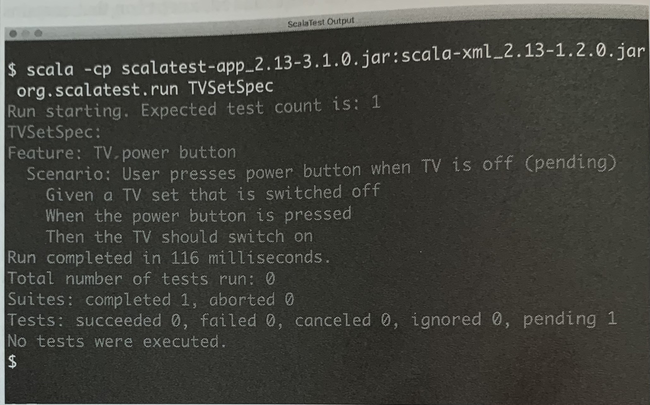
Organizing
`

Slide 19
Questions

