Slide 1
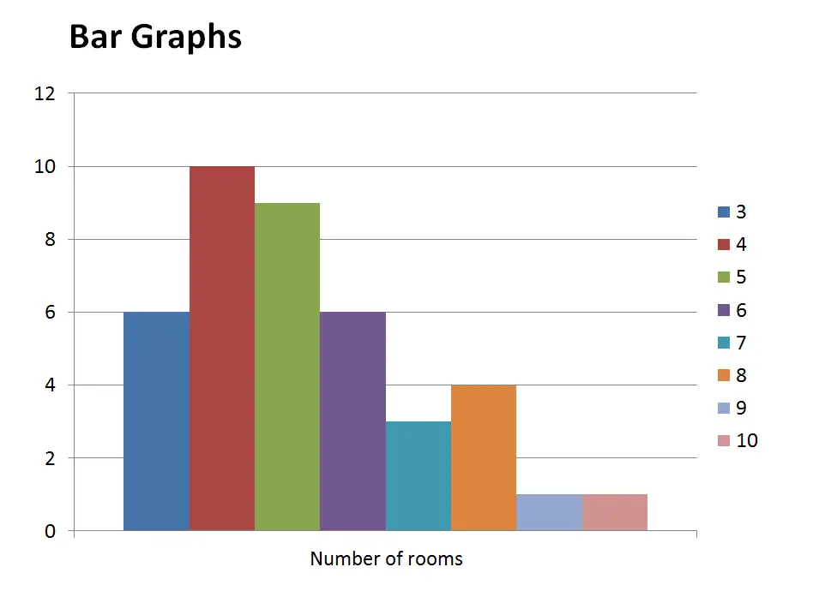
What is Dash?
By Kyle Hinkle and Zachary Stray

Slide 2
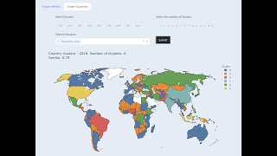
What is Dash?
Dash was created by Plotly, the same creators of Plotly.js. Plotly is a Canada-based company which built Dash and supports its development.
Dash was created as a means to make web-based analytic application in a quick and simple way when compared to typical Javascript or stand alone python libraries.

Slide 3
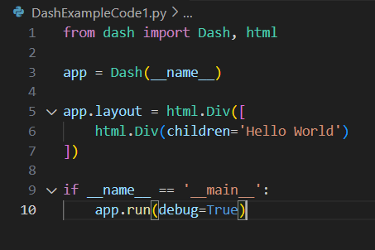
What is Dash? (Continued)
Dash helps data scientists build analytical web applications without requiring advanced web development knowledge. Primarily relying on their Python Skills.
Three technologies constitute the core of Dash.
Flask supplies the web server functionality,
React.js renders the user interface of the web page.
Plotly.js generates the charts used in your application.
Notes:
Talk about how there are so many languages and libraries needed to code a proper website. Html, CSS, JavaScript, PHP, BootStrap, etc. You don’t need purely Python but it is possible to use only Python.

Slide 4
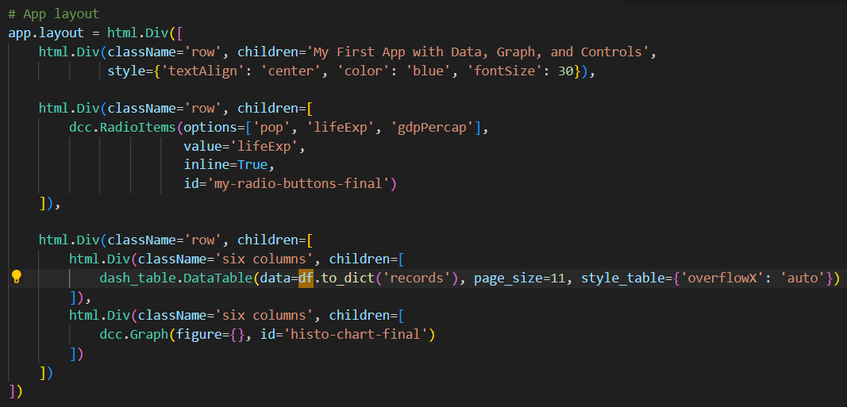
How to think of a dash program
You create components To be applied to the layout That interacts by the callback

Slide 5
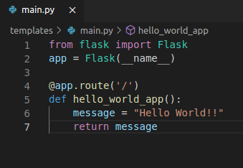
Flask in Dash
Flask is a web application framework written in Python by Armin Ronacher. It allows you to create webpages using Python or to assist in certain parts of it.

Slide 6
React.js in Dash
“Dash uses React under the hood to render the user interface you see when you load a web page created with Dash.”(L5)
React is only concerned with the user interface and rendering components

Slide 7
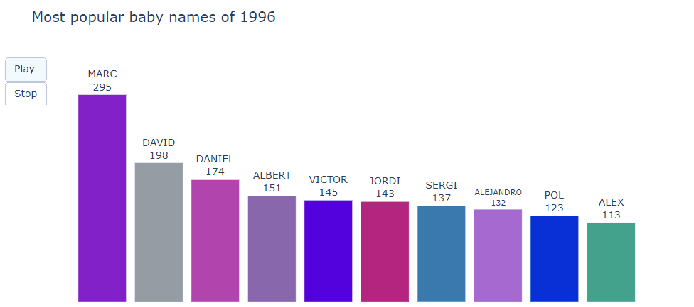
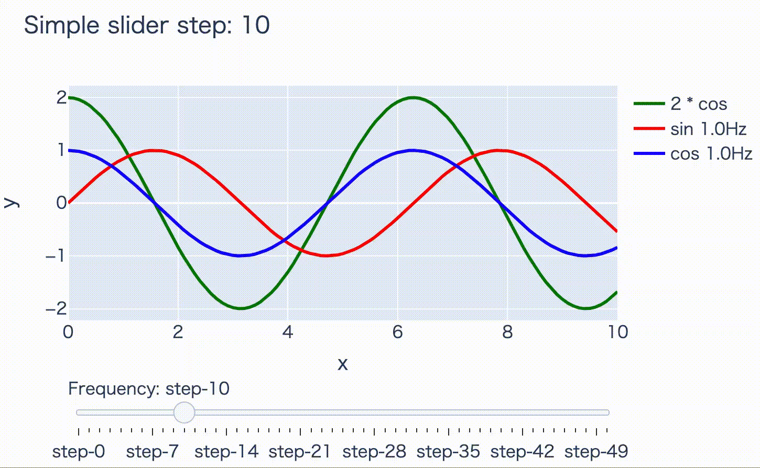
Plotly.js in Dash
Plotly plays a huge part in Dash primarily because Dash is designed to fix the weaknesses of Plotly.
Plotly can create a wide host of plots and graphs but they all run into the same issue in that they aren’t fully dynamic. They aren’t capable of updating in real time.
“You need to re-run the .py script and re-generate the .html file to see any updates.”(L7) However this is why Dash was created.
Dash takes what plotly has done and then allows it to communicate with other components and update in real time.
Notes:
Talk about an example being asking for a user to input their name and age to the site. Plotly can’t update the graph to showcase that in real time. Dash can.

Slide 8
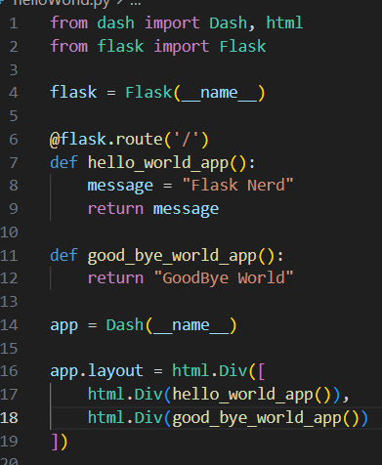
How they work together
Python code for the layout and logic
Flask serves as the webserver
React is use to Render the UI
Plotly is used to create interactive
Notes:
Python code for layout and logic, use dash components to build apps and the interactions. Dask UI internally, while react is use for client side UI, for dynamic changes in UI

Slide 9
Dash Example One: Basics
Pandas is a python library that is commonly used alongside Dash. It is one of the most popular data wrangling packages which brings no surprise that it would be used in Dash.
Notes:
Dash example code 1: Shows us how to quickly and easily incorporate data into a table.

Slide 10
Dash Example Two: Callback
@callback behaves similarly to buttons, allowing us to display data and information in a new way.
Alert allows you to create contextual feedback messages on user actions.

Slide 11
Dash Example Three: Graphs
dcc.Graph allows us to create plotly graphs.
It is super easy for us to change graphs.
https://plotly.com/python/

Slide 12
Dash Example Four: Adding To A Graph
Use Callback to add arguments to update_graph

Slide 13
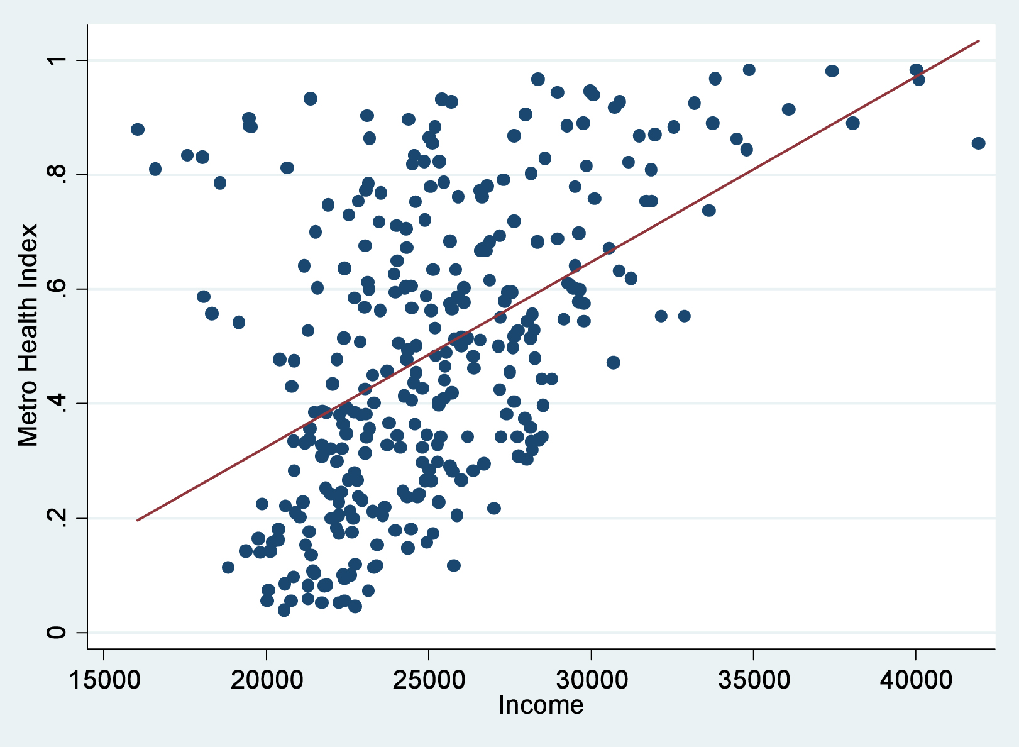
Conclusion
Dash is the upgraded version of plotly that takes everything plotly can do and takes it a step higher by creating a system dedicated to using it.
This ease of use is what makes Dash so useful for creating compelling statistics that everyone can see and use easily.

Slide 14
What is Dash?
By Kyle Hinkle and Zachary Stray

Slide 15
What is Dash?
Dash was created by Plotly, the same creators of Plotly.js. Plotly is a Canada-based company which built Dash and supports its development.
Dash was created as a means to make web-based analytic application in a quick and simple way when compared to typical Javascript or stand alone python libraries.

Slide 16
What is Dash? (Continued)
Dash helps data scientists build analytical web applications without requiring advanced web development knowledge. Primarily relying on their Python Skills.
Three technologies constitute the core of Dash.
Flask supplies the web server functionality,
React.js renders the user interface of the web page.
Plotly.js generates the charts used in your application.
Notes:
Talk about how there are so many languages and libraries needed to code a proper website. Html, CSS, JavaScript, PHP, BootStrap, etc. You don’t need purely Python but it is possible to use only Python.

Slide 17
How to think of a dash program
You create components To be applied to the layout That interacts by the callback

Slide 18
Flask in Dash
Flask is a web application framework written in Python by Armin Ronacher. It allows you to create webpages using Python or to assist in certain parts of it.

Slide 19
React.js in Dash
“Dash uses React under the hood to render the user interface you see when you load a web page created with Dash.”(L5)
React is only concerned with the user interface and rendering components

Slide 20
Plotly.js in Dash
Plotly plays a huge part in Dash primarily because Dash is designed to fix the weaknesses of Plotly.
Plotly can create a wide host of plots and graphs but they all run into the same issue in that they aren’t fully dynamic. They aren’t capable of updating in real time.
“You need to re-run the .py script and re-generate the .html file to see any updates.”(L7) However this is why Dash was created.
Dash takes what plotly has done and then allows it to communicate with other components and update in real time.
Notes:
Talk about an example being asking for a user to input their name and age to the site. Plotly can’t update the graph to showcase that in real time. Dash can.

Slide 21
How they work together
Python code for the layout and logic
Flask serves as the webserver
React is use to Render the UI
Plotly is used to create interactive
Notes:
Python code for layout and logic, use dash components to build apps and the interactions. Dask UI internally, while react is use for client side UI, for dynamic changes in UI

Slide 22
Dash Example One: Basics
Pandas is a python library that is commonly used alongside Dash. It is one of the most popular data wrangling packages which brings no surprise that it would be used in Dash.
Notes:
Dash example code 1: Shows us how to quickly and easily incorporate data into a table.

Slide 23
Dash Example Two: Callback
@callback behaves similarly to buttons, allowing us to display data and information in a new way.
Alert allows you to create contextual feedback messages on user actions.

Slide 24
Dash Example Three: Graphs
dcc.Graph allows us to create plotly graphs.
It is super easy for us to change graphs.
https://plotly.com/python/

Slide 25
Dash Example Four: Adding To A Graph
Use Callback to add arguments to update_graph

Slide 26
Conclusion
Dash is the upgraded version of plotly that takes everything plotly can do and takes it a step higher by creating a system dedicated to using it.
This ease of use is what makes Dash so useful for creating compelling statistics that everyone can see and use easily.

Slide 27
Questions?

Slide 28
How to download Dash
Download the latest version of python if you don’t already have it. https://www.python.org/downloads/
Download Dash and Panda using Pip (Pip is part of python)
pip install dash pip install Pandas
Those are the most important to download but there are many more you can get such as dash-bootstrap-components.
Still need help? Use this: https://www.youtube.com/watch?v=vkuL9Be0S7w

Slide 29
Example 1 Code
from dash import Dash, html, dash_table
import pandas as pd
# Incorporate data
df = pd.read_csv('https://raw.githubusercontent.com/plotly/datasets/master/gapminder2007.csv')
# Initialize the app
app = Dash(__name__)
# App layout
app.layout = html.Div([
html.Div(children='My First App with Data'),
dash_table.DataTable(data=df.to_dict('records'), page_size=20)
])
# Run the app
if __name__ == '__main__':
app.run(debug=True)

Slide 30
Example Code 2
DashFavoriteFood.txt
Name, Food
Kyle, Lemon
Bob, Carrot
Keven, Apples
Cody, Steak
Emily, Milkshake
Pablo, Pear
Terry, Hamburger
Astrid, Gumbo
Perry, Salmon
Derrick, Chicken
from dash import Dash, Input, html, Output, callback, dash_table
import pandas as pd
import dash_bootstrap_components as dbc
# Incorporate data
df = pd.read_csv('DashFavoriteFood.txt')
# Initialize the app
app = Dash(__name__)
# App layout
app.layout = html.Div([
html.Div(children='Favorite Foods'),
dash_table.DataTable(df.to_dict('records'),[{"name": i, "id": i} for i in df.columns], id='tbl'),
dbc.Alert(id='tbl_out'),
])
# Button Response
@callback(Output('tbl_out', 'children'), Input('tbl', 'active_cell'))
def update_graphs(active_cell):
return str(active_cell) if active_cell else "Click the table"
# Run the app
if __name__ == '__main__':
app.run(debug=True)

Slide 31
Example Code 3
from dash import Dash, html, dash_table, dcc
import pandas as pd
import plotly.express as px
# Incorporate data
df = pd.read_csv('https://raw.githubusercontent.com/plotly/datasets/master/gapminder2007.csv')
# Initialize the app
app = Dash(__name__)
# App layout
app.layout = html.Div([
html.Div(children='Average life expetancy'),
dash_table.DataTable(df.to_dict('records'),[{"name": i, "id": i} for i in df.columns], id='tbl', page_size=10),
html.A(children='https://plotly.com/python/'),
#dcc.Graph(figure=px.histogram(df, x='continent', y='lifeExp', histfunc='avg')),
dcc.Graph(figure=px.scatter(df, x='continent', y='lifeExp')),
])
# Run the app
if __name__ == '__main__':
app.run(debug=True)

Slide 32
Example Code 4
DashExample.txt
from dash import Dash, html, dcc, callback, Output, Input, State
import pandas as pd
import plotly.express as px
app = Dash(__name__)
global df
df = pd.read_csv('DashExample.txt')
# App layout
app.layout = html.Div([
#title
html.Div(className='row', children='Age To Sport',
style={'textAlign': 'center', 'color': 'blue', 'fontSize': 30}),
#input
html.Div(className='row', children=[
html.Div([
dcc.Input(id='name-input', type='text', placeholder='Enter Name'),
dcc.Input(id='age-input', type='number', placeholder='Enter Age'),
dcc.Input(id='sport-input', type='text', placeholder='Enter Sport'),
html.Button(id='submit-button-state', n_clicks=0, children='Submit')
])
]),
#graph
html.Div(className='six columns', children=[
dcc.Graph( figure={}, id='graph')
]),
])
# Add controls to build the interaction
@callback(
Output(component_id='graph', component_property='figure'),
Input('submit-button-state', 'n_clicks'),
State('name-input', 'value'),
State('age-input', 'value'),
State('sport-input', 'value')
)
def update_graph(n_clicks, name, age, sport):
df = pd.read_csv('DashExample.txt')
if name and age and sport:
nd = pd.DataFrame({
'Name':[name],
'Age':[age],
'Sport':[sport]}
)
df = pd.concat([df, nd], ignore_index=True)
return px.scatter(df, x='Sport', y='Age', hover_data='Name')
# Run the app
if __name__ == '__main__':
app.run(debug=True)
Name,Age,Sport
Zac Stray,21,Wrestling
Steve Rogers,38,Mixed Martial Arts
Jonh Doe,27,Football
Charrels,48,Football
Derrick Blade,27,Fencing
Evengeline Laura,24,Fencing
Willow Basket,34,Wrestling
Rahmschnitzel Cream,18,Football
Sporticus Legion,44,Mixed Martial Arts

Slide 33
Resources
(L1)https://realpython.com/lessons/what-is-dash/
(L2)https://realpython.com/python-dash/
(L3)https://community.plotly.com/t/plotly-ecosystem-explanation/53826/2
(L4)https://dash.plotly.com/
(L5)https://medium.com/plotly/introducing-dash-5ecf7191b503
(L6)https://dash.plotly.com/react-for-python-developers
(L7)https://dash.plotly.com/tutorial
(L8)https://aiplanet.com/learn/data-visualization-plotly-dash/introduction-to-plotly-and-dash/949/introduction-to-plotly-and-dash

Slide 34
Questions?

Slide 35
How to download Dash
Download the latest version of python if you don’t already have it. https://www.python.org/downloads/
Download Dash and Panda using Pip (Pip is part of python)
pip install dash pip install Pandas
Those are the most important to download but there are many more you can get such as dash-bootstrap-components.
Still need help? Use this: https://www.youtube.com/watch?v=vkuL9Be0S7w

Slide 36
Example 1 Code
from dash import Dash, html, dash_table
import pandas as pd
# Incorporate data
df = pd.read_csv('https://raw.githubusercontent.com/plotly/datasets/master/gapminder2007.csv')
# Initialize the app
app = Dash(__name__)
# App layout
app.layout = html.Div([
html.Div(children='My First App with Data'),
dash_table.DataTable(data=df.to_dict('records'), page_size=20)
])
# Run the app
if __name__ == '__main__':
app.run(debug=True)

Slide 37
Example Code 2
DashFavoriteFood.txt
Name, Food
Kyle, Lemon
Bob, Carrot
Keven, Apples
Cody, Steak
Emily, Milkshake
Pablo, Pear
Terry, Hamburger
Astrid, Gumbo
Perry, Salmon
Derrick, Chicken
from dash import Dash, Input, html, Output, callback, dash_table
import pandas as pd
import dash_bootstrap_components as dbc
# Incorporate data
df = pd.read_csv('DashFavoriteFood.txt')
# Initialize the app
app = Dash(__name__)
# App layout
app.layout = html.Div([
html.Div(children='Favorite Foods'),
dash_table.DataTable(df.to_dict('records'),[{"name": i, "id": i} for i in df.columns], id='tbl'),
dbc.Alert(id='tbl_out'),
])
# Button Response
@callback(Output('tbl_out', 'children'), Input('tbl', 'active_cell'))
def update_graphs(active_cell):
return str(active_cell) if active_cell else "Click the table"
# Run the app
if __name__ == '__main__':
app.run(debug=True)

Slide 38
Example Code 3
from dash import Dash, html, dash_table, dcc
import pandas as pd
import plotly.express as px
# Incorporate data
df = pd.read_csv('https://raw.githubusercontent.com/plotly/datasets/master/gapminder2007.csv')
# Initialize the app
app = Dash(__name__)
# App layout
app.layout = html.Div([
html.Div(children='Average life expetancy'),
dash_table.DataTable(df.to_dict('records'),[{"name": i, "id": i} for i in df.columns], id='tbl', page_size=10),
html.A(children='https://plotly.com/python/'),
#dcc.Graph(figure=px.histogram(df, x='continent', y='lifeExp', histfunc='avg')),
dcc.Graph(figure=px.scatter(df, x='continent', y='lifeExp')),
])
# Run the app
if __name__ == '__main__':
app.run(debug=True)

Slide 39
Example Code 4
DashExample.txt
from dash import Dash, html, dcc, callback, Output, Input, State
import pandas as pd
import plotly.express as px
app = Dash(__name__)
global df
df = pd.read_csv('DashExample.txt')
# App layout
app.layout = html.Div([
#title
html.Div(className='row', children='Age To Sport',
style={'textAlign': 'center', 'color': 'blue', 'fontSize': 30}),
#input
html.Div(className='row', children=[
html.Div([
dcc.Input(id='name-input', type='text', placeholder='Enter Name'),
dcc.Input(id='age-input', type='number', placeholder='Enter Age'),
dcc.Input(id='sport-input', type='text', placeholder='Enter Sport'),
html.Button(id='submit-button-state', n_clicks=0, children='Submit')
])
]),
#graph
html.Div(className='six columns', children=[
dcc.Graph( figure={}, id='graph')
]),
])
# Add controls to build the interaction
@callback(
Output(component_id='graph', component_property='figure'),
Input('submit-button-state', 'n_clicks'),
State('name-input', 'value'),
State('age-input', 'value'),
State('sport-input', 'value')
)
def update_graph(n_clicks, name, age, sport):
df = pd.read_csv('DashExample.txt')
if name and age and sport:
nd = pd.DataFrame({
'Name':[name],
'Age':[age],
'Sport':[sport]}
)
df = pd.concat([df, nd], ignore_index=True)
return px.scatter(df, x='Sport', y='Age', hover_data='Name')
# Run the app
if __name__ == '__main__':
app.run(debug=True)
Name,Age,Sport
Zac Stray,21,Wrestling
Steve Rogers,38,Mixed Martial Arts
Jonh Doe,27,Football
Charrels,48,Football
Derrick Blade,27,Fencing
Evengeline Laura,24,Fencing
Willow Basket,34,Wrestling
Rahmschnitzel Cream,18,Football
Sporticus Legion,44,Mixed Martial Arts

Slide 40
Resources
(L1)https://realpython.com/lessons/what-is-dash/
(L2)https://realpython.com/python-dash/
(L3)https://community.plotly.com/t/plotly-ecosystem-explanation/53826/2
(L4)https://dash.plotly.com/
(L5)https://medium.com/plotly/introducing-dash-5ecf7191b503
(L6)https://dash.plotly.com/react-for-python-developers
(L7)https://dash.plotly.com/tutorial
(L8)https://aiplanet.com/learn/data-visualization-plotly-dash/introduction-to-plotly-and-dash/949/introduction-to-plotly-and-dash

