Slide 1
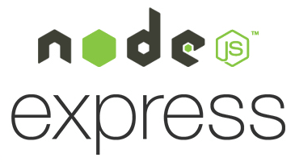
Express.js
Isaac Herbst, Tony Nguyen

Slide 2
About
Express.js is a server-side framework built on top of Node.js
Open-source and minimal with an extensive library
Widely considered a standard for back-end web development

Slide 3
History
Created Tj Holowaychuk
Initial release in November 16 2010
Quickly gained popularity for its server-side development
Acquired by Strongloop in June 2014, then by IBM in November 2015
In February 2016, IBM added Express to the Node.js foundation
Used by IBM, Netflix, PayPal, Walmart, Fox Sports, Uber, and more
Has ~27 million weekly downloads

Slide 4
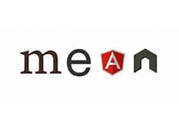
MEAN Stack
Javascript framework for developing full-stack web applications
Components of the “full-stack” are client and server-side
Consists of MongoDB, Express.js, Angular (react/vue), and Node.js
Express.js is the framework used for handling server side tasks

Slide 5
Features
Easy to define HTTP methods, (GET, POST, PUT, DELETE, etc)
Error handling built in to the request response cycle
Template engines like Handlebars, Pug, and Swig
Provides a thin layer of fundamental web application features without obscuring Node.js features

Slide 6
Express application generator
Tool to quickly create an application skeleton
More detail explanation, here.

Slide 7
Basic Routing
Determines how an application responds to a client request to a particular endpoint, which is a URI and a specific HTTP request method. Here are some simple routes
Responds with Hello World! On the homepage:
app.get('/', (req, res) => {
res.send('Hello World!')
})
Responds to POST requests on root route (/), the application’s home page:
app.post('/', (req, res) => {
res.send('Got a POST request')
})

Slide 8
Basic Routing Cont.
Responds to a PUT request to the /user route
app.put('/user', (req, res) => {
res.send('Got a PUT request at /user')
})
Responds to a DELETE request to the /user route
app.delete('/user', (req, res) => {
res.send('Got a DELETE request at /user')
})

Slide 9
Hello World!
This code starts a server and listens on port 3000 for connections. The app responds with “Hello World!” for request to the root URL (/) or route. For every path, it will respond with a 404 Not Found.
Output: Hello World!

Slide 10
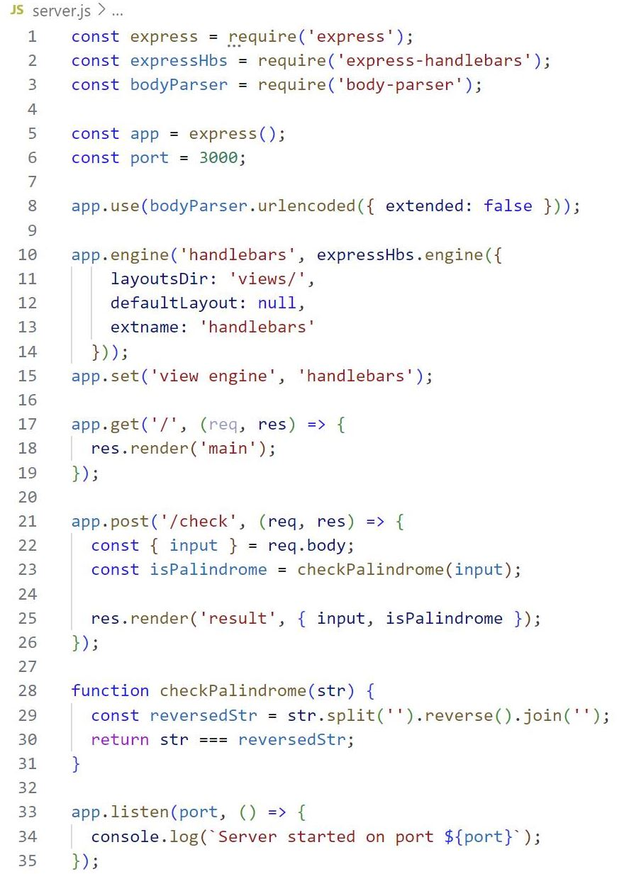
Code demo with Handlebars

Slide 11
Frameworks
Many of the popular frameworks are based on Express are some…
Feather: Builds prototypes in minutes and production ready real-time apps in days
ItemsAPI: Searches the backend for web and mobile applications built on Express and Elasticsearch.
KeystoneJS: Website and API Application Framework / CMS with an auto-generated React.js Admin UI
Poet: Lightweight Markdown Blog Engine with instant pagination, tag and category views
And much more!

Slide 12
Sources
•en.wikipedia.org/wiki/Express.js
•npmjs.com/package/express
•github.com/expressjs/express
•mongodb.com/mean-stack
•geeksforgeeks.org/steps-to-create-an-express-js-application/
•expressjs.com

Slide 13
Questions?

