Slide 1
Owen Willer, Jacob Ramstetter

Slide 2
What is Vue?
Frontend JS framework for building websites and user interfaces
Open source
Used to create single-page apps that run on the client
Design is very flexible that emphasizes component composition and declarative rendering
Can be used to create full stack apps my making HTTP requests to a backend server
Very Popular with Node.js and Express

Slide 3
Vue History
Created by Evan You after working with Angular at Google
Publicly announced in February 2014
Wanted to extract the good from Angular (data binding, dealing with DOM) and make it lightweight
Every new version of Vue has a Manga or Anime Title
0.10: “Blade Runner”
0.12: “Dragon Ball”
2.7: “Naruto”

Slide 5
Transition / Animation
Vue offers a couple ways to implement a transition to HTML components when changing state of the DOM:
<Transition>
For applying animations when an element or component is entering and leaving the DOM.
<TransitionGroup>
For applying animations when an element or component is inserted into, removed from, or moved within a v-for list.

Slide 6
<Transition>
Six classed for entering / leaving transitions:
v-enter-from: Added before the element is inserted, removed one frame after the element is inserted.
v-enter-active: Added before the element is inserted, removed when the transition/animation finishes
v-enter-to: Ending state for enter. Added one frame after the element is inserted, removed when the transition/animation finishes.
v-leave-from: Added immediately when a leaving transition is triggered, removed after one frame.
v-leave-active: Added immediately when a leaving transition is triggered, removed when the transition/animation finishes.
v-leave-to: Added one frame after a leaving transition is triggered (at the same time v-leave-from is removed), removed when the transition/animation finishes.
Vue SFC Playground (vuejs.org)

Slide 7
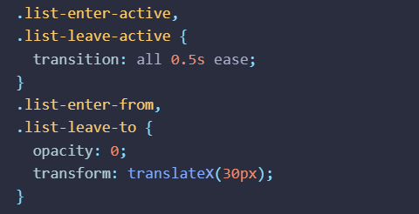
<TransitionGroup>
<TransitionGroup> supports the same props, CSS transition classes, and JavaScript hook listeners as <Transition>, with the following differences:
By default, it doesn't render a wrapper element. But you can specify an element to be rendered with the tag prop.
Transition modes are not available, because we are no longer alternating between mutually exclusive elements.
Elements inside are always required to have a unique key attribute.
CSS transition classes will be applied to individual elements in the list, not to the group / container itself.
TransitionGroup | Vue.js (vuejs.org)

Slide 8
Virtual DOM
Vue operates utilizing Virtual DOM.
These state changes made while app development would not be directly reflected on DOM.
In its place, an imitation of DOM is produced which is present usually in the custom of JS data structures.
This sanctions a developer to test their design and view the modifications in UI design while having a range of undoing everything economically.

Slide 9
Virtual DOM

Slide 10
Computed Properties
In Vue.js, "computed properties" are special functions that allow you to compute and return values based on the data in your Vue component.
These computed properties are like variables that automatically update whenever the underlying data they depend on changes.
Create a computed property by defining a function within your Vue component. This function will return the value you want to compute.
Inside the computed property function, you specify which data properties it depends on. Vue will track these dependencies and automatically recalculate the computed property when any of them change.

Slide 11
Computed Properties

Slide 12
Templates
A Vue.js template is like a blueprint for your web page. It defines the layout and content of what users will see in their browsers.
Vue.js templates look a lot like regular HTML, with tags, attributes, and text content. You use HTML elements to create your user interface.
What makes Vue.js templates special is that they can be dynamic. You can insert placeholders for data and logic within the template, which Vue.js can fill in or manipulate based on the data and actions in your application.
You can connect data from your JavaScript code (usually referred to as the Vue instance's data) to the template. When the data changes, the template automatically updates to reflect those changes, making your UI responsive.

Slide 13
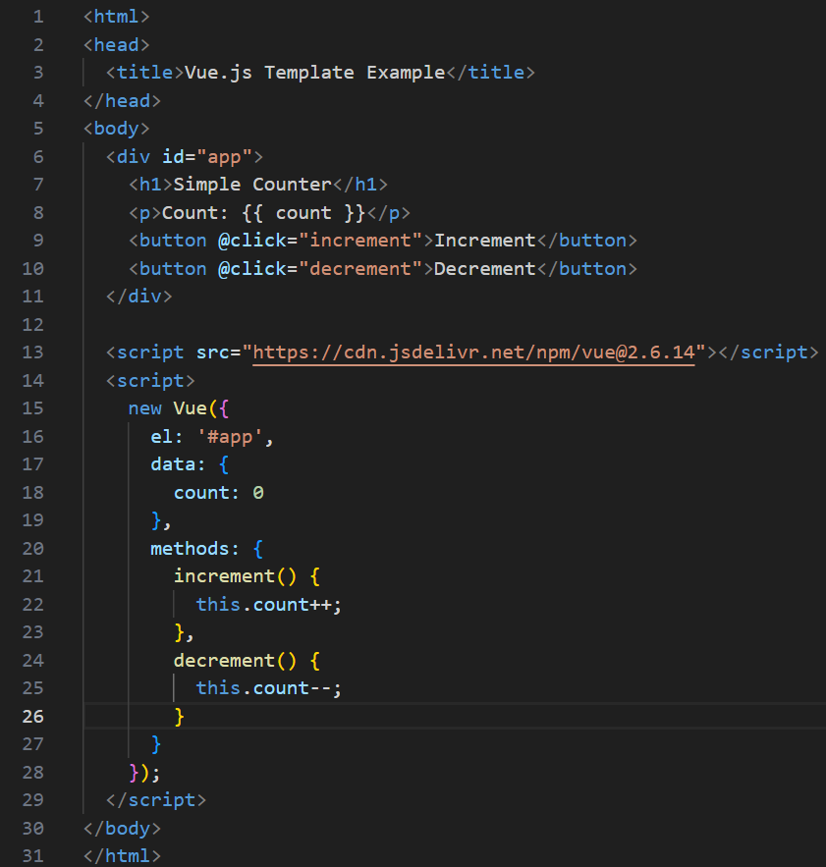
Templates

Slide 14
Data Binding
In Vue.js, you define variables in a special data object. These variables can represent the data you want to display or manipulate in your web application.
Create an HTML template that describes how your web page should look and where the data should be displayed.
Use Vue.js directives to bind the data variables to specific parts of the HTML template. Directives are special attributes that start with "v-" and are used to create a connection between the data and the template.
When the data changes, Vue.js automatically updates the HTML to reflect those changes. Conversely, if a user interacts with the web page (e.g., enters data into an input field), Vue.js can update the data accordingly.

Slide 15
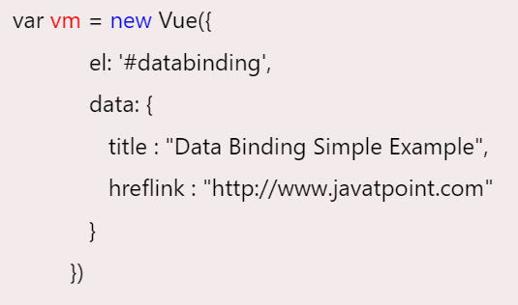
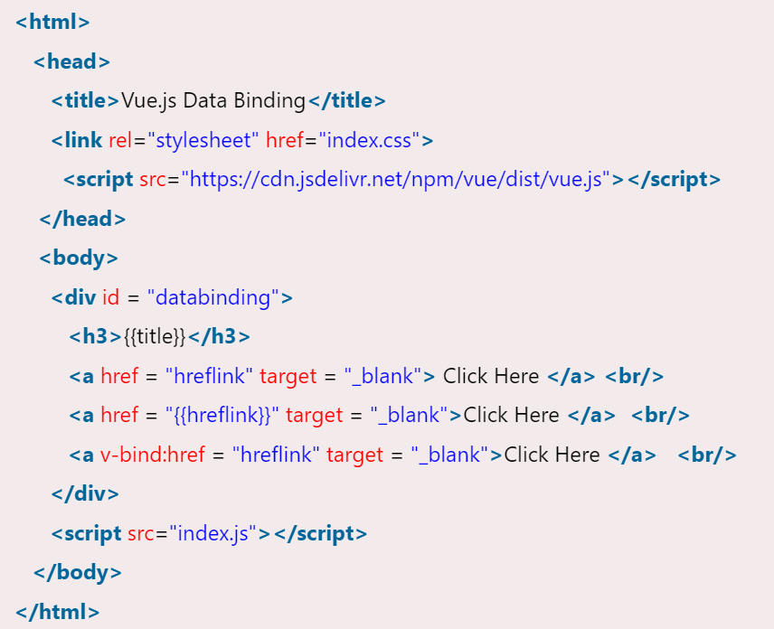
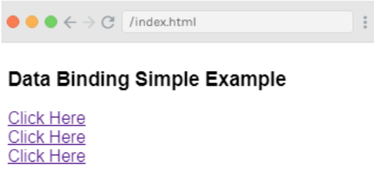
Data Binding Example

Slide 16
Libraries and Tooling
Vue.js comprises a notable package of tools for all rudimentary programming requirements presented on its main page:
Feature Development Tools: Browser development tools utilized for bug fixes apps developed with Vue.
Vue.js authorized Command Line Interface (CLI): CLI employed for installation and development of the Vue framework core libraries and third-party plugins.
Vue Router: Mapping and routing components.
Vue Loader: Authorized loader for web packs.

Slide 17
Why are Vue.js libraries important?
Code Reusability: Libraries provide pre-built components, functions, and modules that you can reuse across different projects. This significantly reduces the amount of code you need to write from scratch, saving time and effort. It also promotes consistency in your applications, as you can use the same libraries for common tasks.
Productivity: Libraries often come with well-documented APIs and established best practices. This allows developers to be more productive by leveraging existing solutions rather than reinventing them. With libraries, you can build applications more quickly and efficiently.
Specialized Functionality: Many Vue.js libraries are tailored to specific use cases, such as UI component libraries (Vuetify, Element UI), form validation (Vuelidate), state management (Vuex), and more. Using specialized libraries can save you time and help you implement complex features with ease.
Community and Support: Popular libraries typically have active communities, which means you have access to community-contributed resources, tutorials, and support. When you encounter issues or have questions, you can often find solutions and guidance from the library's user base.
Performance and Optimization: Some libraries are optimized for performance and may include features like lazy loading, tree shaking, and other performance enhancements. By using these libraries, you can ensure your Vue.js application runs efficiently and smoothly.

Slide 18
Vue vs React
Design Philosophy:
Vue.js: Vue is often described as a progressive framework because it can be incrementally adopted into existing projects. It provides a set of tools and libraries for building complete web applications. Vue emphasizes simplicity and ease of use.
React: React is a JavaScript library for building user interfaces. It focuses on the "V" (View) in the Model-View-Controller (MVC) architecture. React is more of a library than a full-fledged framework, which means that you often need to use third-party libraries or make architectural decisions on your own.
Component Structure:
Vue.js: Vue uses a template-based syntax where you define your component's template, script, and styles in a single file. This makes it easy to understand the component's structure at a glance.
React: React uses JSX (JavaScript XML) for defining component structures. JSX is a syntax extension for JavaScript that allows you to write HTML-like code within your JavaScript code. JSX is transpiled into JavaScript code.

Slide 19
Vue vs React
State Management:
Vue.js: Vue provides a built-in state management system called VueX, which makes it easy to manage and share the application's state between components.
React: React relies on third-party libraries like Redux or the Context API for managing state. You need to make more decisions about how to structure and manage your application's state.
Directives vs. Components:
Vue.js: Vue uses directives like v-if, v-for, and v-bind within its templates to control the DOM and data binding.
React: React uses components for rendering and managing the user interface. In React, you write JavaScript code to handle DOM manipulation and data binding.

Slide 20
Why Vue is Growing
Easy to Understand and Learn
Learning Vue.js is straightforward.
Don't need to be an expert in JSX, TypeScript, or various libraries to get started.
Basic knowledge of CSS, HTML, and JavaScript frameworks is sufficient.
Readability and Single-File Components
Everything is a component, representing different parts of a web page or application.
These components can be written in CSS, JavaScript, and HTML within a single file
Lightweight
Vue.js is lightweight, with a small download size of 18 KB.
Quick installation positively impacts user experience and search engine optimization.

Slide 21
Why Vue is Growing
Easy Customization
Developers can freely customize Vue.js functions as needed, making it adaptable for specific requirements.
Clear Documentation (Vue.js - The Progressive JavaScript Framework | Vue.js (vuejs.org))
Provides comprehensive and regularly updated documentation.
Covers installation, in-depth features, and best practices
High Performance
Vue is fast, offering a smooth user experience in single-page applications (SPAs) and user interfaces (UIs).
Launches mobile apps faster than Angular and React.

Slide 22
Why Vue is Growing
Robust Tooling Ecosystem
Vue CLI 3, which supports TypeScript and Babel, offers testing tools, a plugin installation system, and unit testing.
Provides a server renderer, state manager, and debugging tools for browsers.
Flexibility and Integration Capabilities
Integrates easily with existing applications, relying on JavaScript frameworks and allowing you to write templates using JS, JSX, or HTML.
Its lightweight nature and component-based structure make it suitable for new projects.
Advanced Features
You can gradually incorporate it into your codebase without a complete rewrite, component by component, for enhanced flexibility.

