Slide 1
COMP 3700: Angular
Ezra Morales and Johnathan Kneice

Slide 2
Angular 1 - AngularJS
AngularJS, often referred to as Angular 1, was a JavaScript-based open-source front-end web application framework.
Developed by Google and was maintained primarily by Google.
Created by a developer named Miško Hevery and was initially released in 2010.
AngularJS provided a structured framework for building dynamic web applications with features like two-way data binding, dependency injection, and routing.

Slide 3
Angular 1 - AngularJS
Follows the Model-View-ViewModel (MVVM) architectural pattern.
Which is a variation of Model-View-Controller (MVC).
Data binding between the model, the view, and the ViewModel (which synchronizes the model and view by exposing data for binding).
Had performance limitations due to its two-way data binding and digest cycle, complexity with larger applications, no mobile support, and many more problems.
Google sought to fix these issues by rewriting AngularJS from the ground up, but this time using TypeScript instead of JavaScript.

Slide 4
TypeScript
TypeScript is a strongly typed, object-oriented, compiled programming language that builds on JavaScript. It is a superset of the JavaScript language, designed to give you better tooling at any scale.
Developed and maintained by Microsoft.
Created by Anders Hejlsberg in 2010, and its first version was available to the public in 2012, known as TypeScript 0.8.

Slide 5
JavaScript and TypeScript Comparison
Valid JavaScript
Invalid TypeScript

Slide 6
Angular 2 - Angular
In October 2014, Google announced the complete rewrite of AngularJS
Angular 2 represented a significant departure from AngularJS in terms of architecture and concepts, and it was designed to be more modern, modular, and scalable.
After several months of public testing, the first official version of Angular (2) was released on September 14, 2016.

Slide 7
Websites that use Angular
Google
Gmail
Xbox
Weather.com
Paypal
Deutsche Bank

Slide 8
Angular Design
Angular uses a Component-based architecture.
Components: Building blocks of Angular, defining views that Angular can modify based on program logic and data.
NgModules: Organize related code into functional sets, and an Angular application consists of a collection of these modules.
An application always has at least a root module that enables bootstrapping, and typically has many more feature modules
Modules, Components, and Services are classes marked with decorators providing metadata for Angular to use them effectively.

Slide 9
Templates
A template combines HTML with Angular markup that can modify HTML elements before they are displayed. Template directives provide program logic, and binding markup connects your application data and the DOM. There are two types of data binding:
Before a view is displayed, Angular evaluates the directives and resolves the binding syntax in the template to modify the HTML elements and the DOM, according to your program data and logic. Angular supports two-way data binding, meaning that changes in the DOM, such as user choices, are also reflected in your program data.
Data Bindings | Details
Event Binding | Lets your application respond to user input in the target environment by updating your application data.
Property Binding | Lets you interpolate values that are computed from your application data into the HTML.

Slide 10
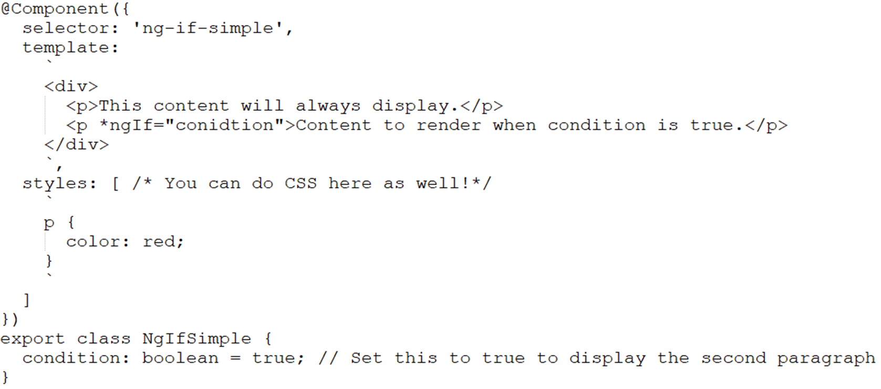
Example - Component with Directive

Slide 11
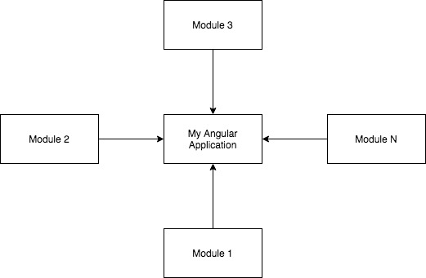
NgModule

Slide 12
Example - NgModule
Say your application has two big sections - wishlist, and cart. You can create modules for each of them - WishlistModule and CartModule. In WishlistModule you will have several components (decorated as @NgComponent) such as displaying items, dragging and dropping items, etc. Similarly for CartModule.

Slide 13
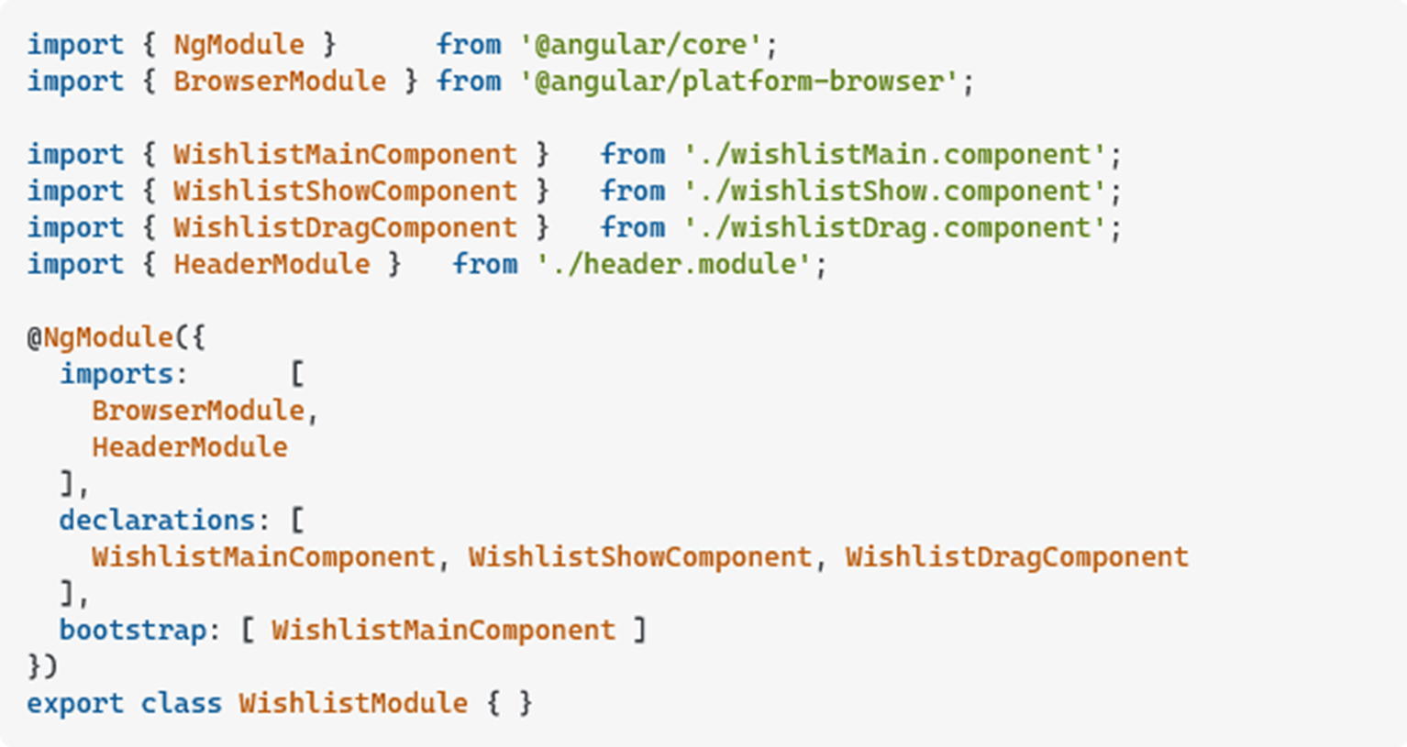
Example - NgModule

Slide 14
Angular Design
Module | Component
A collection of components, services, directives, pipes, and so on. | A building block of the Application with an associated template.
Denoted by @ngModule | Denoted by @Component
Angular apps will contain many modules, each dedicated to a single purpose. | Each component can use other components, which are declared in the same module. To use components declared in other modules, they need to be exported from this module and the module needs to be imported.

Slide 15
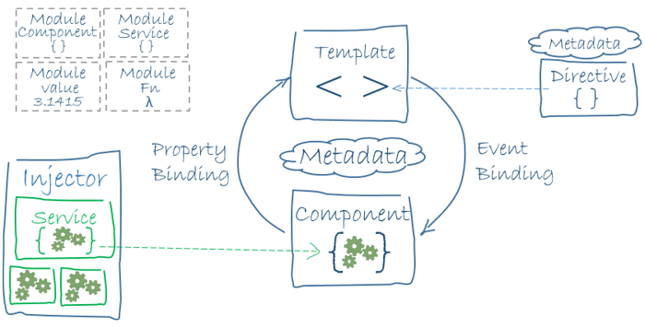
Overview
Together, a component and template define an Angular view.
A decorator on a component class adds the metadata, including a pointer to the associated template.
Directives and binding markup in a component's template modify views based on program data and logic.
The dependency injector provides services to a component, such as the router service that lets you define navigation among views.

Slide 16
Install / Run
You need Node.js for developing Angular applications.
To install:
npm install –g @angular/cli
Create a workspace and initial application
ng new my-app
Run application
ng serve --open

Slide 17
Demo

Slide 18
Sources
https://angular.io/guide/architecture
https://www.monocubed.com/blog/websites-built-with-angular/
https://thenewstack.io/what-is-typescript/
https://en.wikipedia.org/wiki/AngularJS
https://en.wikipedia.org/wiki/Angular_(web_framework)
https://invedus.com/blog/what-is-typescript-definition-history-features-and-uses-of-typescript/
https://www.toptal.com/typescript/typescript-vs-javascript-guide
https://stackoverflow.com/questions/40393701/what-is-ngmodule-actually-in-angular
https://stackoverflow.com/questions/40073941/whats-the-difference-between-an-angular-component-and-module

Slide 19
Questions?

