Slide 1
React.js
Ian Johnston and Jacob McIntosh

Slide 2
History of React.js
Created by Meta software engineer Jordan Walke.
An early prototype was released called FaxJS.
React was first used in Facebook's New Feed in 2011.
Open-sourced in May of 2013.
Popular sites that use React
Apple.com
Linkedin.com
Amazon.com
Wordpress.org
Hubspot.com
Homedepot.com
Nike.com
Notes:
Ian

Slide 3
Overview
What
Why
React is a free, open-source JS library that allows users to mix, and match React components.
React takes JS and organizes it into reusable objects called components.
Single Page Application – It loads a single page at the start then rewrites new or updates parts of the page.
Components are written the same across developers so different teams and organizations can swap them in and out.
React allows the user to create Web or Native applications.
User interfaces are equivalent across Web and Native apps.
Notes:
Ian

Slide 4
Setting up a React Project
NodeJS is required for all React projects
Open the command line
Navigate to where you want your project
Run command npm install -g create-react-app
Run the command npx create-react-app projectname
Change directory into your new project
Run npm start to launch the React app
Notes:
Ian

Slide 5
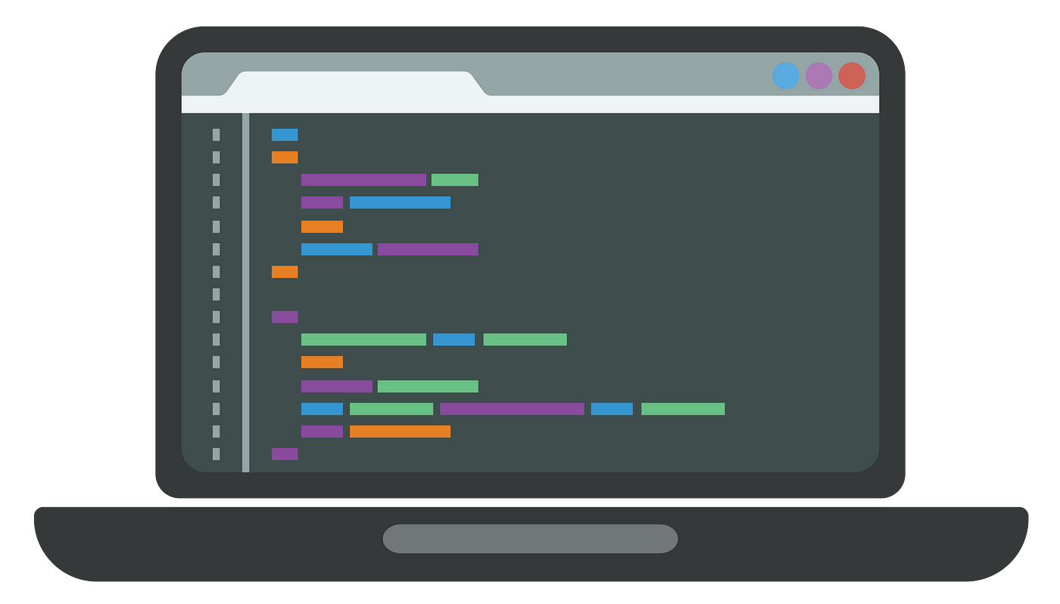
CODE DEMO #1
Notes:
Ian

Slide 6
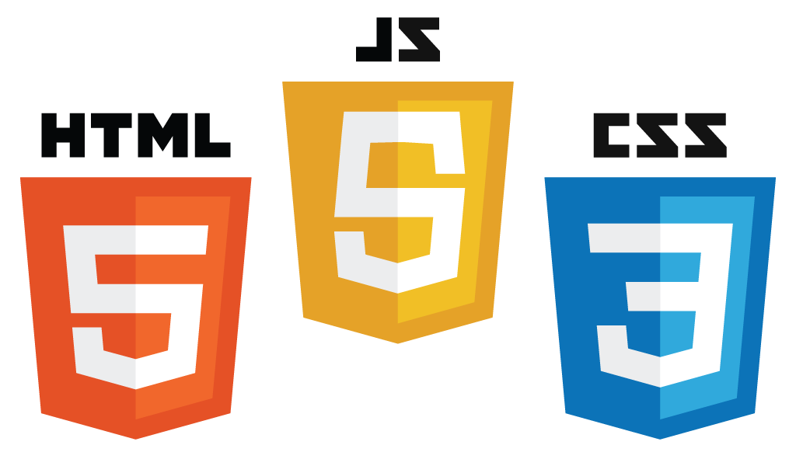
The Old Way: HTML, CSS, and JS
Web developers used to keep their code in separate files
HTML for content
CSS for design/style
JS for logic
This project structure becomes increasingly complex as your project grows
You will often find that you are repeating yourself in the HTML
React offers an intuitive way to bundle your HTML, CSS, and JS into reusable items called components
Notes:
Jacob

Slide 7
The New Way: Components
In a React web app, every UI element you see is a component
JavaScript functions that contain markup code and rendering logic
The rendering logic is written in JavaScript, and the markup code is written in JSX
Components can be nested inside of other components
Components can also be declared as a class with a render() method
Component Requirements:
Name must be capitalized
Returns JSX markup code
Notes:
Jacob

Slide 8
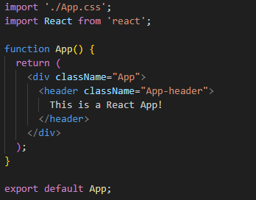
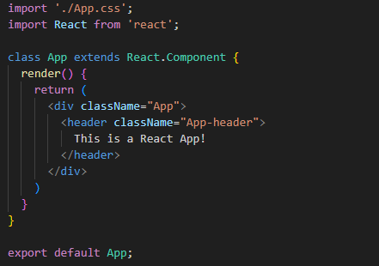
Component Example
Function
Class
Notes:
Jacob

Slide 9
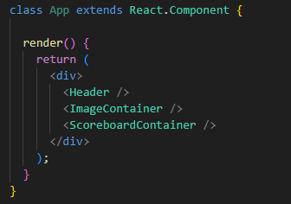
Referencing Components
You can reference components by calling their function/class name as a JSX tag.
Components can utilize other components inside of their JSX that they return
This is where the reusability comes into play. Just drag and drop the component name wherever you need it, and how many times you need it
A component that calls other components is the ‘parent’ of those ‘children’ components
Notes:
Jacob

Slide 10
JSX
Syntax extension that allows you to write HTML in JavaScript
JSX Rules:
All tags must be closed
Everything must be inside of a single root element
Avoid using reserved JavaScript words
Use camelCase
HTML
JSX
Notes:
Jacob

Slide 11
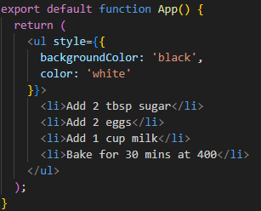
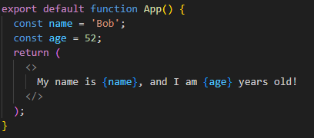
Nesting JS and CSS in JSX
Curly braces allow you to include JavaScript in your JSX
Can be included in the middle of a JSX tag
Can be used during an assignment with ‘=‘
Double curly braces can be used to include objects
Notes:
Jacob

Slide 12
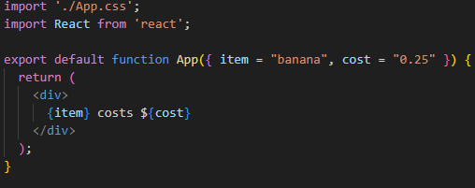
Props
Components can talk to each other by using props
Props are passed to components like attributes are passed in HTML tags
Props are passed from the top down, meaning parent components pass props to their children
Props can be any valid JavaScript Value (string, int, object, array, etc…)
Notes:
Jacob

Slide 13
CODE DEMO #2
Notes:
Jacob

Slide 14
Events
When a user performs an action, that event is handled.
Naming convention: start with ”on” followed by a capital letter
Events are handled by passing a function as a prop to an element.
handleClick is an event handler function that is passed in as a prop.
React event handlers are different from JS as they are cross-browser compatible.
Notes:
Ian

Slide 15
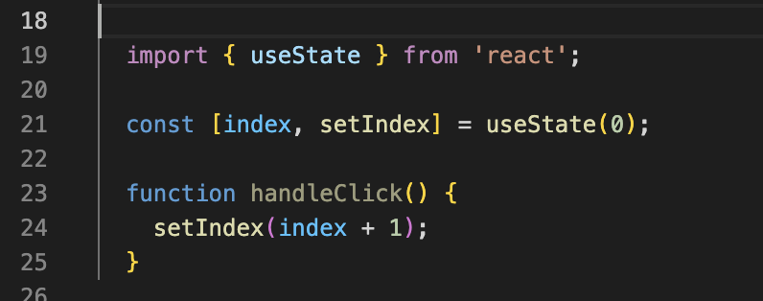
Altering State
The components need to change the data on the screen in response to a user event.
User input or changing the picture displayed on an image carousel.
These events need to be remembered by the component.
The memory of these events happening is called state.
Sets index to 0
Increment index by 1 each time the handleClick event occurs
Notes:
Ian

Slide 16
CODE DEMO #3
Notes:
Ian

Slide 17
OAC Mobile Showcase
Notes:
Ian

Slide 18
Sources
https://en.wikipedia.org/wiki/React_(software)#:~:text=React%20was%20created%20by%20Jordan,JSConf%20US%20in%20May%202013.
https://react.dev/
https://blog.hubspot.com/website/react-js
https://w3techs.com/technologies/details/js-react

