Slide 1
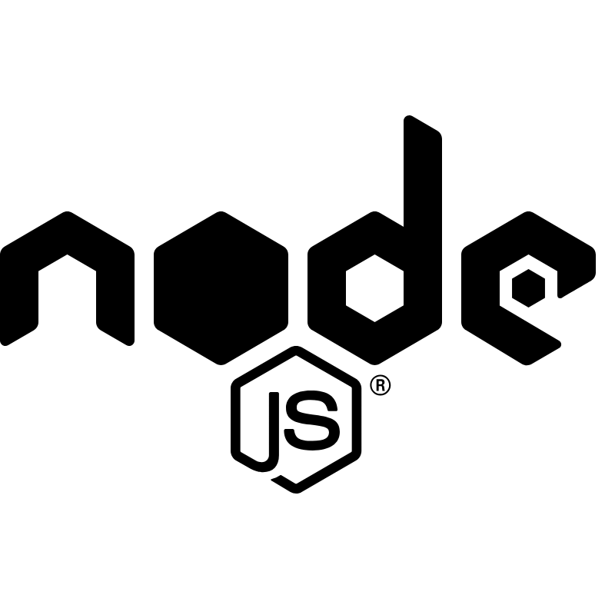
Node.js
Created by Jacob Littler and Joel Justice

Slide 2
What is Node?
Created by Ryan Dahl, released in 2009
Open-source, server-side JavaScript runtime environment that allows developers to run JS code outside of a web browser
JavaScript used to only be used for front-end development to make web applications interactive.
Node.js is not its own programming language, but an environment in which you run JavaScript code on a physical machine to build web and mobile applications on the server side
*

Slide 3
Motivation
Dahl was working on a web-based project and noticed problems with traditional server-side technologies that relied heavily on thread-based models.
These technologies were inefficient for handling large numbers of concurrent connections, which is obviously not great for a web-based project
*

Slide 4
Creation
Dahl envisioned an event driven and non-blocking architecture environment for JavaScript for input/output (I/O) operations
Dahl believed this new approach would significantly improve performance and allow for better management of concurrent connections without blocking I/O operations
Node.js was built on Google's V8 JavaScript engine for its speed and efficiency, which allows for quick execution of JavaScript in Node.js
Its public release in May of 2009 brought much excitement and interest in the development community
*

Slide 5
Non-blocking I/O model
The ability to handle multiple connections as well as I/O operations concurrently without having to wait for each operation to complete before executing the next connection/ I/O
This is crucial for applications that need to handle a large amount of connections at the same time, such as API's and real time applications
Node.js is highly scalable, which makes it great for building server applications
Its use of system resources does not significantly increase as number of connections increases
This model reduces latency for users
Great for online games and applications that have chat features

Slide 6
Single language stack
Single Language Stack means that it allows developers to utilize one language on both the client and server side
Allows developers to use JavaScript on both the server side as well as client side(browser)
This advantage helps streamline development by allowing back-end and front-end developers to share code easily, reducing context switching and improving productivity
Single Language Stack promotes code reusability and ensures that developers don’t need to switch between multiple languages when working on projects

Slide 7
Cross platform compatibility
Can run on various operating systems such as Linux, macOS, Windows, Unix, and more. This allows for minimum changes when running on different environments
Node utilizes serverless platforms and cloud computing through platforms such as AWS, Azure, and Google Cloud
The V8 engine also plays a large role in making its cross-platform compatibility and consistency across multiple different platforms

Slide 8
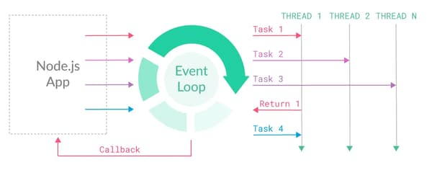
Event Loop
Node.js is built on an event-driven architecture
The heart of this design is the event loop, which is responsible for managing and dispatching events and allows Node.js to efficiently handle asynchronous operations
*

Slide 9
Event Queue
When an asynchronous event is initiated, it will not block the main thread of execution. It is instead delegated to either an underlying system or a separate thread. There, a callback function will be registered to be executed when the operation computes
These completed operations and their callbacks are placed in an event queue. The event loop continuously checks this queue for pending events. When the event loop finds an event, the associated callback is executed
This is what contributed to the non-blocking aspect of Node.js
*

Slide 10
Single-threaded nature
Node is described as being single-threaded, being that it has a main thread that is responsible for executing JS code and delegating the commands
Although Node is single-threaded in nature, what makes it efficient is its ability to run multiple threads asynchronously, through incorporation of the Event loop
Node then delegates this command to background threads or the operating system, allowing the main thread to continue to process and take in commands
The Event loop is responsible for coordinating the execution of these command's callbacks. This ensures that the single thread remains responsive and can efficiently handle multiple tasks at the same time

Slide 11
npm
npm is the standard package manager for Node upon installation and is the most popular package manager in the world
npm is a software library that programmers can use to access and publish code packages to share with others across the globe
npm originally stood for Node Package Manager, but now is a package manager for JS. This explains why it is lower case
npm is crucial for building large scale applications or even side projects, as it allows for code reusability and is a large library to select from
https://www.npmjs.com/

Slide 12
Web Servers
Code example
const http = require('http’); // Import the 'http' module, which allows us to create an HTTP server
// Define the hostname and port number on which the server will listen
const hostname = '127.0.0.1'; // This is the localhost IP address
const port = 9231; // You can choose any available port number
// Create an HTTP server
const server = http.createServer((req, res) => {
// Set the response header with a 200 OK status and plain text content type
res.statusCode = 200;
res.setHeader("Content-Type", "text/plain");
// Send the "Hello World!" message as the response
res.end('Hello World!\n');
});
// Start the HTTP server and make it listen for incoming requests
server.listen(port, hostname, () => {
// This callback function will be executed once the server starts listening
console.log(`Server running at http://${hostname}:${port}/`);
});
*

Slide 13
Asynchronous Operations-Why do we need them?
Reminder- JavaScript is a single threaded, blocking, and synchronous language
Some issues that one may fall into with this model is that some operations may take longer than others to run. We do not want to stop other operations due to blocking while we are waiting on an operation. Doing so keeps your application responsive.
JavaScript is also single threaded, which means it only performs one task at a time. This is where Node.js steps in

Slide 14
Asynchronous Operations- The Solution
Node introduces APIs and functions that allow for your code to operate asynchronously to not slow up other operations within your application. Common techniques are as follows…
Callbacks- a function that you pass to another function that starts to execute code in the background
Promises- are objects that are returned by asynchronous functions that represent the current state of an operation
EventEmitter Class-class that allows for the handling of events through communicating with different parts of the program as they occur. EventEmitter follows the observer pattern

Slide 15
Real World Applications of Node
Web Servers
API Development
Browser Games
Streaming Applications
Apps Built with Node
Uber
Netflix
PayPal
LinkedIn
*

Slide 16
Node Community
Currently, Node has one of the best communities in regard to programming needs.
npm
Encourages Collaboration
Active Forums e.g. Reddit, StackOverflow, Github
Active Development
*

Slide 17
Statistics and facts
In 2023 Node developers are expected to be around 27.7 million
Roughly 6.3 million websites incorporate Node
36.4% of the Node libraries, frameworks, and tools are utilized by professional developers
Through the incorporation of Node, developing costs can be decreased upwards of 58%
Node is able to cut loading times by 50-60%
Found via-Enterprise Apps Today
*

Slide 18
Conclusion and Future Trends
To leave off on, Node is an open-source runtime environment that enables execution of JavaScript code on the server side. Node utilizes blocking and an event-driven architecture that promotes an asynchronous programming style. Node is commonly used to build web servers, API’s, in person-real time applications, and more.
Future trends include
An updated V8 engine
Cloud Computing
Serverless no Hardware
Larger Scalability

Slide 19
Questions?

Slide 20
Sources
https://www.codecademy.com/article/what-is-node
https://www.knowledgehut.com/blog/web-development/node-js-future
https://www.enterpriseappstoday.com/stats/node-js-statistics.html#:~:text=Amazing%20Node%20JS%20Statistics%20(Editor's%20Choice),-Node%20JS%20is&text=By%202023%2C%20the%20number%20of,used%20tool%20for%20web%20development.
https://www.imaginarycloud.com/blog/what-is-node-js-used-for/#popular_apps
https://youtu.be/QvIC2z8ADtU?si=QYaohR9-pX5LRdqQ
https://en.wikipedia.org/wiki/Node.js

