Slide 1
AJAX, XML and JSON
with thanks to Rob McMahon

Slide 2
AJAx
Asynchronous JavaScript and XML
Synchronous Events – stop any other events from happening before completion
Asynchronous Events – can happen regardless of any other events that are in progress
The most common use of this in web development happens when loading data onto a page without reloading the page as a whole. Examples include:
File transfers / loading data
Adding items to a cart
Dynamic search bar results

Slide 3
Ajax
Common data formats received from AJAX requests include JSON, XML, and HTML
The process of retrieving information asynchronously involves three major steps:
The browser requests information from the server
The server responds with data (JSON, XML or HTML)
The browser processes the information and adds it to the page
This means that the user is able to do other things while an AJAX request is completed
Thus, UIX (user interface experience) can be sped up

Slide 4
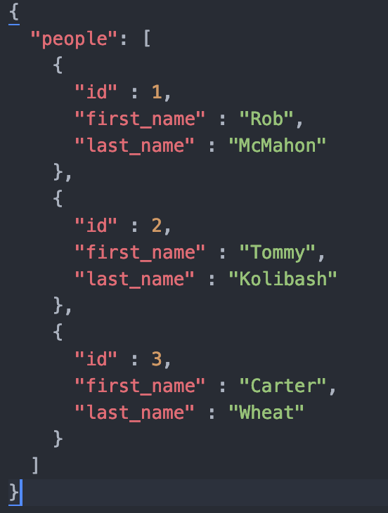
JSON
JavaScript Object Notation
Used as an alternative to XML
Minimal, readable format for structured data
Normally grouped into dictionaries of objects with the same properties
Also includes lists as containers
Limited data types: strings, integers, Booleans

Slide 5
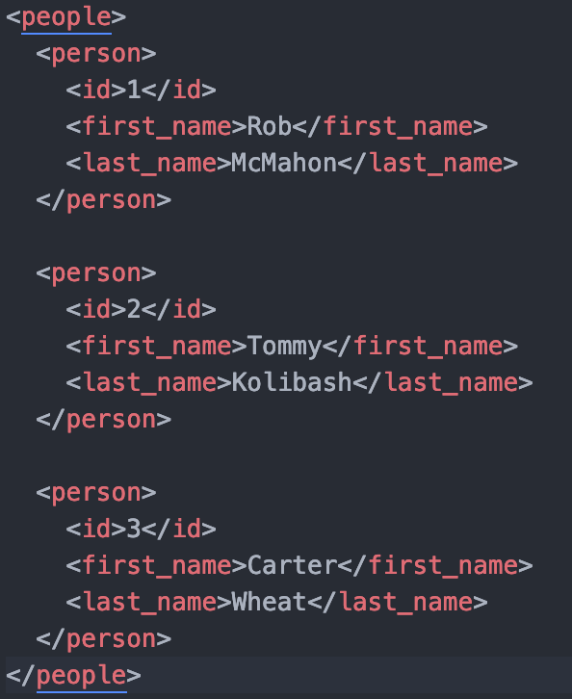
XML
Similar to JSON format with a few key differences…
Provides the ability to display data since it is a markup language
XML supports many data types (ex. strings, integers, images, charts)
Tags can be any word (just not xml)
XML is supported by many more desktop applications than JSON

Slide 6
JSON vs. XML
JSON
Less verbose / easy to read
Faster parsing
Objects align in code
Commonly used with JavaScript
Unforgiving syntax, missed comma can break file
XML
Supported by many more desktop applications / platforms
AJAX includes XML in it, not JSON
Easily converted to XHTML
Flexible data format, can be converted to complex structures

Slide 7
HTML
The Good
The third common format that an AJAX request will respond with
Easy to write, request and display on webpages
Simplest way to update a section of a webpage
The Bad
Not well-suited for anything other than web-applications
Server must produce formatted HTML that is ready to use
Requests must come from the same domain (ex. cannot access an API from another source)

Slide 8
Using ajax
Web development requires a range of languages and technologies
AJAX requests are written in JavaScript, though implementation requires more
Specifically, AJAX requests require a server-side scripting language (PHP, Node.js, Perl, Ruby, Python, etc.)
This allows for communication between the server and browser
jQuery, (a JavaScript framework), can make AJAX much easier to use with its built-in functionality
Specifically, requests and processing data after requests

Slide 9
Ajax requests, without jquery
var xmlHttp = new XMLHttpRequest(); //creates a new instance of XMLHttpRequest object
xmlHttp.open(‘GET’, ‘data.json’, true); //Prepare the Request!
//http method, url to handle info //Boolean → asynchronous?
xmlHttp.send(null); //Send the request, parameter can be any additional info

Slide 10
Ajax responses, without jquery
xmlHttp.onload(function () {
if (xmlHttp.status == 200) { //Ensure that the response was not corrupted
//process the results from the server
}
});

Slide 11
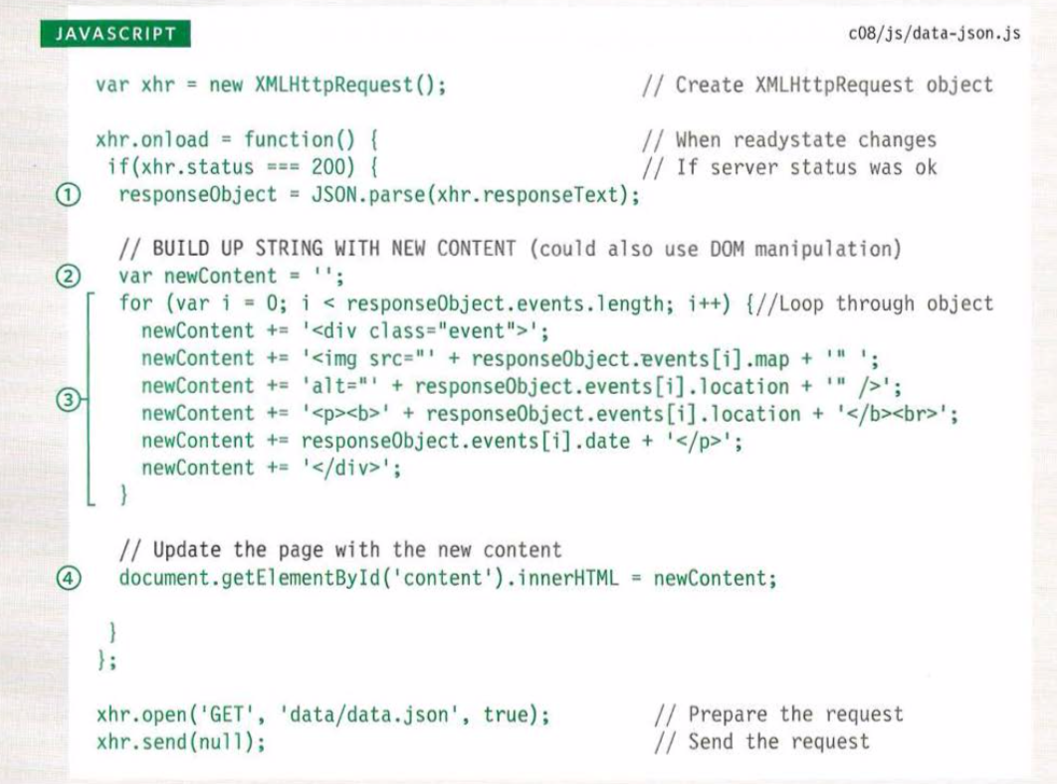
Ajax, without jquery
jQuery makes it much easier to process data when utilizing AJAX
It is much more difficult to access / display specific data without using jQuery
Here is an example from the textbook

Slide 12
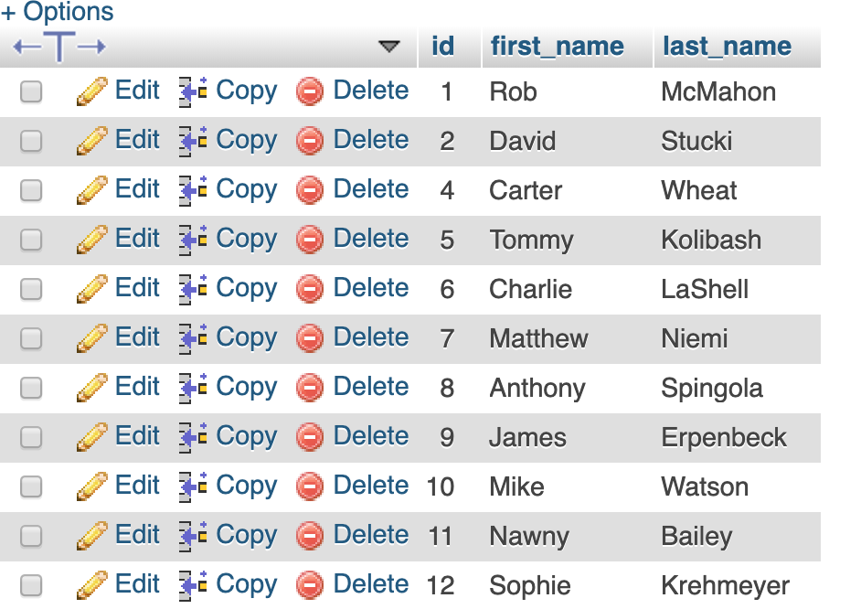
Dynamic search bar example
The languages used to create this example include HTML, CSS, JavaScript / jQuery, PHP, and SQL.
Step 1: create database and users table
id, first_name, last_name
Created with MySQL

Slide 13
Base HTML / connect to DB

Slide 14
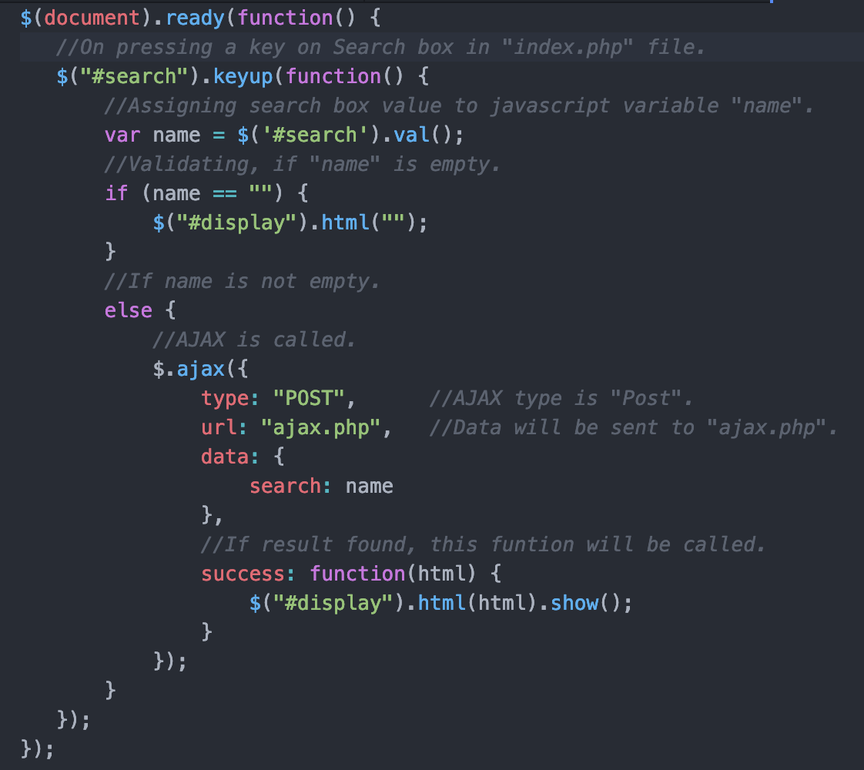
Example cont.
script.js file, using jQuery / AJAX

Slide 15
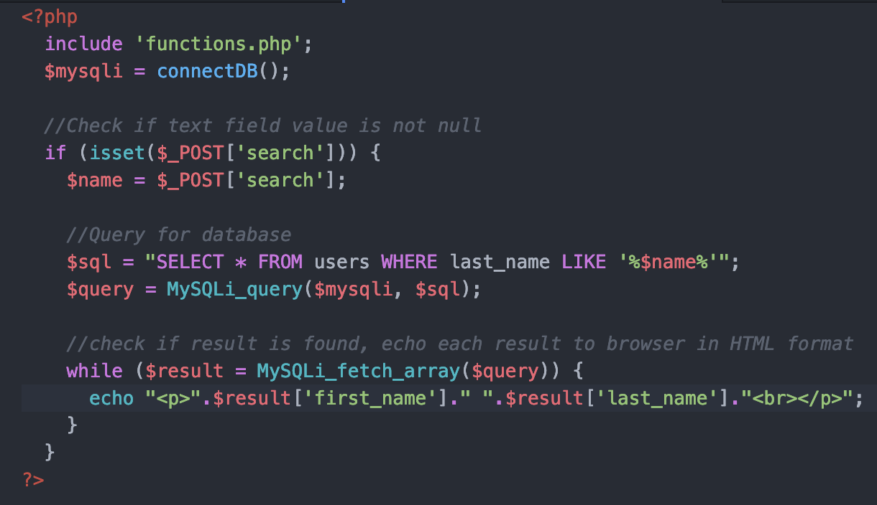
search.php file
Example of processing data in HTML format
Must be done within server-side file
Query to database, echo results to browser

Slide 16
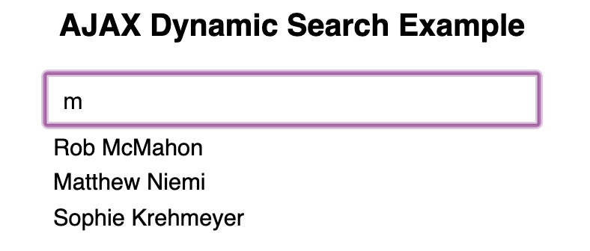
Result
Allows for dynamic search bar without reloading entire webpage
Asynchronous, “on the fly” functionality

Slide 17
What was required?
The browser requested information from the server when any key was pressed (script.js file)
Used AJAX to run PHP script, using url property
The PHP query script is fired upon the AJAX request, scanning the database for any potential last-name matches
The browser processes the formatted HTML response received from the database in the PHP query script.

Slide 18
More JSON & XML
Example from Industry

