Slide 1
Introduction to JQUERY
COMP 3700
Thanks to Tom Gant & Kaitlin Dosch

Slide 2
jQuery History
Created in 2005 and released in 2006
“jQuery is a Javascript library that takes this motto to heart: Writing Javascript code should be fun.”
Making common, repetitive tasks, short and understandable
Popularity
2015 – 62.7% of top 1 million websites
2018 – 78% of top 1 million websites
2021 – 77.8% of top 10 million websites

Slide 3
What is jQUERY?
Pre-written JavaScript code that allows for easier -
HTML traversal/manipulation
Event handling
Animation
Create Ajax applications
Less code than JavaScript (no need to understand)
CSS-style selectors (one or more nodes from Document Object Model (DOM) tree)
Built in methods to work with selections
Methods to attach event listeners to elements
Notes:
Simplified selectors and

Slide 4
Why Use jQuery?
JQuery does nothing you can’t achieve with JavaScript
Simple Selectors
DOM complexity selecting elements (older browsers, IE whitespace)
CSS-style selectors (faster, more accurate)
Common Tasks in Less Code
Looping through elements, add/remove elements, handle events & Ajax
Chaining of methods
Cross-Browser Compatibility
Automatic handling inconsistency of browsers select element and event handling

Slide 5
<body>
<div id=“page”>
<h1 id=“header”>List</h1>
<h2>Buy groceries</h2>
<ul>
<li id=“one” class=“hot”><em>fresh</em> figs</li>
<li id=“two” class=“hot”>pine nuts</li>
<li id=“three” class=“hot”>honey</li>
<li id=“four”>balsamic vinegar</li>
</ul>
</div>
<script src=“js/jquery-3.6.0.min.js”></script>
<script src=“js/basic-example.js”></script>
</body>
1. Include jQuery script in HTML
2. Include JavaScript file that uses JQuery
Notes:
Minification which removes unnecessary spaces, carriage returns and comments.

Slide 6
<body>
<div id=“page”>
<h1 id=“header”>List</h1>
<h2>Buy groceries</h2>
<ul>
<li id=“one” class=“hot”><em>fresh</em> figs</li>
<li id=“two” class=“hot”>pine nuts</li>
<li id=“three” class=“hot”>honey</li>
<li id=“four”>balsamic vinegar</li>
</ul>
</div>
<script type =“text/javascript” src=“http://ajax.googleapis.com./ajax/libs/jquery/3.6.0/jquery.min.js”></script>
<script src=“js/basic-example.js”></script>
</body>
1. Include jQuery by Content Delivery Network
2. Include JavaScript file that uses JQuery
Notes:
Minification which removes unnecessary spaces, carriage returns and comments.

Slide 7
jQuery Selectors
jQuery () function – creates jQuery Object
jQuery(‘li.hot’) or $(‘li.hot’)
FUNCTION CREATES JQUERY OBJECT
SELECTOR
SELECTOR
One parameter – CSS-style selector
Can be stored as a variable
Simpler element access compared to DOM

Slide 8
<body>
<div id=“page”>
<h1 id=“header”>List</h1>
<h2>Buy groceries</h2>
<ul>
<li id=“one” class=“hot”><em>fresh</em> figs</li>
<li id=“two” class=“hot”>pine nuts</li>
<li id=“three” class=“hot”>honey</li>
<li id=“four”>balsamic vinegar</li>
</ul>
</div>
<script src=“js/jquery-3.6.0.js”></script>
<script src=“js/basic-example.js”></script>
</body>

Slide 9
Finding Elements
Basic/Hierarchy selectors (CSS-style)
* - All elements
element – specific element reference
parent > child – Direct child or another
Extra selectors
:last/:even/:odd – selection of index
:hidden/:visible
:input/:text/:password – specific forms
Full list on page 302 and 303 of Duckett book

Slide 10
Matched Set
jQuery object returned with one or more objects
ul
li
li
li
li
Single Element/Node
jQuery (‘ul’) or $(‘ul’)
INDEX ELEMENT NODE
0 ul
Multiple Element/Node
jQuery (‘li’) or $(‘li’)
INDEX ELEMENT NODE
0 li#one.hot
1 li#two.hot
2 li#three
3 li#four

Slide 11
jQuery Methods
Built-in methods for selectors
$(‘li.hot’).addClass(‘complete’);
FUNCTION CREATES JQUERY OBJECT
Method
Dot notation syntax
Built to work with jQuery elements
Some methods do take parameters

Slide 12
Built-in Methods
Content filters
Get/change content (.html(), .text(), .replaceWith(), .remove())
Elements (.before(), .after() .prepend(), .append(), .add())
Finding elements
General (.find(), .next())
Filter/Test (.filter(), .has())
Order in selection (.eq(), .lt(), .rt())
Dimension/Position (.height(), .width(), .position(), .scrollTop())
Effects & Animation
Basic (.show(), .hide())
Fading/Sliding ()
Events
Document/file (.ready(), .load())
User Interaction (.on())
Full list on pages 304 & 305 of Duckett

Slide 13
Get Data
Get Information
jQuery .html() selection with multiple objects returns only first item
Traverse or filter methods used for different elements
.each() used for all items (discuss more later)
$(‘li.hot’).html();
Returned => <em>fresh</em> figs

Slide 14
Set Data
Set Information
Example
jQuery selection with multiple objects sets all elements
Traverse or filter methods used for updating one element
More specific selector
$(‘li.hot’).html(‘Updated’);
Modifies all li.hot elements

Slide 15
JQuery Storing References
jQuery selection store reference to DOM node
Copies are not made
DOM Nodes
Complex JavaScript Object
< >
< >
< >
var
var
var
Variables
< >
< >
< >
$(‘li’);
0 A4
1 B4
2 C4
var
< >
< >
< >
li
li
li

Slide 16
JQuery Selection Caching
Caching stores reference to jQuery object
$ used to denote variable containing jQuery object
$listItems = $(‘li’)
DOM Nodes
< >
< >
< >
var
var
var
Complex JavaScript Object
< >
< >
< >
$(‘li’);
0 A4
1 B4
2 C4
var
< >
< >
< >
Variables
li
li
li

Slide 17
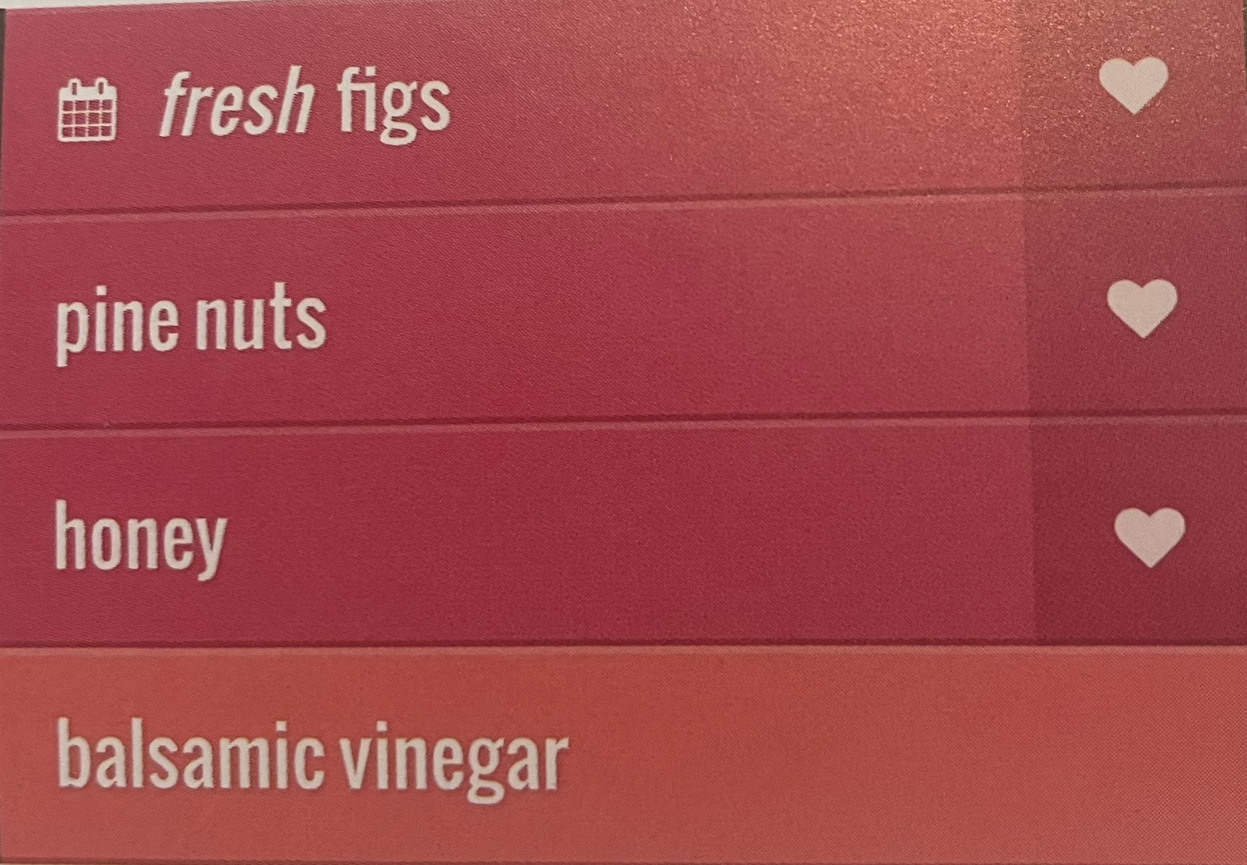
Looping
JavaScript code needs to be written
jQuery object with multiple items can be all updated
$(‘li em’).addClass(‘seasonal’);
$(‘li.hot’).addClass(‘favorite’);
Ability to update all elements – implicit iteration
.each() is used to iterate to retrieve information

Slide 18
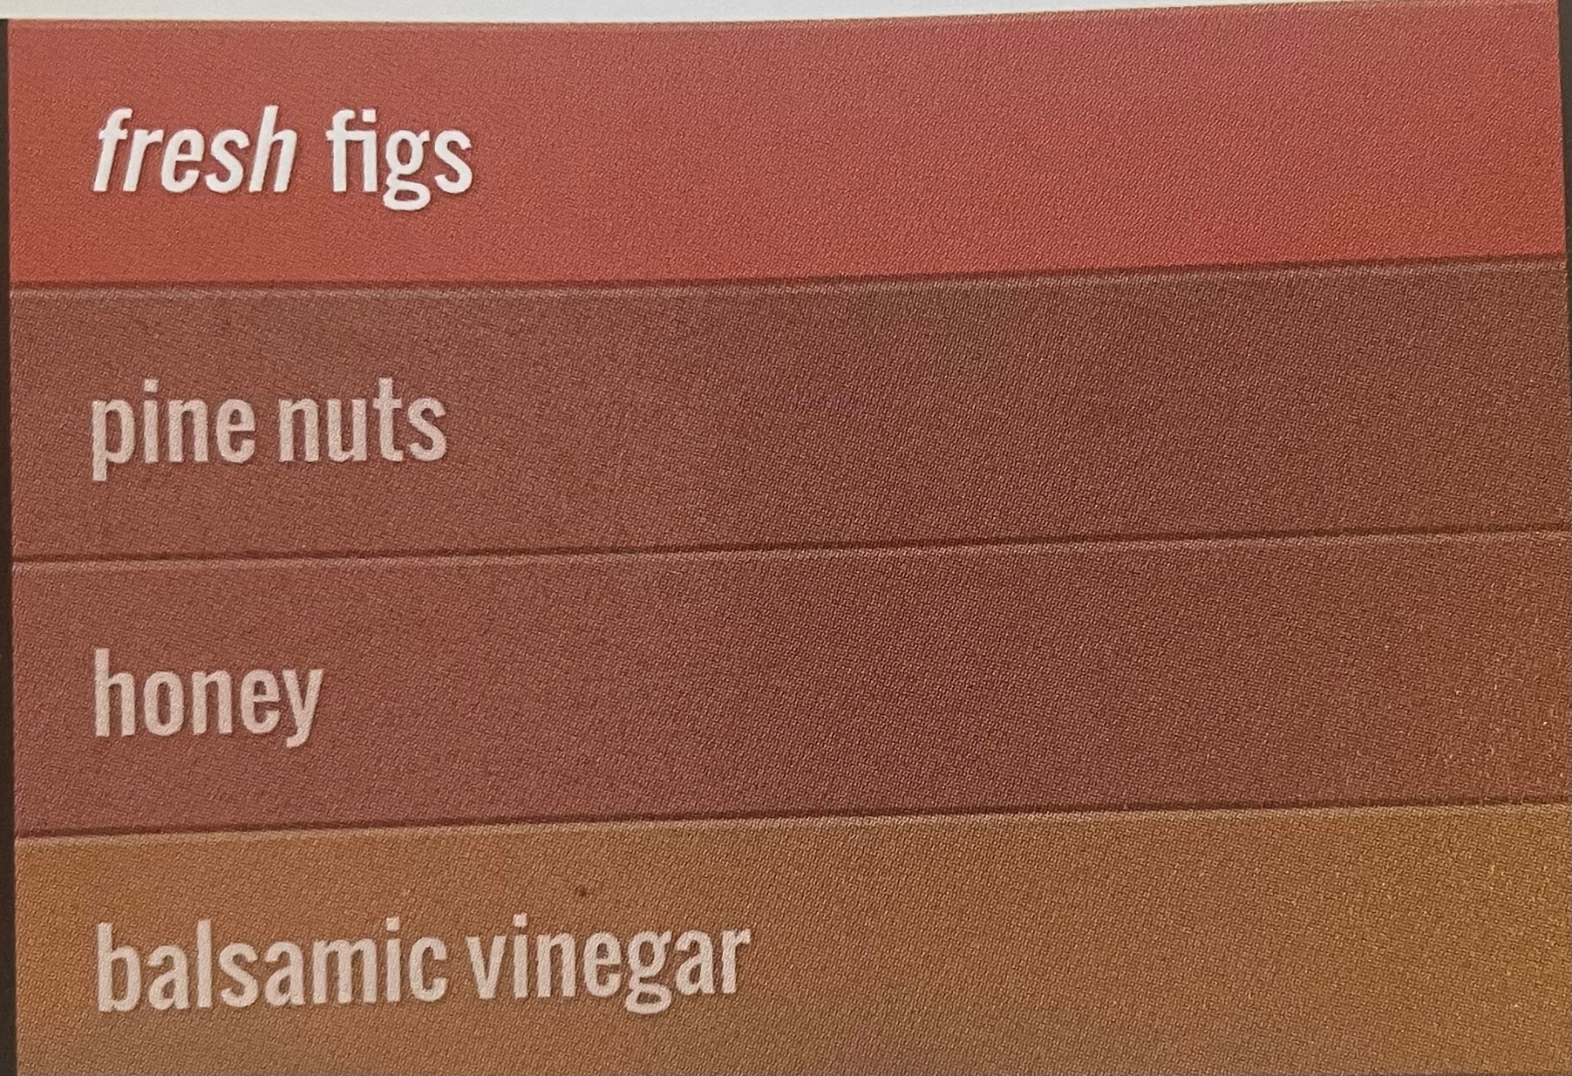
Chaining
Dot notation used for multiple methods
$(‘li [id! = “one”]’)
.hide()
.delay(500)
.fadeIn(1400);
Methods to retrieve info can’t be chained
All methods must work or none work - Example

Slide 19
.ready() Method
Checks that page is ready for code to work with.
$(document).ready(function() {
// Your script goes here
});
JQUERY OBJECT
READY EVENT METHOD

Slide 20
Element Content
.html() and .text() retrieve and update content
.html() returns first element in matched set
.text() returns content for every element in the selection
Example
$(‘ul’).html()
<li id=“one” class=“hot”><em>fresh</em> figs</li>
<li id=“two” class=“hot”>pine nuts</li>
<li id=“three” class=“hot”>honey</li>
<li id=“four”>balsamic vinegar</li>
$(‘ul’).text()
fresh figs
pine nuts
honey
balsamic vinegar

Slide 21
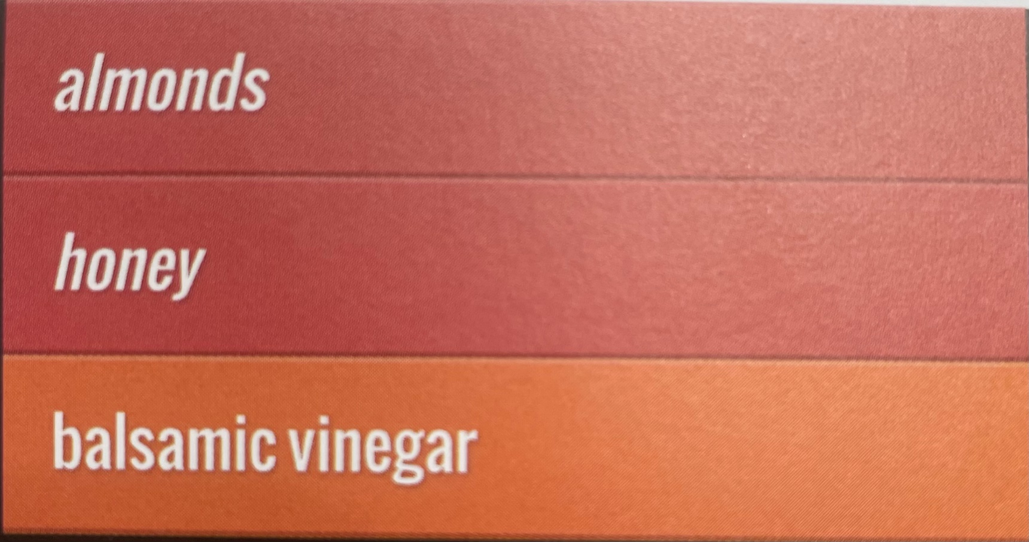
Updating Elements
.html() every element new content
.text() every element new text content
.replaceWith() replaces every element with new content
.remove() removes all of the elements in matched set.
$function(){
$(‘li:contains(“pine”’).text(‘almonds’);
$(‘li.hot’).html(function() {
Return ‘<em>’ + $(this).text() + ‘<em>’; });
$(‘li#one’).remove();
});

Slide 22
Inserting Elements
Two step process
Create the new element in a jQuery object
Use a method to insert the content into the page
.before()
.after()
.prepend()
.append() Example
<li>item</li>
.before()
.after()
.prepend()
.append()

Slide 23
Attributes Values
Can create attributes, or access and update their contents
$(function() {
$(‘li#three’).removeClass(‘hot’);
$(‘li.hot’).addClass(‘favorite’);
$(‘ul’).attr(‘id’,’group’);
});
1
2
3
Finds #third list item and removes class
Selects all <li> with class hot and adds class
Updates properties for all <li> elements

Slide 24
Changing CSS Rules
.css() method used to select and update CSS properties
$(function() {
var backgroundColor = $(‘li’).css(‘background-color’);
$(‘ul’).append(‘<p>Color was: ‘ + backgroundColor + ‘</p>’);
$(‘li’).css({
‘background-color’: ‘#c5a996’,
‘border’: ‘1px solid #fff’,
‘color’: ‘#000’,
});
});
1
2
3
backgroundColor variable to hold first item’s background color
Written onto the page with append
Updates properties for all <li> elements - Example

Slide 25
Working with Each Element
Functionality of a loop with .each()
Methods to update all, but loops may be needed
Get information from each element in matched set
Perform series of actions on each element
.each() takes one parameter, a function to perform on each element
.this() accesses current element on each loop iteration

Slide 26
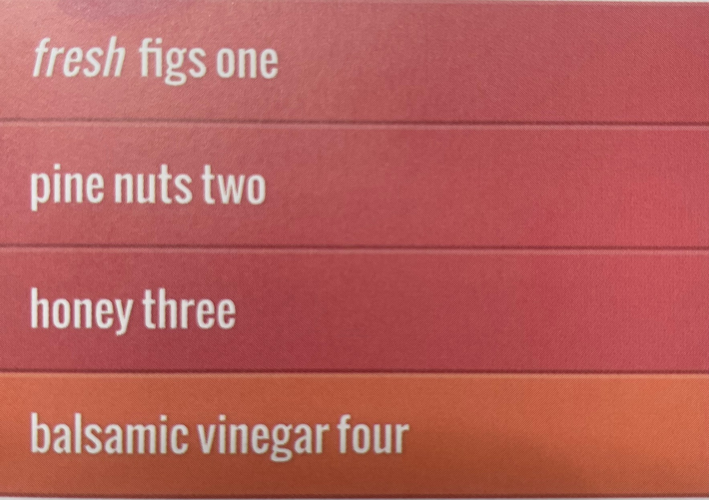
Working with Each Element (cont.)
$(function(){
$(‘li’).each(function() {
var ids = this.id;
$(this).append(‘ <span class=“order”> + ids + ‘</span>’);
});
});

Slide 27
jQuery Events

Slide 28
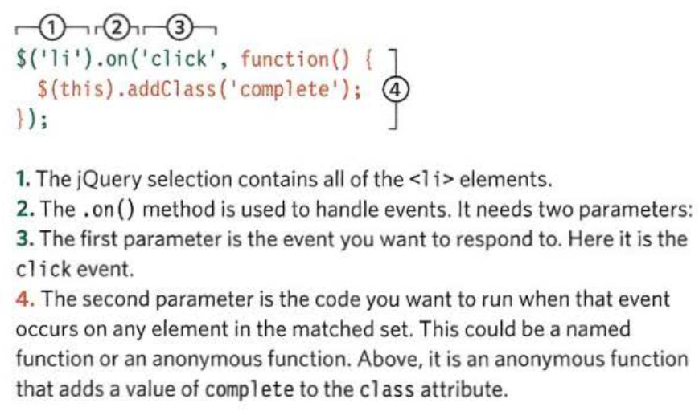
.on() method
The .on() method is used to handle all events
Notes:
.on() deals with events such as mouse clicks, document ready, document load, form submit, keyboard keypress

Slide 29
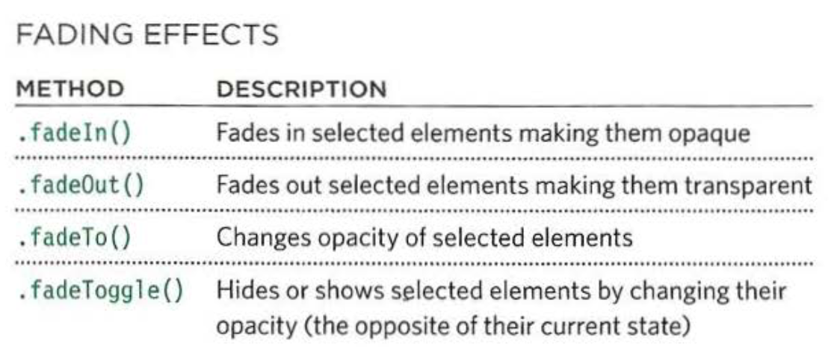
Effects
The effects methods are used to enhance your web page with transitions and movement
Notes:
Basic syntax: $selector.method(speed, callback);
Animate syntax: $selector.animate({params}, speed, callback);

Slide 30
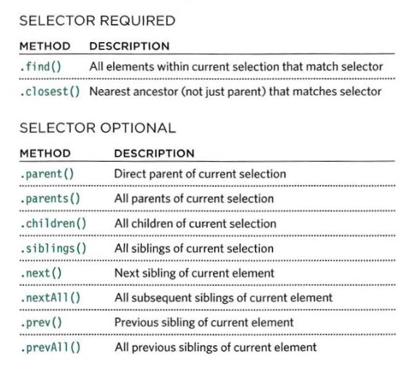
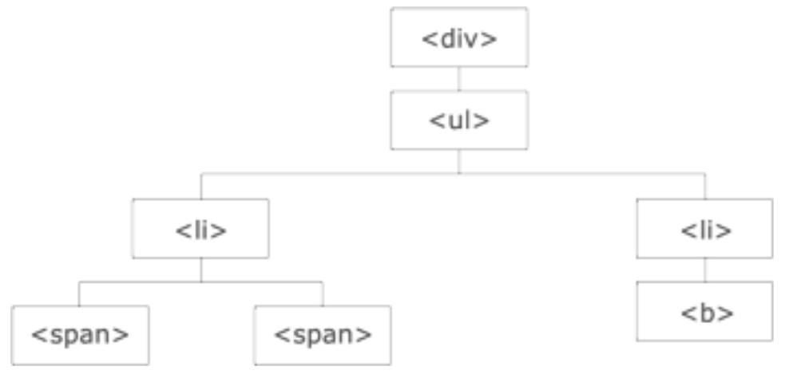
Traversing the DOM
When you have made a jQuery selection, you can use these methods to access other element nodes relative to the initial selection
Notes:
DOM tree
jQuery provides methods to traverse the DOM

Slide 31
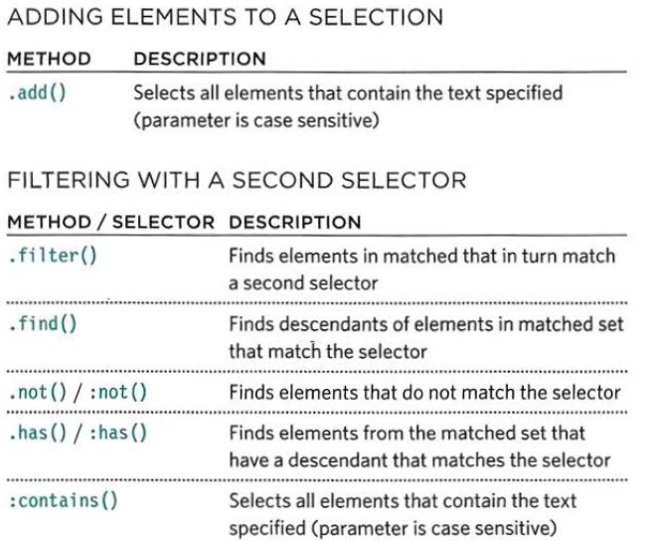
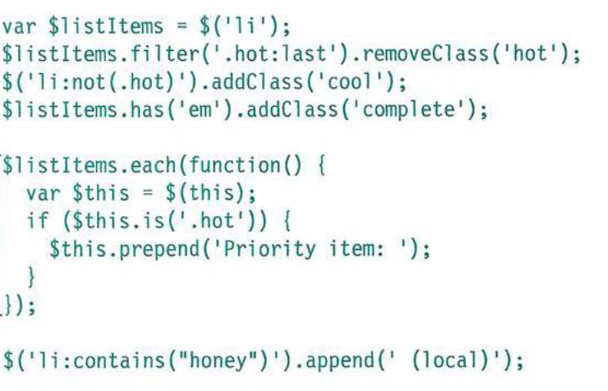
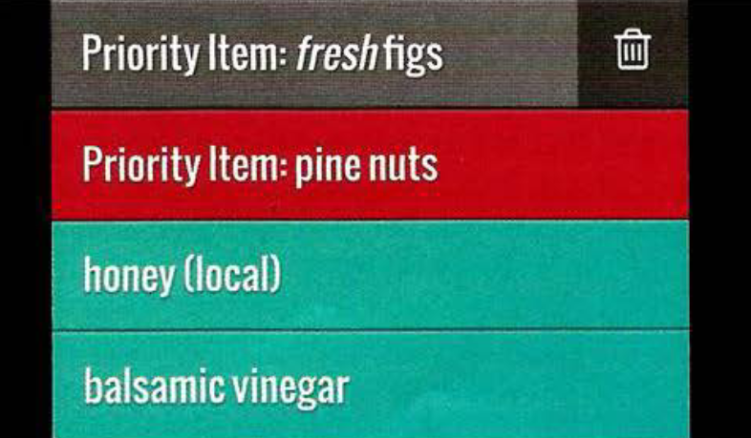
Filtering
Once you select, you can add elements to it, or you can filter the selection to work with a subset of the elements

Slide 32
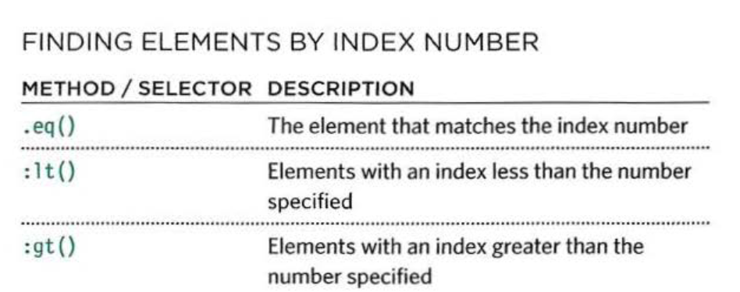
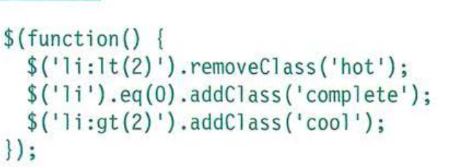
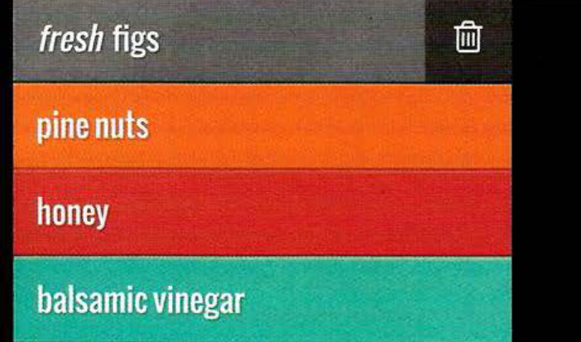
Finding Items by Order
Each item returned by a selector is given an index number
Notes:
Index number can be used to filter the selection
jQuery objects are described as array-like because of index number

Slide 33
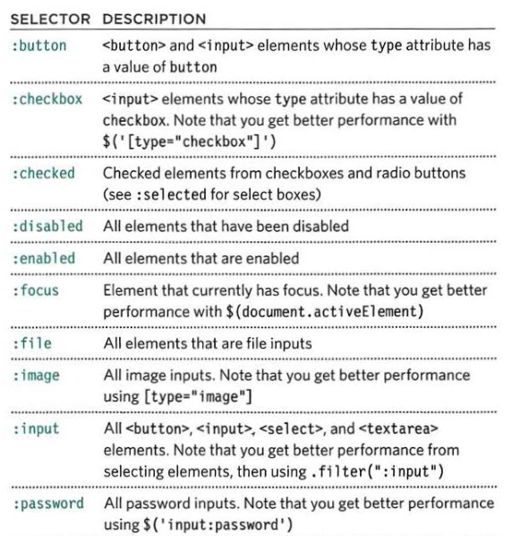
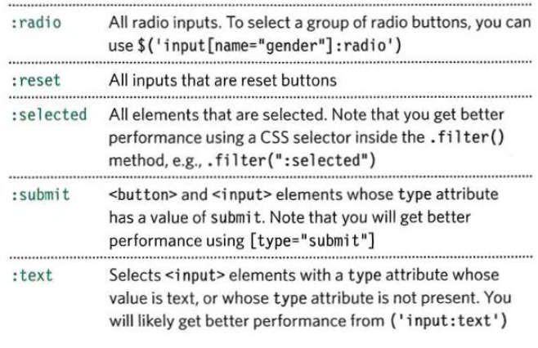
Selecting Form Elements
jQuery has selectors that are designed specifically to work
with forms
Notes:
Not always the quickest (accessing form elements using the same selectors to pick any elements often is)
Examines each element, therefore narrow down where the script needs to look

Slide 34
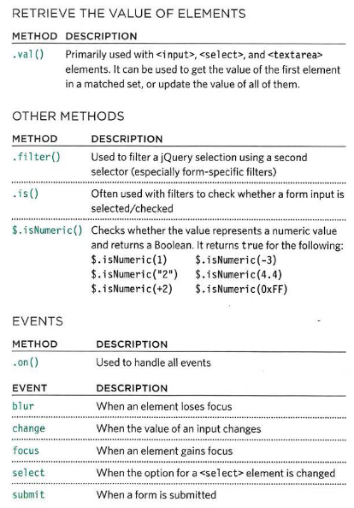
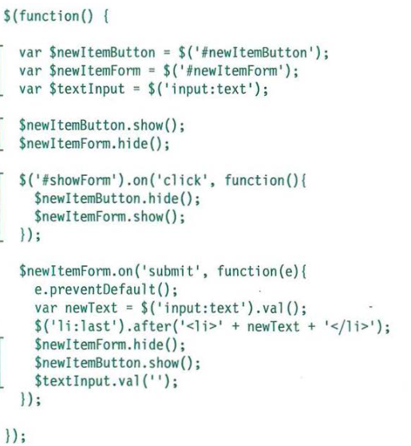
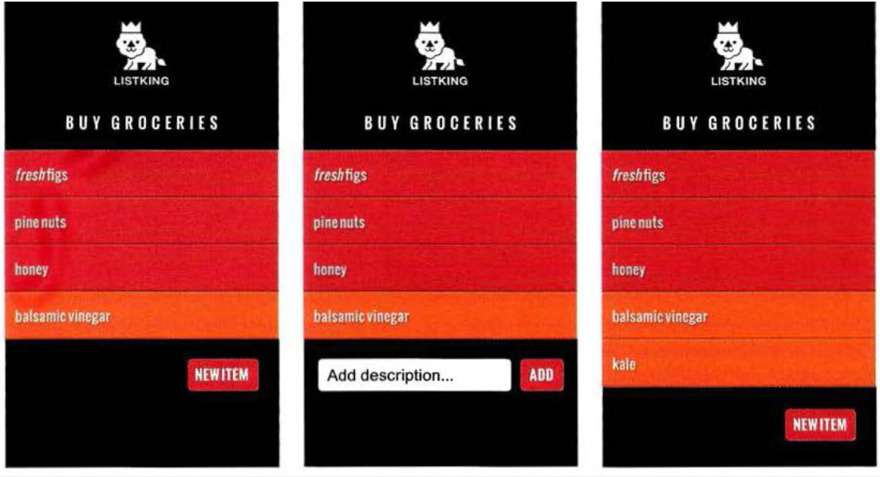
Form Methods and Events

Slide 35
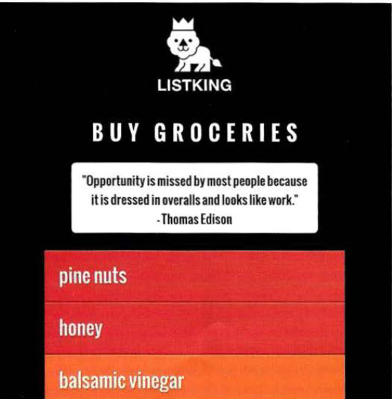
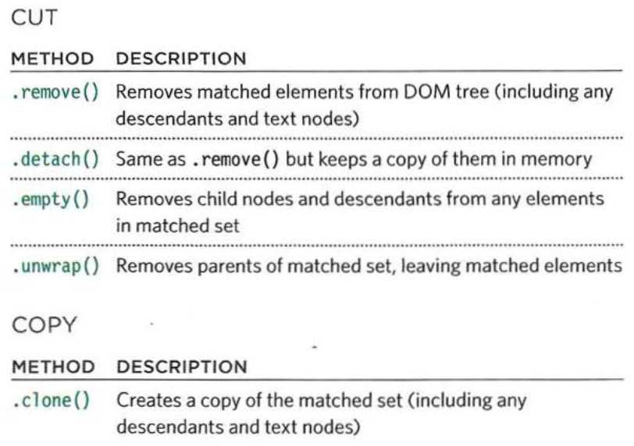
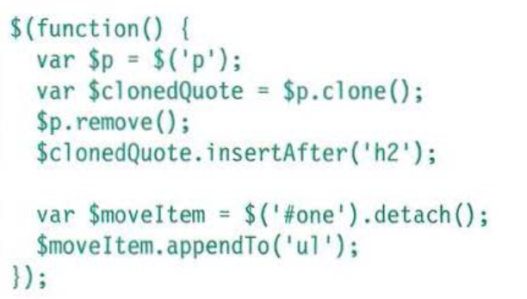
Cutting and Copying Elements
After selection, you can use methods to remove those elements or make a copy of them

Slide 36
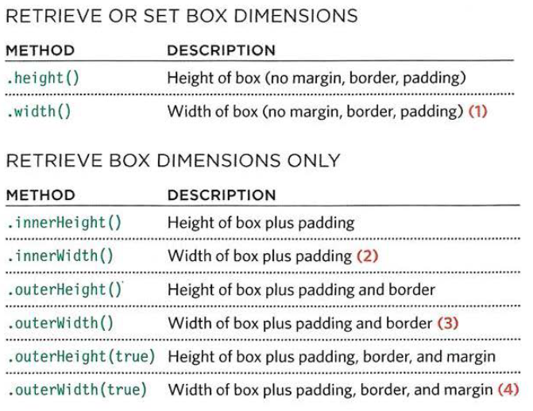
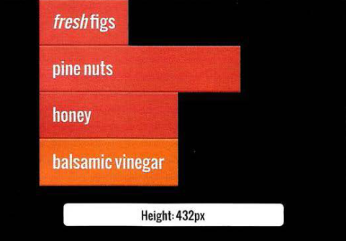
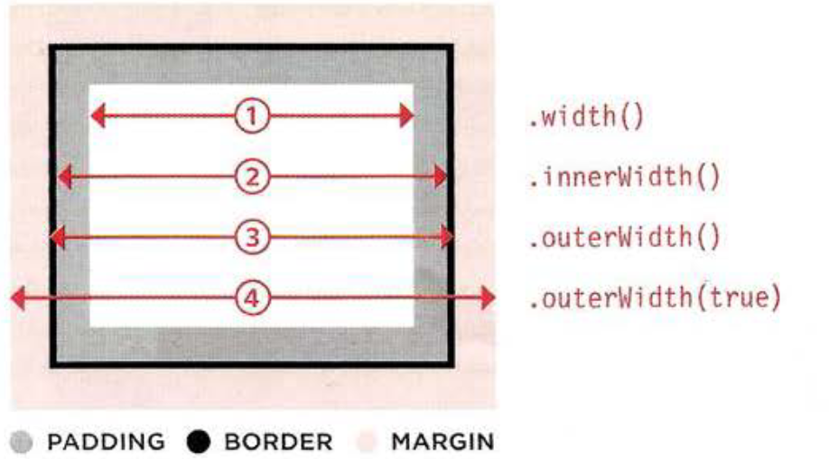
Box Dimensions
Use these methods to retrieve or update the width and height of all boxes on a page
Notes:
CSS treats each element in a webpage as if it were in its own box
.outerHeight() and .outerWidth() take true as a parameter to include margins
Speaking of .height() and .width()…

Slide 37
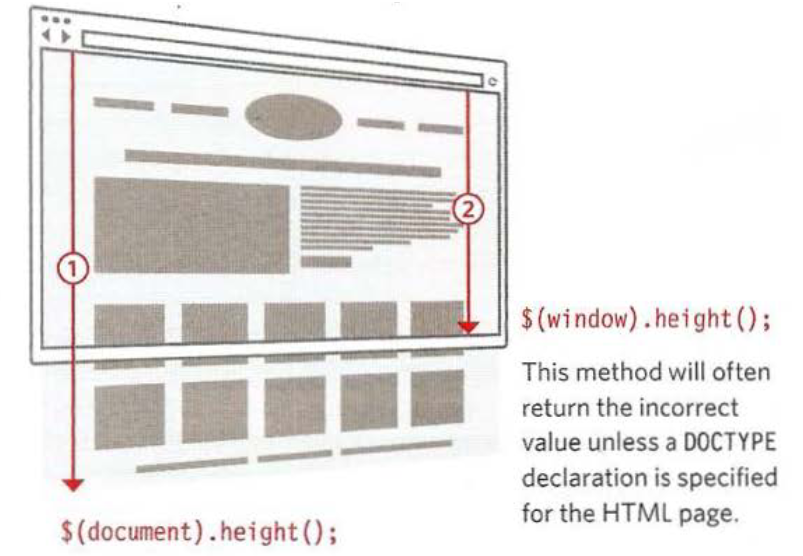
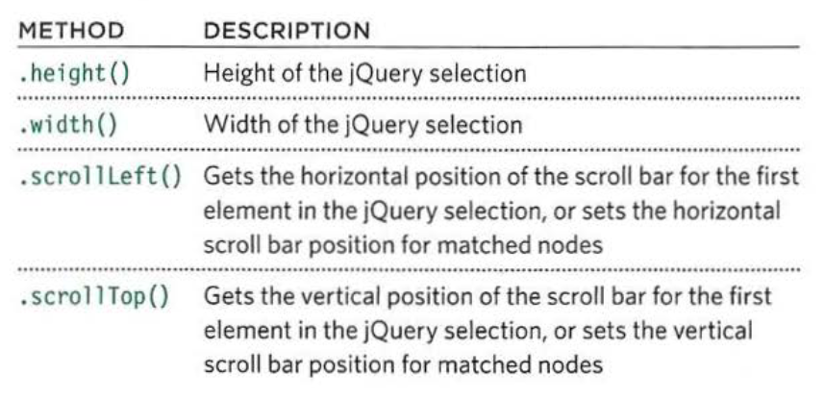
Window and Page Dimensions
.height() and .width() can be used to determine the dimensions of both the browser window and the HTML document
Notes:
There are also methods to get and set the position of the scroll bars

Slide 38
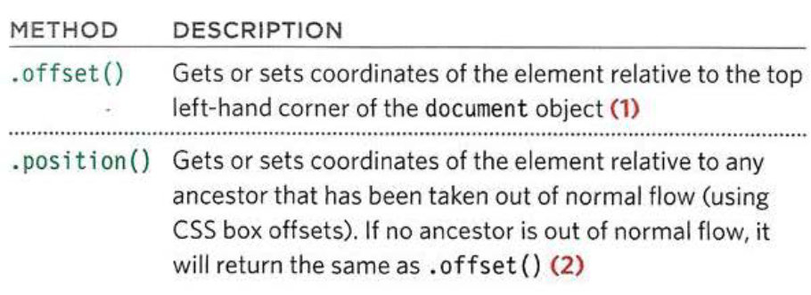
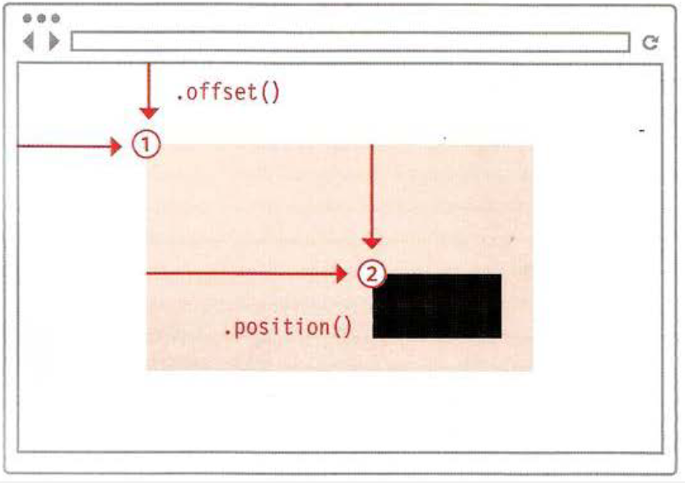
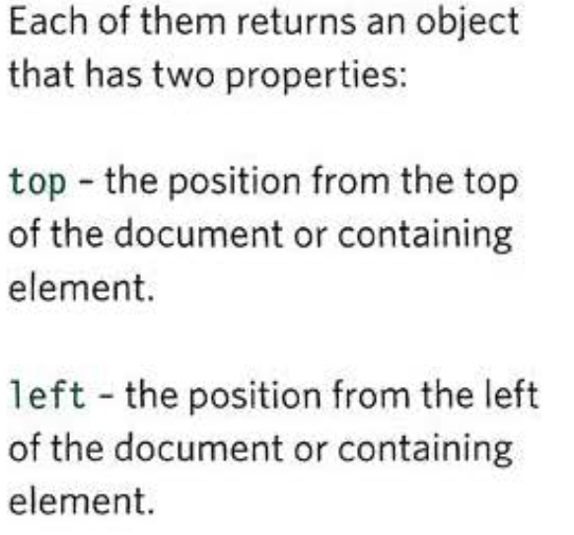
Position of Elements
Notes:
The 2 methods help you determine the position of an element: within the page and in relation to an ancestor that is offset from normal flow
They return the co-ordinates of the first element in the matched set

Slide 39
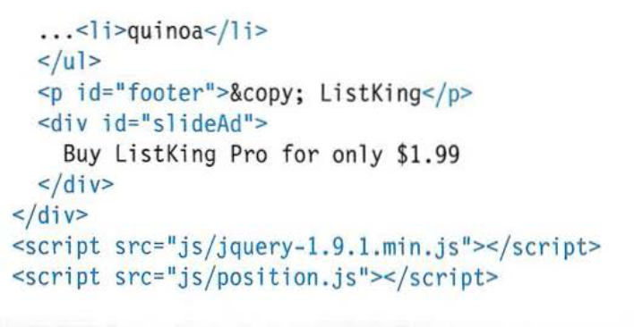
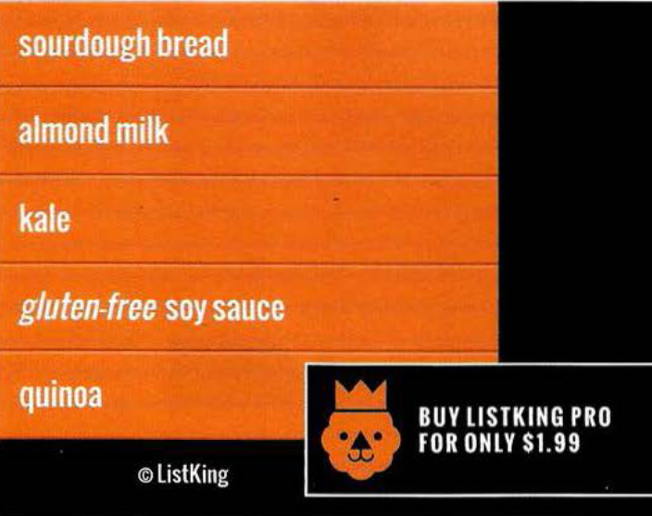
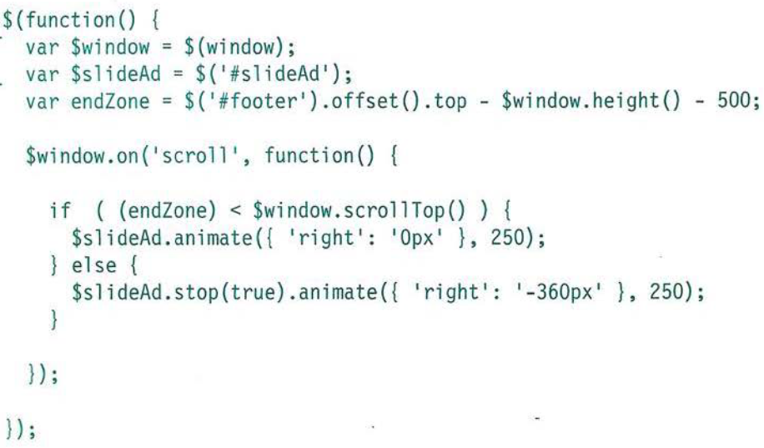

Slide 40
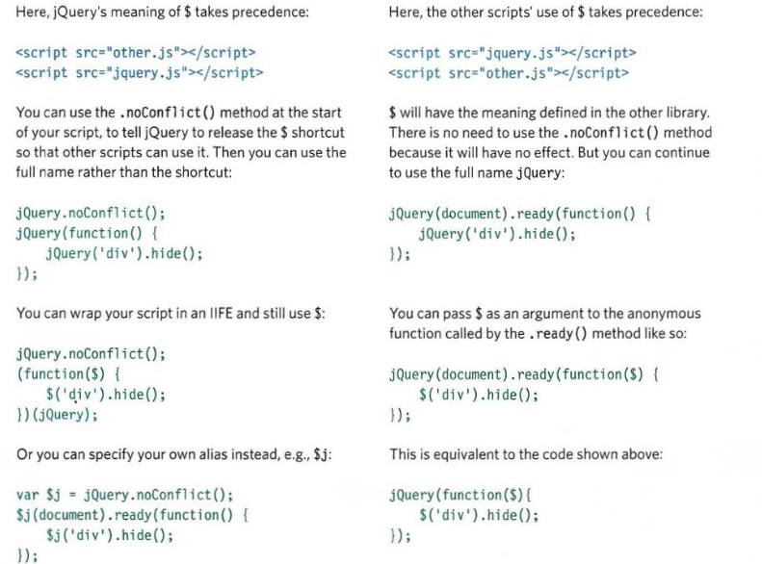
Libraries and Conflict
jQuery is one of many JavaScript libraries
$() is shorthand for jQuery(), but the $
symbol is used by other libraries
Notes:
Others include Angular.js and Ember.js
Conflict can be avoided by including jQuery either before or after (.noConflict()) other libraries

Slide 41
Additional Information
Placing the script at the end of the page before the closing </body> tag will not affect the rendering of the rest of the page
jQuery Documentation: https://api.jquery.com/
Notes:
In the early days, developers were told to put <script> tags in the <head>; however, this can make pages seem to load slower
When a browser starts to download a JS file, it stops all other downloads and pauses laying out the page until the script has finished loading and been processed

