Slide 1
Document Object Model (DOM)
By: Ryan Whitten

Slide 2
What is the Document Object Model?
DOM specifies how browsers should create a model of a HTML page and how JavaScript can be used to access and update the contents of a webpage
DOM is not a part of HTML neither is it a part of JavaScript
DOM is its own set of rules
The Document Object Model covers two primary areas:
Making a Model of the HTML page
and
2) Accessing and Changing the HTML page

Slide 3
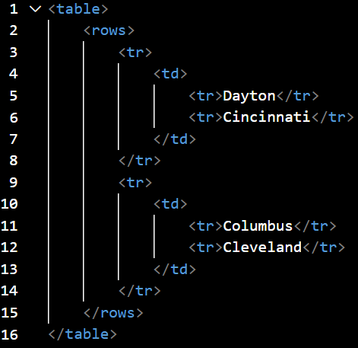
DOM is structured in a tree-like representation.
Below is an example of source code
Below is what it looks like in a tree
TABLE
ROWS
TR
TR
TD
TD
TD
TD
DAYTON
CINCINNATI
COLUMBUS
CLEVELAND

Slide 4
Another example of this from Duckett:

Slide 5
Accessing the Elements
Getting a Single Node, Getting Multiple Nodes, Traversing between Nodes

Slide 6
Two Ways to get a Single Node
getElementById()
Uses an elements id attribute
Ex)
Given a element in a list:
<li id=“one” class=“hot”><em>fresh</em>figs</li>
Select by:
Var el = document.getElementById(‘one’);
querySelector()
Uses a CSS selector and returns the first matching element
Ex)
Var el = document.querySelector(‘li.hot’);

Slide 7
Three Ways to select Multiple Nodes
getElementsByClassName()
Selects all elements that have a specific value for their class attribute
Ex) var el = document.getElementsByClassName(‘hot’);
getElementsByTagName()
Selects all elements that have the specified tag name
Ex) var el = document.getElementsByTagName(‘li’);
querySelectorAll()
Uses a CSS selector to select all matching elements
Ex) var els = document.querySelectorAll(‘li.hot’);

Slide 8
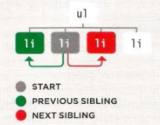
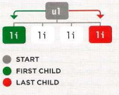
Traversing between Element Nodes
parentNode
Selects the parent of the current element node (which returns a single element)
Ex) The parent of the first <li> element is <ul>
Var child, var parent;
Parent = child.parentNode;
UL
LI
LI
LI
LI
previousSibling / nextSibling
Selects the previous or next sibling from the DOM tree
Ex)
Var startItem = document.getElementById(‘two’);
Var prevItem = startItem.previousSibling;
Var nextItem = startItem.nextSibling;
firstChild / lastChild
Selects the first or last child of current element
Ex)
Var startItem = document.getByTagName(‘ul’)[0];
Var firstItem = startItem.firstChild;
Var lastItem = startItem.lastChild;

Slide 9
Working with the Elements
Access/Update text nodes, Working with HTML content, Access/Update attribute values

Slide 10
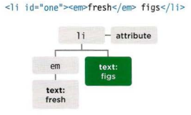
Accessing / Updating Text Nodes
Given the code:
<li id = “one”><em>fresh</em> figs</li>
Lets say you want to access the second text node “figs”
To do this you need the following code:
document.getElementById(‘one’).firstChild.nextSibling.nodeValue;
<li> is selected by getElementByID
firstChild = <em> element
nextSibling = text node containing “figs”
nodeValue = accesses the text nodes contents

Slide 11
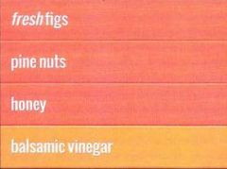
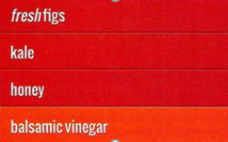
Accessing and Changing a Text Node
Before
Ex)
The JavaScript below shows how to access the text content of the second thing in the list and change it from “pine nuts” to kale”
After

Slide 12
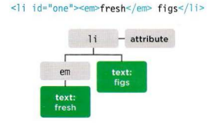
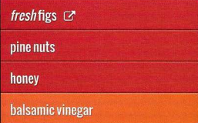
Working with HTML Content
innerHTML
Allows access to child elements and text content
Gets the content of an element and return it as a single string
Collecting content of a list and adding it to a variable:
elContent now holds the string ‘<em>fresh</em> figs’
Ex) Before: After:
This example shows changing the text into a link

Slide 13
Example of Using getElementByID() and using innerHTML
Output:

Slide 14
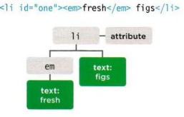
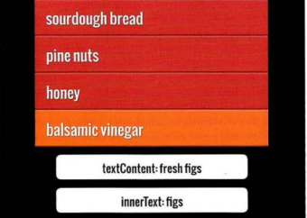
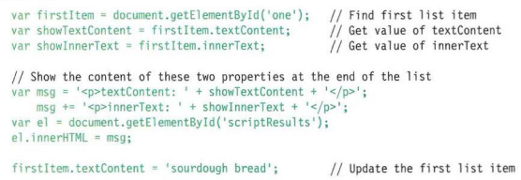
Working with HTML Content (cont.)
If you want to access text only use:
textContent
By doing this code:
Document.getElementById(‘one’).textContent;
It would return the value: ‘fresh figs’
innerText
Generally not used as a result of:
Firefox does not adopt the property
Obeys CSS ( if CSS hid the <em> elements, only figs would be shown)
Slower than using textContent
Ex) The following code shows the difference between textContent & innerText

Slide 15
Example using createElement(), querySelector(), textContent, and replaceChild().

Slide 16
Accessing or Updating Attribute Values
className / id – lets you get/update the value of class and id attributes
hasAttribute() – checks to see if the attribute exists
getAttribute() – gets the value of the attribute
setAttribute() – updates the value of an attribute
removeAttribute() – removes an attribute

Slide 17
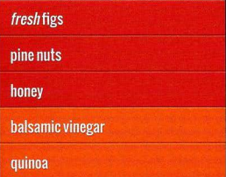
Adding Elements using DOM Manipulation
createElement() – creates new element inside a variable
Ex)
Var newel = document.createElement(‘li’);
createTextNode() – creates a text node inside a variable
Ex)
Var newText = document.createTextNode(‘quinoa’);
appendChild() – attaches the new textnode to new element
Ex)
newel.appendChild(newText);
Result ----------->
Using the code to the left, we are going to add to a DOM tree:
//This finds what position the element should be added
Var position = document.getElementsByTagName(‘ul’)[0]’
//Inserts the new element into the position
Position.appendChild(newEl);

Slide 18
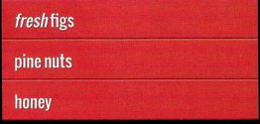
Removing an Element from the DOM TREE
The following example uses the removeChild() method to remove the fourth item:
Below code picks element to remove
Var removeEl = document.getElementsByTagName(‘li’)[3];
Then references its containing element
Var containerEl = removeEl.parentNode;
Then finally removes the element
ContainerEl.removeChild(removeEl);

Slide 19
Resources:
JavaScript & JQuery, interactive front-end web development by Jon Duckett
GeeksforGeeks, DOM (Document Object Model)
Educaba, JavaScript DOM by Priya Pedamkar

