Slide 1
UNDERSTANDING THE DOM

Slide 2
Elements can contain: Text nodes Element content Attributes

Slide 3
<li id=“one”>figs</li>
li
attribute
text:
figs

Slide 4
<li id=“one”><em>fresh</em> figs</li>
li
attribute
em
text:
figs
text:
fresh

Slide 5
<li id=“one”>six <em>fresh</em> figs</li>
li
attribute
text:
six
em
text:
figs
text:
fresh

Slide 6
To access their content you can use: nodeValue on text nodes textContent for text content of elements innerHTML for text and markup

Slide 7
var el = document.getElementById(‘one’); el.firstChild.nextSibling.nodeValue; returns: figs
nodeValue works on text nodes
li
attribute
em
text:
figs
text:
fresh

Slide 8
document.getElementById(‘one’).textContent; returns: fresh figs
textContent just collects text content
li
attribute
em
text:
figs
text:
fresh

Slide 9
document.getElementById(‘one’).innerHTML; returns: <em>fresh</em> figs
innerHTML gets text and markup
li
attribute
em
text:
figs
text:
fresh

Slide 10
DOM MANIPULATION createElement() createTextNode() appendChild()
innerHTML
Builds up a string
Contains markup
Updates elements
vs

Slide 11
CROSS-SITE SCRIPTING (XSS) ATTACKS

Slide 12
Untrusted data is content you do not have complete control over. It can contain malicious content.

Slide 13
Sources of untrusted data: User creates a profile Multiple contributors Data from third-party sites Files such as uploaded images / videos

Slide 14
Validate all input that is sent to the server
DEFENDING AGAINST XSS
Escape data coming from the server

Slide 15
Defending against XSS Avoid using innerHTML to add user content Ensure that all stored data is plain text and not as a script When using jQuery, use .text() not .html()

Slide 16
Miss Alenious JavaScript

Slide 17
An example of using anonymous functions var u = { a:1, b:2 } var v = { a:3, b:4 } var d = (function (x,y) { // begin local block return sqrt((x.a-y.a)**2 + (x.b-y.b)**2); }) (u,v) // end local block

Slide 18
Logical Operators

Slide 19
Logical Operators

Slide 20
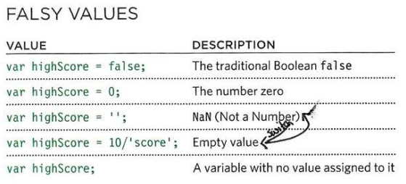
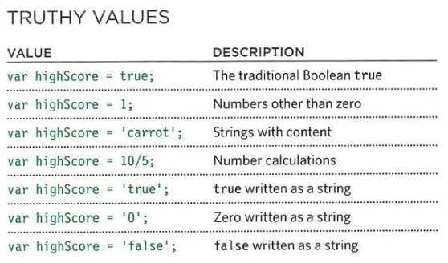
Truthy & Falsy

