Slide 1
JavaScript: Functions, Methods, and Objects
Jy’el Mason & Max Latkovski​

Slide 2
Functions
Function Declaration
How to instantiate/create functions for later use
Named functions
A name the function uses for later use

Slide 3
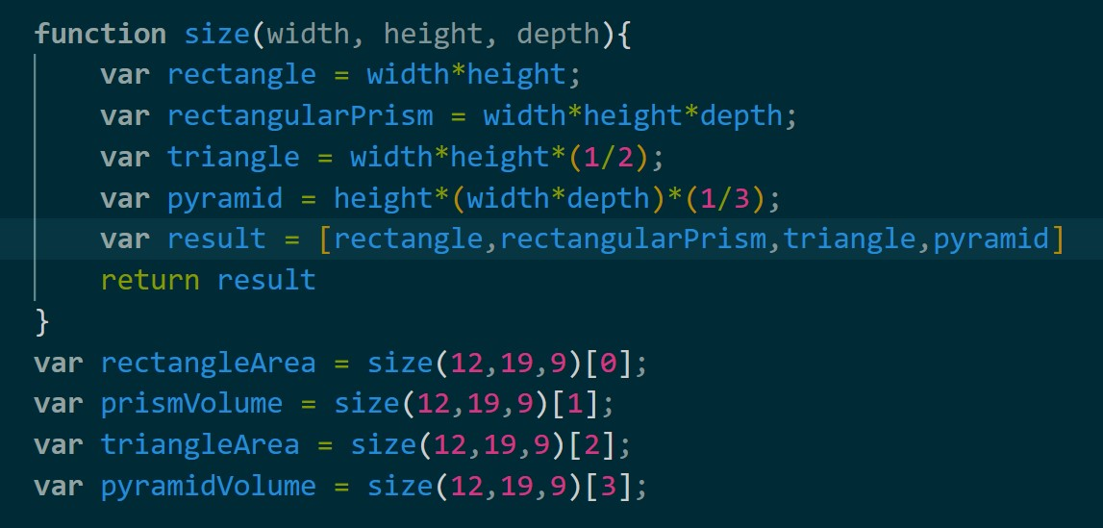
Functions
One vs multiple return values
Depending on if you have a variable that contains an array you can return more than one value

Slide 4
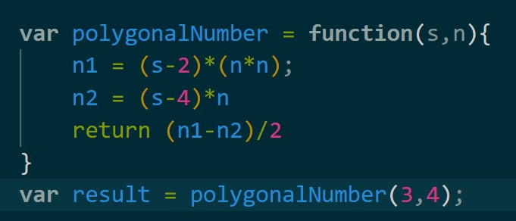
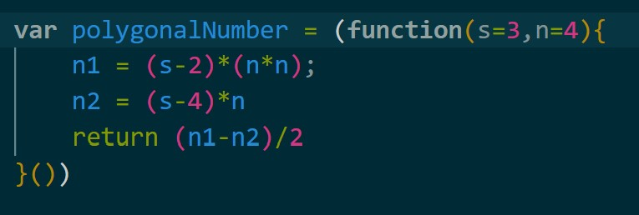
Can you spot the difference?

Slide 5
Functions
Anonymous Functions
Unlike named functions these do not have a name
Function expression
Functions where you would expect an expression
Immediately Invoked Function Expressions (IIFE)
Functions that are immediately invoked

Slide 6
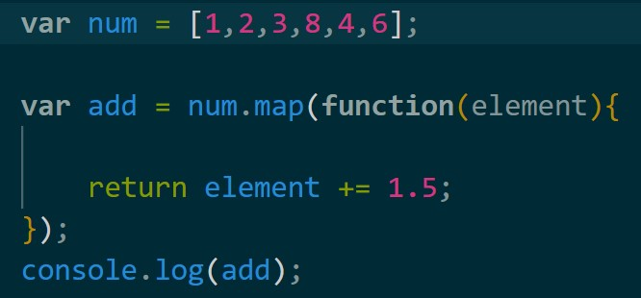
Functions
Functions used as arguments
Functions can act as arguments for other functions which will return specific or new values with said function

Slide 7
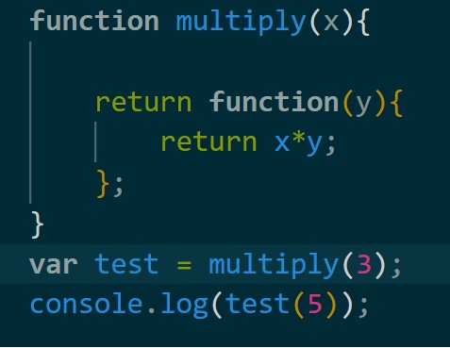
Functions
Functions that return a function
By first assigning the function to a variable and then calling it using the variables name, followed by parentheses we can use the returned function.

Slide 8
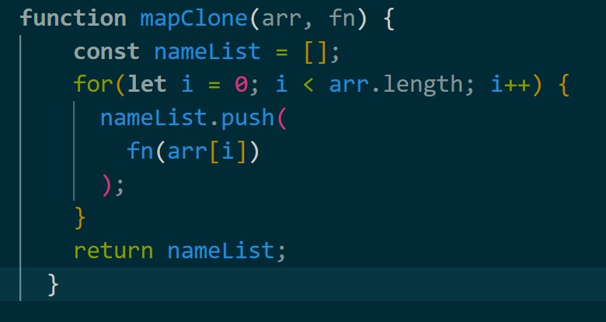
Functions
Creating Higher Order Functions
Functions can act as a parameter for other functions, doing so allows for functions as arguments

Slide 9
Common Functions
Map
is a very simple function; it attaches itself to an array and helps us convert each item into something else, resulting in a new array
Every
returns a Boolean value depending on whether all the items in the array pass the given test
Filter
this function filters an array based on the rules/logic you provide and returns a new array containing items that satisfy those rules
Slice
Given two indices this function will return the substring but not including the ending (just like java)

Slide 10
Common Functions
setTimeout
sets a timer which executes a function or specified piece of code once the timer expires.
setInterval
repeatedly calls a function or executes a code snippet, with a fixed time delay between each call.
Entries
This function returns an array of a given object's own enumerable property [key, value] pairs
padStart/padEnd
The function pads the current string with a given string (repeated, if needed) so that the resulting string reaches a given length. It will pad from the left or right depending on Start and End
flat
This function creates a new array with all sub-array elements concatenated into it recursively up to the specified depth

Slide 11
Functions
Asynchronous Functions for API fetching
Using the keyword async before function
Using the await keyword stops executing the code until the function is complete
The fetch keyword request data from a server whose API is in JSON or XML and returns a promise
A promise is an object representing the eventual completion or failure of an asynchronous operation

Slide 12
Let's do an example

Slide 13
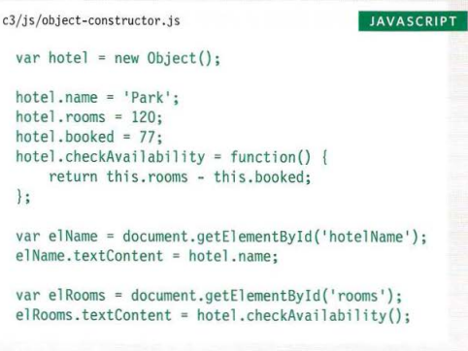
Methods
What are they and what do they do?
Methods and functions are very similar
Represent tasks for an object
How to instantiate and call methods (dot notation)
Method of an object & Function expression as method
Inside the object or function, you create a method
It is made by creating a normal function

Slide 14
Methods (cont.)
The ‘this’ keyword
When making a method inside a function, you can use the keyword: ‘this’
Built in methods
Math
Math.round()
Math.sqrt()
String
String.length()
String.toUpperCase()
Date
Date.now()
Array
Object

Slide 15
Method Example

Slide 16
Objects: Creating & Updating
Literal Notation
The easiest and most popular way
Constructor Notation
This is similar to Java
We create an object then use the ‘new’ keyword to instantiate it
You add properties after declaring that it is an object

Slide 17
Literal Notation

Slide 18
Constructor Notation

Slide 19
Objects: accessing, adding & removing
Accessing Properties & Methods
When accessing, we can use them to change the properties, or we can use them in creating other variables
Adding Properties & Methods
We do this by calling the object name and then using dot notation to add the property of method
We can also update a property by using square bracket syntax
Removing Properties & Methods
We use the ‘delete’ keyword to fully eliminate the property or method from existing
We can also set a variable to the empty string in order to clear the variable of any data that has been stored in it

Slide 20
Let’s make an example and show how to do all of these

Slide 21
Any Questions??

