Slide 1
CSS Essentials
COMP 3700

Slide 2
ALERTS
Small Project #1 due before midnight tonight
Let's keep organized...
index.html in your main folder: edit to point to all the projects you've submitted
use folders for each project
use subfolders for images, css, and JavaScript
Small Project #2 is available on now
On the course web site
Don't forget to send me quiz screenshots

Slide 3
What is CSS?
Cascading Style Sheets
What's that mean?
Elements of HTML can be styled (made to look a certain way)
More than one style may apply to a given element, and 'cascading' refers to the hierarchical way that styles are organized to resolve which one will be used
CSS is not new
The earliest browsers incorporated style features
CSS1: 1996
CSS2: 1998
CSS3: 1999 and beyond
CSS4? not likely...

Slide 4
Why CSS?
Content vs. Presentation
An early goal of the WWW
Easy to update many pages at once
Easier to maintain consistency
Early goal: dynamically selected rules
User agent's style: the default style sheet built into the browser
Author's style: included in a web site (by the site's author)
Reader's style: a style sheet supplied by the user of the site
Normally the Author's style takes precedence, but that can be overridden
CSS 1 ---> CSS 2 ---> CSS 3
Extended the scope of the rules

Slide 5
CSS Zen Garden
A demonstration of the power of CSS3
A single well-structured, but static, HTML5 page
that has appropriate element attributes for CSS3 hooks
A wide assortment of CSS3 style designs that make the same content appear in vastly different 'skins'
Let's Walk in the Garden

Slide 6
How CSS Works — Rules
Rules provide presentation hints to browser
Browser can ignore hints
Three sources of rules:
User agent (browser's default settings),
Author (source file),
Reader (personal settings in the browser)
A rule-set consists of a selector and a declaration block:
Rules apply when selectors match context
E.g. p {text-indent: 1.5em }
Selector is p (matches any <p> element)

Slide 7
Rules
Attached to elements
As attributes of elements (inline style, not recommended)
<p style="color: red;">
Tied to id attribute of elements
#para1 { color: red; }
Tied to class attribute of elements
.center { color: red; }
Tied to types of elements
p { color: red; }

Slide 8
Special Elements
div and span
Only for grouping other elements
div is block-level (think about paragraphs)
span is in-line (think about code)

Slide 9
HTML Parse Tree
<html>
<head>
<meta … />
<title>…</title>
</head>
<body>
<h1>…</h1>
<p>…</p>
<ul>
<li>…</li>
<li>…</li>
<li>…</li>
</ul>
<p>…</p>
</body>
</html>

Slide 10
How CSS Works — Matching
Every HTML document represents a document tree
The browser uses the tree to determine which rules apply
What about inheritance? And conflicts?

Slide 11
CSS Combinators
A selector can contain more than one simple selector.
There are four ways to combine selectors:
Descendant (space): div p {} selects all <p> elements inside <div> elements
Child (>): div > p {} selects all <p> elements that are children of a <div> element
Adjacent sibling (+): div + p {} selects <p> elements that immediately follow a <div> element
General sibling (~): div ~ p {} selects <p> elements that are siblings of <div> elements

Slide 12
HTML Parse Tree
<html>
<head>
<meta … />
<title>…</title>
</head>
<body>
<h1>…</h1>
<p>…<span>…</span>…</p>
<ul>
<li>…</li>
<li>…</li>
<li>…<span>…</span>…</li>
</ul>
<p>…</p>
</body>
</html>
What will h1 + p match?
What will ul span match?
What will ul {color:blue} do?

Slide 13
Inheritance in CSS The Cascade
Inheritance moves down tree
Cascading move horizontally
It works on elements that the same rules apply to
It is only used for tie-breaking when ≥2 rules apply
The highest ranking rule wins
Most specific wins (usually)
But important rules override others
!important beats plain
User's !important beats everything else
DON’T USE !important !!

Slide 14
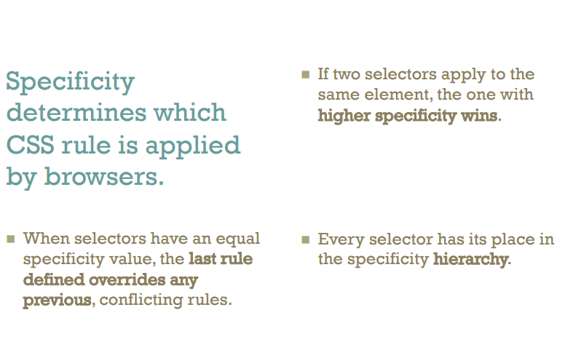

Slide 15
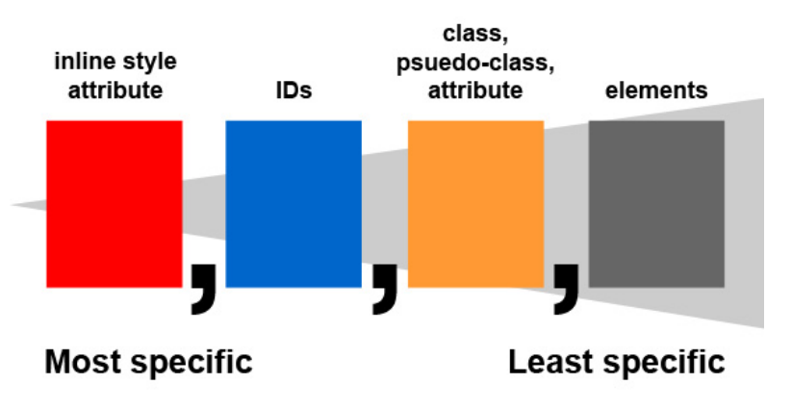

Slide 16
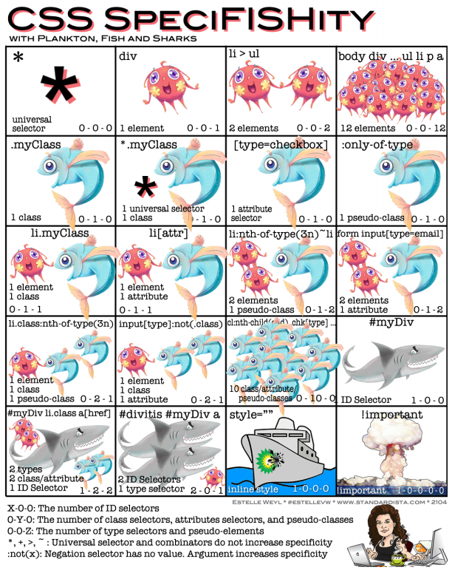

Slide 17
Pseudo-Elements? Pseudo-Attributes?!
‘CSS introduces the concepts of pseudo-elements and pseudo-classes to permit formatting based on information that lies outside the document tree.’
Classes
:first-child
:link
:visited
:hover
:active
:focus
:lang
Elements
:first-line
:first-letter
:before
:after
CSS 2.2 §5.10
Pseudo-elements
and pseudo-classes

Slide 18
Selector Resources on the WWW
The CSS 3 Standard
At W3.org (https://www.w3.org/TR/2019/CR-css-writing-modes-3-20190903/)
Selector Tutorial [Excellent!] (http://css.maxdesign.com.au/selectutorial/)

