Slide 1
An Introduction to
Jacob McIntosh

Slide 2
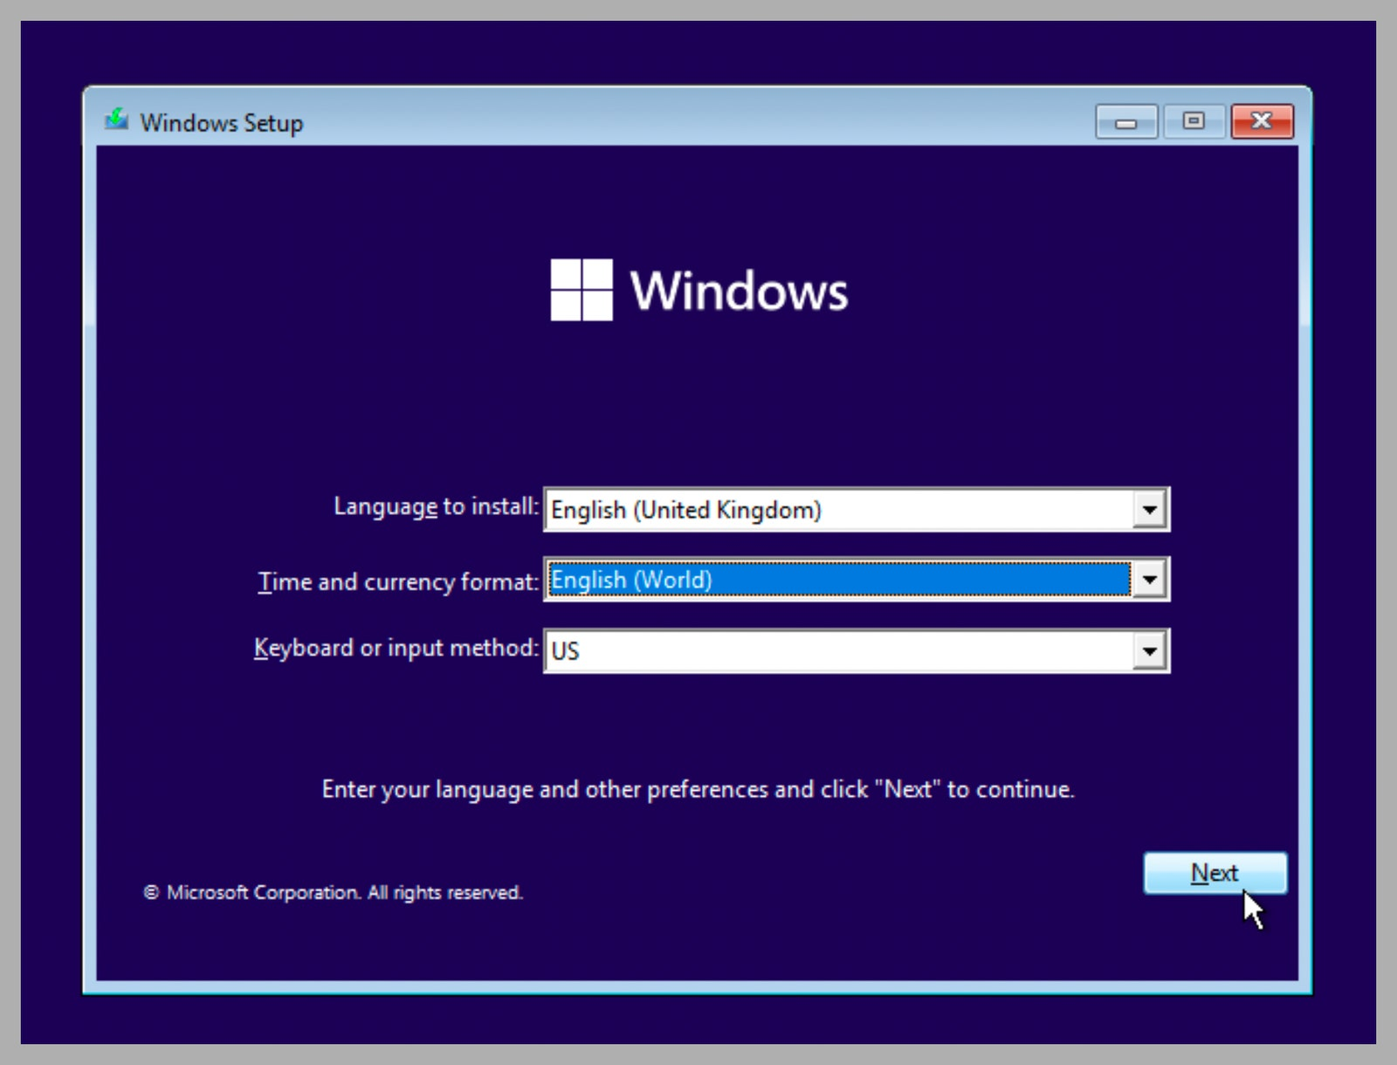
The Purpose of AutoIT
A programming language that can be used for general scripting.
Has built-in features for automating repetitive tasks in the Windows user interface.
Can simulate keystrokes, mouse movements and window manipulation to automate these tasks.
Scripts are turned into small, self-contained executables that can run on all versions of Windows.
In the industry, it is best used during “roll-out” scenarios, where thousands of computers need to be initialized at once.

Slide 3
Main Ideas Introduced by AutoIT
Easy to learn syntax
Simulate keystrokes, mouse movements and window interactions
Ability to create Windows GUI’s as well as interact with them
Can manipulate Windows processes
Scripts are converted to standalone exes
Compatible with all Windows versions
It’s completely FREE!

Slide 4
Creation of AutoIT
Created by Jonathan Bennett, an Australian software developer.
Development began in 1998.
It has evolved through various versions, gradually incorporating features found in more popular languages.
Versions 1 and 2 were primarily focused on simulating user interaction.
Version 3, released in 2002, has features/syntax like that found in the BASIC family.

Slide 5
Influencers…
BASIC – AutoIt’s syntax is very similar to BASIC, making it relatively easy for users to learn and use.
C++/C - It incorporates some concepts from C and C++ such as data types and function calls.
Perl – Incorporates string manipulation functions like those found in Perl.

Slide 6
Who Uses AutoIT?
Not many companies have publicly reported their use of AutoIT.
JJSoft
Evolve IP
Client_Windows
NetSPI
Due to its user input automation capabilities, AutoIT is frequently used to create bots for video games.

Slide 7
CODE DEMO

Slide 8
Sources
https://www.autoitscript.com/site/
https://www.autoitscript.com/forum/
https://en.wikipedia.org/wiki/AutoIt
https://stackshare.io/autoit
https://rocketreach.co/jonathan-bennett-email_65043383
https://github.com/jonathanbennett73
https://ashears.medium.com/easily-create-game-bots-with-autoit-817c8d6c4439
https://images.google.com/

Slide 9
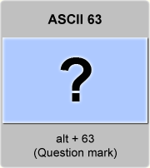
Questions?

