Slide 1
COMP 3200
Models of Computation
Strings & Languages

Slide 2
ALERTS
Programming Assignment #1 (Python exercises) due Friday
Reading Assignment #2 available
Project #1 is available so that you can see it
  The draft for Project #1 will be on Friday
  Let's look at the assignment...

Slide 3
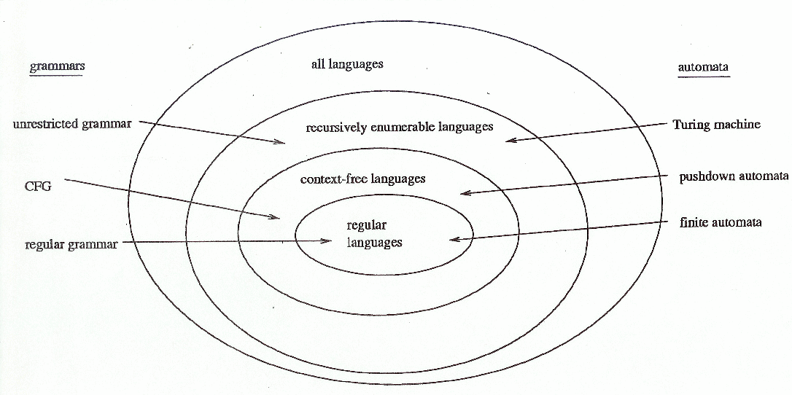
Models of Computation
Review: what have we covered so far?
Languages: models of representation
Grammars: models of language structure
Automata: models of computation

Slide 4
Rice's Theorem
[Wolfram MathWorld] If A is a class of recursively enumerable sets, then the set of Gödel numbers of functions whose domains belong to A is called its index set. If the index set of A is a recursive set, then either A is empty or A contains all recursively enumerable sets.
[Wikipedia] In computability theory, Rice's theorem states that
all non-trivial, semantic properties of programs are undecidable.
A semantic property is one about the program's behavior, unlike a syntactic property. A property is non-trivial if it is neither true for every partial computable function, nor false for every partial computable function.

Slide 5
Models of Computation
Types of Computation
  Acceptors: check the validity of an input (with respect to some spec)
    Binary output
    Compilers, pattern matchers, finite automata, etc.
  Recognizers: like an acceptor, but with semantic capabilities
    Any output
    Classifiers, any kind of acceptor, etc.
  Transducers: transforms input to output according to some algorithm
    Any output
    Turing Machines, Moore & Mealy machines, mathematical functions, compilers, etc.

Slide 6
Models of Computation
Turing Machine (Alan Turing): abstract machine w/finite control
λ-Calculus (Alonzo Church): recursive functions
RAM-Machine (John von Neumann): cpu/memory w/fetch-execute
Production Systems (Emil Post): rewrite rules
Markov Systems (Andrey Markov): stochastic processes
Neural Networks (McCulloch & Pitts): feedback learning
Logic Circuits: boolean functions
and many, many more...
Church-Turing Thesis

Slide 7
Languages (Genesis 11:1-9)
Now the whole earth had one language and the same words. And as people migrated from the east, they found a plain in the land of Shinar and settled there. And they said to one another, “Come, let us make bricks, and burn them thoroughly.” And they had brick for stone, and bitumen for mortar. Then they said, “Come, let us build ourselves a city and a tower with its top in the heavens, and let us make a name for ourselves, lest we be dispersed over the face of the whole earth.” And the Lord came down to see the city and the tower, which the children of man had built. And the Lord said, “Behold, they are one people, and they have all one language, and this is only the beginning of what they will do. And nothing that they propose to do will now be impossible for them. Come, let us go down and there confuse their language, so that they may not understand one another's speech.” So the Lord dispersed them from there over the face of all the earth, and they left off building the city. Therefore its name was called Babel, because there the Lord confused the language of all the earth. And from there the Lord dispersed them over the face of all the earth.

Slide 8
What is a string?
A sequence of characters over an alphabet
  E.g., sentences, programs, equations, etc.
What alphabet do we use?
  Latin
  ASCII / Unicode
  Binary
  etc.
What is a language?
  A collection of valid strings
  E.g., Java, matched parentheses, even-length strings, etc.

Slide 9
Observations...
How hard is it to write a compiler?
How hard is it to write an interpreter?
How hard is it to understand English?
How hard is it to speak English?
The questions of Language Recognition & Language Generation
ARE FUNDAMENTAL!

Slide 10
Formal Languages
DEF: An alphabet is any finite, non-empty set of symbols
DEF: A string is any finite sequence of symbols taken from a specified alphabet
  A string MAY be empty: “” or ε or λ
DEF: A language is any set of strings over some alphabet
  Let Σ = {a, b}. Then each of the following are languages:
  {a}
  {a, b}
  {a, aa, aaa, aaaa, aaaaa, …}
  {ε, aa, ab, ba, bb, aaaa, aaab, aaba, aabb, abaa, abab, abba, abbb, baaa, …}
  Others?

Slide 11

Formal Languages
DEF: Given an alphabet Σ, Σ^{k} is the set of all strings over Σ of length k (where $k∈ℕ$)
  Let Σ = {a, b}.
  Σ⁰ = {ε}
  Σ¹ = {a, b}
  Σ² = {aa, ab, ba, bb}
DEF: Given an alphabet Σ, Σ* is the set of all possible strings over Σ
  Is Σ* a language?
  If $L⊆Σ^{∗}$, is L a language?
  How big is Σ*?
  How many languages are there (over Σ)?

Slide 12
Operations on Languages
Set operations?
  union
  intersection
  complement
  set difference
  power set
  etc.
String operations?
  concatenation
  iterated concatenation (what's that?)

Slide 13
Operations on Languages
Set operations?
  union
  intersection
  complement
  set difference
  power set
  etc.
String operations?
  concatenation
  iterated concatenation

Slide 14

Operating on Languages
Union: $A∪B=A+B=\{w:w∈A or w∈B\}$
Concatenation: $A⋅B=AB=\{uv:u∈A and v∈B\}$
Kleene Star: $\begin{matrix}A^{0}=\{ε\} \\ A^{k}=A^{k−1}⋅A\end{matrix}$ $A^{∗}=\bigcup_{k∈ℕ}{A^{k}}$
Note: $A^{+}=A^{∗}−\left\{ε\right\}=$ $\bigcup_{k>0}{A^{k}}$

Slide 15

Examples
Let A = {aa, aba} and B = {b, baba}
  What is $A+B$?
  What is AB?
  What is BA?
  What is B*?
Let C = {w: w is even-length} and D = {w : w begins with b}
  What is $C+D$?
  What is CD?
  What is DC?
  What is C*?
  What is D*?

