Slide 1
Tensorflow
Data Analytics in Python
COMP 2800
Otterbein University

Slide 2
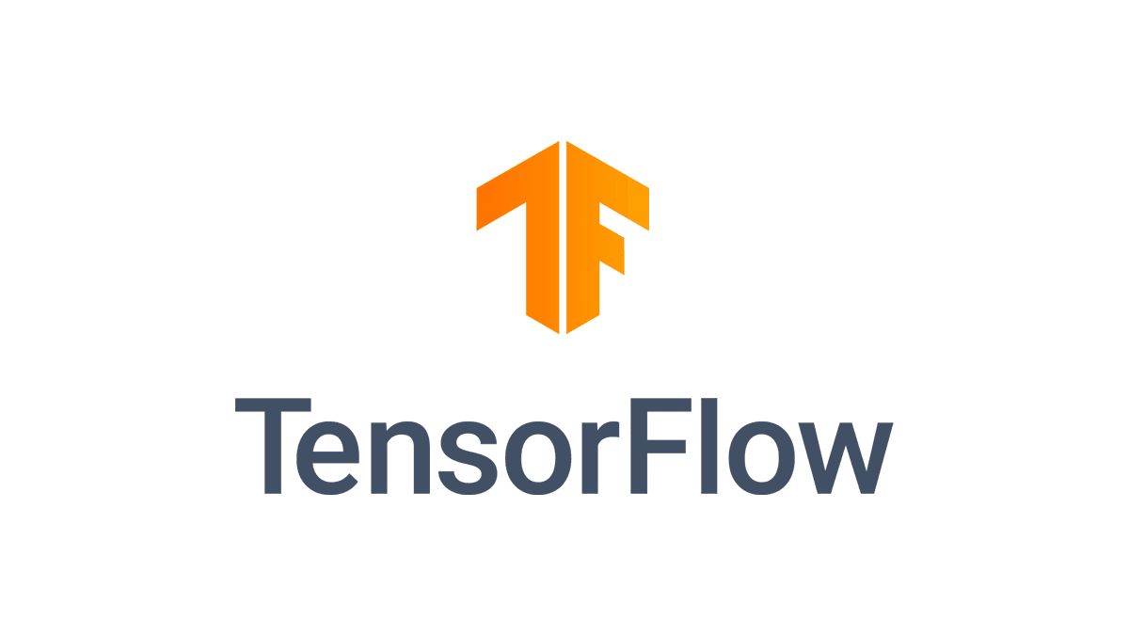
Tensorflow
TensorFlow is an open source software package for machine learning created by Google. Version 2.0 was released in 2019.
It uses deep learning neural networks to create predictive models for data sets.
The preferred and recommended way to work with TensorFlow is within Google Colab, a free cloud service for running Python
Colab requires no pip or conda installation or configuration and provides access to high power GPUs for processing
There is an introduction to some of what Tensorflow is about here

Slide 3
Questions?

Slide 4
Next time
wrap up

