Slide 1
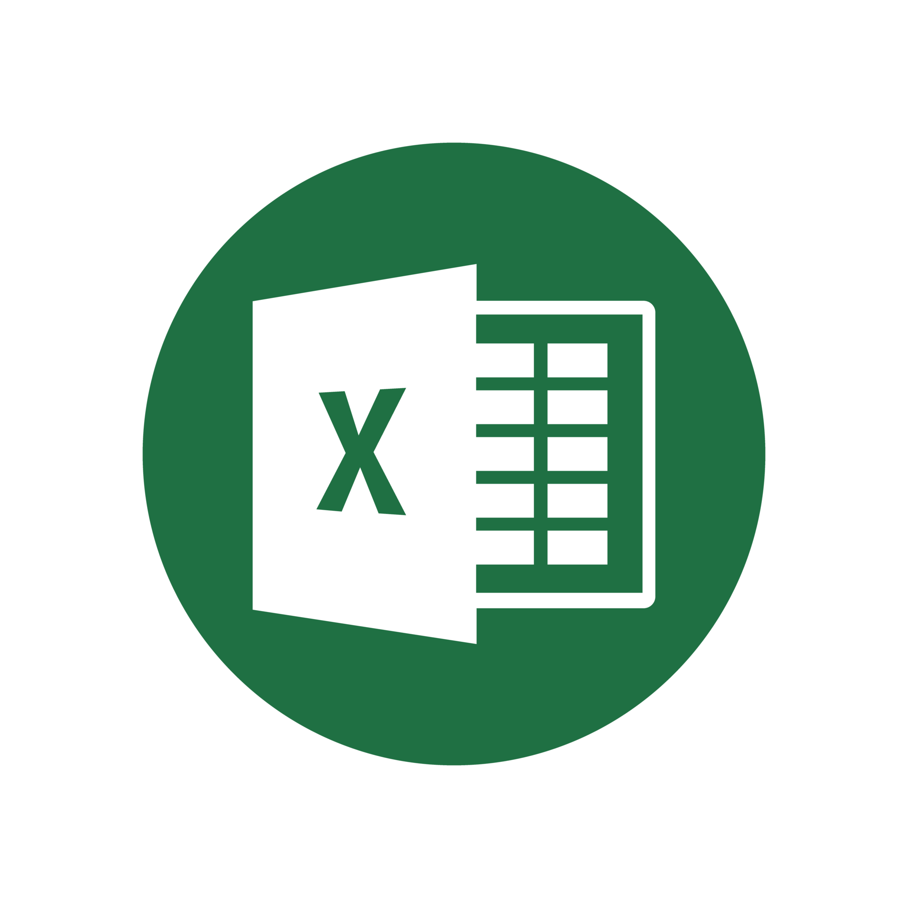
Python Packages for .
Data Analytics in Python
COMP 2800
Otterbein University

Slide 2
Alerts
Assignment 5: due today before 11:59pm
Midterm
  Take home exam: given Wednesday, due Friday, before class
  Individual work – no collaboration
  Open book/open notes/open static online resources (no ChatGPT, or other generative AI; no interactive forums)
Questions?

Slide 3
Demo
Translating risk model from JSON/XML to Excel VBA using Python pandas, xlwings, and win32.com

Slide 4
Excel Packages
So far, we've seen bits of different packages:
  xlwings
  win32.com
  xlrd
  openpyxl
  pandas.read_excel
It is important to understand what the options are and how they relate...

Slide 5
Top Python Packages
openpyxl
  most widely used
  read/write/modify/create files
  .xlsx, .xlsm, .xltx, .xltm
  some security vulnerabilities
xlsxwriter
  .xlsx
  create new files, can't read or modify existing files
  can create charts, and apply formulas
pyxlsb
  .xlsb
  read existing files only
  updated version pyxlsb2 has slightly different features
pylightxl
  lightweight, zero-dependency
  read .xlsx & .xlsm; write .xlsx
  reads files contents as in-memory database
  no charts, macros, formatting

Slide 6
More Python Packages
xlrd & xlwt
  read/write older Excel files
  .xls
  limited features and support, since it is for legacy formats
xlutils
  Excel utilities that are dependent on xlrd and xlwt
  copy workbook, filtering, formatting, etc.

Slide 7
Integrating Excel & Python
These packages require Excel to be installed and interact with the Excel application as well as the files
xlwings
  Windows and MacOS compatible
  can call Excel from Python and vice versa
  can create User Defined Functions (UDF) in Python that can be called in workbook formulas
  open source (pro version available for purchase)
PyXLL
  Commercial product for writing Excell add-ins in Python with no VBA
  UDFs, macros, menus, ribbon tool-bar capabiliies
Microsoft 365 Python in Excel
  Announced in August 2023
  Essentially integrates Python and its most popular libraries (numpy, pandas, matplotlib, etc.) into the Excel application
  Makes VBA largely obsolete
  Available in eligible Microsoft 365 subscriptions
  Demo...

Slide 8
Questions?

Slide 9
Next time
Matplotlib

