Slide 1
Data Analytics in Python
Data Loading & Reading Files
COMP 2800
David J Stucki
Otterbein University

Slide 2
Alerts
Assignment 3: Due next Monday, 2/9 by 11:59pm
Questions?

Slide 3
reading from csv (comma separated values)
pandas.read_csv()
  Despite the name, csv files can be separated by characters other than commas (i.e., sep='|', or sep='\s+')
  ex1.csv, ex1bar.csv, ex1space.csv
Real-world data is messy. So over time, read_csv has acquired around 50 optional parameters to cater to all the data situations you may need to deal with. The pandas online documentation has explanations of each one.
read_csv assumes that each column in the input file has a header. What happens when that is not the case?
  ex2.csv
  header=None
  names=['a', 'b', 'c', 'd', 'message']

Slide 4
Missing Values
Let's look at ex5.csv...
something,a,b,c,d,message
one,1,2,3,4,NA
two,5,6,,8,world
three,9,10,11,12,foo
What do you notice?
Let's read it with read_csv
something a b c d message
0 one 1 2 3.0 4 NaN
1 two 5 6 NaN 8 world
2 three 9 10 11.0 12 foo
keep_default_na=False
something a b c d message
0 one 1 2 3.0 4 NA
1 two 5 6 8 world
2 three 9 10 11.0 12 foo
sentinels = {"message": ["foo", "NA"], "something": ["two"]}
something a b c d message
0 one 1 2 3.0 4 NaN
1 NaN 5 6 8 world
2 three 9 10 11.0 12 NaN

Slide 5
read_csv Parameters
Argument | Description
path | String indicating filesystem location, URL, or file-like object.
sep or delimiter | Character sequence or regular expression to use to split fields in each row.
header | Row number to use as column names; defaults to 0 (first row), but should be None if there is no header row.
index_col | Column numbers or names to use as the row index in the result; can be a single name/number or a list of them for a hierarchical index.
names | List of column names for result.
skiprows | Number of rows at beginning of file to ignore or list of row numbers (starting from 0) to skip.
na_values | Sequence of values to replace with NA. They are added to the default list unless keep_default_na=False is passed.
keep_default_na | Whether to use the default NA value list or not (True by default).
Argument | Description
parse_dates | Attempt to parse data to datetime; False by default. If True, will attempt to parse all columns. Otherwise, can specify a list of column numbers or names to parse. If element of list is tuple or list, will combine multiple columns together and parse to date
converters | Dictionary containing column number or name mapping to functions (e.g., {"foo": f} would apply the function f to all values in the "foo" column).
nrows | Number of rows to read from beginning of file (not counting the header).
iterator | Return a TextFileReader object for reading the file piecemeal. This object can also be used with the with statement.
chunksize | For iteration, size of file chunks.
skip_footer | Number of lines to ignore at end of file.
encoding | Text encoding (e.g., "utf-8 for UTF-8 encoded text). Defaults to "utf-8" if None.
thousands | Separator for thousands (e.g., "," or "."); default is None.
decimal | Decimal separator in numbers (e.g., "." or ","); default is ".".

Slide 6
Iterating (in chunks)
If you set the chunksize parameter, read_csv will return a TextFileReader object (from pandas.io.parsers.readers)
You can then iterate over that object, and each iteration will read chunksize many lines from the file.
chunker = pd.read_csv("examples/ex6.csv", chunksize=1000)
tot = pd.Series([], dtype='int64')
for piece in chunker:
tot = tot.add(piece["key"].value_counts(), fill_value=0)
tot = tot.sort_values(ascending=False)

Slide 7

JSON
JavaScript Object Notation
  Official standard: https://www.json.org/json-en.html
  Native Python library: https://docs.python.org/3/library/json.html
  W3 Schools: https://www.w3schools.com/python/python_json.asp
  Pandas: https://pandas.pydata.org/pandas-docs/stable/reference/api/pandas.read_json.html
  W3 Schools: https://www.w3schools.com/python/pandas/pandas_json.asp
Real world example

Slide 8
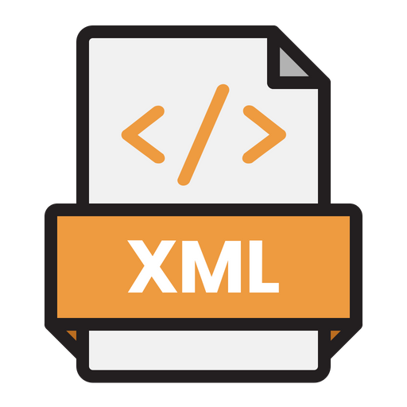
XML
Extensible Markup Language
  Official standard: https://developer.mozilla.org/en-US/docs/Web/XML/XML_introduction
  Native Python library: https://docs.python.org/3/library/xml.html
  Roadmap: https://realpython.com/python-xml-parser/
  Pandas: https://pandas.pydata.org/docs/reference/api/pandas.read_xml.html
Real world example

Slide 9

Excel
Microsoft Excel made a radical change in 2007 in how the files were structured
  Files are now zip archives of XML documents
  https://en.wikipedia.org/wiki/Microsoft_Excel#Current_file_extensions
pandas supports opening both the old (using xlrd) and the new (using openpyxl) formats of Excel
  xlrd
  openpyxl
pandas
  pandas.ExcelFile: class
  pandas.read_excel: function ExcelFile Vs. read_excel in pandas - Stack Overflow
Real world example

Slide 10
Questions?

Slide 11
Next Time
Scrubbing Data

