Slide 1
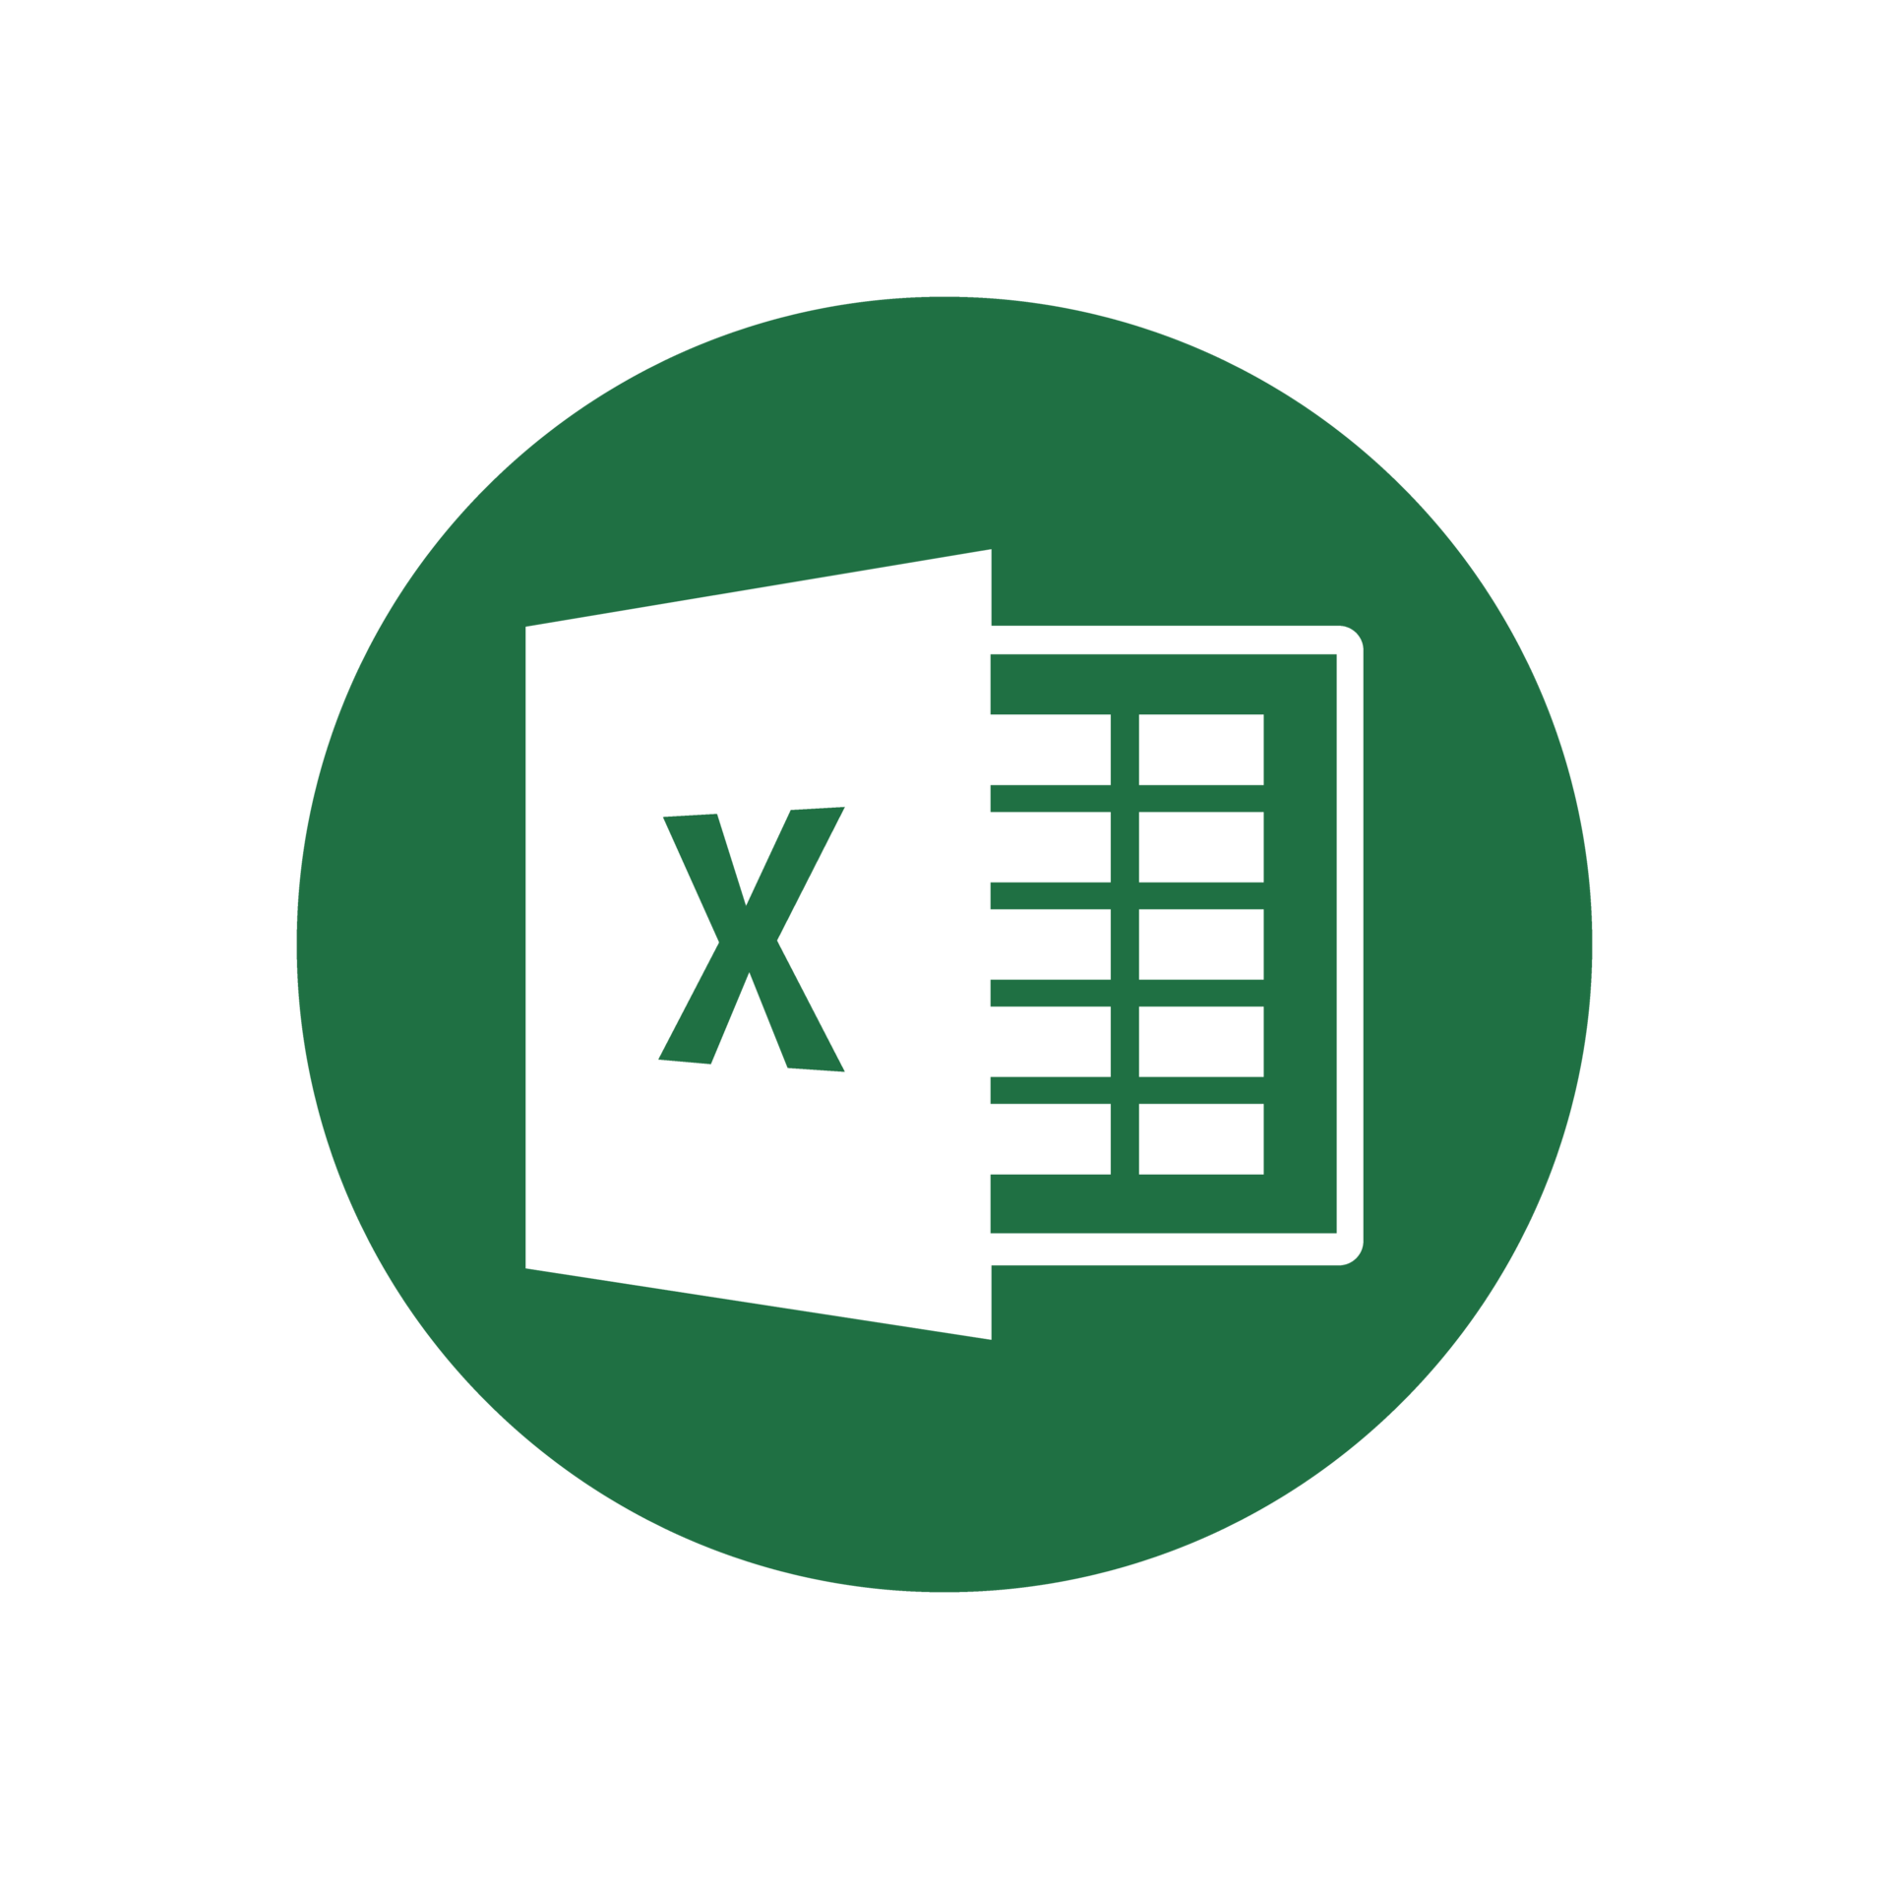
Python Packages for .
Data Analytics in Python
COMP 2800
Otterbein University

Slide 2
Alerts
Assignment 5: due Friday before 11:59pm
Midterm
Take home exam: given Wednesday, due Friday, before class
Individual work – no collaboration
Open book/open notes/open static online resources (no ChatGPT, or other generative AI; no interactive forums)
Questions?

Slide 3
Excel Packages
So far, we've seen bits of different packages:
xlwings
win32.com
xlrd
openpyxl
pandas.read_excel
It is important to understand what the options are and how they relate...

Slide 4
Top Python Packages
openpyxl
most widely used
read/write/modify/create files
.xlsx, .xlsm, .xltx, .xltm
some security vulnerabilities
xlsxwriter
.xlsx
create new files, can't read or modify existing files
can create charts, and apply formulas
pyxlsb
.xlsb
read existing files only
updated version pyxlsb2 has slightly different features
pylightxl
lightweight, zero-dependency
read .xlsx & .xlsm; write .xlsx
reads files contents as in-memory database
no charts, macros, formatting

Slide 5
More Python Packages
xlrd & xlwt
read/write older Excel files
.xls
limited features and support, since it is for legacy formats
xlutils
Excel utilities that are dependent on xlrd and xlwt
copy workbook, filtering, formatting, etc.

Slide 6
Integrating Excel & Python
These packages require Excel to be installed and interact with the Excel application as well as the files
xlwings
Windows and MacOS compatible
can call Excel from Python and vice versa
can create User Defined Functions (UDF) in Python that can be called in workbook formulas
open source (pro version available for purchase)
PyXLL
Commercial product for writing Excell add-ins in Python with no VBA
UDFs, macros, menus, ribbon tool-bar capabiliies
Microsoft 365 Python in Excel
Announced in August 2023
Essentially integrates Python and its most popular libraries (numpy, pandas, matplotlib, etc.) into the Excel application
Makes VBA largely obsolete
Available in the Beta Channel only; full public release data unknown

Slide 7
Questions?

Slide 8
Next time
Work day

