Slide 1
Data Analytics in Python READING FILES
COMP 2800
David J Stucki
Otterbein University

Slide 2
Alerts
Assignment 3: Due next Monday, 2/12 by 11:59pm
Questions?

Slide 3
JSON
JavaScript Object Notation
Official standard: https://www.json.org/json-en.html
Native Python library: https://docs.python.org/3/library/json.html
W3 Schools: https://www.w3schools.com/python/python_json.asp
Pandas: https://pandas.pydata.org/pandas-docs/stable/reference/api/pandas.read_json.html
W3 Schools: https://www.w3schools.com/python/pandas/pandas_json.asp
Real world example
Notes:
Obj = pd.read_csv(‘values.csv’)

Slide 4
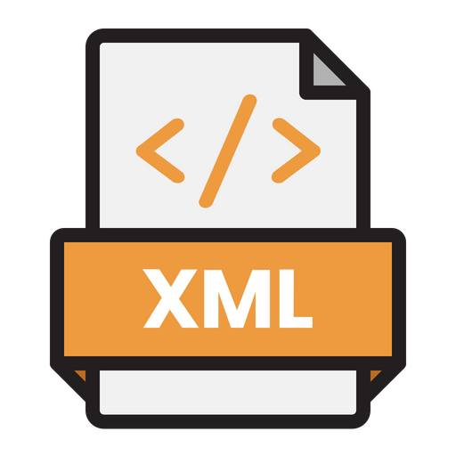
XML
Extensible Markup Language
Official standard: https://developer.mozilla.org/en-US/docs/Web/XML/XML_introduction
Native Python library: https://docs.python.org/3/library/xml.html
Roadmap: https://realpython.com/python-xml-parser/
Pandas: https://pandas.pydata.org/docs/reference/api/pandas.read_xml.html
Real world example
Notes:
Obj = pd.read_csv(‘values.csv’)

Slide 5
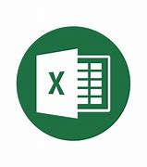
Excel
Microsoft Excel made a radical change in 2007 in how the files were structured
Files are now zip archives of XML documents
https://en.wikipedia.org/wiki/Microsoft_Excel#Current_file_extensions
pandas supports opening both the old (using xlrd) and the new (using openpyxl) formats of Excel
xlrd
openpyxl
pandas
pandas.ExcelFile: class
pandas.read_excel: function ExcelFile Vs. read_excel in pandas - Stack Overflow
Real world example

Slide 6
Questions?

Slide 7
Next Time
Scrubbing Data

