Slide 1
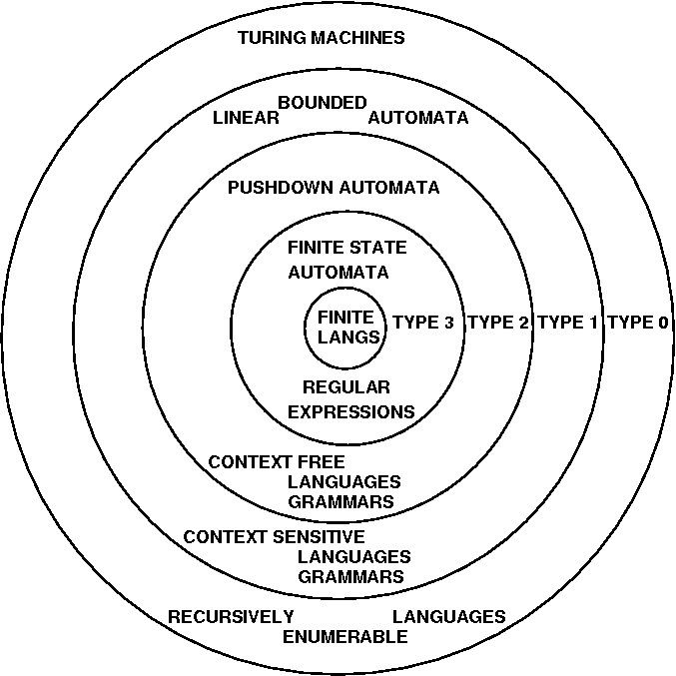

Slide 2
UTM Schematic

Slide 3
How simple can UTMs be?
People have designed Universal Turing Machines with
4 symbols, 7 states (Marvin Minsky)
4 symbols, 5 states
2 symbols, 22 states
18 symbols, 2 states
2 states, 5 symbols (Stephen Wolfram)
No one knows what the smallest possible UTM is

Slide 4
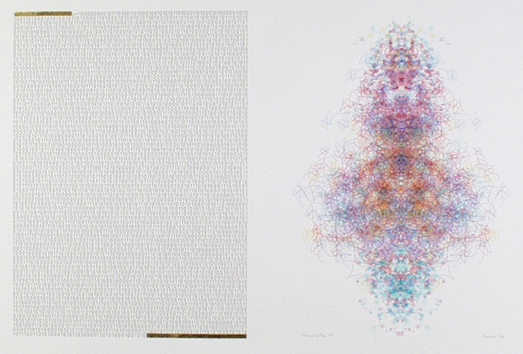
Manchester Illuminated Universal Turing Machine, #9
from http://www.verostko.com/manchester/manchester.html

Slide 5
Minecraft?
https://www.youtube.com/watch?v=1X21HQphy6I

