Slide 1
Asymptotic Analysis
Section 3.2

Slide 2
Big-Oh
Informal Notion
f (n) ∈ O(g(n)) means that (within a constant factor) g(n) eventually overtakes (dominates) f (n).
Captures the idea of worst-case.
Disregards constant factors & lower order terms.
Characterizes time complexity in an abstract fashion that is implementation independent.
Defines a set of functions that have the given function g as an upper-bound

Slide 3
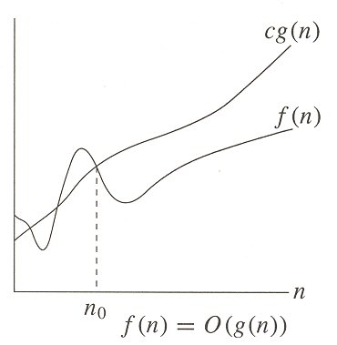
Big-Oh
$$∈$$

Slide 4
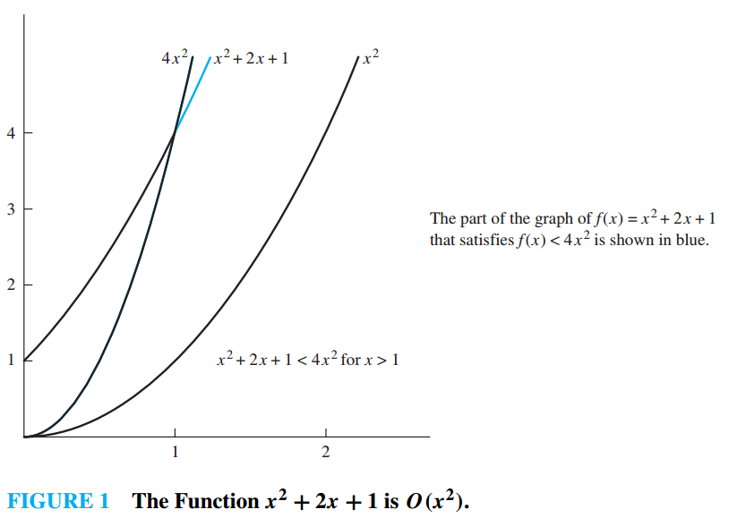
Big-Oh proofs
$$∈$$

Slide 5
Complexity Classes

Slide 6
Comparing Complexity Classes
Times of more than 10¹⁰⁰ years are indicated with an *.

Slide 7
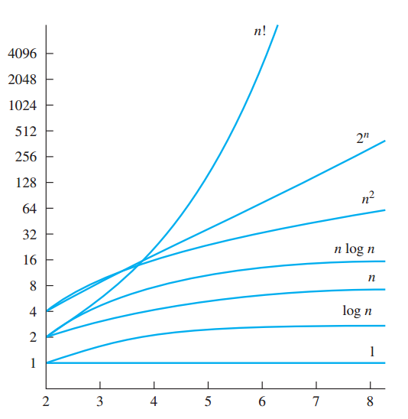
Function growth rates
Logarithmic scale!

Slide 8
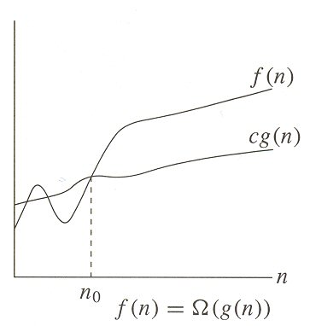
Big-Omega

Slide 9
Big-Omega
Formal Definition
This captures the notion of lower bound, just as Big‑Oh captures the notion of upper bound.

Slide 10
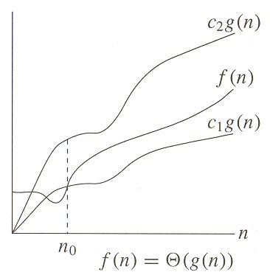
Big-Theta

Slide 11
Big-Theta
Formal Definition
Big-Theta partitions the class of functions into equivalence classes.
Functions that are in the same equivalence class are asymptotically equivalent. That is they have the same order of growth.

Slide 12
Big-Oh Properties
Transitivity
f (n) ∈O (g(n)) ∧ g(n) ∈O (h(n)) → f(n) ∈O (h(n))
Addition
f (n) + g(n)) ∈O (max{f(n), g(n)})
Polynomials
a₀ + a₁n + … + a_{d}n^{d} ∈O (n^{d})
Base of logarithms
log_{a} n ∈O (log_{b} n)
Powers in logarithms
log (n²) ∈O (log n)
Exponents
3^{n} ∉O (2^{n})

Slide 14
Big-Oh
Formal Definition
Since this definition uses an inequality, a given function can have many upper bounds. For example,
2n²+3 ∈ O(n²)
2n²+3 ∈ O(n³)
Although both of these examples are true, the first provides a tighter characterization of 2n²+3

Slide 15
Big-Oh proofs
Show that f(x) = x² + 2x + 1 is O(x²)
In other words, show that x² + 2x + 1 ≤ c*x²
Where c is some constant
For all x greater than some n₀
We know that 2x² ≥ 2x whenever x ≥ 1
And we know that x² ≥ 1 whenever x ≥ 1
So we replace 2x+1 with 2x² + x²
We then end up with x² + 2x² + x² = 4x²
This yields 4x² ≤ c*x²
Thus, for input sizes 1 or greater, when the constant is 4 or greater, f(x) is O(x²)
Note: We could have chosen values for c and n₀ that were different

Slide 16
Sample Big-Oh problems
Show that f(x) = x² + 1000 is O(x²)
In other words, show that x² + 1000 ≤ c*x²
We know that x² > 1000 whenever x > 31
Thus, we replace 1000 with x²
This yields 2x² ≤ c*x²
Thus, f(x) is O(x²) for all x > 31 when c ≥ 2

Slide 17
Sample Big-Oh problems
Show that f(x) = 3x+7 is O(x)
In other words, show that 3x+7 ≤ c*x
We know that x > 7 whenever x > 7
Uh huh….
So we replace 7 with x
This yields 4x ≤ c*x
Thus, f(x) is O(x) for all x > 7 when c ≥ 4

Slide 18
A variant of the last question
Show that f(x) = 3x+7 is O(x²)
In other words, show that 3x+7 ≤ c*x²
We know that x > 7 whenever x > 7
Uh huh….
So we replace 7 with x
This yields 4x < c*x²
This will also be true for x > 7 when c ≥ 1
Thus, f(x) is O(x²) for all x > 7 when c ≥ 1

