Slide 1
Bayes Theorem
COMP 2230
David J Stucki

Slide 2
Alerts
We will finish chapter 7 today (with 7.3)
  HW 7.3: 1, 3, 5, 8, 15
Wednesday is a review day – come with lots of questions
  Review HW Chapter 5 (pp. 400-402): 2, 10, 37, 58
  Chapter 7 (pp. 521-524): 1, 3, 5, 17, 19, 23, 26
Exam I is on Friday, covering chapters 5 & 7

Slide 3
Introduction
Suppose you are trying to determine if a patient has inhalational anthrax. You observe the following symptoms:
The patient has a cough
The patient has a fever
The patient has difficulty breathing

Slide 4
Introduction
You would like to determine how likely the patient is infected with inhalational anthrax given that the patient has a cough, a fever, and difficulty breathing
We are not 100% certain that the patient has anthrax because of these symptoms. We are dealing with uncertainty!

Slide 5
Introduction
Now suppose you order an x-ray and observe that the patient has a wide mediastinum.
Your belief that that the patient is infected with inhalational anthrax is now much higher.

Slide 6
Introduction
In the previous slides, what you observed affected your belief that the patient is infected with anthrax
This is called reasoning with uncertainty
Wouldn’t it be nice if we had some methodology for reasoning with uncertainty?
Why in fact, we do…

Slide 7

Probability Review
We will write P(A = true) to mean the probability that A = true.
What is probability? It is the relative frequency with which an outcome would be obtained if the process were repeated a large number of times under similar conditions*
The sum of the red and blue areas is 1
P(A = true)
*Ahem…there’s also the Bayesian definition which says probability is your degree of belief in an outcome
P(A = false)

Slide 8

Introduction - Bayes’ Theorem
Test A (test to screen for disease X)
Prevalence of disease X was 0.3%
Sensitivity (true positive) of the test was 50%
False positive rate was 3%.
What is the probability that someone who tests positive actually has disease X?
Doctors’ answers ranged from 1% to 99% (with ~half of them estimating the probability as 50% or 47%)
Gerd Gigerenzer, Adrian Edwards “Simple tools for understanding risks: from innumeracy to insight” BMJ VOLUME 327 (2003)
Notes:
For instance, doctors with an average of 14 years of professional experience were asked to imagine using the Haemoccult test to screen for colorectal cancer. The prevalence of cancer was 0.3%, the sensitivity of the test was 50%, and the false positive rate was 3%. The doctors were asked: what is the probability that someone who tests positive actually has colorectal cancer? The correct answer is about 5%.
However, the doctors’ answers ranged from 1% to 99%, with about half of them estimating the probability as 50% (the sensitivity) or 47% (sensitivity minus false positive rate). If patients knew about this degree of variability and statistical innumeracy they would be justly alarmed.

Slide 9
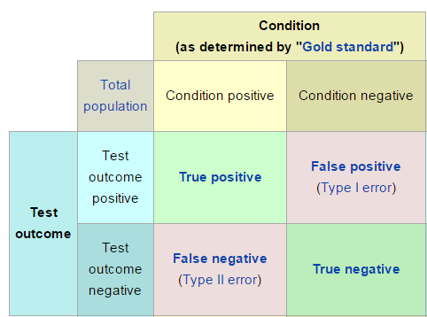
Test Terminology

Slide 10
Introduction - Bayes’ Theorem
Test A (test to screen for disease X)
Prevalence of disease X was 0.3%
Sensitivity (true positive) of the test was 50%
False positive rate was 3%.
What is the probability that someone who tests positive actually has disease X?
Doctors’ answers ranged from 1% to 99% (with ~half of them estimating the probability as 50% or 47%)
The correct answer is ~5%!
Gerd Gigerenzer, Adrian Edwards “Simple tools for understanding risks: from innumeracy to insight” BMJ VOLUME 327 (2003)
Notes:
For instance, doctors with an average of 14 years of professional experience were asked to imagine using the Haemoccult test to screen for colorectal cancer. The prevalence of cancer was 0.3%, the sensitivity of the test was 50%, and the false positive rate was 3%. The doctors were asked: what is the probability that someone who tests positive actually has colorectal cancer? The correct answer is about 5%.
However, the doctors’ answers ranged from 1% to 99%, with about half of them estimating the probability as 50% (the sensitivity) or 47% (sensitivity minus false positive rate). If patients knew about this degree of variability and statistical innumeracy they would be justly alarmed.

Slide 11
Let’s do the math…
What is the probability that someone who tests positive actually has disease X?

Slide 12
Conditional Probability
P(A | B) = Out of all the outcomes in which B is true, how many also have A equal to true
Read this as: “Probability of A conditioned on B” or “Probability of A given B”
H = “Have a headache”
F = “Coming down with Flu”
P(H) = 1/10
P(F) = 1/40
P(H | F) = 1/2
“Headaches are rare and flu is rarer, but if you’re coming down with flu there’s a 50-50 chance you’ll have a headache.”
What is P(F | H)?
P(H)
P(F)

Slide 13
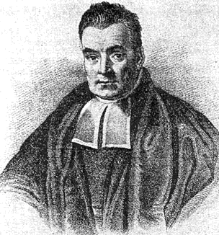
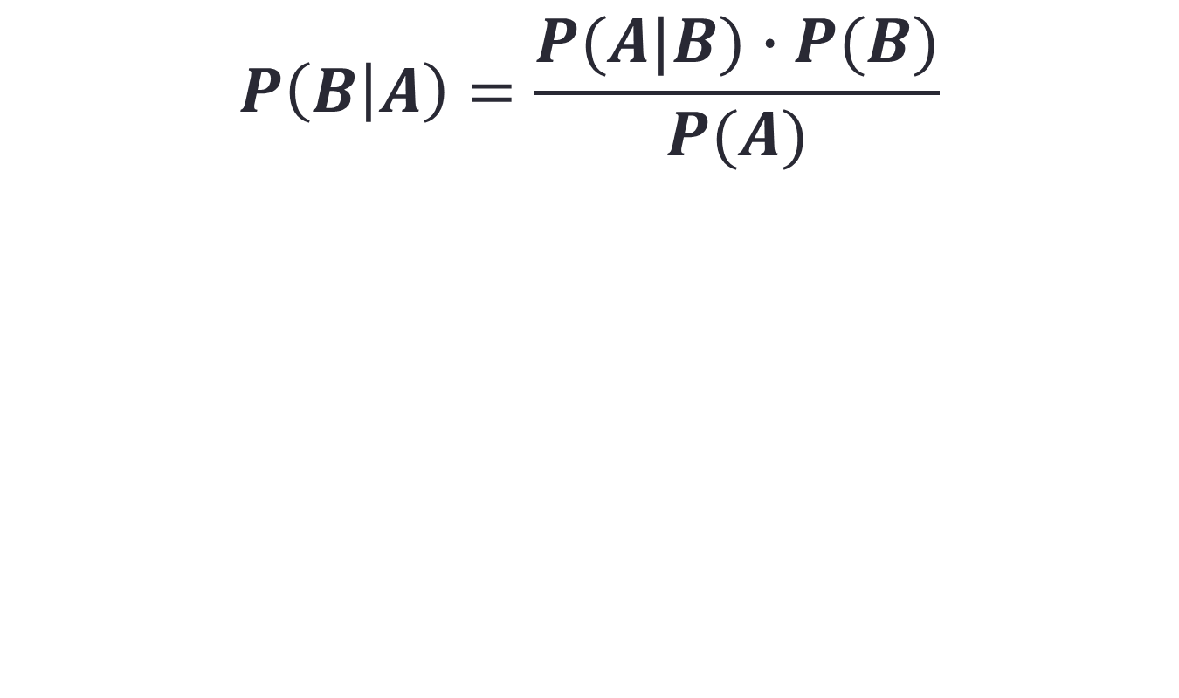
Bayes’ Theorem
$$P\left(B | A\right)=\frac{P(A|B)∙P(B)}{P(A)}$$
where A and B are events.
P(A) and P(B) are the probabilities of A and B independent of each other.
P(A|B), a conditional probability, is the probability of A given that B is true.
P(B|A), is the probability of B given that A is true.

Slide 14
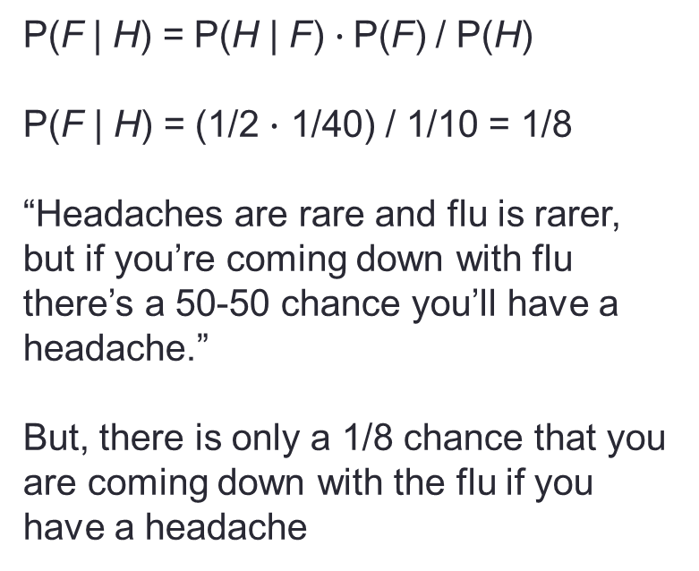
Conditional Probability
H = “Have a headache”
F = “Coming down with Flu”
P(H) = 1/10
P(F) = 1/40
P(H | F) = 1/2
P(F | H) = P(H | F) $∙$P(F) / P(H)
P(F | H) = (1/2 $∙$ 1/40) / 1/10 = 1/8
“Headaches are rare and flu is rarer, but if you’re coming down with flu there’s a 50-50 chance you’ll have a headache.”
But, there is only a 1/8 chance that you are coming down with the flu if you have a headache
P(H)
P(F)

Slide 15
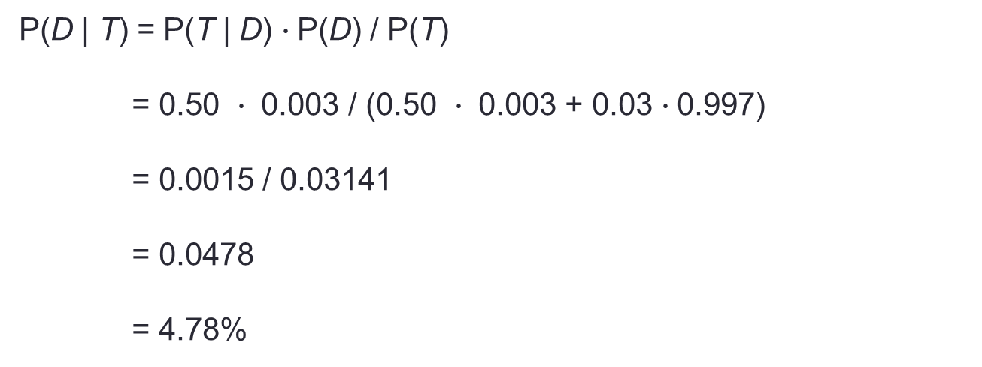
Bayesian Reasoning
 |  | Belief
DISEASE | Yes | 0.003
 | No | 0.997
 | DISEASE | Yes | No
TEST | Positive | 0.50 | 0.03
 | Negative | 0.50 | 0.97
P(D | T) = P(T | D) $∙$P(D) / P(T)
= 0.50 $∙$ 0.003 / (0.50 $∙$ 0.003 + 0.03 $∙$0.997)
= 0.0015 / 0.03141
= 0.0478
= 4.78%
Here is where Bernoulli trials may play an important role in helping with uncertainty...

Slide 16
Bonus Material
The remaining slides contain interesting information, but you will not be tested on this, or be asked to solve problems with Bayesian networks.

Slide 17
A Bayesian Network
A Bayesian network is made up of:
1. A Directed Acyclic Graph
A
B
C
D
2. A set of tables for each node in the graph
A | P(A)
false | 0.6
true | 0.4
A | B | P(B|A)
false | false | 0.01
false | true | 0.99
true | false | 0.7
true | true | 0.3
B | D | P(D|B)
false | false | 0.02
false | true | 0.98
true | false | 0.05
true | true | 0.95
B | C | P(C|B)
false | false | 0.4
false | true | 0.6
true | false | 0.9
true | true | 0.1

Slide 18
A Directed Acyclic Graph
Each node in the graph is a random variable
A node X is a parent of another node Y if there is an arrow from node X to node Y eg. A is a parent of B
A
B
C
D
Informally, an arrow from node X to node Y means X has a direct influence on Y

Slide 19
A Set of Tables for Each Node
A | P(A)
false | 0.6
true | 0.4
A | B | P(B|A)
false | false | 0.01
false | true | 0.99
true | false | 0.7
true | true | 0.3
Each node X_{i} has a conditional probability distribution P(X_{i} | Parents(X_{i})) that quantifies the effect of the parents on the node
The parameters are the probabilities in these conditional probability tables (CPTs)
B | C | P(C|B)
false | false | 0.4
false | true | 0.6
true | false | 0.9
true | true | 0.1
A
B
B | D | P(D|B)
false | false | 0.02
false | true | 0.98
true | false | 0.05
true | true | 0.95
C
D

Slide 20
Inference
Using a Bayesian network to compute probabilities is called inference
In general, inference involves queries of the form:
P( X | E )
E = The evidence variable(s)
X = The query variable(s)

Slide 21
Inference
HasAnthrax
HasCough
HasFever
HasDifficultyBreathing
HasWideMediastinum
An example of a query would be:
P( HasAnthrax| HasFever and HasCough)
Note: Even though HasDifficultyBreathing and HasWideMediastinum are in the Bayesian network, they are not given values in the query (ie. they do not appear either as query variables or evidence variables)
They are treated as unobserved variables

Slide 22
The Bad News
Exact inference is feasible in small to medium-sized networks
Exact inference in large networks takes a very long time
We resort to approximate inference techniques which are much faster and give pretty good results

Slide 23
Person Model (Initial Prototype)
Anthrax Release
Time Of Release
Location of Release
…
…
Female
20-30
Gender
50-60
Male
Age Decile
Age Decile
Gender
Home Zip
Home Zip
Anthrax Infection
Other ED
Disease
Anthrax Infection
Other ED
Disease
15213
15146
Respiratory
from Anthrax
Respiratory CC
From Other
Respiratory
from Anthrax
Respiratory CC
From Other
Respiratory
CC
Respiratory
CC
ED Admit
from Anthrax
ED Admit
from Other
ED Admit
from Anthrax
Unknown
ED Admit
from Other
False
Respiratory CC
When Admitted
Respiratory CC
When Admitted
Yesterday
ED Admission
never
ED Admission

Slide 24
Bayesian Networks
HasAnthrax
HasCough
HasFever
HasDifficultyBreathing
HasWideMediastinum
In the opinion of many AI researchers, Bayesian networks are the most significant contribution in AI in the last 15 years
They are used in many applications, e.g., spam filtering, speech recognition, robotics, diagnostic systems and even syndromic surveillance

