Slide 1
Probability Theory
Section 7.2 (part 1)

Slide 2
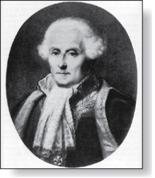
Probability of an Event
Pierre-Simon Laplace
(1749-1827)
We first studied Pierre-Simon Laplace’s classical theory of probability, which he introduced in the 18th century, when he analyzed games of chance.
Here is how Laplace defined the probability of an event:
Definition: If S is a finite sample space of equally likely outcomes, and E is an event, that is, a subset of S, then the probability of E is p(E) = |E|/|S|.
For every event E, we have 0 ≤ p(E) ≤ 1. This follows directly from the definition because 0 ≤ p(E) = |E|/|S| ≤ |S|/|S| ≤ 1, since 0 ≤ |E| ≤ |S|.

Slide 3
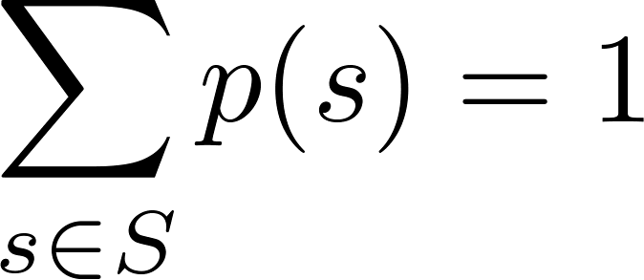
Assigning Probabilities
Laplace’s definition from the previous section, assumes that all outcomes are equally likely. Now we introduce a more general definition of probabilities that avoids this restriction.
Let S be a sample space of an experiment with a finite number of outcomes. We assign a probability p(s) to each outcome s, so that:
i. 0 ≤ p(s) ≤ 1 for each s ∈ S
ii.
The function p from the set of all outcomes of the sample space S is called a probability distribution.

Slide 4
Assigning Probabilities
Example: What probabilities should we assign to the outcomes H (heads) and T (tails) when a fair coin is flipped?
p(T) = p(H) = 0.5
What probabilities should be assigned to these outcomes when the coin is biased so that heads comes up twice as often as tails?
Solution: We have p(H) = 2p(T).
Because p(H) + p(T) = 1, it follows that
2p(T) + p(T) = 3p(T) = 1.
Hence, p(T) = 1/3 and p(H) = 2/3.

Slide 5
Uniform Distribution
Definition: Suppose that S is a set with n elements. The uniform distribution assigns the probability 1/n to each element of S. (Note that we could have used Laplace’s definition here.)
Example: Consider again the coin flipping example, but with a fair coin. Now p(H) = p(T) = 1/2.

Slide 6
Probability of an Event
Definition: The probability of the event E is the sum of the probabilities of the outcomes in E.
Note that now no assumption is being made about the distribution.

Slide 7
Example
Example: Suppose that a die is biased so that 3 appears twice as often as each other number, but that the other five outcomes are equally likely. What is the probability that an odd number appears when we roll this die?
Solution: We want the probability of the event E = {1,3,5}. We have p(3) = 2/7 and
p(1) = p(2) = p(4) = p(5) = p(6) = 1/7.
Hence, p(E) = p(1) + p(3) + p(5) =
1/7 + 2/7 + 1/7 = 4/7.

Slide 8
Probabilities of Complements and Unions of Events
Complements: still holds. Since each outcome is in either E or , but not both,
Unions:
also still holds under the new definition.

Slide 9
Combinations of Events
Theorem: If E₁, E₂, … is a sequence of pairwise disjoint events in a sample space S, then
see Exercises 36 and 37 for the proof

Slide 10
Conditional Probability
Definition: Let E and F be events with p(F) > 0. The conditional probability of E given F, denoted by P(E|F), is defined as:
Example: A bit string of length four is generated at random so that each of the 16 bit strings of length 4 is equally likely. What is the probability that it contains at least two consecutive 0s, given that its first bit is a 0?
Solution: Let E be the event that the bit string contains at least two consecutive 0s, and F be the event that the first bit is a 0.
Since E ⋂ F = {0000, 0001, 0010, 0011, 0100}, p(E⋂F)=5/16.
Because 8 bit strings of length 4 start with a 0, p(F) = 8/16= ½.
Hence,

Slide 11
Conditional Probability
Example: What is the conditional probability that a family with two children has two boys, given that they have at least one boy. Assume that each of the possibilities BB, BG, GB, and GG is equally likely where B represents a boy and G represents a girl.
Solution: Let E be the event that the family has two boys and let F be the event that the family has at least one boy. Then E = {BB}, F = {BB, BG, GB}, and E ⋂ F = {BB}.
It follows that p(F) = 3/4 and p(E⋂F)=1/4.
Hence,

Slide 12
Independence
Definition: The events E and F are independent if and only if
Example: Suppose E is the event that a randomly generated bit string of length four begins with a 1 and F is the event that this bit string contains an even number of 1s. Are E and F independent if the 16 bit strings of length four are equally likely?
Solution: There are eight bit strings of length four that begin with a 1, and eight bit strings of length four that contain an even number of 1s.
Since the number of bit strings of length 4 is 16,
Since E⋂F = {1111, 1100, 1010, 1001}, p(E⋂F) = 4/16=1/4.
We conclude that E and F are independent, because
p(E⋂F) =1/4 = (½) (½)= p(E) p(F)
p(E⋂F) = p(E)p(F).
p(E) = p(F) = 8/16 = ½.

Slide 13
Independence
Example: Assume (as in the previous example) that each of the four ways a family can have two children (BB, GG, BG,GB) is equally likely. Are the events E, that a family with two children has two boys, and F, that a family with two children has at least one boy, independent?
Solution: Because E = {BB}, p(E) = 1/4. We saw previously that that p(F) = 3/4 and p(E⋂F)=1/4. The events E and F are not independent since
p(E) p(F) = 3/16 ≠ 1/4= p(E⋂F) .

Slide 14
Pairwise and Mutual Independence
Definition: The events E₁, E₂, …, E_{n} are pairwise independent if and only if p(E_{i}⋂E_{j}) = p(E_{i}) p(E_{j}) for all pairs i and j with i ≤ j ≤ n.
The events are mutually independent if
whenever i_{j} (j ∈ {1,2,…., m}) are integers with
1 ≤ i₁ < i₂ <∙∙∙ < i_{m} ≤ n and m ≥ 2.

