Slide 1
Data Compression
COMP 2100
Otterbein University

Slide 2
Alerts
Homework #10 due today
Lab 7 due Wednesday
Project #3 due Friday
Final Exam: Friday, December 9
Exam will be at 10:15am

Slide 3
Data compression
Compression reduces the size of a file:
To save space when storing it.
To save time when transmitting it.
Most files have lots of redundancy.
Who needs compression?
Moore's law: # transistors on a chip doubles every 18–24 months.
Parkinson's law: data expands to fill space available.
Text, images, sound, video, …
Basic concepts ancient (1950s), best technology recently developed.
“ Everyday, we create 2.5 quintillion bytes of data—so much that
90% of the data in the world today has been created in the last
two years alone. ” — IBM report on big data (2011)
Notes:
This data comes from everywhere: from digital pictures and videos posted online, posts to social media sites, sensors used to gather climate information, transaction records of online purchases, and from cell phone GPS signals to name a few
Despite incomprehensible increases in storage and bandwidth, we always thirst for more!
“Global digital content created will increase some 30 times over the next ten years – to 35 zettabytes).” [Digital Universe Study.” IDC study sponsored by EMC, May 2010.]

Slide 4
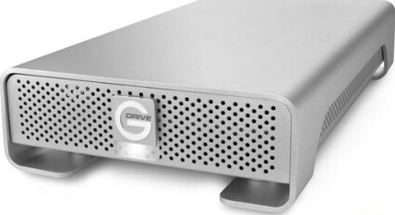
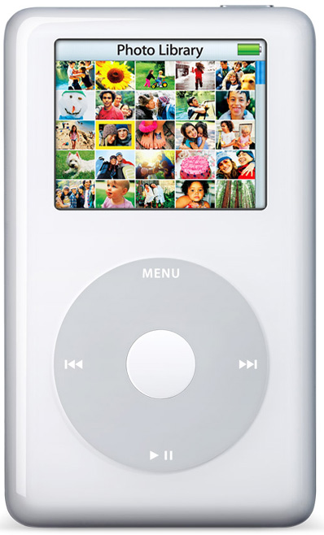
Applications
Generic file compression
Files: GZIP, BZIP, 7z
Archivers: PKZIP
File systems: NTFS, ZFS, HFS+, ReFS, GFS
Multimedia
Images: GIF, JPEG
Sound: MP3
Video: MPEG, DivX™, HDTV
Communication
ITU-T T4 Group 3 Fax
V.42bis modem
Skype, Facetime, Zoom
Databases. Google, Facebook, ....
Notes:
NTFS = Windows NT file system. ReFS = Windows 8 file system built on top of NTFS. GFS = Google file system.
MP3: requires less computation to decode than to encode.
DivX is open source project based on MPEG4

Slide 5
Lossless compression and expansion
Message. Binary data B we want to compress. Compress. Generates a "compressed" representation C (B). Expand. Reconstructs original bitstream B.
Compression ratio. Bits in C (B) / bits in B. Ex. 50–75% or better compression ratio for natural language.
uses fewer bits
(you hope)
Notes:
"codec" = coder and decoder
Lossy does not necessarily mean loss of quality. In fact the output could be “better” than the input.
Drop random noise in images (dust on lens); Drop background in music; Fix spelling errors in text. Put into better form.
Ex. Natural language, source code, executables.
Don't want lossy compression for source code, executables, medical x-rays, pictures taken by large telescopes, etc.
Don't won't lossy compression for teleportation. :)
Lossy. M ≈ M', 10% or better compression ratio.
Ex. Images, sound, video.

Slide 6
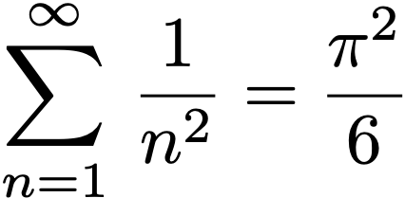
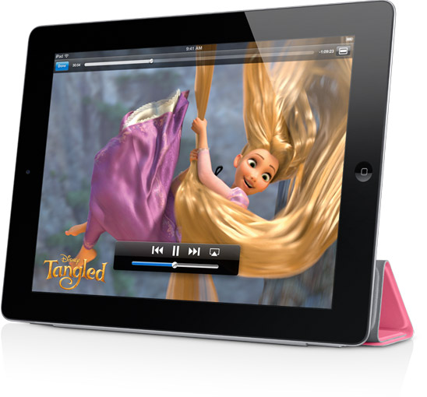
Food for thought
Data compression has been omnipresent since antiquity:
Number systems.
Natural languages.
Mathematical notation.
has played a central role in communications technology,
Grade 2 Braille.
Morse code.
Telephone system.
and is part of modern life.
MP3.
MPEG.
Q. What role will it play in the future?
braille
but
rather
a
I
like
like
every
Notes:
Grade 1 Braille: 8-bit alphabet encoding
Grade 2 Braille: contractions and abbreviations that save room when writing Braille (also special symbols for capital sign, letter sign, number sign, th, er, ed, st, in).
"Poetry is the art of lossy data compression"
Ex. If memory is cheap and ubiquitous, why are we doing lossy compression for music and movies??
Simple, but powerful idea.
Will all data be stored in the cloud?

Slide 7
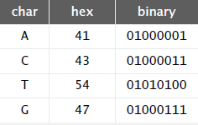
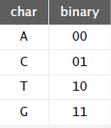
Data representation: genomic code
Genome. String over the alphabet { A, C, T, G }.
Goal. Encode an N-character genome: ATAGATGCATAG...
Standard ASCII encoding.
8 bits per char.
8 N bits.
Fixed-length code. k-bit code supports alphabet of size 2^{k}.
Amazing but true. Some genomic databases in 1990s used ASCII.
Two-bit encoding.
2 bits per char.
2 N bits.
Notes:
decoder needs to know the code

Slide 8
Reading and writing binary data
Binary standard input. Read bits from standard input.
Binary standard output. Write bits to standard output

Slide 9
Writing binary data
Date representation. Three different ways to represent 12/31/1999.
Notes:
Assume month, day, and year are integer instance variables
Note: when printed to terminal, bits will display as characters (typically unreadable)

Slide 10
Binary dumps
Q. How to examine the contents of a bitstream?
Notes:
'A' is 65 in ASCII (or 41 in hex)

Slide 11
Universal data compression
Proposition. No algorithm can compress every bitstring.
Pf 1. [by contradiction]
Suppose you have a universal data compression algorithm U that can compress every bitstream.
Given bitstring B0, compress it to get smaller bitstring B1.
Compress B1 to get a smaller bitstring B2.
Continue until reaching bitstring of size 0.
Implication: all bitstrings can be compressed to 0 bits!
Pf 2. [by counting]
Suppose your algorithm that can compress all 1,000-bit strings.
2¹⁰⁰⁰ possible bitstrings with 1,000 bits.
Only 1 + 2 + 4 + … + 2⁹⁹⁸ + 2⁹⁹⁹ can be encoded with ≤ 999 bits.
Similarly, only 1 in 2⁴⁹⁹ bitstrings can be encoded with ≤ 500 bits!
Notes:
If any one message shortened, then some other messages are lengthened. Try gzip'ing a GIF.
Practical test for any compression algorithm:
given a file M, compress it to get a (smaller, you hope) file M1
compress that file to get a still smaller file M2.
continue until file size does not decrease

Slide 12
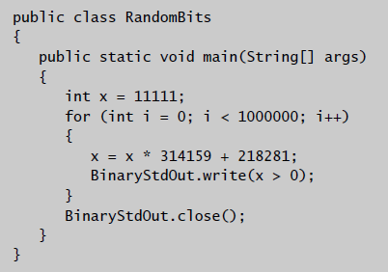
Undecidability
Notes:
video of ocean waves is also hard to compress
video of crowds in a football game are hard to compress

Slide 13
Rdenudcany in Enlgsih lnagugae
Q. How mcuh rdenudcany is in the Enlgsih lnagugae?
A. Quite a bit.
“ ... randomising letters in the middle of words [has] little or no effect on the ability of skilled readers to understand the text. This is easy to denmtrasote. In a pubiltacion of New Scnieitst you could ramdinose all the letetrs, keipeng the first two and last two the same, and reibadailty would hadrly be aftcfeed. My ansaylis did not come to much beucase the thoery at the time was for shape and senqeuce retigcionon. Saberi's work sugsegts we may have some pofrweul palrlael prsooscers at work. The resaon for this is suerly that idnetiyfing coentnt by paarllel prseocsing speeds up regnicoiton. We only need the first and last two letetrs to spot chganes in meniang. ” — Graham Rawlinson
Notes:
works well with English, maybe not Chinese

Slide 14
Genomic code
public class Genome {
public static void compress() { Alphabet DNA = new Alphabet("ACTG");
String s = BinaryStdIn.readString();
int N = s.length();
BinaryStdOut.write(N);
for (int i = 0; i < N; i++) {
int d = DNA.toIndex(s.charAt(i));
BinaryStdOut.write(d, 2);
}
BinaryStdOut.close();
}
public static void expand() {
Alphabet DNA = new Alphabet("ACTG");
int N = BinaryStdIn.readInt();
for (int i = 0; i < N; i++) {
char c = BinaryStdIn.readChar(2);
BinaryStdOut.write(DNA.toChar(c));
}
BinaryStdOut.close();
}
}
Alphabet data type converts between symbols { A, C, T, G } and integers 0―3.
read genomic string from stdin;
write to stdout using 2-bit code
read 2-bit code from stdin;
write genomic string to stdout

Slide 15
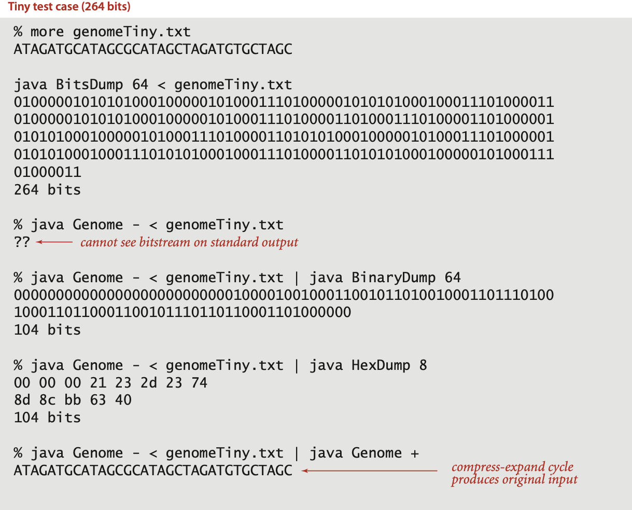
Genomic code: test client and sample execution
public static void main(String[] args) { if (args[0].equals("-")) compress(); if (args[0].equals("+")) expand(); }
Notes:
264 = 33 characters * 8 bits/char
104 = 32 bits for count + 33 chars * 2 bits/char + 6 bits for pading

Slide 16
Run-length encoding
Simple type of redundancy in a bitstream. Long runs of repeated bits.
Representation. 4-bit counts to represent alternating runs of 0s and 1s: 15 0s, then 7 1s, then 7 0s, then 11 1s.
Q. How many bits to store the counts?
A. We'll use 8 (but 4 in the example above).
Q. What to do when run length exceeds max count?
A. If longer than 255, intersperse runs of length 0.
Applications. JPEG, ITU-T T4 Group 3 Fax, ...
0000000000000001111111000000011111111111
40 bits
Notes:
JPEG combines several compression schemes including run-length encoding.
Fax combines run-length encoding with fixed Huffman codes.

Slide 17
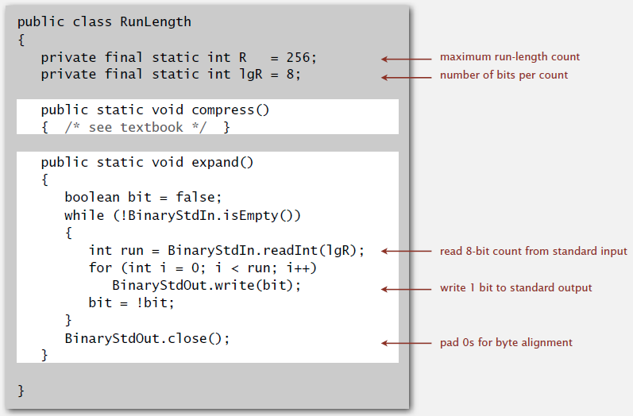
Run-length encoding: Java implementation

Slide 18
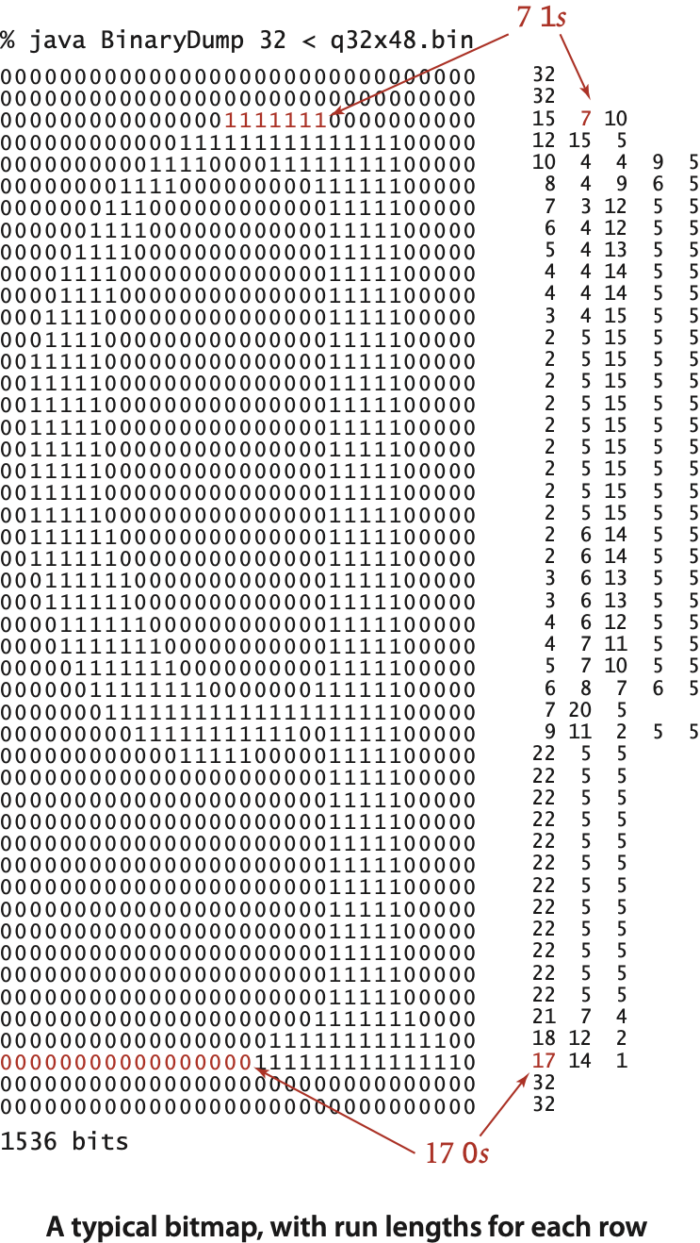
An application: compress a bitmap
Typical black-and-white-scanned image.
300 pixels/inch.
8.5-by-11 inches.
300 × 8.5 × 300 × 11 = 8.415 million bits.
Observation. Bits are mostly white.
Typical amount of text on a page. 40 lines × 75 chars per line = 3,000 chars.
Notes:
lossy compression algorithm: try to determine the sequence of characters using OCR, transmit the characters, and reconstruct. But this algorithm is complicated and lossy.

Slide 19
Black and white bitmap compression: another approach
Fax machine (~1980).
Slow scanner produces lines in sequential order.
Compress to save time (reduce number of bits to send).
Electronic documents (~2000).
High-resolution scanners produce huge files.
Compress to save space (reduce number of bits to save).
Idea.
use OCR to get back to ASCII (!)
use Huffman on ASCII string (!)
Bottom line. Any extra information about file can yield dramatic gains.

Slide 20
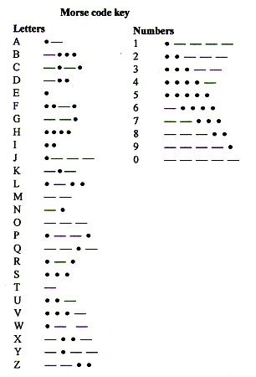
Variable-length codes
Use different number of bits to encode different chars.
Ex. Morse code: • • • − − − • • •
Issue. Ambiguity.
SOS ?
V7 ?
IAMIE ?
EEWNI ?
In practice. Use a medium gap to separate codewords.
codeword for S is a prefix of codeword for V
Notes:
Note that the letter E is just one dot (and T is just one dash)
Simple, but powerful idea.
Morse code is a static model, but very inefficient when transmitting numerical data since codewords for numbers are long

Slide 21
Variable-length codes
Q. How do we avoid ambiguity?
A. Ensure that no codeword is a prefix of another.
Ex 1. Fixed-length code.
Ex 2. Append special stop char to each codeword.
Ex 3. General prefix-free code.
Notes:
in general, need codewords to be uniquely decodable. Prefix-free codes are not the only way to accomplish this, e.g., suffix-free codes.

Slide 22
Prefix-free codes: trie representation
Q. How to represent the prefix-free code?
A. A binary trie!
Chars in leaves.
Codeword is path from root to leaf.
Notes:
neither is optimal - can do 28 bits with Huffman code
prefix-free property follows because symbols are not in internal nodes

Slide 23
Prefix-free codes: compression and expansion
Compression.
Method 1: start at leaf; follow path up to the root; print bits in reverse.
Method 2: create ST of key-value pairs.
Expansion.
Start at root.
Go left if bit is 0; go right if 1.
If leaf node, print char and return to root.

Slide 24
Huffman coding overview
Dynamic model. Use a custom prefix-free code for each message.
Compression.
Read message.
Built best prefix-free code for message. How?
Write prefix-free code (as a trie) to file.
Compress message using prefix-free code.
Expansion.
Read prefix-free code (as a trie) from file.
Read compressed message and expand using trie.

Slide 25
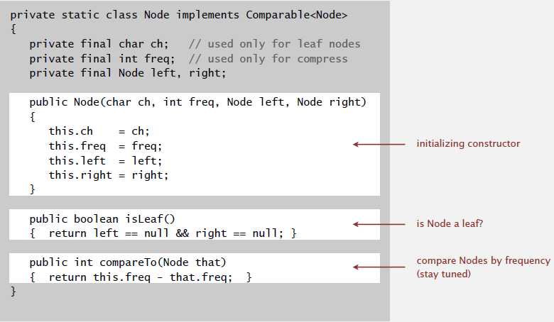
Huffman trie node data type

Slide 26
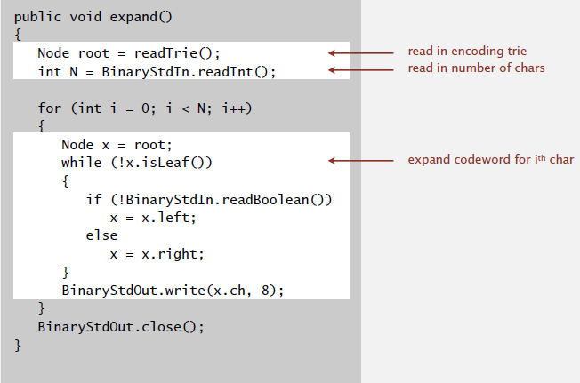
Prefix-free codes: expansion
Running time. Linear in input size N.
Notes:
constant amount of work per bit read

Slide 27
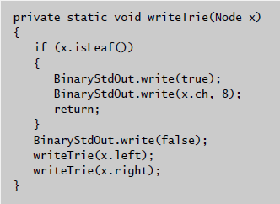
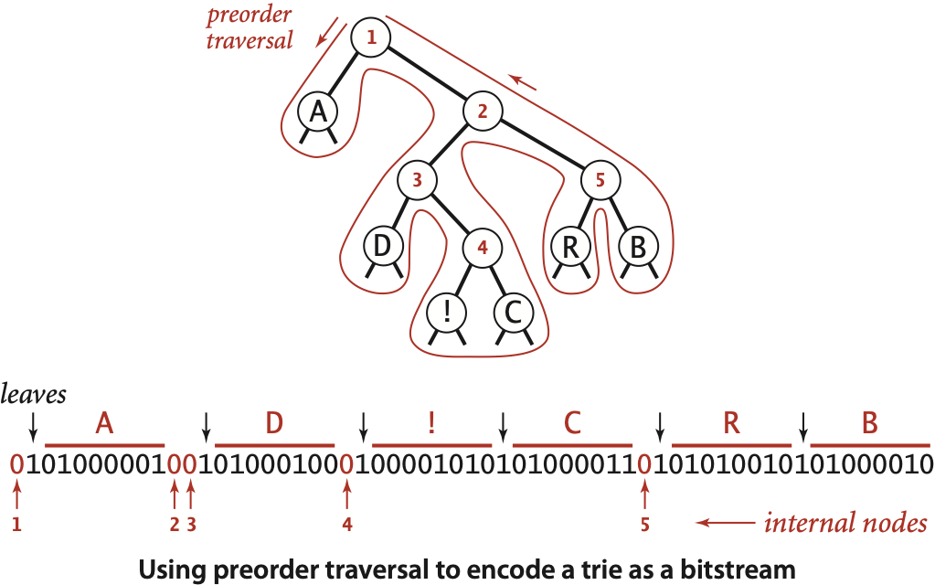
Prefix-free codes: how to transmit
Q. How to write the trie?
A. Write preorder traversal of trie; mark leaf and internal nodes with a bit.
Note. If message is long, overhead of transmitting trie is small.

Slide 28
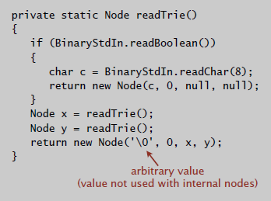
Prefix-free codes: how to transmit
Q. How to read in the trie?
A. Reconstruct from preorder traversal of trie.

Slide 29
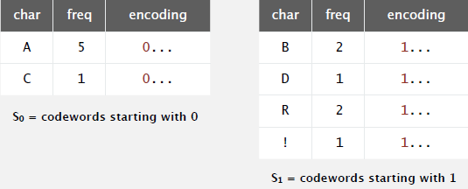
Shannon-Fano codes
Q. How to find best prefix-free code?
Shannon-Fano algorithm:
Partition symbols S into two subsets S0 and S1 of (roughly) equal freq.
Codewords for symbols in S0 start with 0; for symbols in S1 start with 1.
Recur in S0 and S1.
Problem 1. How to divide up symbols?
Problem 2. Not optimal!
Notes:
top-down approach

Slide 30
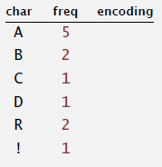
Huffman algorithm demo
Count frequency for each character in input.
input
A B R A C A D A B R A !
Notes:
run 55DemoHuffman.key

Slide 31
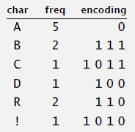
Huffman algorithm demo
0
1
A
0
1
0
1
0
1
D
R
B
0
1
!
C

Slide 32
Huffman codes
Q. How to find best prefix-free code?
Huffman algorithm:
Count frequency freq[i] for each char i in input.
Start with one node corresponding to each char i (with weight freq[i]).
Repeat until single trie formed:
select two tries with min weight freq[i] and freq[j]
merge into single trie with weight freq[i] + freq[j]
Applications:
Notes:
http://www.huffmancoding.com/my-family/my-uncle/scientific-american
In 1951 David A. Huffman and his classmates in an electrical engineering graduate course on information theory were given the choice of a term paper or a final exam. For the term paper, Huffman’s professor, Robert M. Fano, had assigned what at first appeared to be a simple problem. Students were asked to find the most efficient method of representing numbers, letters or other symbols using a binary code. Besides being a nimble intellectual exercise, finding such a code would enable information to be compressed for transmission over a computer network or for storage in a computer’s memory.
Huffman worked on the problem for months, developing a number of approaches, but none that he could prove to be the most efficient. Finally, he despaired of ever reaching a solution and decided to start studying for the final. Just as he was throwing his notes in the garbage, the solution came to him. “It was the most singular moment of my life,” Huffman says. “There was the absolute lightning of sudden realization.”

Slide 33
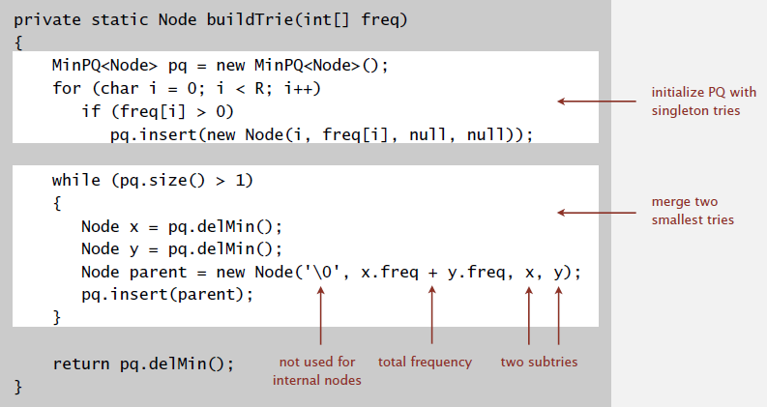
Constructing a Huffman encoding trie: Java implementation
Notes:
we'll assume the frequencies have been computed

Slide 34
Huffman encoding summary
Proposition. [Huffman 1950s] Huffman algorithm produces an optimal prefix-free code. Pf. See textbook.
Implementation.
Pass 1: tabulate char frequencies and build trie.
Pass 2: encode file by traversing trie or lookup table.
Running time. Using a binary heap ⇒ N + R log R .
Q. Can we do better? [stay tuned]
no prefix-free code
uses fewer bits
input
size
alphabet size
Notes:
Note: number of symbols can be huge if Unicode or each word in English language is a symbol.
if block size grows to infinity, then Huffman can approach Shannon limit (under order 0 markov model)
Note: no uniquely decodable code uses fewer bits either

Slide 35
RLE and Huffman codes in the wild
ITU-T T4 Group 3 Fax. [for black-and-white bitmap images]
Up to 1728 pixels per line.
Typically mostly white.
Step 1. Use run-length encoding.
Step 2. Encode run lengths using two Huffman codes.
one for white and one for black
based on statistics from huge number of faxes
130
run | white | black
0 | 00110101 | 0000110111
1 | 000111 | 010
2 | 0111 | 11
3 | 1000 | 10
… | … | …
63 | 00110100 | 000001100111
64+ | 11011 | 0000001111
128+ | 10010 | 000011001000
… | … | ...
1728+ | 010011011 | 0000001100101
 |  |  |  |  |  |  |  |  |  |  | ... |  | ...
3 | 1 | 2 | 2 | 130 | ...
1000 | 010 | 0111 | 11 | 10010 0111 | ...
128 + 2
Notes:
The run-lengths alternate between white and black, so it is always clear which prefix-free code to use.
One complication is runs of length more than 64. But using a code like 010111 (192+ white) means that the next
codeword should be interpreted as white.
Convention: start each row with a sentinel white pixel.

Slide 36
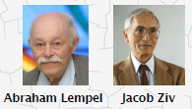
Statistical methods
Static model. Same model for all texts.
Fast.
Not optimal: different texts have different statistical properties.
Ex: ASCII, Morse code.
Dynamic model. Generate model based on text.
Preliminary pass needed to generate model.
Must transmit the model.
Ex: Huffman code.
Adaptive model. Progressively learn and update model as you read text.
More accurate modeling produces better compression.
Decoding must start from beginning.
Ex: LZW.
Notes:
Dynamic model: need to transmit the model. Usually, when I send email, I don't send an addendum that explains how to decode the email.

Slide 37
Lempel-Ziv-Welch compression
LZW compression.
Create ST associating W-bit codewords with string keys.
Initialize ST with codewords for single-char keys.
Find longest string s in ST that is a prefix of unscanned part of input.
Write the W-bit codeword associated with s.
Add s + c to ST, where c is next char in the input.
Q. How to represent LZW compression code table?
A. A trie to support longest prefix match.
longest prefix match
A
B
C
D
R
41
42
43
44
52
B
C
D
R
A
A
A
81
84
86
82
85
87
83
R
88
A
8A
B
89
A
8B
Notes:
Q. Why does it work?
A. Length of string keys in ST grows, hence compression.
Remark. Every prefix of a key in encoding table is also in encoding table.

Slide 38
LZW expansion
LZW expansion.
Create ST associating string values with W-bit keys.
Initialize ST to contain single-char values.
Read a W-bit key.
Find associated string value in ST and write it out.
Update ST.
Q. How to represent LZW expansion code table?
A. An array of size 2^{W}.
Notes:
role of key and value is switched; no need to explicitly transmit dictionary.

Slide 39
LZW in the real world
Lempel-Ziv and friends.
LZ77.
LZ78.
LZW.
Deflate / zlib = LZ77 variant + Huffman.
LZ77 not patented ⇒ widely used in open source LZW patent #4,558,302 expired in U.S. on June 20, 2003
Notes:
LZW works fastest for pictures (perhaps explaining why it's in GIF)
LZ77 isn't patented so it's widely used in open source software
PNG started as replacement by CompuServe to GIF to avoid infringement of Unisys’s patent on LZW

Slide 40
LZW in the real world
Lempel-Ziv and friends.
LZ77.
LZ78.
LZW.
Deflate / zlib = LZ77 variant + Huffman.
Unix compress, GIF, TIFF, V.42bis modem: LZW.
zip, 7zip, gzip, jar, png, pdf: deflate / zlib.
iPhone, Sony Playstation 3, Apache HTTP server: deflate / zlib.
Notes:
deflation never increases the size of a file
http://www.gettyicons.com/free-icon/153/cute-file-extension-icon-set/free-jar-file-icon-png/
"The lovely zlib-vise image above was provided courtesy of Bruce Gardner, art director of Dr. Dobb's Journal. It appears in Mark Nelson's article in the January 1997 issue."

Slide 41
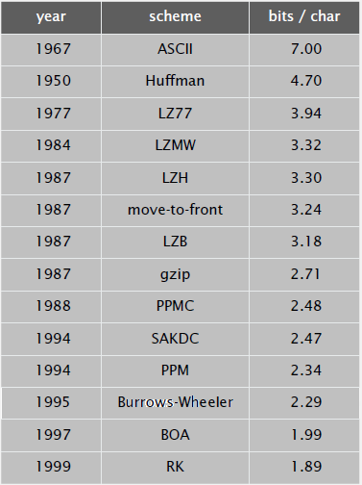
Lossless data compression benchmarks
data compression using Calgary corpus
Notes:
you get pretty far down this list using mid 1990s technology
Entropy bits/char
char-by-char 4.5
8 chars at a time 2.4
asymptotic 1.3

Slide 42
Data compression summary
Lossless compression.
Represent fixed-length symbols with variable-length codes. [Huffman]
Represent variable-length symbols with fixed-length codes. [LZW]
Lossy compression. [not covered in this course]
JPEG, MPEG, MP3, …
FFT, wavelets, fractals, …
Theoretical limits on compression. Shannon entropy:
Practical compression. Use extra knowledge whenever possible.
Notes:
Theoretical limits closely match what we can achieve in practice.

