Slide 1
Divide & Conquer Sorting
COMP 2100
Otterbein University

Slide 2
Alerts
Homework #7 due on Friday, 11/4
Lab 7 available next Tuesday
This is the last lab for the semester!
It will take all of four weeks to complete!!
(don't procrastinate...)

Slide 3
Divide & Conquer
Divide & conquer design paradigm
Divide: divide the input data S in two (or more) disjoint subsets S₁ and S₂
Recur: Solve the subproblems associated with S₁ and S₂
Conquer: combine the solutions for S₁ and S₂ into a solution for S
Base case: directly solve and do not divide for “small” subproblem sizes (typically 0 or 1)
MergeSort and QuickSort are sorting algorithms based on divide & conquer
MergeSort divides based on position
QuickSort divides based on value

Slide 4
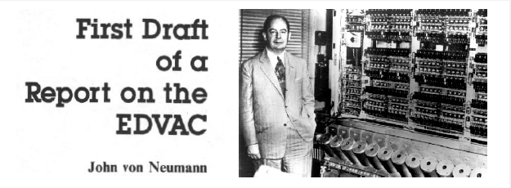
MergeSort (1945)
MergeSort on an input sequence S with n elements consists of three steps:
Divide: partition S into two sequences S₁ and S₂ of about n/2 elements each
Recur: recursively sort S₁ and S₂
Conquer: merge S₁ and S₂ into a unique sorted sequence
Algorithm mergeSort (S)
Input sequence S with n elements
Output sequence S sorted
if n > 1
(S₁, S₂) ← partition (S, n/2)
S₁ ← mergeSort (S₁)
S₂ ← mergeSort (S₂)
S ← merge (S₁, S₂)
return S

Slide 5
Partitioning a Sequence
The divide step of mergeSort consists of partitioning input sequence S
Use new arrays for the subsequences
It is easy to see that partition takes O(n) time
Algorithm partition (S, k)
Input sequence S, with n items; k, partition size
Output partition of S into S₁ of size k and S₂ of size n – k
S₁ ← new array of size k
S₂ ← new array of size n - k
pos ← 0
for i ← 0 to k-1 do
S₁[i] ← S[pos++]
for i ← 0 to n-k-1 do
S₂[i] ← S[pos++]
return (S₁, S₂)

Slide 6
Merging Two Sorted Sequences
The conquer step of mergeSort consists of merging two sorted sequences S₁ and S₂
Use new array for the merged sequence
It is easy to see that partition takes O(n) time
Algorithm merge (S₁, S₂)
Input sequences S₁ and S₂, both sorted, with n total items combined
Output sorted sequence containing all the elements of S₁ and S₂
S ← new array of size n
p ← length of S₁; q ← length of S₂
i ← 0; j ← 0; k ← 0
while i < p and j < q do
if S₁[i] < S₂[j]
S[k++] ← S₁[i++]
else S[k++] ← S₂[j++]
if i =p
copy S₂[j..q-1] to S[k..p+q-1]
else copy S₁[i..p-1] to S[k..p+q-1]
return S

Slide 7
MergeSort in Action
Partition
7 2 9 4 | 3 8 6 1

Slide 8
MergeSort in Action
Recursive Call, Partition
7 2 9 4 | 3 8 6 1
7 2 | 9 4

Slide 9
MergeSort in Action
Recursive Call, Partition
7 2 9 4 | 3 8 6 1
7 2 | 9 4
7 | 2

Slide 10
MergeSort in Action
Recursive Call, Base Case
7 2 9 4 | 3 8 6 1
7 2 | 9 4
7 | 2
7→7

Slide 11
MergeSort in Action
Recursive Call, Base Case
7 2 9 4 | 3 8 6 1
7 2 | 9 4
7 | 2
7→7
2→2

Slide 12
MergeSort in Action
Merge
7 2 9 4 | 3 8 6 1
7 2 | 9 4
7 | 2→2 7
7→7
2→2

Slide 13
MergeSort in Action
Recursive Call, …, Base Case, Merge
7 2 9 4 | 3 8 6 1
7 2 | 9 4
7 | 2→2 7
9 4 → 4 9
7→7
2→2
9→9
4→4

Slide 14
MergeSort in Action
Merge
7 2 9 4 | 3 8 6 1
7 2 | 9 4 → 2 4 7 9
7 | 2→2 7
9 4 → 4 9
7→7
2→2
9→9
4→4

Slide 15
MergeSort in Action
Recursive Call, …, Merge, Merge
7 2 9 4 | 3 8 6 1
7 2 | 9 4 → 2 4 7 9
3 8 | 6 1 → 1 3 6 8
7 | 2→2 7
9 4 → 4 9
3 8 → 3 8
6 1 → 1 6
7→7
2→2
9→9
4→4
3→3
8→8
6→6
1→1

Slide 16
MergeSort in Action
Merge
7 2 9 4 | 3 8 6 1 → 1 2 3 4 6 7 8 9
7 2 | 9 4 → 2 4 7 9
3 8 | 6 1 → 1 3 6 8
7 | 2→2 7
9 4 → 4 9
3 8 → 3 8
6 1 → 1 6
7→7
2→2
9→9
4→4
3→3
8→8
6→6
1→1

Slide 17
MergeSort Analysis
Use recurrence relation.
T(0) = T(1) = 2
T(n) = cn + T(n/2) + T(n/2) + cn = 2cn + 2T(n/2) where c is a constant
Master Theorem: T(n) ∈ Θ(n lg n)
Algorithm mergeSort (S)
Input sequence S with n elements
Output sequence S sorted
if n > 1
(S₁, S₂) ← partition (S, n/2)
S₁ ← mergeSort (S₁)
S₂ ← mergeSort (S₂)
S ← merge (S₁, S₂)
return S

Slide 18
Why is MergeSort Θ(n lg n)?
The height of the mergeSort tree is O(lg n) because at each recursive call we divide the sequence in half
The overall amount of work done at the nodes of depth i is O(n): partition, merge, and recursive calls
Thus the total running time of mergeSort is O(n lg n)
depth #calls size cost
0 1 n O(n)
1 2 n/2 O(n)
i 2^{i} n/2^{i} O(n)
… … … …

Slide 19
Practical Considerations
Mergesort’s use of auxiliary arrays is expensive
Implementing an in-place version can be tricky
Mergesort has too much overhead for small arrays
Solution: Cut-off the recursion early (~10 items) and use insertion sort for small blocks
It is possible to short circuit the merge step if max(left) < min(right)
Old versions of Java used this as the system sort for Object arrays (Now uses Timsort)
Intro
-----
This describes an adaptive, stable, natural mergesort, modestly called
timsort (hey, I earned it <wink>). It has supernatural performance on many
kinds of partially ordered arrays (less than lg(N!) comparisons needed, and
as few as N-1), yet as fast as Python's previous highly tuned samplesort
hybrid on random arrays.
In a nutshell, the main routine marches over the array once, left to right,
alternately identifying the next run, then merging it into the previous
runs "intelligently". Everything else is complication for speed, and some
hard-won measure of memory efficiency.
...

Slide 20
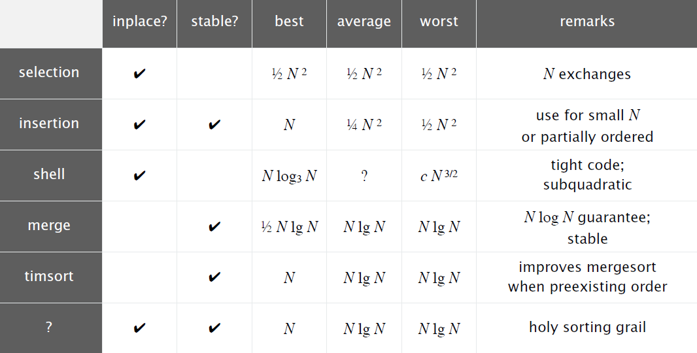
Summary so far...

Slide 21
QuickSort (1959)
Select a partitioning element, p
Rearrange the array such that
element p is in its final position
what is to the left of p is less than or equal to p
what is to the right of p is greater than or equal to p
Sort the left and right sub-arrays independently by recursion

Slide 22
QuickSort
Divide:
Select any element S[k] of the array to be the pivot
Partition S into two sequences S₁ and S₂, such that
S[k] is relocated to its final position, S[i]
j < i ⇒ S[j] < S[i]
j > i ⇒ S[j] > S[i]
Recur: recursively sort S₁ and S₂
Conquer: trivial
Algorithm quickSort (S, i, j)
Input sequence S; i and j, the upper and lower bound of sorting
Output sequence S sorted from i to j
if j - i > 0
select pivot and move it to S[j]
k ← partition (S, i, j)
quickSort (S₁, i, k-1)
quickSort (S₂ , k+1, j)
k
i

Slide 23
Selecting the Pivot
Fixed element
Right-most
Left-most
Center
Median
Random
Median of 3 (right, left, center)

Slide 24
QuickSort Partition
QuickSort’s partition is performed in place
Scan from ends towards center looking for pairs of elements out of order to be exchanged
It is easy to see that partition takes O(n) time
Algorithm partition (S, i, j)
Input sequence S, with pivot at S[j]; i and j, the upper and lower bound of sorting
Output S with elements rearranged so elements smaller than pivot are to its left & those larger to it right; returns final index of pivot
p ← S[j]
u ← i; v ← j-1
while u < v do
while S[u] < p do
u++
while S[v] > p do
v—
swap (S, u, v)
swap (S, u, j)
return u

Slide 25
QuickSort in Action
3
72
1
5
47
34
20
10
9
23
u
v

Slide 26
QuickSort in Action
3
72
1
5
47
34
20
10
9
23
u
v

Slide 27
QuickSort in Action
3
9
1
5
47
34
20
10
72
23
u
v

Slide 28
QuickSort in Action
3
9
1
5
10
34
20
47
72
23
u
v

Slide 29
QuickSort in Action
3
9
1
5
10
20
34
47
72
23
u
v

Slide 30
QuickSort in Action
3
9
1
5
10
20
23
47
72
34
v
u

Slide 31
QuickSort is not stable
6
8
5
2
7
1
2
3
2
1
2
3
7
8
6
5

Slide 32
QuickSort Analysis
T(n) = n + T(p – 1) + T(n – p)
If pivot always lands in the middle, this yields T(n) ≤ 2T(n/2) + n
Thus, T(n) ∈ Θ(n lg n)
If pivot always lands at the end, we get T(n) = n + T(n – 1)
Here, T(n) ∈ Θ(n²)
Algorithm quickSort (S, i, j)
Input sequence S; i and j,
the upper and lower bound of sorting
Output sequence S sorted from i to j
if j - i > 0
select pivot and move it to S[j]
p ← partition (S, i, j)
quickSort (S₁, i, p-1)
quickSort (S₂ , p+1, j)
Best case: Θ(n lg n)
Worst case: Θ(n²)

Slide 33
Average Case Analysis
It turns out, as we will now prove, that QuickSort’s average time complexity is Θ(n log n)
Warning: this derivation is long and complicated—now may be a good time for a nap…
Z Z Z Z

Slide 34
Average Case Analysis
It is reasonable to assume that the pivot has equal probability (1/n) to land in each of the n possible positions.
Since we can simplify:

Slide 35
Average Case Analysis
Multiply by n
Substitute (n – 1) for n
Subtract last two equations
$$nT_{a}(n)−(n−1)T_{a}(n−1)=n^{2}−(n−1)^{2}+2T_{a}(n−1)$$
Simplify

Slide 36
Average Case Analysis
Divide by n(n+1)
Drop small term, creating inequality
Define F(n) = T_{a}(n)/(n+1) and substitute

Slide 37
Average Case Analysis
Expand
Expand completely into a sum
Remember that F(n) = T_{a}(n)/(n+1), so
WAKE
UP!!

Slide 38
For more information...
This was a very fast overview/review of these two sorting algorithms
Sections 2.2 & 2.3 are a treasure trove of good, solid reasoning about mergesort and quicksort variations and tweaks: definitely worthwhile reading!

