Slide 1
Hashing in Java
COMP 2100
Otterbein University
Notes:
No Day22 (review), Day23 (exam), or Day24 (Project 2 reset/discussion)

Slide 2
Alerts
Immutable Deadlines:
Lab 6 due next Thursday, 10/27
Project 2 due next Monday, 10/24
Homework #6 available today

Slide 3
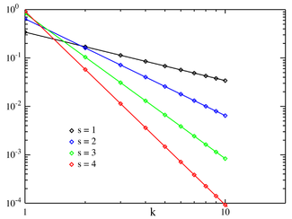
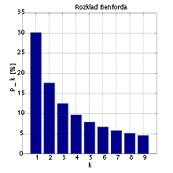
Perfect Hashing
More challenges to hashing
Data Bias
Benford’s Law
Zipf’s Law
Human Names
Hashing non-numeric data
Strings
Date/Time
Double
User-defined objects

Slide 4
Java Hash Codes
Every class in Java inherits the method hashCode() from the Object class
This method returns a 32-bit int
Java requires the following assertion to hold
if x.equals(y) then x.hashCode() == y.hashCode()
Java does not require the following assertion to hold, but it is highly encouraged
if !x.equals(y) then x.hashCode() != y.hashCode()
By default (if unimplemented by a class or a class’s ancestors) the hash value of an object is its memory address.
Java does provide implementations for most standard types...

Slide 5
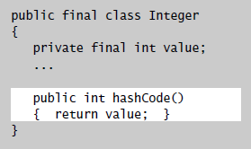
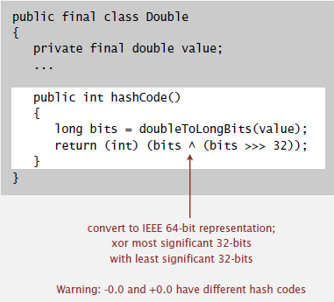
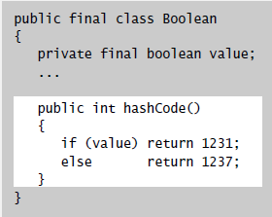
Java hashCode()

Slide 6
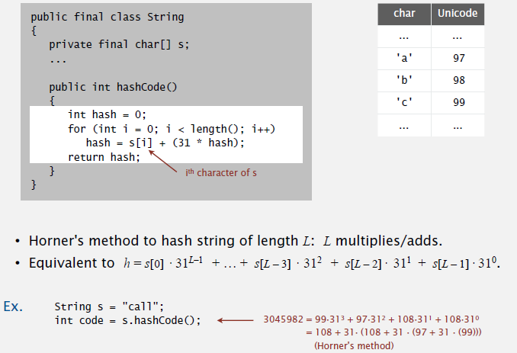
Java hashCode()

Slide 7
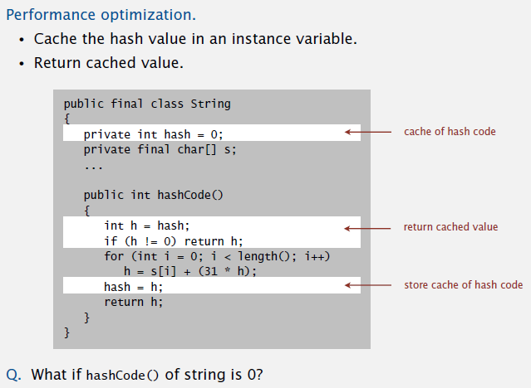
Java hashCode()

Slide 8
Hash Code Design
“Standard” recipe for user-defined types
Combine each significant field using the 31x+y rule.
If a field is a primitive type, use wrapper class hashCode()
If field is null, return 0
If field is a reference type, use its hashCode()
This applies recursively
If field is an array, apply to each entry
Or use Arrays.deepHashCode()
In practice, this works reasonably well
There are alternative “universal” hash functions that work on bitstrings.
Using all the bits of the key matter
Consult an expert for state-of-the-art hash code functions

Slide 9
Modular Hashing
Hash code: an int between ${−2}^{31}$ and $2^{31}−1$
Hash function: an int between 0 and M – 1
Symbol Table being stored in an array of size M

Slide 10
Uniform Hashing Assumption
Uniform Hashing Assumption: each key is equally likely to hash to an integer between 0 and M – 1
Bins and Balls: Throw balls uniformly at random into M bins
Birthday paradox: Probabilistically, we expect two balls two land in the same bin after $\sim \sqrt{\frac{πM}{2}}$ tosses
When M = 365 this gives 23.9
We expect every bin to have $≥1$ ball after $∼M\ln{M}$ tosses
After M tosses, we expect the most number of balls in a bin to be
$$Θ\left(\frac{\log{M}}{\log{\log{M}}}\right)$$
As a result, unless there is a ridiculous (quadratic) quantity of memory available it is impossible to avoid collisions!

Slide 11
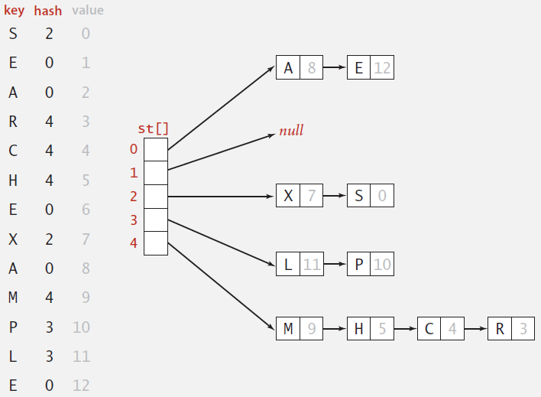
Separate-Chaining
Instead of a simple array of M key/value pairs, use an array of M linked lists [H.P. Luhn, IBM 1953]
Hash: map key to index, as before
Insert: insert key/value pair at front of list located at index
Search: perform sequential search on one linked list

Slide 12
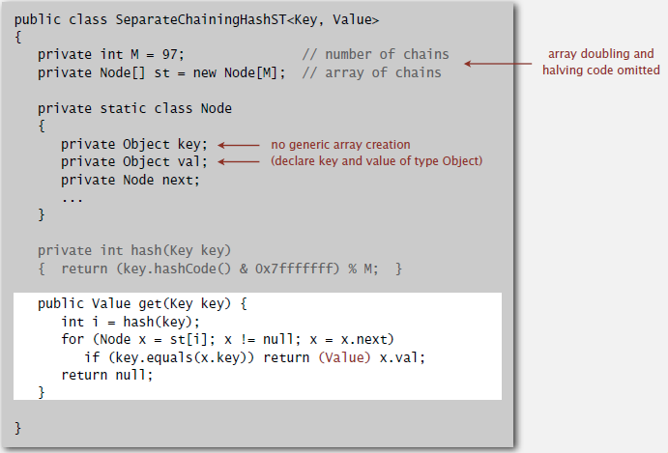
Java Implementation

Slide 13
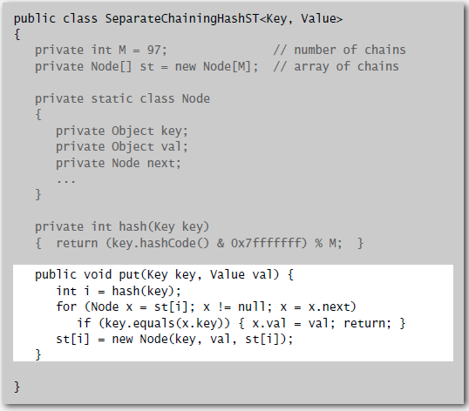
Java Implementation

Slide 14
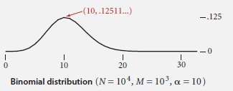
Analysis: Separate-Chaining
Under uniform hashing assumption, the probability that the number of keys in a list is within a constant factor of N/M is extremely close to 1
So the number of times hash() and equals() are called for searches and insertions is proportional to N/M
If M is too large, there will be many empty lists
If M is too small, there will be very long lists
A typical choice to balance these effects is M roughly equal to N/4
If over time it becomes apparent that M is too small, the hash table can be resized with a larger M. All keys would have to be re-hashed.

Slide 15
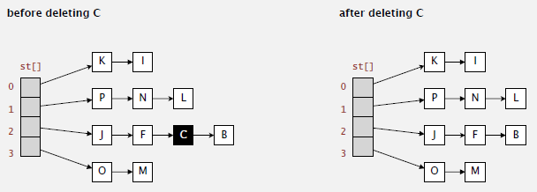
Deletion
How would we perform a deletion in a hash table?
It turns out to be fairly easy
Hash to get the index and then delete from the list

Slide 16
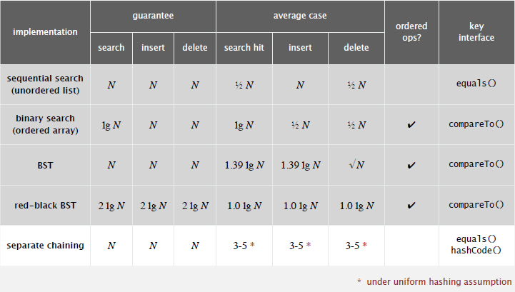
Compare Results

