Slide 1
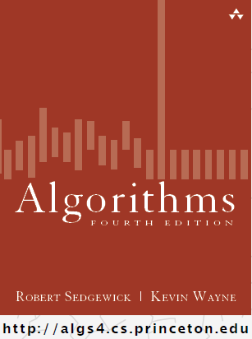
Hashing Introduction
COMP 2100
Otterbein University
Notes:
No Day22 (review), Day23 (exam), or Day24 (Project 2 reset/discussion)

Slide 2
Alerts
Return Midterm
Project 2 due Friday
Lab 6 due next Thursday, 10/27

Slide 3
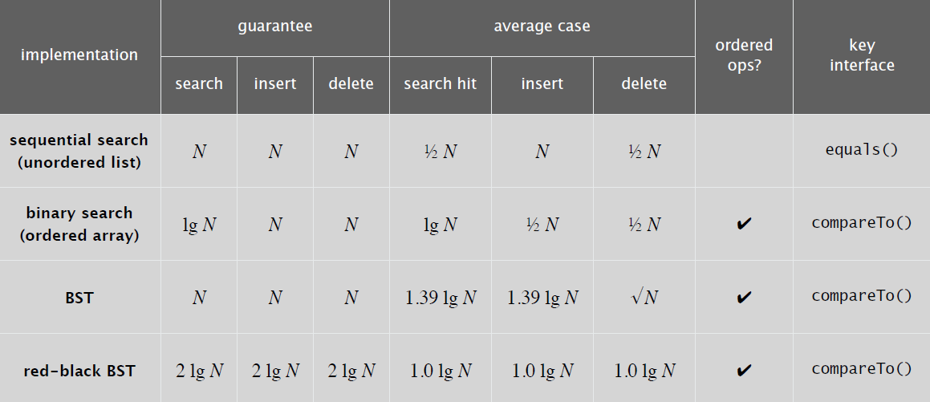
Motivation
Why did we introduce trees?
In particular, Binary Search Trees?
Performance efficiency for Symbol Tables!
All ST operations guaranteed O(lg N) time
They also are much more interesting data structures!!
Recall:
Can we do better?
Of course! But at a cost...

Slide 4
Strategy
What if an item’s key encoded its location within the ST?
Example: Student IDs in a BIG ARRAY?
How many digits are in your Student ID? Or SSN?
This determines the size of the key-space
Create an array that is this size:
Complexity: O(1) for all operations!!! Wow!
But, what’s the catch?
Principle: If the key-space is very large compared to N (expected number of items), the table will be sparsely populated (i.e., mostly empty)
Hashing: If the table (index-space) is smaller than the key-space, we will need to map keys to indices
A hash function is a method for computing an index from a key

Slide 5
Issues
Devising a good hash function is challenging!
We’ll consider that today
Collisions: when two different keys hash to the same index, this is called a collision
There are several methods for dealing with this
We’ll consider those later this week
Space-time Tradeoffs
Minimize collisions without wasting space
Unlimited space: use key as index in sparse table
Unlimited time: use sequential search to resolve collisions
Balance: the art of good hashing

Slide 6
Perfect Hashing
In the real world, is a myth... ☹
Idealistic goal: scramble the keys uniformly to produce an index to the table
Computationally efficient
Each index is equally likely to be produced
Both of these goals are elusive in practice, so we’ll rely on experts
Example: phone numbers
Key-space?
Assume database of 1,000 numbers
3-digit indices
First proposal: key = first three digits
Terrible idea: that’s the area code
Better proposal: key = last three digits
Example: social security numbers
Unless you know in advance the complete set of keys that will be used, and have the time to pre-compute a perfect hash.

Slide 7
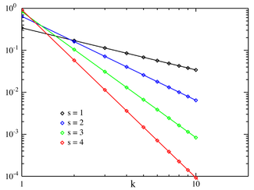
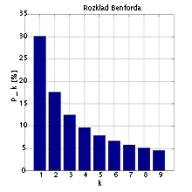
Perfect Hashing
More challenges to hashing
Data Bias
Benford’s Law
Zipf’s Law
Human Names
Hashing non-numeric data
Strings
Date/Time
Double
User-defined objects

Slide 8
Java Hash Codes
Every class in Java inherits the method hashCode() from the Object class
This method returns a 32-bit int
Java requires the following assertion to hold
if x.equals(y) then x.hashCode() == y.hashCode()
Java does not require the following assertion to hold, but it is highly encouraged
if !x.equals(y) then x.hashCode() != y.hashCode()
By default (if unimplemented by a class or a class’s ancestors) the hash value of an object is its memory address.
Java does provide implementations for most standard types...

Slide 9
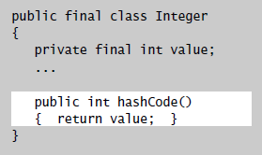
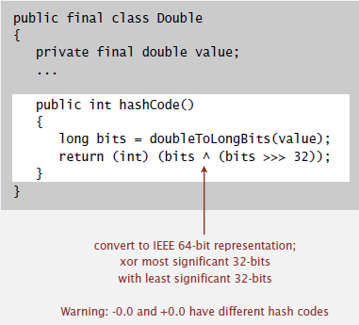
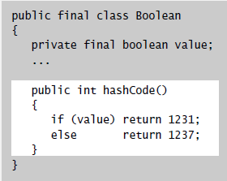
Java hashCode()

Slide 10
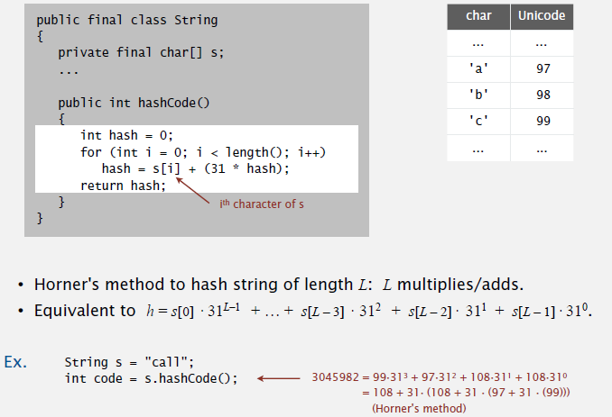
Java hashCode()

Slide 11
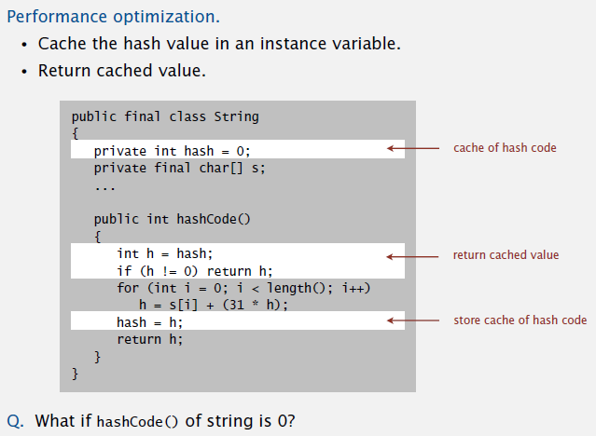
Java hashCode()

Slide 12
Hash Code Design
“Standard” recipe for user-defined types
Combine each significant field using the 31x+y rule.
If a field is a primitive type, use wrapper class hashCode()
If field is null, return 0
If field is a reference type, use its hashCode()
This applies recursively
If field is an array, apply to each entry
Or use Arrays.deepHashCode()
In practice, this works reasonably well
There are alternative “universal” hash functions that work on bitstrings.
Using all the bits of the key matter
Consult an expert for state-of-the-art hash code functions

Slide 13
Modular Hashing
Hash code: an int between ${−2}^{31}$ and $2^{31}−1$
Hash function: an int between 0 and M – 1
Symbol Table being stored in an array of size M

Slide 14
Uniform Hashing Assumption
Uniform Hashins Assumption: each key is equally likely to hash to an integer between 0 and M – 1
Bins and Balls: Throw balls uniformly at random into M bins
Birthday paradox: Probabilistically, we expect two balls two land in the same bin after $\sim \sqrt{\frac{πM}{2}}$ tosses
When M = 365 this gives 23.9
We expect every bin to have $≥1$ ball after $∼M\ln{M}$ tosses
After M tosses, we expect the most number of balls in a bin to be
$$Θ\left(\frac{\log{M}}{\log{\log{M}}}\right)$$

