Slide 1
Red-Black Trees
COMP 2100
Otterbein University

Slide 2
Alerts
Read 3.3
Midterm next Friday (10/14)
Will cover 1.1-1.5 and 3.1-3.3
HW 5: due today
Project 2: Friday, in two weeks (10/21)
Lab 6 due after Project 2

Slide 3
2-3 Tree: Review
A 2-3 insertion always adds the new key to an existing leaf:
A 2-node becomes a 3-node, or
A 3-node becomes a 4-node and the 4-node is then split by moving its middle element up one level
So the tree only grows in height when the root becomes a 4-node and is split

Slide 4
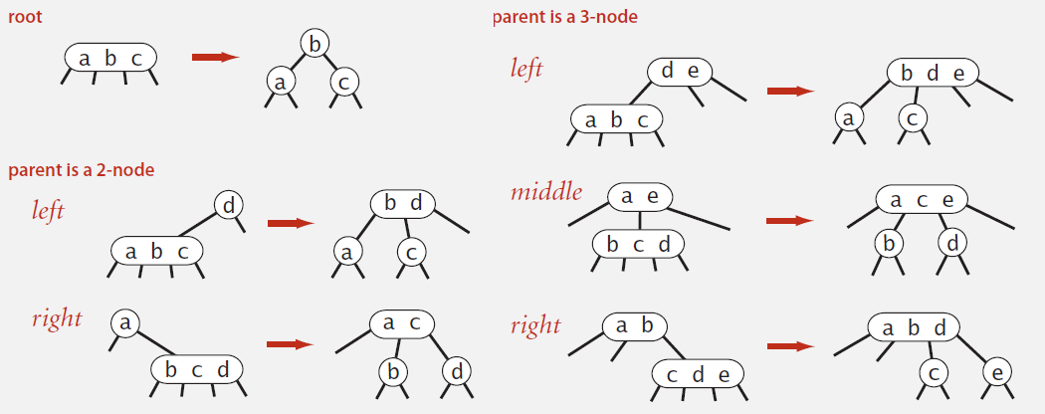
2-3 Tree: Invariants
Symmetric order
Perfect balance

Slide 5
2-3 Tree: Performance
Tree Height
Worst case: $\log_{2}{N}$ (when all nodes are 2-nodes)
Best case: $\log_{3}{N}$ (when all nodes are 3-nodes)
This puts it between 12 and 20 for 1M nodes, and between 18 and 30 for 1B nodes

Slide 6
2-3 Tree: Implementation
Direct implementation is complicated
maintaining multiple node types ☹
multiple compares while navigating ☹
splitting 4-nodes requires upward movement ☹
splitting has too many cases ☹
Could do it, but there is a more clever option...

Slide 7
Interlude
Take a deep breath...
and laugh a little
Abstraction is about to get serious!
Let’s encode A as B
Then we’ll encode B as C
So that when we implement C
We’ll really have A
We ultimately want a binary tree so that the code we already have won’t be obsolete

Slide 8
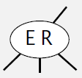
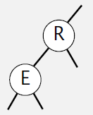
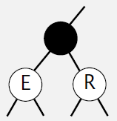
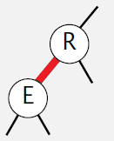
Representing 3-nodes
We could just encode it as a pair of 2-nodes
How to tell a 2-node from a 3-node?
We could add a dummy node
Wastes space
Extra reference
Ugly code
We can color code the links
With some additional rules we can make this work

Slide 9
Red-Black BSTs
A 2-3 Tree will be represented as a Red-Black Binary Search Tree
Red links will always be to left-child (this is an arbitrary choice)

Slide 10
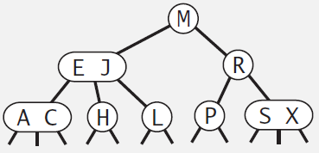
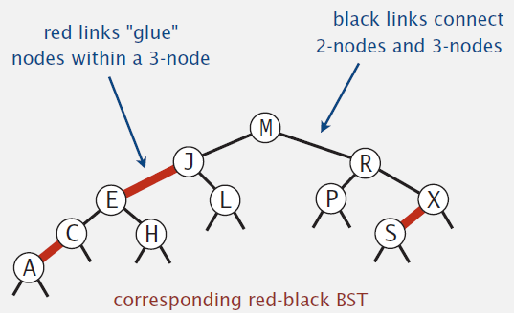
Red-Black Example

Slide 11
Red-Black BSTs Defined
There are several alternative definitions
Sedgewick & Wayne
No node has two red links connected to it
Every path from the root to a null link has the same number of black links (in other words it has ‘perfect black balance’)
Red links always go to left subtree (in fact, it is helpful to think of red links as horizontal rather than down)

Slide 12
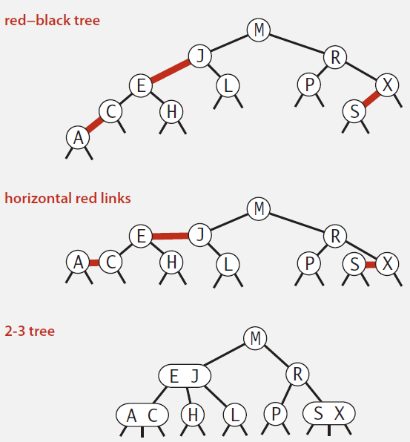
Red-Black BSTs = 2-3 Trees
Each RB BST has an equivalent 2-3 Tree
Each 2-3 Tree has an equivalent RB BST

Slide 13
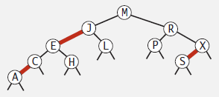
Why?
Remember all the methods we implemented for BSTs?
Most of them were query methods: they didn’t modify the tree, but just answered questions about the tree
Get
Floor
Keys (iterator)
Etc.
None of those methods need to be modified for red-black trees!
public Val get(Key key) {
Node x = root;
while (x != null) {
int cmp = key.compareTo(x.key);
if (cmp < 0) x = x.left;
else if (cmp > 0) x = x.right;
else if (cmp == 0) return x.val;
}
return null;
}

Slide 14
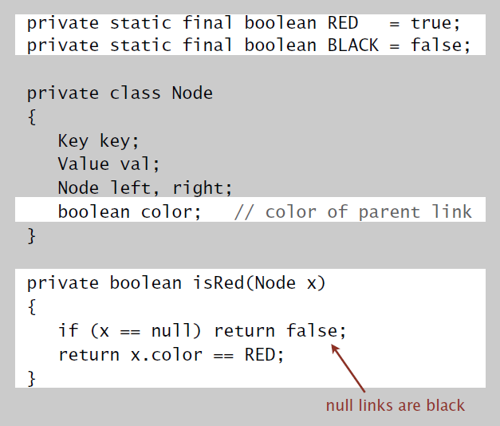
Red-Black BST Nodes
It is standard practice to attach the color of the link to the node it is referencing
A red node is connected to its parent by a red link
A black node is connected to its parent by a black link

Slide 15
Red-Black BST: Insertion
Adding a new node in a 2-3 Tree translates into interesting problems in the red-black representation
Basic strategy: make sure that we preserve:
definition of red-black tree, including perfect black balance
symmetric order
Four anomalous scenarios can arise:
We will get to these in due course...

Slide 16
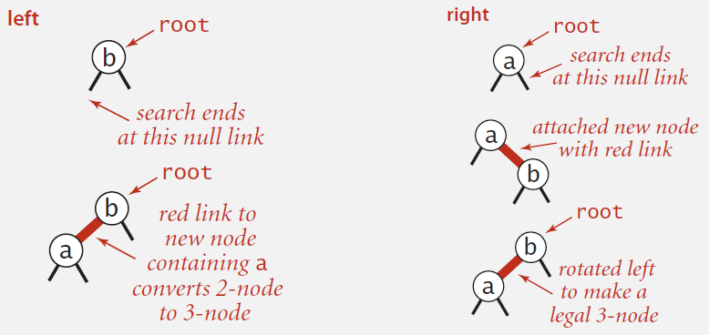
Red-Black BST: Insertion
Warmup 1: insert into tree with a single node

Slide 17
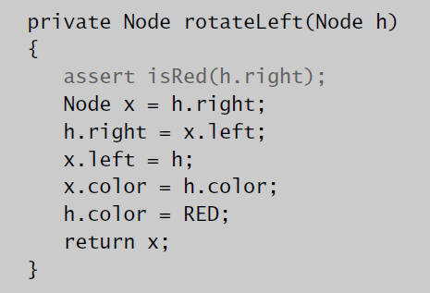
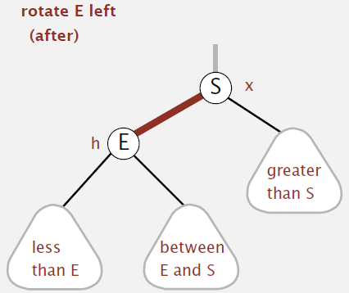
Red-Black BST: Rotations
Invariant: Maintains
symmetric order and
perfect black balance

Slide 18
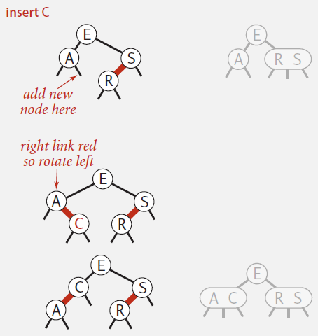
Red-Black BST: Insertion
Case 1: insert into a 2-node leaf
Perform a standard BST insert; color new link red
If new red link is a right link, rotate left

Slide 19
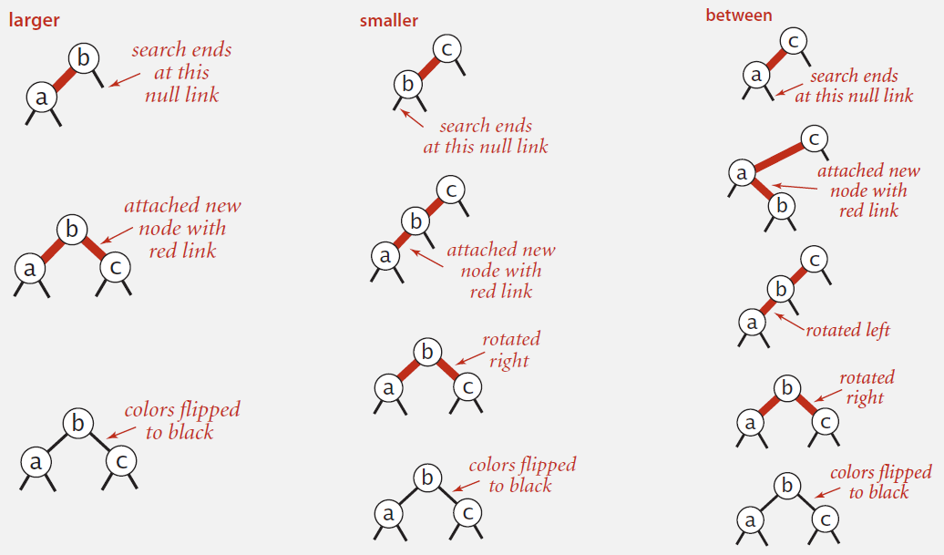
Red-Black BST: Insertion
Warmup 2: insert into tree with exactly 2 nodes

Slide 20
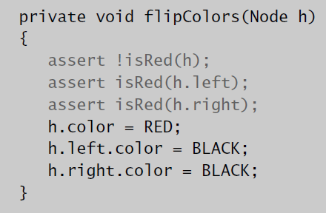
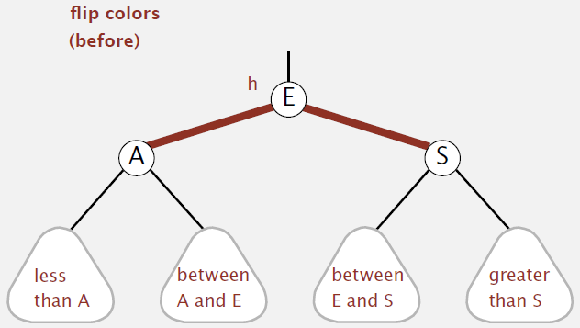
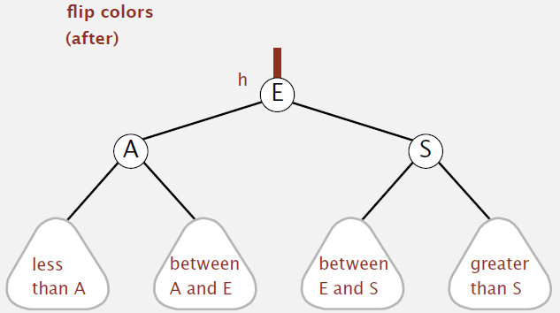
Red-Black BST: Color Flip
Invariant: Maintains
symmetric order and
perfect black balance

Slide 21
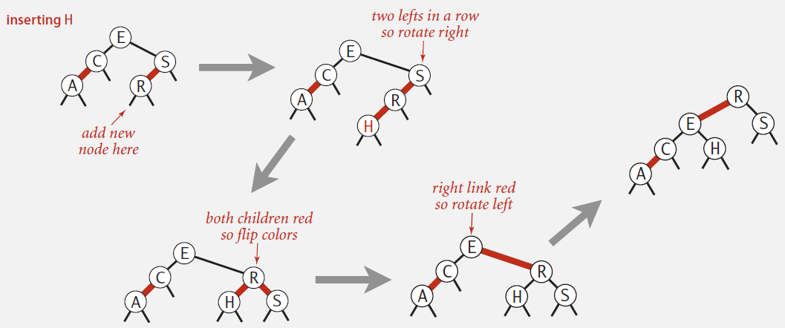
Red-Black BST: Insertion
Case 2: insert into a 3-node leaf
Perform a standard BST insert; color new link red
Rotate to balance the 4-node (if needed)
Flip colors to pass red link up one level
Rotate to make it lean left (if needed)

Slide 22
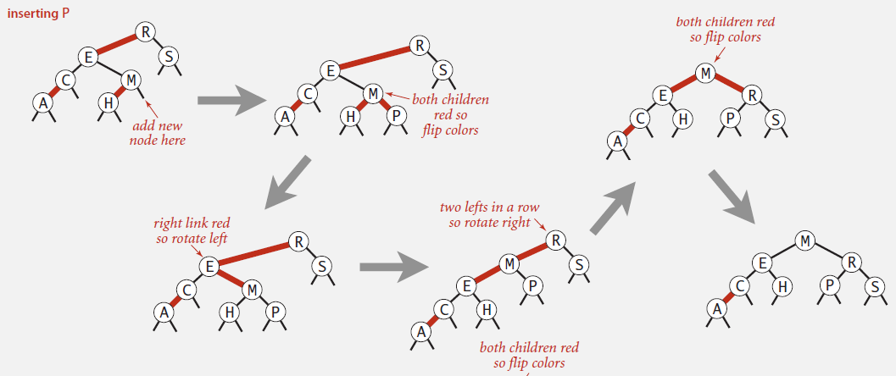
Red-Black BST: Insertion
Case 2: insert into a 3-node leaf
Perform a standard BST insert; color new link red
Rotate to balance the 4-node (if needed)
Flip colors to pass red link up one level
Rotate to make it lean left (if needed)
Repeat Case 1 or Case 2 up the tree (if needed)

