Slide 1
2-3 Search Trees
COMP 2100
Otterbein University

Slide 2
Alerts
Read 3.3
Midterm next Friday (10/14)
Will cover 1.1-1.5 and 3.1-3.3
HW 4: due Friday (10/7)
Project 2: two weeks from Friday (10/21)
Lab 6 released yesterday

Slide 3
AVL-Tree Demo
VS Code
jGrasp animation

Slide 4
Generalizing the BST
What are the two defining characteristics of a BST?
Binary
Ordered
We aren’t willing to give up on the ordered property, otherwise we wouldn’t be able to efficiently search
However, there is no reason that a search tree must be a binary tree

Slide 5
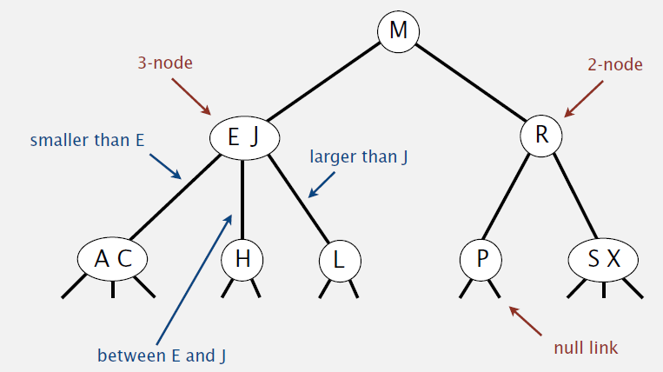
2-3 Tree
Consider a tree in which there is more than one kind of node
2-node: one key, two children (as in a BST)
3-node: two keys, three children
4-node: three keys, four children (only temporarily)
Symmetric order still holds: an in-order traversal would still produce keys in ascending order
Perfect balance: Every path from the root to a leaf would have the same length

Slide 6
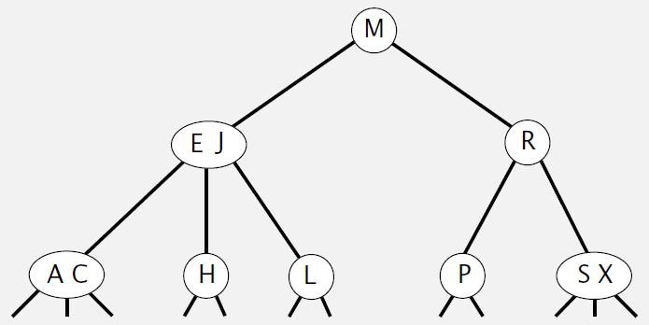
2-3 Tree: Search
Key: H
Key: D

Slide 7
2-3 Tree: Insertion
Adding a key/value pair to a 2-3 tree is more complicated than for a BST
There are several cases to consider:
Insertion to a 2-node leaf
Insertion to 3-node
at the root (i.e., no parent)
with a 2-node parent
with a 3-node parent

Slide 8
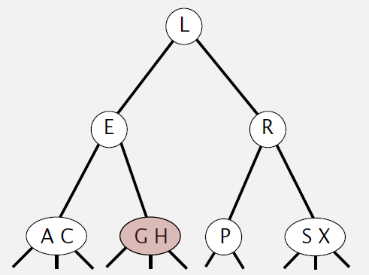
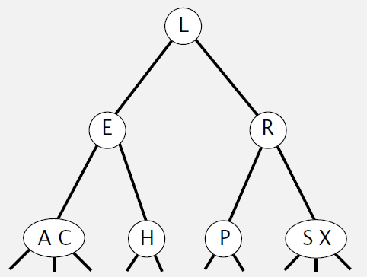
2-3 Tree: Insertion
Insertion to a 2-node leaf
Create a 3-node
Key: G

Slide 9
2-3 Tree: Insertion
Insertion to a 3-node leaf with no parent
Create a 4-node
Split 4-node into three 2-nodes
Key: B

Slide 10
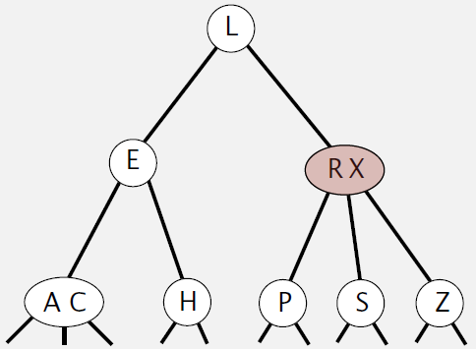
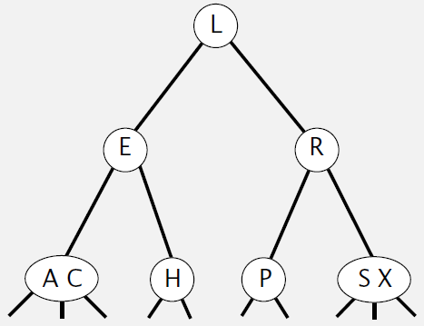
2-3 Tree: Insertion
Insertion to a 3-node leaf w/ 2-node parent
Create a 4-node
move middle key from 4-node to parent
Key: Z
S X Z

Slide 11
2-3 Tree: Construction
White Board Demo
Insert the following letters into an initially empty 2-3 tree
OTTERBEIN UNIVERSITY BEATS CAPITAL

Slide 12
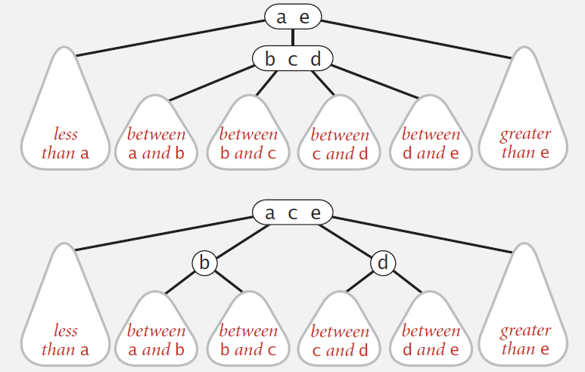
2-3 Tree: Locality
Splitting a 4-node is always a local transformation
there will be a constant number of operations

Slide 13
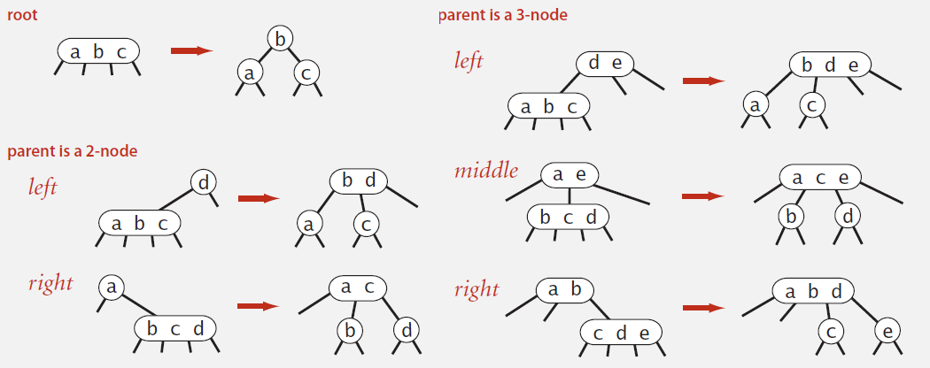
2-3 Tree: Invariants
Symmetric order
Perfect balance

Slide 14
2-3 Tree: Performance
Tree Height
Worst case: $\log_{2}{N}$ (when all nodes are 2-nodes)
Best case: $\log_{3}{N}$ (when all nodes are 3-nodes)
This puts it between 12 and 20 for 1M nodes, and between 18 and 30 for 1B nodes
Wow!

Slide 15
2-3 Tree: Implementation
Direct implementation is complicated
maintaining multiple node types ☹
multiple compares while navigating ☹
splitting 4-nodes requires upward movement ☹
splitting has too many cases ☹
Could do it, but there is a more clever option...

