Slide 1
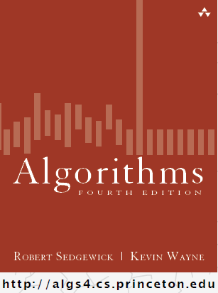
Union-Find
COMP 2100
Otterbein University

Slide 2
Alerts
HW 2 due Friday
Project 1 due Friday!!
Lab 4: How's it going?
Lab 5 won't be available until Tuesday...

Slide 3
Steps to developing an algorithm
Model the problem
Find an algorithm that solves it
Is it fast enough? Does it fit in memory?
If not, figure out why
Find a new way to address the problem
Iterate until happiness
Remember the scientific method?
Remember O() and mathematical analysis?

Slide 4
Dynamic connectivity problem
Given a set of N objects, we want to support two operations
Connect two objects
Determine whether a path exists connecting two objects
connect 4 and 3
connect 3 and 8
connect 6 and 5
connect 9 and 4
connect 2 and 1
are 0 and 7 connected?
are 8 and 9 connected?
connect 5 and 0
0
1
2
3
4
5
6
7
8
9
connect 7 and 2
connect 6 and 1
connect 1 and 0
are 0 and 7 connected?

Slide 5
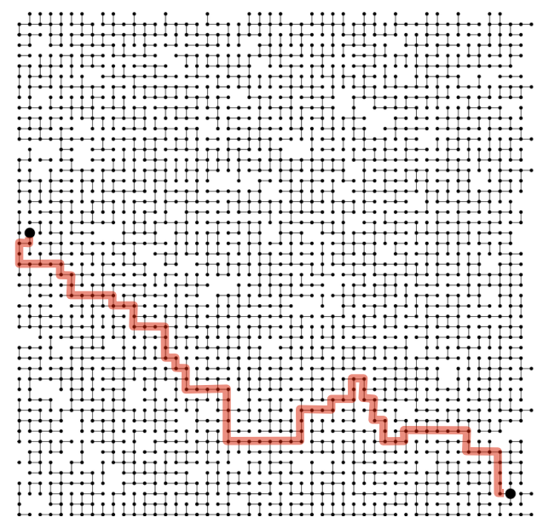
A larger example
Is there a path connecting p and q?
p
q

Slide 6
Applications
When might this type of abstraction be useful?
Pixels in digital photo
Computers in a network
Friends in a social network
Transistors in a computer chip
Elements in a mathematical set
Variable names in a Fortran program
Others?

Slide 7
Modeling
The name for this abstraction is Union-Find
When programming it, it is common to name objects 0 to N-1
These objects names can serve as indices to an array
In chapter 3 we will learn about symbol tables that can be used as a data structure for translating from objects to integer names
We want a minimal representation that only supports what is necessary for Union-Find

Slide 8
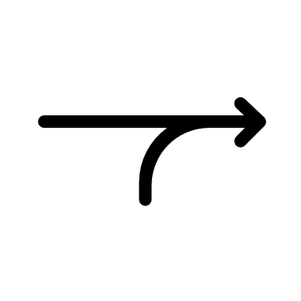
More Modeling
"Is connected to" is an equivalence relation
What does that mean?
I will use to mean "is connected to"
Reflexive: p p
Symmetric: if p q then q p
Transitive: if p q and q s then p s
A connected component is a maximal set of objects that are all mutually connected

Slide 9
Union-Find Data Type
Operations
Find: which component is p in?
Connected: are p and q in the same component?
Union: merge the components that p and q each belong to into a single connected component

Slide 10
Approach I: Quick-Find
Data Structure: integer array id[] of length N
Interpretation: id[p] contains the name of the representative element of the component containing p
What does that mean?
0, 1, and 8 are the elements representing each of the three components

Slide 11
Approach I: Quick-Find Implementation
Find(p): what would this look like?
return id[p]
Connected(p, q)?
return Find(p) == Find(q)
Union(p, q)?
iterate over array and change all entries that contain id[p] to id[q]

Slide 12
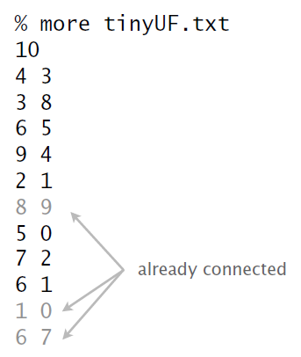
Demo I

Slide 13
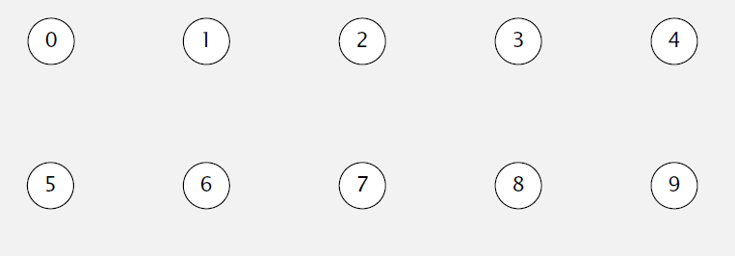
Demo I
id[]
0 | 1 | 2 | 3 | 4 | 5 | 6 | 7 | 8 | 9
0 | 1 | 2 | 3 | 4 | 5 | 6 | 7 | 8 | 9
union (4, 3)

Slide 14
Demo I
id[]
0 | 1 | 2 | 3 | 4 | 5 | 6 | 7 | 8 | 9
0 | 1 | 2 | 3 | 3 | 5 | 6 | 7 | 8 | 9
union (3, 8)

Slide 15
Demo I
id[]
0 | 1 | 2 | 3 | 4 | 5 | 6 | 7 | 8 | 9
0 | 1 | 2 | 8 | 8 | 5 | 6 | 7 | 8 | 9
union (6, 5)

Slide 16
Demo I
id[]
0 | 1 | 2 | 3 | 4 | 5 | 6 | 7 | 8 | 9
0 | 1 | 2 | 8 | 8 | 5 | 5 | 7 | 8 | 9
union (9, 4)

Slide 17
Demo I
id[]
0 | 1 | 2 | 3 | 4 | 5 | 6 | 7 | 8 | 9
0 | 1 | 2 | 8 | 8 | 5 | 5 | 7 | 8 | 8
union (2, 1)

Slide 18
Demo I
id[]
0 | 1 | 2 | 3 | 4 | 5 | 6 | 7 | 8 | 9
0 | 1 | 1 | 8 | 8 | 5 | 5 | 7 | 8 | 8
union (8, 9)

Slide 19
Demo I
id[]
0 | 1 | 2 | 3 | 4 | 5 | 6 | 7 | 8 | 9
0 | 1 | 1 | 8 | 8 | 5 | 5 | 7 | 8 | 8
union (5, 0)

Slide 20
Demo I
id[]
0 | 1 | 2 | 3 | 4 | 5 | 6 | 7 | 8 | 9
0 | 1 | 1 | 8 | 8 | 0 | 0 | 7 | 8 | 8
union (7, 2)

Slide 21
Demo I
id[]
0 | 1 | 2 | 3 | 4 | 5 | 6 | 7 | 8 | 9
0 | 1 | 1 | 8 | 8 | 0 | 0 | 1 | 8 | 8
union (6, 1)

Slide 22
Demo I
id[]
0 | 1 | 2 | 3 | 4 | 5 | 6 | 7 | 8 | 9
1 | 1 | 1 | 8 | 8 | 1 | 1 | 1 | 8 | 8
union (1, 0)

Slide 23
Demo I
id[]
0 | 1 | 2 | 3 | 4 | 5 | 6 | 7 | 8 | 9
1 | 1 | 1 | 8 | 8 | 1 | 1 | 1 | 8 | 8
union (6, 7)

Slide 24
Demo I
id[]
0 | 1 | 2 | 3 | 4 | 5 | 6 | 7 | 8 | 9
1 | 1 | 1 | 8 | 8 | 1 | 1 | 1 | 8 | 8

Slide 25
Quick-Find in Java

Slide 26
Quick-Find: Analysis
Union is too expensive. It takes N² array accesses to process a sequence of N union operations on N objects.
So a billion objects would take 30+ years of CPU time ☹

Slide 27
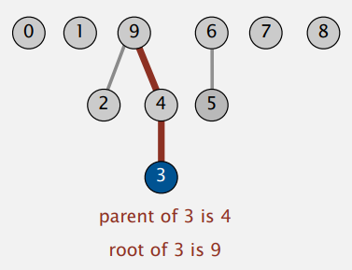
Approach II: Quick-Union
Data Structure: integer array id[] of length N
Interpretation: id[p] is the parent of p
What does that mean?
Each component is a rooted tree with every node in a tree (except the root) having a parent. The root is the representative of the component.

Slide 28
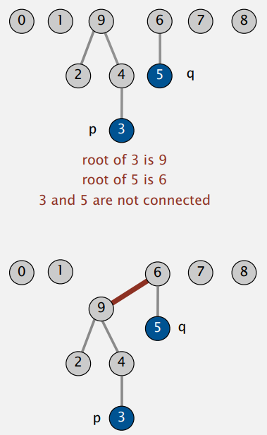
Approach II: Quick-Union Implementation
Find(p): what would this look like?
iterate p = id[p] until p doesn't change
Connected(p, q)?
return find(p) == find(q)
Union(p, q)?
set the id of p's root to the id of q's root

Slide 29
Demo II
id[]
0 | 1 | 2 | 3 | 4 | 5 | 6 | 7 | 8 | 9
0 | 1 | 2 | 3 | 4 | 5 | 6 | 7 | 8 | 9
union (4, 3)

Slide 30
Demo II
id[]
0 | 1 | 2 | 3 | 4 | 5 | 6 | 7 | 8 | 9
0 | 1 | 2 | 3 | 3 | 5 | 6 | 7 | 8 | 9
union (3, 8)

Slide 31
Demo II
id[]
0 | 1 | 2 | 3 | 4 | 5 | 6 | 7 | 8 | 9
0 | 1 | 2 | 8 | 3 | 5 | 6 | 7 | 8 | 9
union (6, 5)

Slide 32
Demo II
id[]
0 | 1 | 2 | 3 | 4 | 5 | 6 | 7 | 8 | 9
0 | 1 | 2 | 8 | 3 | 5 | 5 | 7 | 8 | 9
union (9, 4)

Slide 33
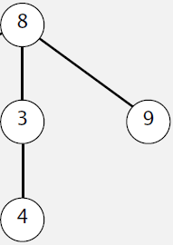
Demo II
id[]
0 | 1 | 2 | 3 | 4 | 5 | 6 | 7 | 8 | 9
0 | 1 | 2 | 8 | 3 | 5 | 5 | 7 | 8 | 8
union (2, 1)

Slide 34
Demo II
id[]
0 | 1 | 2 | 3 | 4 | 5 | 6 | 7 | 8 | 9
0 | 1 | 1 | 8 | 3 | 5 | 5 | 7 | 8 | 8
union (8, 9)

Slide 35
Demo II
id[]
0 | 1 | 2 | 3 | 4 | 5 | 6 | 7 | 8 | 9
0 | 1 | 1 | 8 | 3 | 5 | 5 | 7 | 8 | 8
union (5, 0)

Slide 36
Demo II
id[]
0 | 1 | 2 | 3 | 4 | 5 | 6 | 7 | 8 | 9
0 | 1 | 1 | 8 | 3 | 0 | 5 | 7 | 8 | 8
union (7, 2)

Slide 37
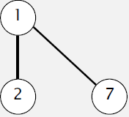
Demo II
id[]
0 | 1 | 2 | 3 | 4 | 5 | 6 | 7 | 8 | 9
0 | 1 | 1 | 8 | 3 | 0 | 5 | 1 | 8 | 8
union (6, 1)

Slide 38
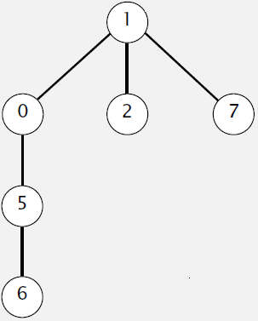
Demo II
id[]
0 | 1 | 2 | 3 | 4 | 5 | 6 | 7 | 8 | 9
1 | 1 | 1 | 8 | 3 | 0 | 5 | 1 | 8 | 8
union (5, 3)

Slide 39
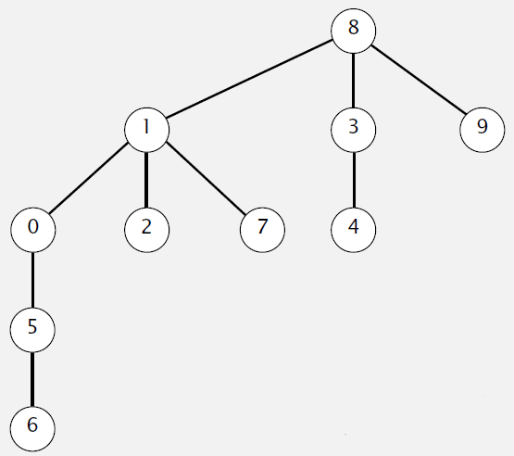
Demo II
id[]
0 | 1 | 2 | 3 | 4 | 5 | 6 | 7 | 8 | 9
1 | 8 | 1 | 8 | 3 | 0 | 5 | 1 | 8 | 8

Slide 40
Quick-Union in Java

Slide 41
Quick-Union: Analysis
Trees can become tall chains. It still takes N² array accesses to process a sequence of N union operations on N objects.

