Slide 1
COMP 2000 Object-Oriented Design
David J Stucki
Otterbein University

Slide 2
ALERTS
Read the rest of The Object-Oriented Thought Process
Read https://www.geeksforgeeks.org/conceptual-model-of-the-unified-modeling-language-uml/ (including the linked pages for each of the diagram types)
Read SmartDraw's documentation and tutorials about UML (including all the 'Learn More' links) at https://www.smartdraw.com/uml-diagram/
Lab 10.2 is available and due next Thursday before 11:59pm
Lab 10.3 will be available next Tuesday and due Friday, April 19 before 11:59pm
Questions?

Slide 3
UML: State Diagrams
Also known as State Machine Diagrams and State Chart Diagrams
What do we mean by State?
Recall that the state of an object is the value of all of its instance variables at some point in time.
However, programs will algorithmically change the state of objects as time passes (using assignment statements)
So a State Diagram models how the state of one or more objects evolves over time
It also captures information about the events that cause these state transitions

Slide 4
UML: State Diagrams
Notation
Start state
Final state
Transitions
States
States are given names that communicate what that state represents in the object's timeline. Transitions are labeled with a description of what triggers the transition.

Slide 5
UML: State Diagram Example

Slide 6
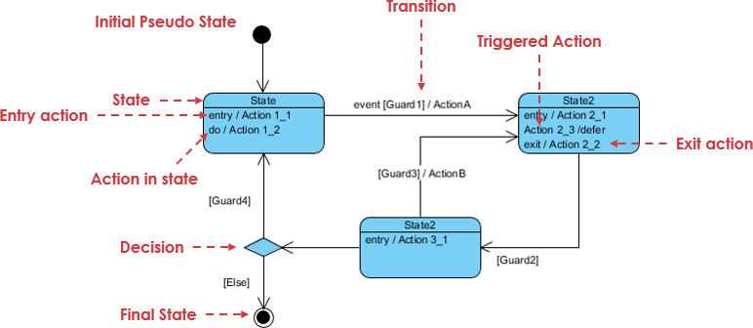
UML: More State Diagram Notations
State Actions
Entry
Internal
Exit
Decisions
Guards

Slide 7
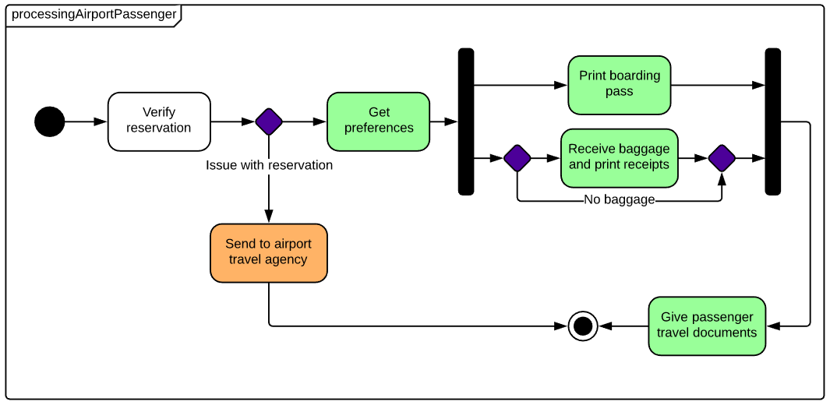
UML: More State Diagram Notations
Concurrent States
Fork
Join

Slide 8
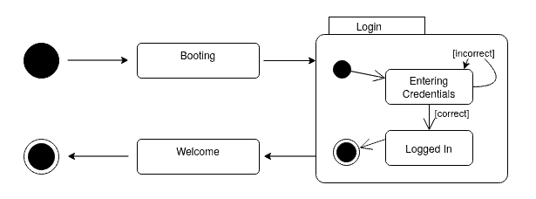
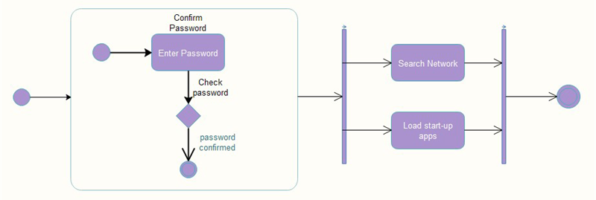
UML: More State Diagram Notations
Composite States
Self-transitions

Slide 9
UML: State Diagram Example

Slide 10
3 basic building blocks of UML – Diagrams
A connected graph: Vertices are things; Arcs are relationships/behaviors.
UML 1.x: 9 diagram types.
UML 2.0: 12 diagram types
Structural Diagrams
Represent the static aspects of a system.
Class;
Object
Component
Deployment
Structural Diagrams
Class;
Object
Component
Deployment
Composite Structure
Package
Behavioral Diagrams
Represent the dynamic aspects.
Use case
Sequence;
Collaboration
Statechart
Activity
Behavioral Diagrams
Use case
Statechart
Activity
Interaction Diagrams
Sequence;
Communication
Interaction Overview
Timing

Slide 11
Summary and Tools
UML is a modeling language that can be used independent of development
Adopted by OMG and notation of choice for visual modeling
http://www.omg.org/uml/
Creating and modifying UML diagrams can be labor and time intensive.
Lots of tools exist to help
See http://plg.uwaterloo.ca/~migod/uml.html for a list of tools, some free

Slide 12
Next Time...
Refactoring

