Slide 1
COMP 2000 Object-Oriented Design
David J Stucki
Otterbein University

Slide 2
ALERTS
Read https://www.geeksforgeeks.org/conceptual-model-of-the-unified-modeling-language-uml/ (including the linked pages for each of the diagram types)
Read SmartDraw's documentation and tutorials about UML (including all the 'Learn More' links) at https://www.smartdraw.com/uml-diagram/
Lab 10.1 is due tomorrow before 11:59pm
Lab 10.2 will be available Friday morning and due next Thursday before 11:59pm
Lab 10.3 will be available next Tuesday and due Friday, April 19 before 11:59pm
Questions?

Slide 3
UML: Object Diagrams
Derived from Class Diagrams
Not surprising since objects are derived from classes
Static vs. Dynamic Design
Static design describes code structure and state references between classes
Class relations
Doesn't change with time, or take time into account
Dynamic design shows communication between objects
Can follow sequences of events
May vary based on execution scenario (use case)
Class Diagrams
Object Diagrams

Slide 4
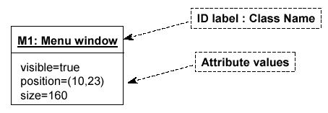
UML: Object Diagrams
Format
Two sections (rather than three)
Instance name: Class name
Attributes & Values
Association type and message type can be added

Slide 5
UML: Object Diagram Example
Class diagram → Object diagram

Slide 6
UML: Object Diagram Example
Class diagram → Object diagram

Slide 7
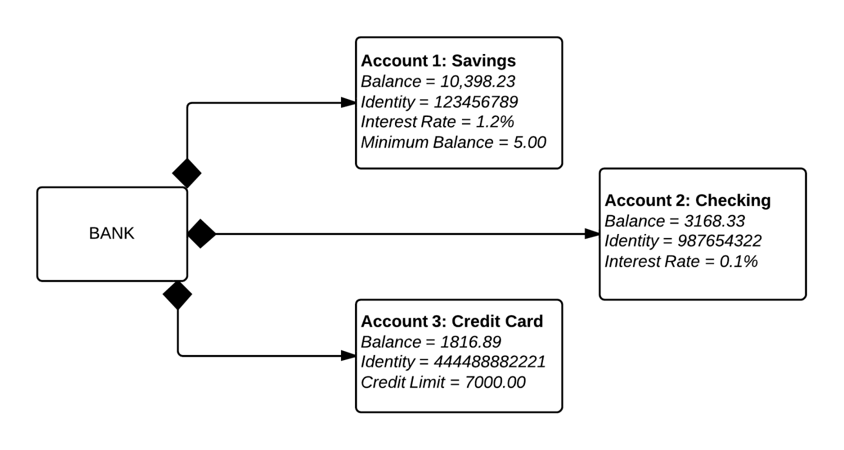
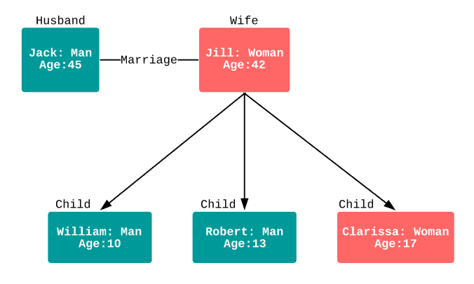
UML: Object Diagram Examples

Slide 8
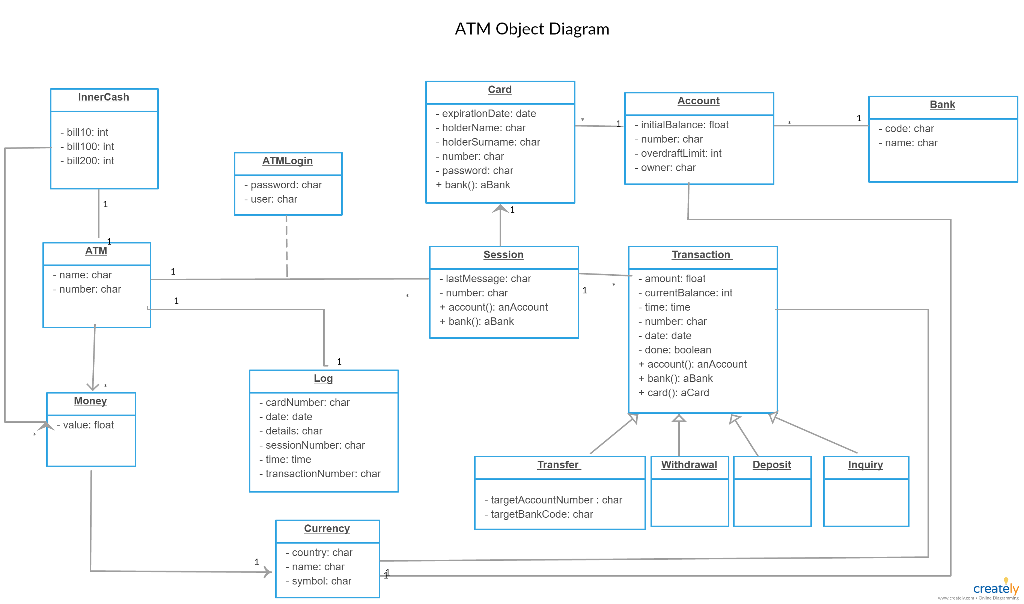
UML: Object Diagram Example

Slide 9
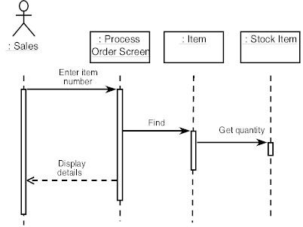
UML: Sequence Diagrams
Describes the collaboration or interactions of objects over time
Indicates what messages are sent and when
Time progresses from top to bottom
Objects involved are listed left to right
Messages are sent left to right between objects in sequence
Actor from
Use Case
Objects
1
Activation
2
3
4
Lifeline
Calls = Solid Lines
Returns = Dashed Lines

Slide 10
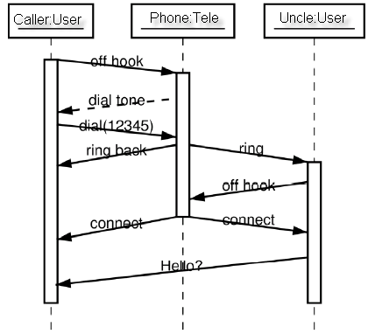
UML: Sequence Diagram Examples
Shows
Construction
of b
Shows
Destruction
of b
Slanted Lines show propagation delay of messages
Good for modeling real-time systems

Slide 11
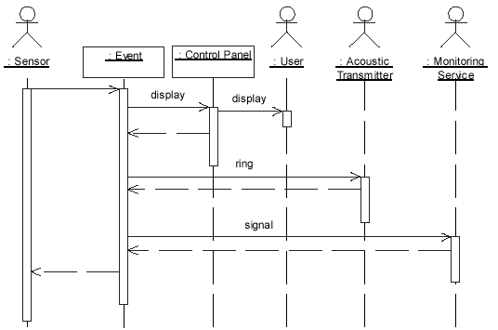
UML: Alarm System Sequence Diagram
When the alarm goes off, it rings the alarm, puts a message on the display, notifies the monitoring service

Slide 12
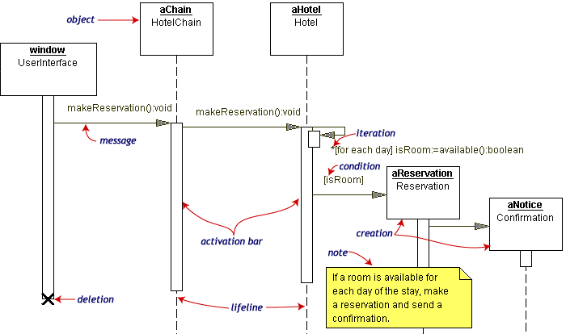
UML: Hotel Reservation Sequence Diagram

Slide 13
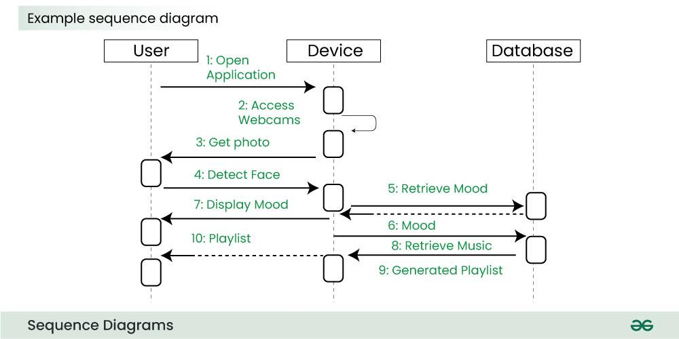
UML: Sequence Diagram Example

Slide 14
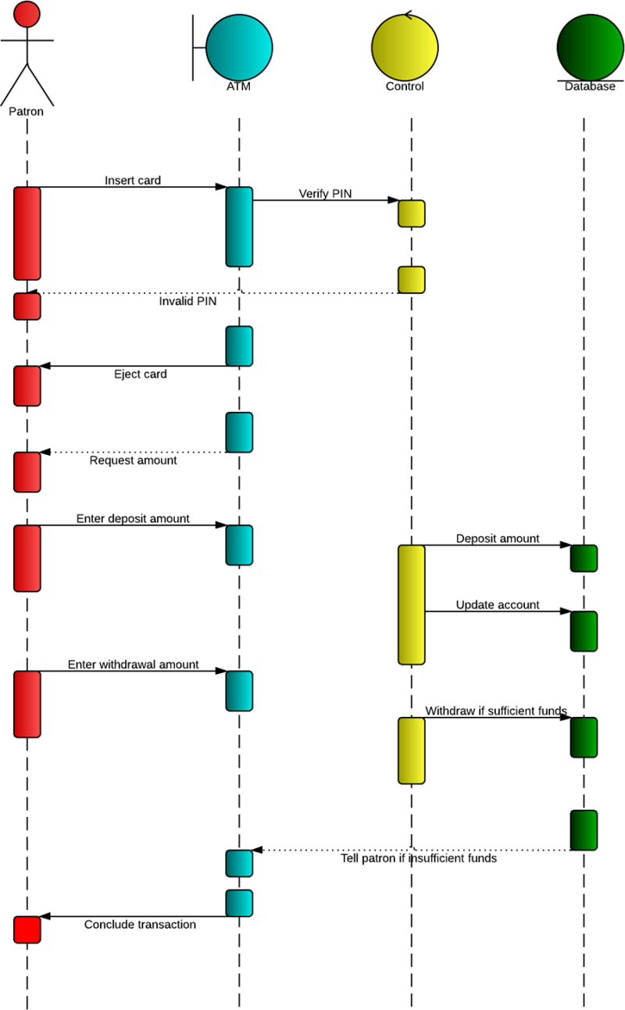
UML: ATM Sequence Diagram

Slide 15
Next Time...
Finish UML

