Slide 1

COMP 2000 Object-Oriented Design
David J Stucki
Otterbein University

Slide 2
ALERTS
  Read SmartDraw's documentation and tutorials about UML (including all the 'Learn More' links) at https://www.smartdraw.com/uml-diagram/
  Read Chapter 10 from The Object-Oriented Thought Process
  Lab 10.1 is due Thursday before 11:59pm
  Lab 10.2 will be available Friday morning
  Questions?

Slide 3
What is UML?
Unified Modeling Language
  OMG Standard, Object Management Group
  Based on work from Booch, Rumbaugh, Jacobson
UML is a modeling language to express and design documents, software
  Particularly useful for OO design
  Not a process, but some have been proposed using UML
  Independent of implementation language

Slide 4
Why use UML
Open Standard, Graphical notation for
  Specifying, visualizing, constructing, and documenting software systems
UML can be used from general initial design to very specific detailed design across the entire software development lifecycle
Increase understanding/communication of product to customers and developers
Support for diverse application areas
Support for UML in many software packages today (e.g. Rational, plugins for popular IDE’s like NetBeans, Eclipse)
Based upon experience and needs of the user community

Slide 5
Brief History
Inundated with methodologies in early 90’s
  Booch, Jacobson, Yourden, Rumbaugh
Booch, Jacobson merged methods 1994
Rumbaugh joined 1995
1997 UML 1.1 from OMG includes input from others, e.g. Yourden
UML v2.5.1 current version (December 2017)

Slide 6
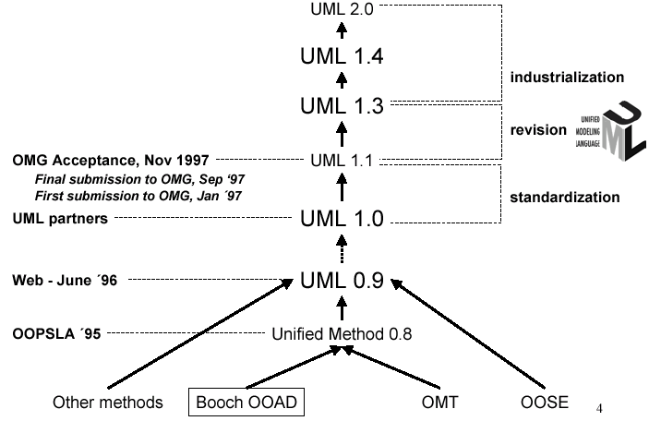
History of UML

Slide 7
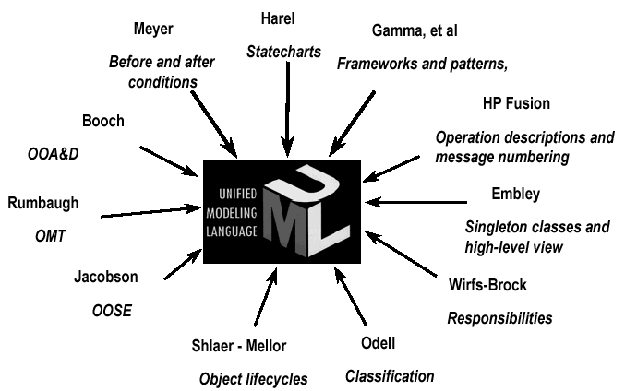
Contributions to UML

Slide 8
Systems, Models and Views
A model is an abstraction describing a subset of a system
A view depicts selected aspects of a model
A notation is a set of graphical or textual rules for depicting views
Views and models of a single system may overlap each other
Examples:
System: Aircraft
Models: Flight simulator, scale model
Views: All blueprints, electrical wiring, fuel system

Slide 9
Systems, Models and Views
Flightsimulator
Blueprints
Aircraft
Electrical
Wiring
Scale Model

Slide 10
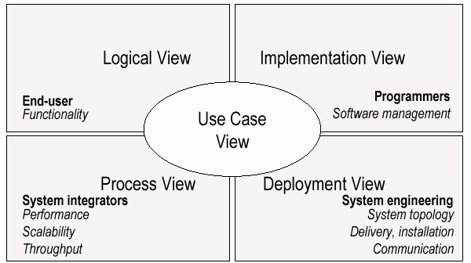
UML Models, Views, Diagrams
UML is a multi-diagrammatic language
  Each diagram is a view into a model
    Diagram presented from the aspect of a particular stakeholder
    Provides a partial representation of the system
    Is semantically consistent with other views

Slide 11
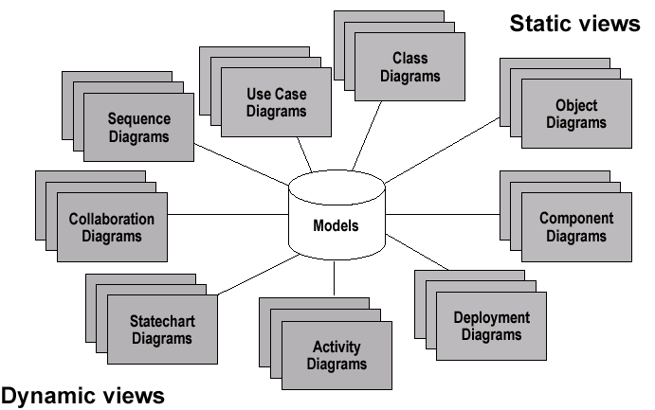
Models, Views, Diagrams

Slide 12
Three (3) basic building blocks of UML
  Things - important modeling concepts
  Relationships - tying individual things
  Diagrams - grouping interrelated collections
  of things and relationships
Just glance thru
for now
Water
have
Fresh water
Rivers
Oceans
have
have
live in
Salt water
have
Fish
have
Crocodiles
Penguins

Slide 13
3 basic building blocks of UML - Things
UML 1.x
  Structural — nouns/static of UML models (irrespective of time)
  conceptual or physical elements
    Class, Active Class, Component, Interface, Node, Use Case, Collaboration
  Behavioral — verbs/dynamic parts of UML models ('behavior over time')
  usually connected to structural things
    Interaction, State Machine

Slide 14
3 basic building blocks of UML - Relationships
1. Associations
Structural relationship that describes a set of links, a link being a connection between objects.
2. Generalization
a specialized element (the child) is more specific the generalized element.
3. Realization
one element guarantees to carry out what is expected by the other element.
4. Dependency
a change to one thing (independent) may affect the semantics of the other thing (dependent).
Student
attends
University
Student
IGrade
variants: aggregation & composition
Student
Person
harry: Student
<<instanceOf>>
Student
(direction, label are optional)

Slide 15
3 basic building blocks of UML – Diagrams
A connected graph: Vertices are things; Arcs are relationships/behaviors.
UML 1.x: 9 diagram types.
UML 2.0: 12 diagram types
Structural Diagrams
Represent the static aspects of a system.
  Class;
  Object
  Component
  Deployment
Structural Diagrams
  Class;
  Object
  Component
  Deployment
  Composite Structure
  Package
Behavioral Diagrams
Represent the dynamic aspects.
  Use case
  Sequence;
  Collaboration
  Statechart
  Activity
Behavioral Diagrams
  Use case
  Statechart
  Activity
Interaction Diagrams
  Sequence;
  Communication
  Interaction Overview
  Timing

Slide 16
UML: First Pass
You can model 80% of most problems by using about 20% of UML
We only cover the 20% here

Slide 17
Diagrams in UML
Otterbein wants to computerize its registration system
The Registrar sets up the curriculum for a semester
Students select 3 core courses and 2 electives
Once a student registers for a semester, the billing system is notified so the student may be billed for the semester
Students may use the system to add/drop courses for a period of time after registration
Professors use the system to set their preferred course offerings and receive their course offering rosters after students register
Users of the registration system are assigned passwords which are used at logon validation
What’s most important?

Slide 18
Diagrams in UML – Actors in Use Case Diagram
An actor is someone or some thing that must interact with the system under development
Otterbein wants to computerize its registration system
The Registrar sets up the curriculum for a semester
Students select 3 core courses and 2 electives
Once a student registers for a semester, the billing system is notified so the student may be billed for the semester
Students may use the system to add/drop courses for a period of time after registration
Professors use the system to set their preferred course offerings and receive their course offering rosters after students register
Users of the registration system are assigned passwords which are used at logon validation
Registrar
Student
Billing System
Professor

Slide 19
Diagrams in UML – Use Cases in Use Case Diagram
A use case is a sequence of interactions between an actor and the system under development
Maintain
Curriculum
Register
for Courses
Otterbein wants to computerize its registration system
The Registrar sets up the curriculum for a semester
Students select 3 core courses and 2 electives
Once a student registers for a semester, the billing system is notified so the student may be billed for the semester
Students may use the system to add/drop courses for a period of time after registration
Professors use the system to set their preferred course offerings and receive their course offering rosters after students register
Users of the registration system are assigned passwords which are used at logon validation
Registrar
Student
Billing System
Request
Course Roster
Set
Course Offerings
Professor

Slide 20
Use Cases are useful for…
Determining requirements
  New use cases often generate new requirements as the system is analyzed and the design takes shape.
Communicating with clients
  Their notational simplicity makes use case diagrams a good way for developers to communicate with clients.
Generating test cases
  The collection of scenarios for a use case may suggest a suite of test cases for those scenarios.

Slide 21
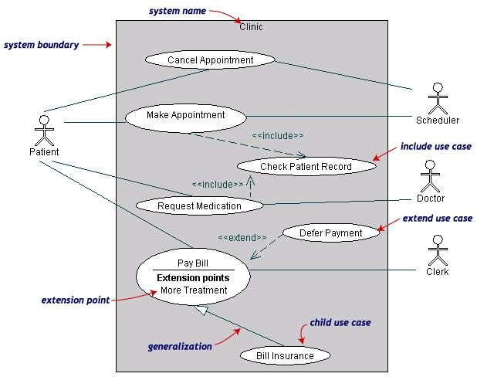
Use Case Diagram Example

Slide 22
Use Case Description: Example
Name: Purchase ticket
Participating actor: Passenger
Entry condition:
Passenger standing in front of ticket kiosk.
Passenger has sufficient money to purchase ticket.
Exit condition:
Passenger has ticket.
Event flow:
1. Passenger selects the destination of travel.
2. Kiosk displays the amount due.
3. Passenger inserts money, of at least the amount due.
4. Kiosk returns change.
5. Kiosk issues ticket.

Slide 23
Use Case Diagrams: Summary
Use case diagrams represent external behavior
Use case diagrams are useful as an index into the use cases
Use case descriptions provide meat of model, not the use case diagrams.
All use cases need to be described for the model to be useful.

Slide 24
Next Time...
More UML

