Slide 1
COMP 2000 Object-Oriented Design
David J Stucki
Otterbein University

Slide 2
ALERTS
Read Head First Design Patterns, Chapters 7 & Appendix A
Lab 9 tomorrow, due Thursday before 11:59pm
Lab 10: is available
should read assignment right away and start thinking about it
you will have time Thursday to work on this, provided you make good progress on lab 9 tomorrow
Questions?

Slide 3
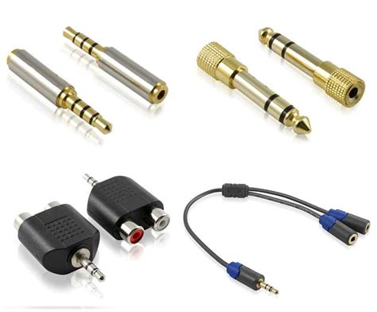
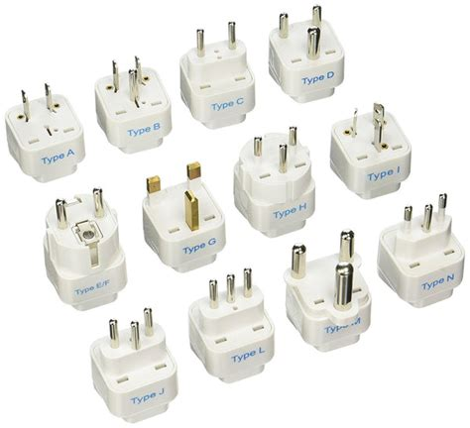
Adapter: Another Structural Pattern
What is an adapter?
Why do we need it?
How could that be a design pattern?
When we have code that expects to interact via a certain interface, but the api had changed and there is a new interface.
Rather than recode our system, or modify the new api, we can create adapters that externally have the expected interface, but internally call the new api.
This allows the existing code to work without ever knowing that the api changed.

Slide 4
Adapter: Class Diagram

Slide 5
Adapter: Example
Before Java 2, which is when Iterator was introduced, there was an interface called Enumeration
There is still legacy code that uses Enumerations, and occasionally you might call a method from the JCF or standard libraries that returns a reference to an Enumeration object.
Wouldn't it be nice if you could use the modern for loop on these? Well, you can't.
Unless, that is, you use an adapter to make the Enumeration look like an Iterator...
https://docs.oracle.com/en/java/javase/17/docs/api/java.base/java/util/Enumeration.html
Coding demo...

Slide 6
Flyweight: Another Structural Pattern
That's a strange name, what does it mean?
A flyweight is a boxer who participates in the lighest weight category
As a design pattern, flyweight addresses memory issues in applications with lots of similar objects
If there are a large number of instances of a class (like Asteroid?) that mostly have identical state, but which only differ in small and specific ways, it is wasteful to allocated memory for all of the state they have in common.
The flyweight allows the shared state (intrinsic) to be represented by a single instance of the class while the differences (extrinsic state) are kept externally in a central location.

Slide 7
Flyweight: Class Diagram
By Vanderjoe - Own work, CC BY-SA 4.0, https://commons.wikimedia.org/w/index.php?curid=62242641

Slide 8
Flyweight: Example
A word processor needs to store lots of characters. Each character might have many properties that details what it looks like and how it is displayed
If there are several thousand upper case A's, and each of them is instantiated as an object, then this will require ridiculous amounts of memory.
Instead, the properties of the character can be instantiated in a flyweight that separates the intrinsic (how it looks) from the extrinsic (where it is), only storing locations individually for each instance in an array that is external to the flyweight object.
Extrinsic data can be passed to methods of the object that need that info.

Slide 9
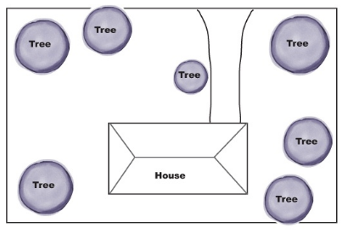
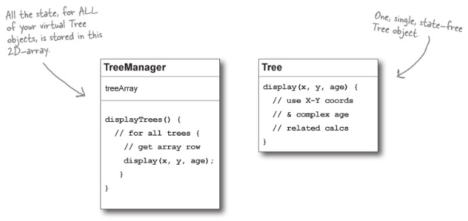
Flyweight: Another Example (from HFDP)
A landscaping application may need to draw a large number of trees on the property.
A single instance of the tree object that knows how to draw a tree.
An extrinsic array of (x,y) coordinate pairs representing the tree locations.
The location of each tree can be passed to a method of the single tree instance in order to draw it.

Slide 10
Next Time...
Wrapping up design patterns

