Slide 1
COMP 2000 Object-Oriented Design
David J Stucki
Otterbein University

Slide 2
ALERTS
Read Head First Design Patterns, Chapters 2-3 & 9
Lab 8: due TODAY before 11:59 pm
Lab 9: due Thursday before 11:59 pm
Lab 10: next week
Questions?

Slide 3
Decorator Pattern
Intent: Attach additional responsibilities or functionality (decorations) to an object dynamically without impacting client code. Provides an alternative to inheritance (via composition) that provides greater flexibility.
AKA: Wrapper
Methodology: A new class is defined that has the same interface as the one being decorated and that contains an instance variable of the decorated type.
New functionality is added to the 'outer' class while access to the old functionality is delegated to the 'inner' object on demand.
This is a Structural Pattern

Slide 4
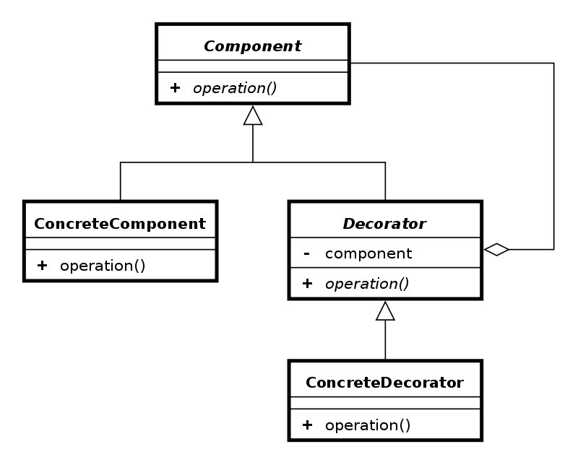
Decorator Class Diagram
The new class can then be used anywhere the original can, and client gets the added value

Slide 5
An Application (with thanks to Rick Mercer)
TextView_Plain
TextView_Fancy
TextView_3D
TextView_Horizontal
TextView_Vertical
TextView_Horizontal_Vertical
TextView_Plain_Horizontal
TextView_Plain_Vertical
TextView_Plain_Horizontal_Vertical
TextView_3D_Horizontal
TextView_3D_Vertical
TextView_3D_Horizontal_Vertical
TextView_Fancy_Horizontal
TextView_Fancy_Vertical
TextView_Fancy_Horizontal_Vertical
Suppose there is a TextView GUI component and you want to add different kinds of borders and/or scrollbars to it
You can add 3 types of borders
Plain, 3D, Fancy
and 1 or 2 two scrollbars
Horizontal and Vertical
An inheritance solution requires 15 classes for one view

Slide 6
Subclassing Disadvantages
Inheritance solution has an explosion of classes
With another type of border added, how many more classes would be needed with this design?
If another view were added such as StreamedVideoView, double the number of Borders/Scrollbar classes
Use the Decorator Pattern instead

Slide 7
Java Borders
Any JComponent can have 1 or more borders
Borders are useful objects that, while not themselves components, know how to draw the edges of Swing components
Borders are useful not only for drawing lines and fancy edges, but also for providing titles and empty space around components
For more on Borders, The Java Tutorial http://java.sun.com/docs/books/tutorial/uiswing/components/border.html

Slide 8
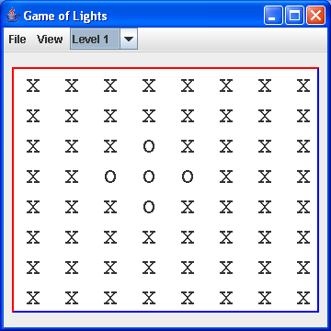
Java Code: Add a Beveled Border
textArea.setBorder( new BevelBorder(
BevelBorder.LOWERED, Color.BLUE, Color.RED) );
https://docs.oracle.com/en/java/javase/16/docs/api/java.desktop/javax/swing/border/BevelBorder.html

Slide 9
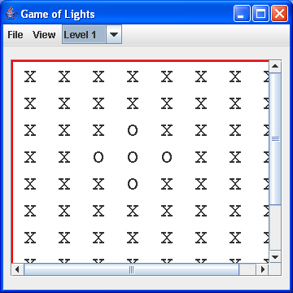
Decorate Again
JScrollPane scrollPane = new JScrollPane(textArea);
add(scrollPane, BorderLayout.CENTER);
https://docs.oracle.com/en/java/javase/16/docs/api/java.desktop/javax/swing/JScrollPane.html

Slide 10
Motivation Continued
The more more flexible containment approach encloses the component in another object that adds the border
The enclosing object is called the decorator
The decorator conforms to the interface of the component so its presence is transparent to clients
The decorator forwards requests to the component and may perform additional actions before or after any forwarding
The decorated object doesn't know it is being decorated!!

Slide 11
Decorator Pattern in Java
InputStreamReader(InputStream in)
System.in is an InputStream object
This provides a bridge from byte streams to character streams: It reads bytes and translates them into characters using the specified character encoding.
BufferedReader
This reads text from a character-input stream, buffering characters so as to provide for the efficient reading of characters, arrays, and lines.
Before Scanner (Java <1.5)
BufferedReader keyboard =
new BufferedReader(
new InputStreamReader(System.in));

Slide 12
Example of decorator pattern use
BufferedReader decorates InputStreamReader
BufferedReader
readLine()
InputStreamReader
read() close()

Slide 13
Observations
The scroll pane decorator is more of an "add-on"
The I/O stream decorator is more of a "filter"
Both Component and InputStream are abstract classes, but pattern works with common interface too

Slide 14
Iterator Pattern
Review: What is it?
Motivation: Why is it useful?.
Bad iteration techniques
Expose collections elements to client and allow client to traverse manually
Why is this bad?
Collection maintains it's own 'cursor' (internal iterator)
Why is this bad?
Conclusion: Iterators balance the tension between access and control

Slide 15
Next Time...
More Patterns

