Slide 1
COMP 2000 Object-Oriented Design
David J Stucki
Otterbein University

Slide 2
ALERTS
Read Head First Design Patterns, Chapters 2-3 & 9
Lab 8: Due Friday before 11:59 pm
Lab 9: Due next Thursday before 11:59 pm
Lab 10, next week
Questions?

Slide 3
Strategy Pattern
Gang-of-Four
Let's look in the book (document camera)
Maze Application
Let's look at it run with a console interface...

Slide 4
Observer Pattern (HFDP, chapter 2)
What does the word Observer suggest to you?
The Idea
One object is performing tasks that are of interest to other objects
The other objects want to be notified when something interesting happens
Examples where we've already seen this:
Action Listeners
How do they do this?
Model-View-Controller
Which is which?

Slide 5
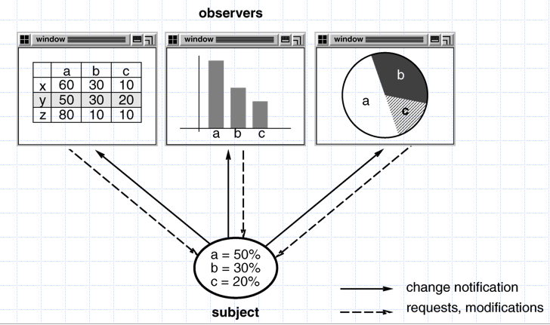
Observer Model-View Illustration

Slide 6
Observer Pattern
How does it work?
The observed object keeps a list of observers
Each observer registers itself with the observed to get on the list
They can also unregister themselves
When an event occurs the observed notifies all the observers on the list
Each observer can then probe the observed to acquire the aspects of the observed's state that they are interested in

Slide 7
Observer Class Diagram (high level)

Slide 8
Observer Pattern Motivation
Why is this helpful?
It contributes to loose coupling
In computing and systems design a loosely coupled system is one in which each of its components has, or makes use of, little or no knowledge of the definitions of other separate components. Subareas include the coupling of classes, interfaces, data, and services. Loose coupling is the opposite of tight coupling. (Wikipedia.com)
Loosely coupled is an attribute of systems, referring to an approach to designing interfaces across modules to reduce the interdependencies across modules or components – in particular, reducing the risk that changes within one module will create unanticipated changes within other modules. (John Hagel)

Slide 9
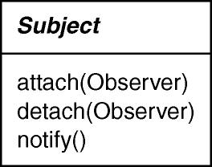
Observer Pattern Structure

Slide 10
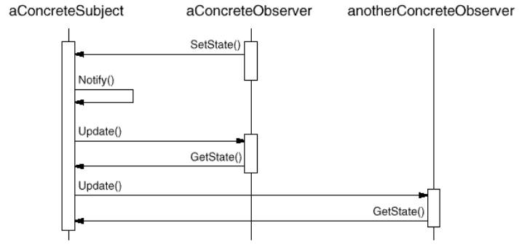
Observer Pattern Collaborations

Slide 11
Observer Pattern Examples
ActionListener
GUI component maintains list of "interested" action listeners
Action listener registers its interest through addActionListener() method
Multiple such listeners may register with the same component
When an interesting event, such as button click, occurs, all action listeners are notified
What method carries out the action listener's response?
What information is that method given?
Let's look at the Java API

Slide 12
Observer Pattern Examples
Observer/Observable
Observable class to represent the subject (object of interest)
Observer interface to represent the observer!
Observable is a class rather than an interface, because it provides registration and notification mechanism
Observer interface has only one method, update() in which the implementer codes the observer's response when notified
Push vs. Pull
Class vs. Interface for Observable
Let's look at the Java API

Slide 13
Next Time...
The Decorator Pattern

