Slide 1
COMP 2000 Object-Oriented Design
David J Stucki
Otterbein University
Notes:
Bring Wirth & playing cards

Slide 2
ALERTS
Have a good weekend!
No class on Monday

Slide 3
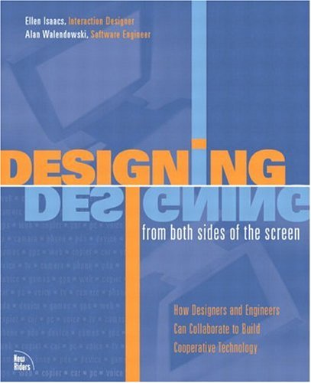
User Interface Design
Designing from Both Sides of the Screen, Ellen Isaacs & Alan Walendowski
Issacs is an Interaction Designer
in front of the screen
Walendowski is a Software Engineer
behind the screen

Slide 4
The Goal
Principles of Human-Computer Interaction
On Being a Butler
Don't Impose: Respect Physical Effort
Don't Impose: Respect Mental Effort
Be Helpful

Slide 5
Butlers
What do you know about them?
Imagine the UI is the butler and the user is the employer...
There are stereotypes of an effective relationship between them that can help with design

Slide 6
An Effective Butler is:
Always available
Prepared to perform requested tasks with no complaints
Able to find ways to deal with problems without bothering employer
Reluctant to interrupt with suggestions
Attentive to past behavior to anticipate (but not initiate) future behavior
Courteous and respectful at all times
Willing to learn to collaborate with employer

Slide 7
An Effective Employer:
Observes what the butler does well
Learns through experience the best way to request things
Learns to collaborate with the butler

Slide 8
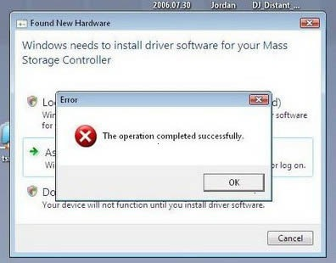
Respect Physical Effort
The basic metric of physical effort is mouse clicks
Expend great effort to minimize clicks
Implement features that will save lots of user cumulative effort
Do not ask for confirmation for actions that can easily be undone
Make frequently used features the easiest to access, even at the cost of making infrequently used features less accessible
Remember user-customizations
Consider the effects of repetitive tasks
Design a task so that it can be performed using only one input device

Slide 9
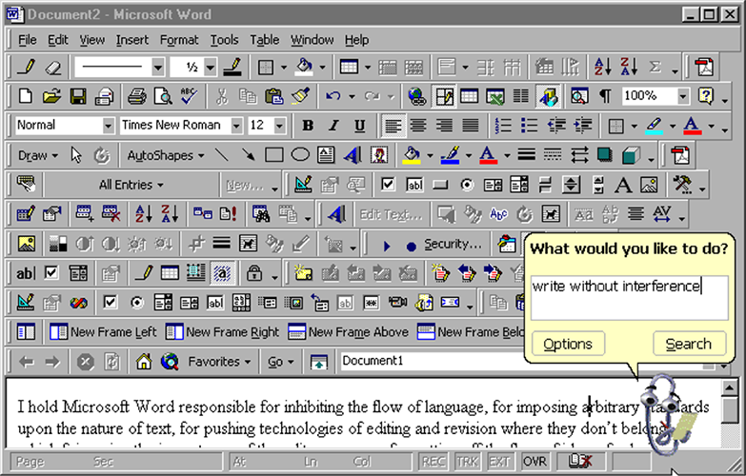
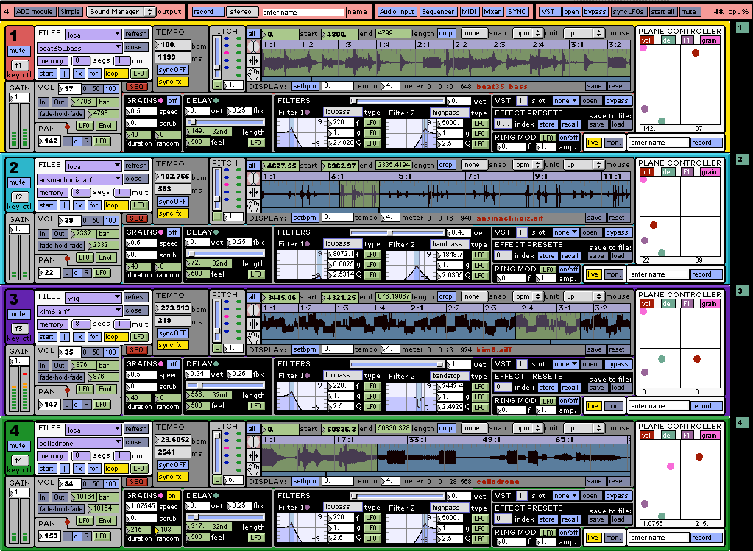
Respect Mental Effort
One of the important factors in mental effort is user flow
Minimize the number of visual elements on the screen
Most common tasks should be visible and less common ones hidden
Acknowledge each user request and show progress for long operations
Allow user to interrupt tasks that may take a long time
Use both sound and visual components to indicate events
Provide user preferences to modify appearance, rather than to modify behavior
Follow interaction conventions for the implementation platform

Slide 10
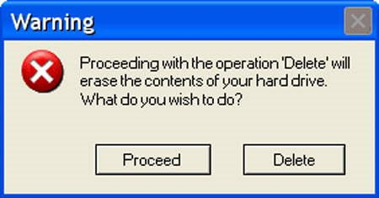
Be Helpful
Minimize the use of unrequested informational pop-ups; use persistent window with status message area instead
Do not interrupt user with problems you can address yourself
Develop and use consistent conventions
Disable unavailable options
Do not request information until it is required
Avoid jargon in labeling widgets
Avoid modal dialogs that prevent interaction with the rest of the application
Take the attitude that the software is at fault when something goes wrong
Use action words to label buttons rather than a generic Yes, OK, etc.

Slide 12
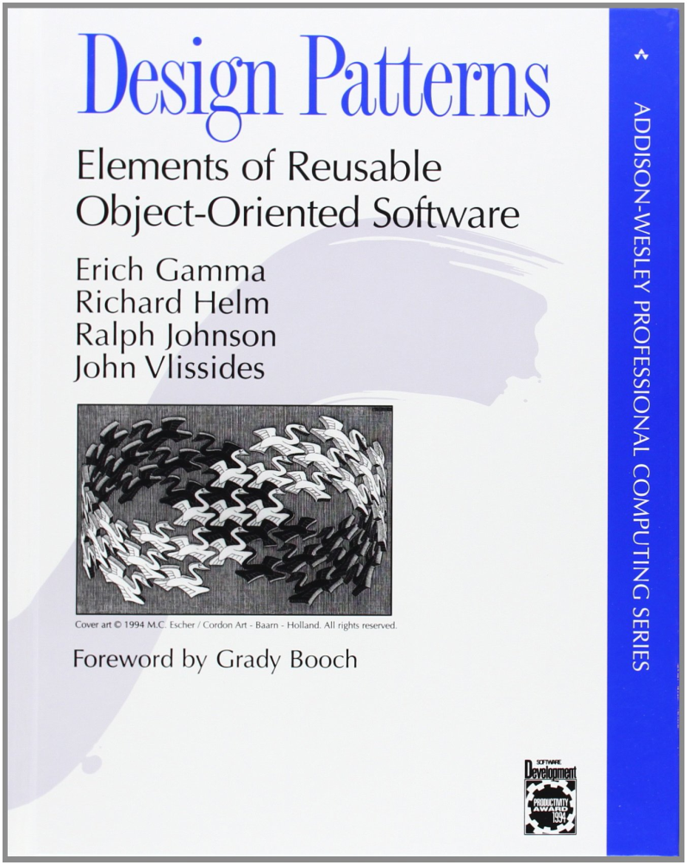
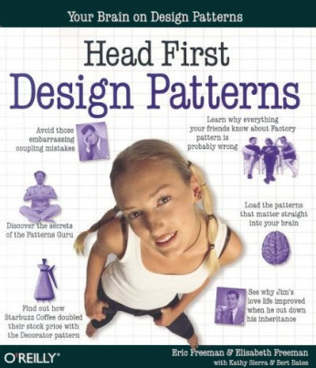

Slide 13
Design Patterns
“Each pattern describes a problem which occurs over and over again in our environment, and then describes the core of the solution to that problem, in such a way that you can use this solution a million times over, without ever doing it the same way twice”
—Christopher Alexander
“A design pattern names, abstracts, and identifies key aspects of a common design structure that makes it useful for creating a reusable object-oriented design.”
—Gang of Four (Design Patterns: Elements of Reusable Object-Oriented Software)

Slide 14
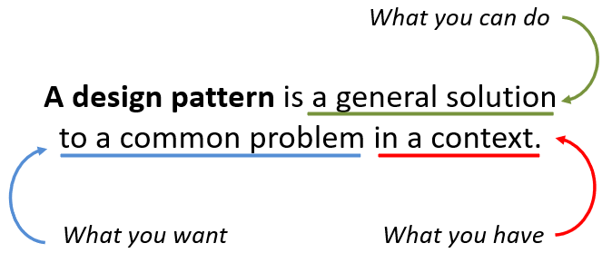
Why Design Patterns?
Patterns are a form of "best practices" for Object-Oriented Design
They solve commonly occurring problems using existing well known and tested approaches
They enable more efficient communication by giving standard terminology to design problems and scenarios.
For example, it is easier to say "Let's use an Adapter" than to say "Let's use a superclass with a getter method and then subclass that with classes that reference instances of the client-supplied classes..."

Slide 15
Design Patterns Structure
A Design Pattern has four essential elements
Name: something simple yet descriptive we can use to refer to it
Problem: what is the situation and the context where the pattern applies? what conditions should be met before this pattern is used?
Solution: a description of the elements that make up the design pattern focus is on relationships, responsibilities, and collaborations
Consequences: the results and trade-offs of using the pattern including impacts on reusability, portability, and extensibility

Slide 16
Design Patterns Types
Design Patterns fall into three broad categories
Creational: having to do with class and object creation
Structural: having to do with class and object composition
Behavioral: having to do with communication between objects

Slide 17
Design Patterns Catalog
The complete Gang-of-Four (GoF) collection is
Creational: Abstract Factory, Builder, Factory Method, Prototype, Singleton
Structural: Adapter, Bridge, Composite, Decorator, Facade, Proxy
Behavioral: Chain of Responsibility, Command, Interpreter, Iterator, Mediator, Memento, Flyweight, Observer, State, Strategy, Template Method, Visitor
Only a few have been added since...
You will recognize some of these from previous experience with the Java API
We will study selected patterns from all three categories

Slide 18
Iterator Pattern (light intro)
Why does this sound familiar?
Java allows iteration over collections using the foreach version of the for loop
The Java Collection Framework (JCF) uses this pattern extensively
Each collection type has an iterator() method and implements the Iterator interface (COMP 2100 will explore deeply why this matters)
Suppose you have a collection of objects and you want clients to be able to iterate over the collection
Simultaneously?
Without knowing anything about how the collection is implemented

Slide 19
Next Time...
More Design Patterns

