Slide 1
COMP 2000 Object-Oriented Design
David J Stucki
Otterbein University

Slide 2
ALERTS
Lab 8 is due next Friday, 3/22, before 11:59pm
Questions?
Now that spring break is over, let's remind ourselves of where we left off...

Slide 3
UML Class Notation: Relationships
Association
One class must know about another in order to do its work (e.g., a model and a view, or a client and a server)
A straight line
Aggregation
Where one class is the element type of a collection (students in a course)
A line with an open diamond on the collection end
Weak 'HAS-A' relationship
Composition
Where one class represents an essential part of another class (a fuel pump in a car)
A line with a solid diamond on the collection end
Strong 'HAS-A'
Inheritance
Generalization/Specialization
Super-class and Sub-class
An open triangle pointing at super-class

Slide 4
Associations
Binary Association
Both entities “Know About” each other
Unary Association
A knows about B, but B knows nothing about A
myB.service();
myA.doSomething();
myB.service();
Arrow points in direction
of the dependency

Slide 5
Aggregation
Aggregation is an association with a "collection-member" relationship
void doSomething() aModule.service();
Hollow diamond on
the Collection side
No sole ownership implied

Slide 6
Composition
Composition is Aggregation with:
Lifetime Control (owner controls construction, destruction)
Part object may belong to only one whole object
members[0] = new Employee();
…
delete members[0];
Filled diamond on side of the Collection

Slide 7
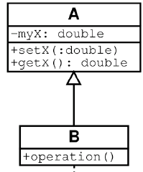
Inheritance
Base Class
Derived Class
class B() extends A
…

Slide 8
UML Multiplicities
Multiplicities | Meaning
0..1 | zero or one instance. The notation n . . m indicates n to m instances.
0..* or * | no limit on the number of instances (including none).
1 | exactly one instance
1..* | at least one instance

Slide 9
Class Diagram Example

Slide 10
Let's Build a Class Diagram
yuml.me

Slide 11
End nested detour
Time to return to our discussion of the JCF...

Slide 12
The Collection<E> Interface
Collects together and specifies the methods that all collections have in common
boolean add​(E e)
void clear()
boolean contains​(Object o)
boolean isEmpty()
Iterator<E> iterator()
boolean remove​(Object o)
int size()

Slide 13
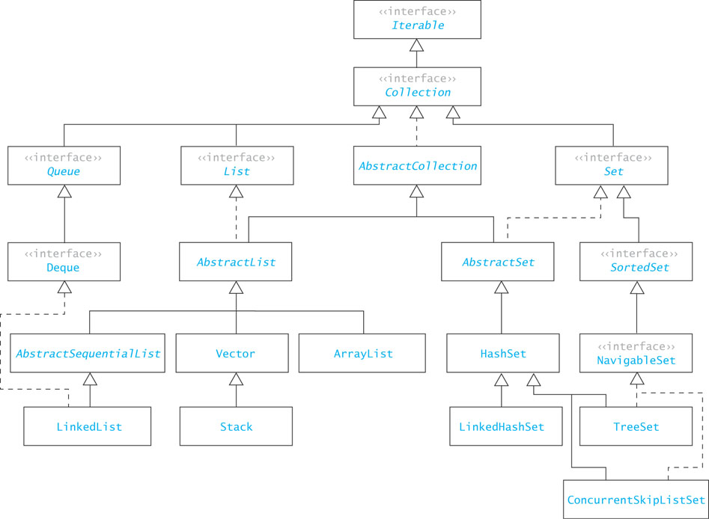

Slide 14
Common Features of Collections
Collections grow (and shrink) as needed. In other words, they are dynamically sized.
Collections contain references to elements (objects)
Collections have at least two constructors
Parameterless: creates empty collection
A collection parameter: constructs a clone of the parameter value
In general collections are unordered, unless implementing the List interface

Slide 15
Implementing Collections
Classes that implement the Collection<E> interface should also extend the AbstractCollection<E> class, which implements most of the methods of the interface
The new class should only need to implement:
add(E e)
size()
iterator() and the inner class that implements Iterator<E>

Slide 16
Arrays vs. Lists
What is an array?
What properties do arrays have?
Sequential
Indexed
Contiguous
Homegeneous
Statically sized
What is a List?
What properties do Lists have?
Sequential
Indexed
Homogeneous
Dynamically sized
Lists are further removed from the computer architecture.

Slide 17
The List<E> Interface
In addition to the methods inherited from Collection<E> it also has:
void add​(int index, E element)
E get(int index)
E remove(int index)
E set(int index, E element)
Classes that implement the List<E> interface should also extend the AbstractList<E> class, which implements all the methods of List<E>, except the four listed above and size()

Slide 18
JCF Source Code
Let's look at the Java source files for some of these components of the JCF...

Slide 19
Next Time...
Finish the JCF

