Slide 1
COMP 2000 Object-Oriented Design
David J Stucki
Otterbein University

Slide 2
ALERTS
Read the following:
The Object-Oriented Thought Process, Chapter 9
https://www.martinfowler.com/bliki/InversionOfControl.html
(if he uses terms you aren't familiar with, look them up!)
Lab 8 is due 3/22 before 11:59pm
Hints...
Questions?

Slide 3
OO Frameworks
A framework is a set of related interfaces, abstract classes and concrete classes
It also includes a set of conventions for implementing the interfaces and extending the classes
Frameworks are usually domain-specific but can be domain-neutral
This supports the reuse of designs and implementations.

Slide 4
OO Application Frameworks
A framework can be considered an application framework with these additional characteristics:
It provides essential mechanisms of an application (it is semicomplete)
Prefabricated (fixed) classes, which were distributed as part of the application framework
User-defined classes, which were implemented by the framework's clients who customized it to their needs
The framework provides inversion of control

Slide 5
Inversion of Control
Also known as the "Hollywood Principle": Don't call us, we'll call you
The idea: Framework methods call the implementer-supplied methods instead of vice versa
Remember the Model-View-Controller example?
Another example: it is common in GUI applications to supply a custom paint() method that is only called by the GUI framework.
We will see more examples of this when we get to design patterns
The framework is responsible for high-level flow in the application while the user controls low-level flow through input events

Slide 6
Template Method design pattern
Also known a generic algorithm (algorithmic abstraction)
When the algorithm consists of a specific sequence of abstract events, but the concrete details of these events can vary
In other words, the algorithm calls a collection of primitive operations in the same sequence or order, but the nature of how the primitive operations behave is problem or domain specific.
The template method is defined in an abstract superclass and calls abstract methods that are defined by its subclasses (see HFDP-8)

Slide 7
Big Picture
What is the difference between a framework and a library?
In a library the application structure is controlled by the client and the library services are subservient
In an application framework the application structure is controlled by the framework and the client fills in details
What is the difference between a framework and a design pattern?
Frameworks are compiled code
Design patterns are ideas
Frameworks can be based on or use design patterns
Frameworks benefit from design pattern advantages

Slide 8
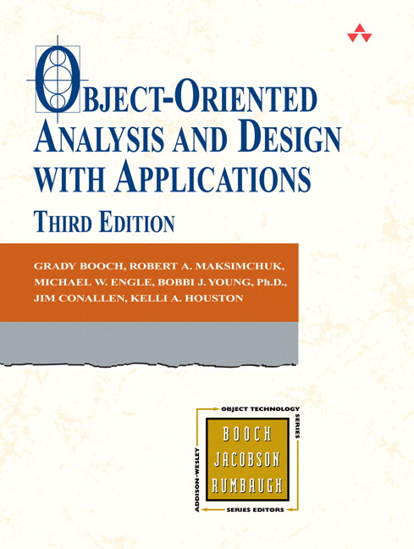
Framework Design (Booch, 1994)
Complete: family of classes with common interface, that provide different implementations for client to select from. Think of ArrayList versus LinkedList. What are time/space tradeoffs?
Efficient: efficient in use of both runtime resources (efficient algorithms), compiler resources, and client resources (easy and reliable to use).
Type-Safe: uses exceptions to indicate violation of client’s end of contract.
Simple: clear organization and interface
Extensible: client can add classes without compromising “architectural integrity” of framework

Slide 9
Java Collections Framework (JCF)
JCF consists of: collection interfaces, general purpose implementations,
abstract implementations, algorithms, infrastructure interfaces and classes, and more
Collection Interfaces: Common interfaces for the different kinds of collections
Polymorphic foundations.
Headed by Collection, and Map
Collection categories (sub-interfaces) include: List, Queue, Set, SortedSet
A list is ordered, with duplicates
A set may be ordered or not, no duplicates
A queue is a collection for “holding elements prior to processing”
Map interface is separate hierarchy
A map is unordered, contains key-value pairs
Map categories (sub-interfaces) are: ConcurrentMap, SortedMap
General-Purpose Implementations: The concrete classes that clients use directly
Implement one or more of the Collection Interfaces.
List Implementations
LinkedList, ArrayList
Set Implementations
TreeSet, HashSet, LinkedHashSet
Queue Implementations
PriorityQueue and others
Map Implementations
TreeMap, HashMap, LinkedHashMap
Note: names combine implementation technique with concept.

Slide 10
Java Collections Framework (JCF)
JCF consists of: collection interfaces, general purpose implementations,
abstract implementations, algorithms, infrastructure interfaces and classes, and more
Abstract Implementations: Partial implementations of the Collection Interfaces
Hooks that a client can use to implement custom concrete collection classes
Implements the more mundane aspects of the interface so the client doesn’t have to
All the concrete implementations on the previous slide extend one of these
Algorithms: Common operations that a client might wish to perform over a collection
Implemented as static methods in Collections class (note the plural)
Infrastructure
Iteration: Iterator and ListIterator
Ordering: Comparable and Comparator
Runtime Exceptions: UnsupportedOperationException and ConcurrentModificationException
Performance:
RandomAccess, a “marker interface” that an implementation can use to “advertise” fast (e.g. constant time) random access
Array Utilities: Common operations that a client might wish to perform over an array
Implemented as static methods in Arrays

Slide 11
Another detour...
In order to more fully explore the JCF we need to familiarize ourselved more fully with UML class diagrams...
Homework assignment: Explore the website yuml.me and practice making Class Diagrams

Slide 12
Review: What is UML?
Unified Modeling Language
UML is a collection of diagram notations intended to facilitate the expression and design of software, including specifications, particularly useful for OO design
Independent of implementation language

Slide 13
Three (3) basic building blocks of UML
Things - important modeling concepts
Relationships - tying individual things
Diagrams - grouping interrelated collections of things and relationships
Water
have
Fresh water
Rivers
Oceans
have
have
live in
Salt water
have
Fish
have
Crocodiles
Penguins

Slide 14
3 basic building blocks of UML – Diagrams
A connected graph: Vertices are things; Arcs are relationships/behaviors.
UML 1.x: 9 diagram types.
UML 2.0: 12 diagram types
Structural Diagrams
Represent the static aspects of a system.
Class;
Object
Component
Deployment
Structural Diagrams
Class;
Object
Component
Deployment
Composite Structure
Package
Behavioral Diagrams
Represent the dynamic aspects.
Use case
Sequence;
Collaboration
Statechart
Activity
Behavioral Diagrams
Use case
Statechart
Activity
Interaction Diagrams
Sequence;
Communication
Interaction Overview
Timing

Slide 15
UML: First Pass
You can model 80% of most problems by using about 20% of UML
We only cover the 20% this semester

Slide 16
Class Diagrams
Give an overview of a system by showing its classes & their relationships
Class diagrams are static
They show what classes interact, but not what happens when they do
Each class is a box in the diagram the documents the class name, class attributes, and class behaviors
The level of detail can vary depending on how the class diagram is being used
Class relationships are edges connecting the boxes

Slide 17
Class Diagram Example

Slide 18
UML Class Notation
A class is a rectangle divided into three parts
Class name
Class attributes (i.e., data members, variables)
Class operations (i.e., behaviors, methods)
Modifiers
Private: –
Public: +
Protected: #
Static: Underlined
Abstract class: italicized name

Slide 19
UML Class Notation: Relationships
Association
One class must know about another in order to do its work (e.g., a model and a view, or a client and a server)
A straight line
Aggregation
Where one class is the element type of a collection (students in a course)
A line with an open diamond on the collection end
Weak 'HAS-A' relationship
Composition
Where one class represents an essential part of another class (a fuel pump in a car)
A line with a solid diamond on the collection end
Strong 'HAS-A'
Inheritance
Generalization/Specialization
Super-class and Sub-class
An open triangle pointing at super-class

Slide 20
Associations
Binary Association
Both entities “Know About” each other
Unary Association
A knows about B, but B knows nothing about A
myB.service();
myA.doSomething();
myB.service();
Arrow points in direction
of the dependency

Slide 21
Aggregation
Aggregation is an association with a "collection-member" relationship
void doSomething() aModule.service();
Hollow diamond on
the Collection side
No sole ownership implied

Slide 22
Composition
Composition is Aggregation with:
Lifetime Control (owner controls construction, destruction)
Part object may belong to only one whole object
members[0] = new Employee();
…
delete members[0];
Filled diamond on side of the Collection

Slide 23
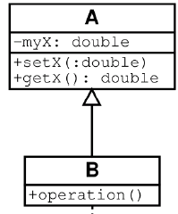
Inheritance
Base Class
Derived Class
class B() extends A
…

Slide 24
UML Multiplicities
Multiplicities | Meaning
0..1 | zero or one instance. The notation n . . m indicates n to m instances.
0..* or * | no limit on the number of instances (including none).
1 | exactly one instance
1..* | at least one instance

Slide 25
Class Diagram Example

Slide 26
Let's Build a Class Diagram
yuml.me

Slide 27
Next Time...
Back to Frameworks and the JCF

