Slide 1
COMP 2000 Object-Oriented Design
David J Stucki
Otterbein University
Notes:
Bring Wirth & playing cards

Slide 2
ALERTS
Lab 8: Due Friday 3/22 before 11:59 pm

Slide 3
MVC: Model-View-Controller
In any application there are two chief parts:
The data (or model) being manipulated
A user-interface (or view) through which the manipulation occurs
Generally, the model is logically independent from how it is presented to the user.
Sales data can be displayed in a table or as a stacked bar chart.
A chess game can be set up and played on a board, or communicated as a textual sequence of moves (e.g., bishop to queen 4)
Negative Example: BigBlob.java (presentation, logic, and state mixed together)

Slide 4
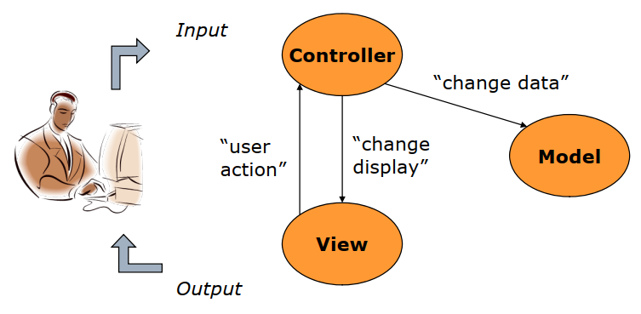
MVC is a Design Pattern
Model
The data (i.e., state)
Methods for accessing and modifying state
View
A visualization or presentation of the model for the user
When the model changes, the view must be updated
Controller
Translates user actions (i.e., interactions with the view) into operations on the model
User actions are GUI events (mouse-driven) or keyboard inputs

Slide 5
MVC in Java Swing
Option 1
View is made up of Swing components (JFrame & widgets)
Controller made up of ActionListeners
Model is made up of ordinary (non-GUI) Java classes
Option 2
View is made up of Swing components, but also includes (inner) ActionListener(s) as event handlers
Controller is an ordinary Java class with logic that maps event handlers to model operations
Model is made up of ordinary (non-GUI) Java classes
What is the difference?

Slide 6
MVC Mechanics
Setup
Instantiate model
Instantiate view
Instantiate controller with references to both model and view
Controller registers action listeners on view widgets
Execution
View recognizes event
View calls appropriate method on controller
Controller accesses model, possibly updating it
If model has been changed, view is updated via the controller
Example: CalcMVC, CalcModel, CalcView, CalcController

Slide 7
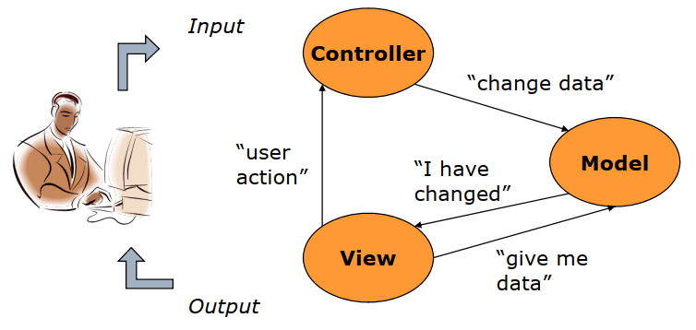
MVC Extended Interactions
Observer Pattern
One object is notified of changes in another
In extended MVC, view is an observer of model
Model must notify views when it changes (a model may have multiple views)

Slide 8
MVC issues
The controller may need to produce its own output (pop-ups, etc.)
Some state may need to be shared between the controller and the view, but doesn't belong in the model (selected items, highlighted text, etc.)
Many widgets in view are interactive and can be directly controlled by user (sliders, scrollbars, etc.)
Input and output are often intermingled in a GUI, requiring view and controller to be tightly coupled.

Slide 9
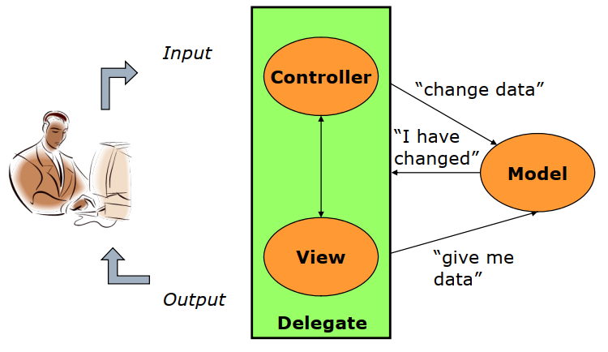
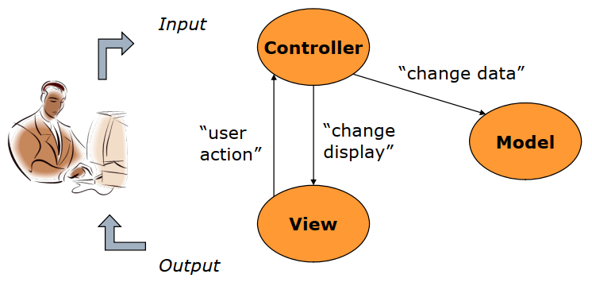
Delegate-Model Pattern
Model
The data (same as before)
Delegate
Responsible for both input and output
A combination of both the view and the controller
Also known as: UI-Model, Document-View, and more...

Slide 10
Delegate-Model Mechanics
Setup
Instantiate model
As with MVC, model does not know or care about the UI
Instantiate delegate with reference to model
Execution
Delegate recognizes event and executes appropriate handler for the event
Delegate accesses model, possibly updating it
If model has been changed, UI is updated
Example: CalcV3, CalcModel, CalcViewController

Slide 11
Summary
Motivation: Information hiding (data vs. UI)
State should be agnostic of user interface
Motivation: Separation of concerns
Organize code by the types of tasks & responsibilities it has
MVC: separates Data, Presentation, and Business Logic
UI-Model: preserves most significant separation while allowing tight coupling between view and controller
Litmus test: can the model be used w/o modification by a different UI?

Slide 12
Next Time...
Take a break from UI Design principles,
and explore Frameworks & the JCF

