Slide 1
COMP 2000 Object-Oriented Design
David J Stucki
Otterbein University
Notes:
Bring Wirth & playing cards

Slide 2
ALERTS
Lab 8: Due Friday 3/22 before 11:59 pm

Slide 3
Complicated layouts
For complicated layouts
Sketch out what you want it to look like
Use BorderLayouts to give components a spatial relationship
Nest JPanels inside of JPanels (inside of JPanels…) if you need to
Use GridLayouts whenever you want to have a grid
Be patient: it's hard to get it right the first time

Slide 4
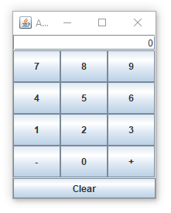
GUI Demo I
Consider the GUI application displayed here.
What widgets are there?
Can we guess the layout?
Let's take a look...

Slide 5
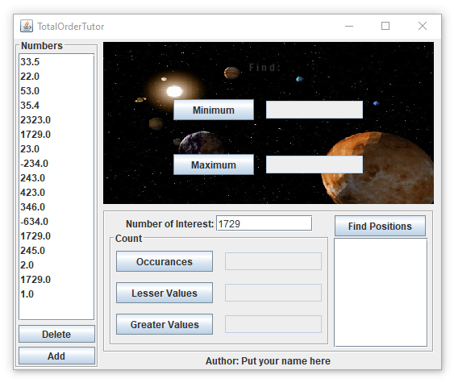
GUI Demo II
Consider the GUI application displayed here.
What widgets are there?
Can we guess the layout?
Let's take a look...

Slide 6
Making buttons do things
We have added JButtons to JFrames, but those buttons don't do anything
When clicked, a JButton fires an event
We need to add an action listener to do something when that event happens
A Command Line Interface (CLI) program runs through loops, calls methods, and makes decisions until it runs out of stuff to do
GUIs usually have an event-based programming model, which does not operate in the same way
They sit there, waiting for events to cause methods to get called

Slide 7
ActionListener interface
What can listen for a JButton to click?
Any object that implements ActionListener
ActionListener is an interface like any other with a single abstract method in it:
void actionPerformed(ActionEvent e);
We need to write a class with such a method
We will rarely need to worry about the ActionEvent object
But it does have a getSource() method that will give us the Object (often a JButton) that fired the event

Slide 8
Anonymous inner classes
Now, we get to something tricky
It's possible to create a class on the fly, right in the middle of other code
Consider the following interface:
We can create, in the middle of other code, a class that implements NoiseMaker, like this:
public interface NoiseMaker {
String makeNoise();
}
NoiseMaker maker = new NoiseMaker() {
public String makeNoise() {
return "Yowza!";
}
};

Slide 9
Anonymous inner classes continued
System.out.println("Minding my business..."); // normal code
NoiseMaker maker = new NoiseMaker() { // create a class
public String makeNoise() {
return "Yowza!";
}
};
What's going on here??
Aren't we instantiating an interface, which is impossible?
No, this makes a new, unnamed class that implements an interface or extends a parent class, on the fly, at the same moment you're allocating an instance of it
Weird

Slide 10
Adding an action listener
The reason we brought up anonymous inner classes is that we can use this syntax to make an ActionListener object right when we need it, for a button
It's ugly, but it works
JButton button = new JButton("Push me!");
button.addActionListener(new ActionListener() {
public void actionPerformed(ActionEvent e) {
button.setText("Ouch!"); // arbitrary code
}
}); // ugly: parenthesis for end of method call

Slide 11
Things you might do in an action listener
Call arbitrary methods
setText() sets the text on many widgets
getText() gets the text from widgets so you can do something with it
Both setText() and getText() apply to:
JButton
JLabel
JTextField
JTextArea
setIcon() sets the icon on many widgets
JButton
JLabel
setEnabled() can be used to enable and disable buttons

Slide 12
Java 8 style
Before Java 8, we only had two choices:
Make a whole class that implements ActionListener and might have to do different actions based on which button fired the event
Make a separate anonymous inner class for every single button, each doing the action for that button
Java 8 adds something called lambdas which actually make anonymous inner classes too, but the syntax is much nicer
Java 8 style:
JButton button = new JButton("Push me!");
button.addActionListener(e -> button.setText("Ouch!"));

Slide 13
More on Java 8 style
An interface with only a single method in it (like ActionListener) is called a functional interface
Java 8 lets us instantiate functional interface by filling out the method:
(Type1 arg1, Type2 arg2, …) -> { /* method body */ }
But if it's possible for the compiler to infer the argument types, they don't have to be written
If you only have a single argument, you don't need parentheses
And if you only have a single line in your method body, you don't need braces
Multi-line example:
JButton button = new JButton("Push me!");
button.addActionListener(e -> {
button.setText("Ouch!");
button.setEnabled(false);
});

Slide 14
Weird rules
Using lambdas looks cleaner, but the same anonymous inner classes are being created
When you write code in the method of an anonymous inner class
You can refer to member variables and methods in the anonymous inner class (if any)
You can refer to member variables and methods in the surrounding object (even private ones)
You can generally read the values of local variables, but you cannot change them
Don't worry too much about all this
Just write your action listeners and ask questions if you have problems

Slide 15
Menus
In addition to widgets scattered across the surface of a JFrame, users are accustomed to menus
Menus, of course, drop down to display a list of options
The good news is that we can add action listeners to these menu items just like we can with JButton objects
All we have to do is learn how to create menus

Slide 16
JMenu
In Swing, the menu itself (not the choices in the menu) is a JMenu
You can create a JMenu with the name of your choice much like any other Swing widget with text
Like other widgets, creating the menu doesn't display it
We'll have to add it to the appropriate container
Common menus are:
File
Edit
View
Help
JMenu fileMenu = new JMenu("File");

Slide 17
JMenuItem
The choices that you add to a JMenu are objects of type JMenuItem
They function much like a JButton in that you can add an action listener to them
Once you create a JMenuItem, you can add it to a JMenu
You can even add a JMenu to another JMenu for nested menus
JMenuItem exitItem = new JMenuItem("Exit");
exitItem.addActionListener(e -> frame.dispose());
fileMenu.add(exitItem);

Slide 18
JMenuBar
Where do the JMenu objects live?
A JMenuBar, of course
First, you create a JMenuBar
Then, you add your JMenu objects to it (in order)
Then, you set it as the frame's menu bar
Make sure you don't add the menu bar to the frame by mistake
JMenuBar menuBar = new JMenuBar();
menuBar.add(fileMenu); // add one or more menus
frame.setJMenuBar(menuBar);

Slide 19
Extras
We're just scratching the surface
It's possible to add accelerators (keyboard shortcuts) to menu items
There's an addSeparator() method on the JMenu object that can create separators between groups of menu items
Menu items can have icons
You can even put check boxes and radio buttons in menus
If you're interested, read a tutorial or the API

Slide 20
Next Time...
UI Design principles

