Slide 1
COMP 2000 Object-Oriented Design
David J Stucki
Otterbein University

Slide 2
ALERTS
Read chapters 7 and 15 in Start Concurrent
Lab 8: Supplement #2 tomorrow
Questions?
Hints...

Slide 3
GUIs
A graphical user interface (GUI) is a way of interacting with a program using a mouse: buttons, menus, icons windows, etc.
Before COMP 1600, that was probably the only way you interacted with programs
The programs in COMP 1600 were command line interface (CLI) programs
We put off GUIs until now…
Because they're much more complicated!

Slide 4
Lab 8: Drawing on a Canvas
In Asteroids you are dealing with graphics and graphical objects.
However, these are different than GUI objects:
Low level drawing of lines and shapes
Interactive game animation
The graphics objects, although implemented as object-oriented components in the code, don't act like GUI objects from the perspective of the end-user

Slide 5
AWT
The oldest Java GUI library is the AWT (abstract windowing toolkit)
AWT objects are connected to OS GUI objects (called widgets)
For this reason, AWT objects
Look and act differently on different OSes
Are slow
Can't be styled with different looks and feels
Even though AWT has limited use in many applications, later libraries used components of it, requiring the java.awt package in many cases

Slide 6
Swing
A newer GUI library is called Swing
Swing objects are independent from OS widgets
For that reason, Swing objects
Look and behave consistently across different OSes
Are relatively fast
Can be styled with different looks and feels (which can make them look like they're natural parts of the OS)
To differentiate between AWT and Swing objects, Swing objects always have a J at the beginnings of their names
Button (AWT) vs. JButton (Swing)

Slide 7
JavaFX
JavaFX was intended as a replacement for Swing
It uses a completely different system for layout that relies on XML files
But it still references AWT and Swing libraries
In spite of some cool features, it is not included in standard Java
So we're not going to cover it

Slide 8
Full GUIs
Chapter 15 explains how to construct full GUIs:
Windows
Buttons
Fields
Labels
Layout
Today, we're only talking about easy additions to our existing programs
These can:
Display a message
Ask a question

Slide 9
JOptionPane
JOptionPane class provides static methods for:
Displaying a message
Asking a question
Although it is possible to create a JOptionPane object, you almost never do
Just call the static methods
Which means typing a lot of JOptionPane.

Slide 10
showMessageDialog()
Perhaps the simplest thing you can do with JOptionPane is have it display a message in a dialog window
By default these dialogs are modal, meaning that you have to deal with it before the program continues
To display a message, the method signature is:
void showMessageDialog(Component parent, Object message)
The parent is the window that waits for you to finish with the dialog, but you can pass in null if you don't have a parent window
Even though the message parameter is an Object, you usually pass in a String

Slide 11
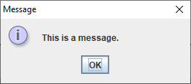
showMessageDialog() example
To display "This is a message." you could call the following:
JOptionPane.showMessageDialog(null,"This is a message.");

Slide 12
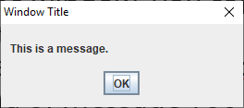
Adding a title
Most JOptionPane methods have many overloads
If you want to put a title on the window, you can pass it in as the third parameter
But this overloaded method also requires an int parameter that says what kind of message you want
To add the title "Window Title", you might call the following method:
JOptionPane.showMessageDialog(null,
"This is a message.", "Window Title",
JOptionPane.PLAIN_MESSAGE);

Slide 13
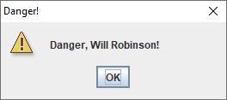
Different icons
You can choose an icon associated with one of the following constants:
ERROR_MESSAGE
INFORMATION_MESSAGE
WARNING_MESSAGE
QUESTION_MESSAGE
PLAIN_MESSAGE
JOptionPane.showMessageDialog(null,
"Danger, Will Robinson!", "Danger!",
JOptionPane.WARNING_MESSAGE);

Slide 14
showConfirmDialog()
What if you don't just want to display a message?
You could also display a prompt with yes, no, and cancel buttons, using the following method signature
int showConfirmDialog(Component parent, Object message)
This method will display message and return one of the following int constants inside JOptionPane:
YES_OPTION
NO_OPTION
CANCEL_OPTION

Slide 15
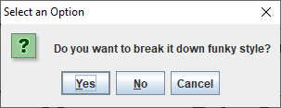
showConfirmDialog() example
int answer = JOptionPane.showConfirmDialog(null,
"Do you want to break it down funky style?");
if(answer == JOptionPane.YES_OPTION)
JOptionPane.showMessageDialog(null, "Dope!");
else
JOptionPane.showMessageDialog(null, "Weak!");
Hitting the X in the corner is the same as Cancel

Slide 16
showOptionDialog()
What if you want options other than yes, no, and cancel?
No problem, you can supply an array of Object values to showOptionDialog()
It returns the index in the array of options
Generally, these values will be String objects, but they could also be Swing widgets
The signature is…long:
int showOptionDialog(Component parent,
Object message, String title,
int optionType, int messageType, Icon icon,
Object[] options, Object initialValue)

Slide 17
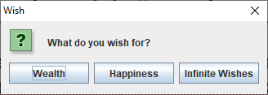
showOptionDialog() example
Here's an example showing a dialog that allows a user to choose between Wealth, Happiness, and Infinite Wishes
Note that many parameters can be null: parent, icon, default option
String[] options = {"Wealth", "Happiness", "Infinite Wishes"};
int answer = JOptionPane.showOptionDialog(null,
"What do you wish for?", "Wish", JOptionPane.DEFAULT_OPTION,
JOptionPane.QUESTION_MESSAGE, null, options, null);

Slide 18
showInputDialog()
A more flexible option for input is showInputDialog()
It allows the user to type arbitrary text into a box
Be careful with the return value
If they cancel, it's null
They might put crazy spaces at the beginning and end (use trim())
Numbers have to be converted from String values
Signature:
String showInputDialog(Component parent, Object message)

Slide 19
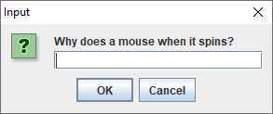
showInputDialog() example
This input dialog asks a pressing question
As with other methods, there are overloaded versions that allow for titles, icons, and other options
String answer = JOptionPane.showInputDialog(null,
"Why does a mouse when it spins?");

Slide 20
Next Time...
Making windows with JFrame
Other Swing widgets

