Slide 1
COMP 2000 Object-Oriented Design
David J Stucki
Otterbein University
Notes:
Bring Wirth & playing cards

Slide 2
ALERTS
Lab 5 due before 9:55am tomorrow
Read The Object-Oriented Thought Process chapters 4 & 5
Read Start Concurrent chapter 17
Lab 6 tomorrow

Slide 3
Inheritance Example: Person
We can imagine a hierarchy of inheritance starting with a Person with the following members:
Name (final)
Age
Student extends Person and adds:
Major
GPA
Politician extends Person and adds:
Political party
OtterbeinStudent extends Student and adds:
ID number (final)
Members should have getters and setters as appropriate
All classes should override the toString() and equals() methods

Slide 4
Overriding Methods Adding to existing classes is nice…
Sometimes you want to do more than add
You want to change a method to do something different
You can write a method in a child class that has the same name as a method in a parent class
The child version of the method will always get called
This is called overriding a method

Slide 5
Weapon example
We can define the Weapon class as follows:
public class Weapon {
public void makeNoise() {
System.out.println("Tick...");
}
}

Slide 6
Weapon subclasses
From there, we can define the Sword, Rifle, and Fist subclasses, overriding the makeNoise() method appropriately
public class Sword extends Weapon {
public void makeNoise() { System.out.println("Swoosh"); }
}
public class Rifle extends Weapon {
public void makeNoise() { System.out.println("Bang"); }
}
public class Fist extends Weapon {
public void makeNoise() { System.out.println("Smack"); }
}

Slide 7
Dynamic binding
All normal Java methods use dynamic binding
This means that the most up-to-date version of a method is always called
It also means that the method called by a reference is often not known until run-time
Consider a class Penguin which extends Bird which extends Object
Let's say that Penguin, Bird, and Object all implement the toString() method

Slide 8
Bird class
Here's a simple Bird class:
public class Bird {
private final boolean flies;
public Bird (boolean flies) {
this.flies = flies;
}
public boolean flightless() {
return !flies;
}
public String toString() {
return "Bird that " + (flies ? "flies" : "doesn't fly");
}
}

Slide 9
Penguin class
And the Penguin class extends the Bird class:
public class Penguin extends Bird {
private final String name;
public Penguin(String name) {
super(false); // Penguins are flightless
this.name = name;
}
public String getName() {
return name;
}
public String toString() {
return name + " the Penguin";
}
}

Slide 10
Pengin example
What happens when we call toString() on an Object, a Bird, and a Penguin, all stored in Object references?
Object object = new Object();
Object bird = new Bird(true);
Object penguin = new Penguin("Penelope");
// Prints "java.lang.Object@7852e922"
System.out.println(object.toString());
// Prints "Bird that flies"
System.out.println(bird.toString());
// Prints "Penelope the Pengin"
System.out.println(penguin.toString());

Slide 11
How to think about inheritance
Every object has a copy of its parent object inside (which has its parent inside, and so on)
All methods from the class and parents are available, but the outermost methods are always chosen
If a class overrides its parent's method, you always get the overridden method
Penguin
toString()
getName()
Bird
toString()
flightless()
Object
toString()

Slide 12
Using super to call parent methods
In addition to using super to call parent constructors, you can use super to call parent methods
You can only call methods "one level up", not methods that were overridden by parents
public class Penguin extends Bird {
private final String name;
public Penguin(String name) {
super(false); // Penguins are flightless
this.name = name;
}
public String getName() {
return name;
}
// Prints "Name the Penguin (Bird that doesn't fly)"
public String toString() {
return name + " the Penguin (" + super.toString() + ")";
}
}

Slide 13
Abstract Classes
Java Classes & Interfaces represent two extremes
But there is a 3rd option that sits in the middle...
The three kinds of compilable units in Java are:
Classes: all methods must be fully implemented
Interfaces: no methods can be implemented (i.e., they are abstract)
Abstract classes: some methods are abstract, but others are not
The keyword abstract must appear in both the class declaration and the method signatures
Of these three, only classes can be instantiated as objects! Why?

Slide 14
Interfaces & Inheritance
We have also now been exposed to all three of the major hierarchical structures in Java:
The Package Hierarchy
mirrors the file system to organize source code
The Class Inheritance Hierarchy
single inheritance
single tree
Object is the root class
The Interface Inheritance Hierarchy
multiple inheritance
no root (forest)

Slide 15
Real world example: JCF
The Java Collections Framework (package java.util) has many classes, abstract classes, and interfaces that share a complex set of relationships, including inheritance.
The main two families (genealogical groups) in the JCF are
Collection
Map
But they are inter-related...

Slide 16
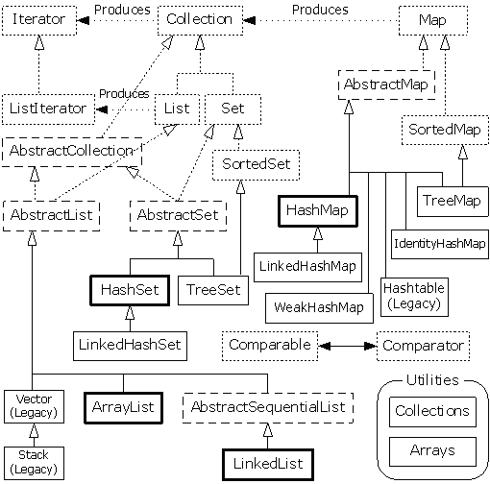

Slide 17
Next Time...
I take exception to that

