Slide 1
COMP 2000 Object-Oriented Design
David J Stucki
Otterbein University
Notes:
Bring Wirth & playing cards

Slide 2
Barbara Liskov
“I still think that the people in hardware have it a lot easier because when you build machines you have obvious components that are connected together by wires, say, and this forces you to a kind of natural modularity where each component does whatever it's doing and it provides a very simple way of interacting with the rest of the world because the connections have to be simple.
But software had no such natural constraints, and so what I was interested in was trying to find the constraints for software that enabled us to end up with a system that you could actually understand.”

Slide 3
ALERTS
Lab 5 due by 9:55am next Tuesday
Questions?
Read Start Concurrent Chapter 11
Lab 3: post-mortem

Slide 4
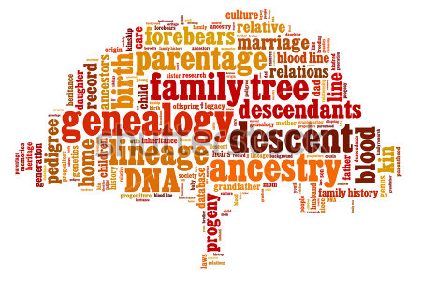
Inheritance
All classes in Java are related to one another in a family tree based on the concept of inheritance.
Java supports only single inheritance: each class (except one) has exactly one parent class
The exception is the ancestor of all classes, unfortunately named Object (Java API)
A class definition can include the identity of the parent class:
public class Dog extends Canine {
Child class
Parent class

Slide 5
Object methods
If you don't explicitly state which class your class extends, it extends Object
Because everything inherits (directly or indirectly) from Object, there are some methods that every object of every class has:
clone()
equals(Object other)
finalize()
getClass()
hashCode()
notify()
toString()
wait()
wait(long timeout)
wait(long timeout, int nanoseconds)

Slide 6
Important Object methods
Return type | Method | Use
boolean | equals(Object other) | Tests if two objects are the same, should be overridden by classes to be meaningful
Class<?> | getClass() | Returns an object representing the class of the object
int | hashCode() | Returns a hash value for the object, useful for hash tables, should be overridden by classes to be meaningful
Object | clone() | Creates and returns a copy of this object. The precise meaning of "copy" may depend on the class of the object.
String | toString() | Returns a String representation of the object, should be overridden by classes to be meaningful

Slide 7
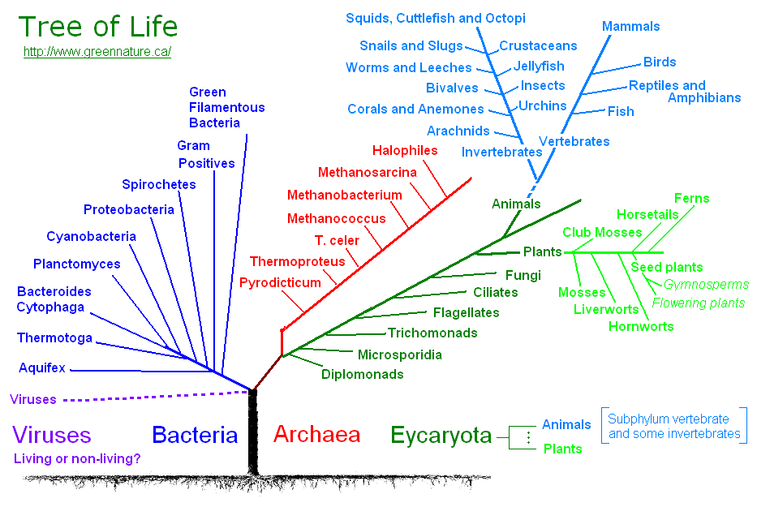
Inheritance
Based on the IS-A concept
A Dog IS-A Canine
A Canine IS-A Carnivore
A Carnivore IS-A Mammal
A Mammal IS-A Vertebrate
A Vertebrate IS-An Animal
Each child class Inherits traits, properties, and behaviors from its parent

Slide 8
Java Inheritance
Another way to think about it is that a parent is a generalization of the child, or alternatively that a child is a specialization of its parent.
So when a class in Java extends another it automatically inherits all of the members of the parent: instance variables, methods, and constructors
In addition to this, it may declare additional members that makes its instances more specific or specialized types of objects than instances of the parent

Slide 9
Example
import java.awt.Color;
public class Shape {
private Color c;
public double area() {
return 0;
}
public String toString() {
return "Shape[" + c + "]";
}
}
public class Rectangle extends Shape {
private int length, width;
public double area() {
return length * width;
}
public String toString() {
return "Rect[" + length +
"," + width + "]";
}
public boolean isSquare() {
return length == width;
}
}

Slide 10
Example
import java.awt.Color;
public class Shape {
private Color c;
public double area() {
return 0;
}
public String toString() {
return "Shape[" + c + "]";
}
}
public class Circle extends Shape {
private int radius;
public double area() {
return Math.PI * radius * radius;
}
public String toString() {
return "Circle[" + radius + "]";
}
public double circumference() {
return 2 * Math.PI * radius;
}
}

Slide 11
Code Reuse
The key idea behind inheritance is safe code reuse
You can use old code that was designed to, say, sort lists of Vehicle objects, and apply that code to lists of Car objects
All that you have to do is make sure that Car is a subclass (or child class) of Vehicle

Slide 12
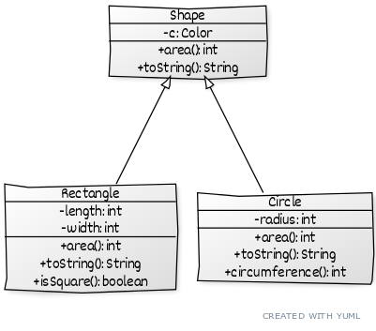
UML Class Diagram
The relationship between classes is depicted here by a UML Class Diagram
Each box is a class
Each box has three parts
Name
Instance Variables
Methods
+ means public
- means private
The arrows represent IS-A

Slide 13
In the weeds...
A reference variable for a class can always reference objects of any sub-classes
In which case the reference still only has access to the members it knows about
Shape s = new Circle(); // s knows about c but not radius; toString but not circumference (Q: which toString?)
However they cannot reference objects of a super-class (why)?
Subclasses cannot access any private members of their parent class
They CAN, however, access any protected members of their parent class
Constructors: a constructor should always call the constructor of its parent class before attempting to do any additional work.

Slide 14
protected keyword
In addition to public and private modifiers, the protected keyword is meaningful in the context of inheritance
Methods and members that are public can be accessed by any code
Methods and members that are private can only be accessed by methods from the same class
Methods and members that are protected can be accessed by code in the same package and by methods of any classes that inherit from the class
Hard-core OOP people dislike the protected keyword since it allows child classes to fiddle with stuff that they probably shouldn't

Slide 15
Example
import java.awt.Color;
public class Shape {
private Color c;
public Shape(Color c) {
this.c = c;
}
...
}
public class Circle extends Shape {
private int radius;
public Circle(Color c, int rad) {
super(c);
radius = rad;
}
...
}

Slide 16
Interfaces can extend other interfaces
Like classes, you can use inheritance to extend an interface
When you do so, the child interface gets all of the required methods from the parent interface
It can also reference the constants and static methods within the parent interface
Consider the following interface:
public interface Defender {
boolean blockWithShield(Attack attack);
}

Slide 17
Child interface
We can make a child interface from Defender using the extends keyword
This interface contains the blockWithShield() abstract method as well as the parryWithKatana() abstract method
A class that implements this interface must have both
public interface NinjaDefender extends Defender {
boolean parryWithKatana(Attack attack);
}

Slide 18
As many as you want!
Child classes can only have a single parent, but child interfaces can extend an unlimited number of parents
The child interface gets the union of all the abstract methods and constants from all the parent interfaces
public interface PunchableNinjaDefender extends NinjaDefender, Punchable {
void hateLife();
}

Slide 19
You can have the same ancestor multiple ways
We can even imagine that you have the same (great)grandparent in multiple ways
We'll use UML class diagrams to show these and other inheritance relationships
SpaceDefender
extends
extends
Defender
SpaceNinjaDefender
extends
extends
NinjaDefender

Slide 20
Next Time...
More Inheritance

