Slide 1
COMP 2000 Object-Oriented Design
David J Stucki
Otterbein University
Notes:
Bring Wirth & playing cards

Slide 2
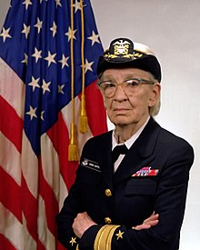
Admiral Grace Hopper
“I am now going to make you a gift that will stay with you the rest of your life. For the rest of your life, every time you say, "We've always done it that way," my ghost will appear and haunt you for twenty-four hours.”

Slide 3
ALERTS
Questions?
Lab 3 – Objects: Due tomorrow, 1/18, by 11:15am
Review: Start Concurrent chapter 9
Read: Start Concurrent chapter 10

Slide 4
The Object-Oriented Paradigm
The old metaphor: Program = Data + Algorithms (Niklaus Wirth)
Early languages focused on algorithms and data was an afterthought
The new metaphor: Everything is an object & a program is a collection of interacting objects.
Computation is object behavior.
Method calls are inter-object communication.
What is an object?
Identity
State
Type
Behavior

Slide 5
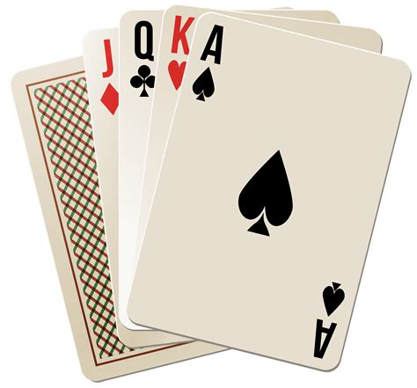
Objects – Examples
A student
Attributes?
First Name, Last Name, Student ID, Transcript, Financial Aid, Status, etc., ...
Behaviors?
Queries: getGPA, getName, getRank, etc., ...
Commands: addCourse, dropCourse, graduate, etc., ...
A playing card
Attributes?
Suit, Rank
Behaviors?
getSuit, getRank

Slide 6
Objects & Classes
What is the relationship?
Objects are instances of classes
A class is a collection of similar objects (whether instantiated or not)
A class is a template for constructing objects
A class is an object factory
A class is an abstraction of its instantiated objects (which details are missing?)
Classes consist of
Instance variables (state—i.e., what it knows)
Methods (behavior—i.e., what it does)
Constructors (guarantee that an object is created with a valid state)

Slide 7
Objects & Classes
One way of thinking about it is that an object is a thing, whereas a class is an idea of a thing
In Java, classes are represented as source code, whereas objects are represented at runtime
In other words, you code a class but you construct an object

Slide 8
Class Components
Attributes (Properties)
Primitive vs. Reference
Instance vs. Class
Models an object's state
Methods
Instance vs. Class
Query vs. Command
Models an object's behavior
Constructors
What observations have you made? What questions do you have?

Slide 9
Example: A class modeling a counter
comments
/**
* A simple integer counter.
*/
public class Counter {
private int count;
/**
* Create new Counter, with
* the count initialized to 0
*/
public Counter () {
count = 0;
}
/**
* Number of items counted
*/
public int currentCount () {
return count;
}
/**
* Increment the count by 1.
*/
public void incrementCount(){
count = count + 1;
}
/**
* Reset the count to 0.
*/
public void reset () {
count = 0;
}
} // end of class Counter
Instance variable
command
Constructor
command
query

Slide 10
Composition of Objects
We know how to model objects' properties such as numbers (using int, float, double), or characters (using char).
But what about properties like name, address, course schedule, or birthday?
These attributes are objects, not primitive values
In which case the instance variable should be a reference variable
For example, to represent a birthday we would use a Date object and to represent a name we would use a String object.

Slide 11
Example: An object modeling a student
String
value
'T'
Student
'o'
name
'm'
birthday
count
3
Date
gpa
3.572
month
10
day
3
year
2000

Slide 12
Java Bonus Topic: Enums
An enum is a special kind of class that has pre-defined constant objects.
These objects are intended to represent a fixed collection of named things:
public enum Day {
SUNDAY, MONDAY, TUESDAY, WEDNESDAY, THURSDAY, FRIDAY, SATURDAY
}
Individual days can be referenced like static variables: Day.MONDAY or Day.FRIDAY
Since enum values are constants, it's convention to name them in ALL CAPS

Slide 13
Enums & switch
Enums can be used in switch statements to make decisions
switch(day) {
case SUNDAY: System.out.println("Concert in the park"); break;
case MONDAY: System.out.println("Is it Friday?"); break;
case TUESDAY: System.out.println("Taco"); break;
case WEDNESDAY: System.out.println("Hump Day!"); break;
case THURSDAY: System.out.println("Throwback"); break;
case FRIDAY: System.out.println("Dress down"); break;
case SATURDAY: System.out.println("Date night"); break;
}
Note that only the value (SUNDAY) not the full name (Day.SUNDAY) is used
This kind of behavior makes enums a useful way to record state information with a fixed number of values

Slide 14
Enum features
Though they aren't often useful, enums have some information baked into them
You can use the static values() method on the enum class to get an array containing all the enum values
You can call the ordinal() method on an enum object to get its zero-based numbering in the list
You can pass a String into the static valueOf() method to retrieve the enum object with a given name

Slide 15
Examples
Sometimes it's useful to iterate over all the enum values
Or get their number
Or map a name to the enum value, but that will crash if you don't spell them right
Day[] days = Day.values();
for(Day day : days)
System.out.println(day + " has index " + day.ordinal());
Day manic = Day.valueOf("MONDAY");
Day francais = Day.valueOf("DIMANCHE"); // Crashes!

Slide 16
Enums as full classes
People usually use enums simply as lists of constant values
However, enums are actually full classes whose objects can contain constant data and methods
Note that the data inside can't be changed
public enum Planet {
MERCURY(2440, 3.3E23, 5.79E7),
VENUS(6052, 4.9E24, 1.08E8),
EARTH(6371, 6.0E24, 1.50E8),
MARS(3390, 6.4E23, 2.28E8),
JUPITER(69911, 1.9E27, 7.78E8),
SATURN(58232, 5.7E26, 1.42E9),
URANUS(25362, 8.7E25, 2.87E9),
NEPTUNE(24622, 1.0E26, 4.50E9);
private int radius; // km
private double mass; // kg
private double distance; // km

Slide 17
Enums as full classes
Here are the methods for the Planet enum from the previous slide
private Planet(int radius, double mass, double distance) {
this.radius = radius;
this.mass = mass;
this.distance = distance;
}
public int getRadius() {
return radius;
}
public double getMass() {
return mass;
}
public double getDistance() {
return distance;
}
}

Slide 18
Next Time...
Classes & Interfaces

